Slide 1
Influenza

Slide 2
What‘s in a disease? It is what we make of it!

Slide 3
-- Seasonal flu vs pandemic flu --
Seasonal flu:
- outbreaks follow predictable seasonal patterns (winter flu)
- usually no risks for healthy adults due to immunity built up from previous exposure
Pandemic flu:
- occurs occassionally / flu virus mutates from animal species to humans
- increased risk due to lacking previous exposure

Slide 4
from Lee and Fidler (2010), p. 217

Slide 5
The Influenza Virus (Swine Flu → 2009 Swine Flu Outbreak) [-6:29; 8:10 -]
Why was the particular virus strain responsible for the 2009 swine flu outbreak so dangerous?
How to prevent the outbreak of such a virus?

Slide 6
H1N1 (swine flu) epidemic, 2009:
Virus strain Infuenza A is related to the 1918 – 1919 “Spanish Flu“ epidemic
First detected in March 2009 in the Mexican state of Veracruz (but origins are unclear)
Spreads within weeks around the world:
- by late March the virus had already spread to the US and Canada
- by 12 May over 5,251 cases in 30 countries, primarily countries in the Americas (95% of those cases)
- by 1 July, more than 77,000 cases and 332 H1N1-related deaths – end of July, more than 162,000 cases and 1,154 fatalities
- by the end of September, more than 343,000 cases and 4,108 deaths
- by November 2009, more than 622,000 cases and more than 7,000 deaths
- by December, more than 12,000 fatalities

Slide 7
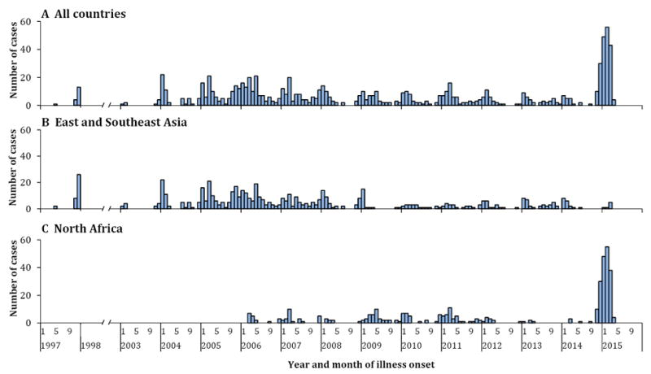
H5N1 (avian flu) outbreaks since 2003:
February 2003: outbreak in Fujian Province, China – spreads across Asia and worldwide
Epidemic curve of human cases with
H5N1 virus infection by region,
May 1997–April 2015
from Lai et al. (2017),
“Global epidemiology of avian influenza,A(H5N1)
virus infection in humans, 1997 – 2015: a systematic review“,
Lancet Infectious Diseases,
https://www.ncbi.nlm.nih.gov/pmc/articles/PMC4933299/

Slide 8
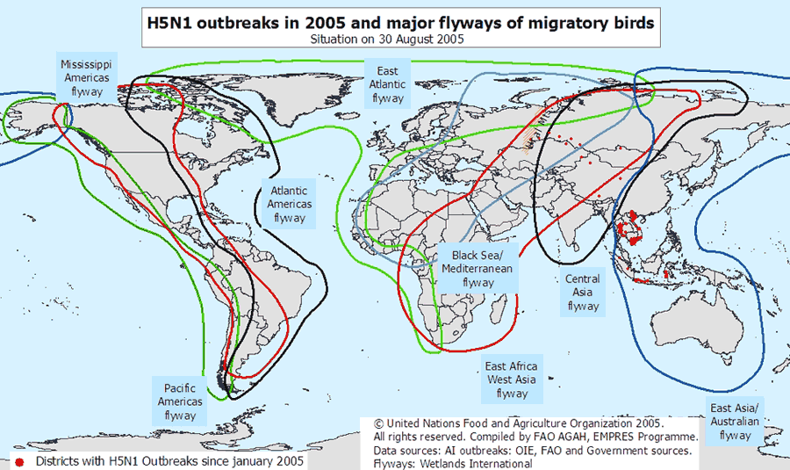

Slide 9
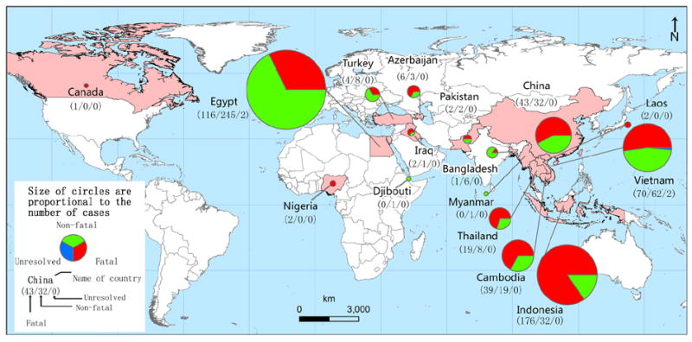
From Lai et al. (2017), “Global epidemiology of avian influenza
A(H5N1) virus infection in humans, 1997 – 2015: a systematic review“, Lancet Infectious Diseases,
https://www.ncbi.nlm.nih.gov/pmc/articles/PMC4933299/

Slide 10
How to tackle influenza epidemics?
1) The narrative: pandemics and discursively constructed facts!
- World Health Organisation (WHO) plays a central role
in defining and constituting global disease risks
- key elements to define a global health risk as a pandemic:
1) novelty of the pandemic agent
2) unpredictability of the virus
3) ability of the virus to spread quickly over a large geographical region
4) ability of the virus to swiftly mutate into different forms
5) mass susceptibility of global populations to the virus
6) differentiation from seasonal influenza

Slide 11
Why did the WHO fail in defining the H1N1 outbreak of 2009 as a pandemic?
- the outbreak was relatively mild
- hard to distinguish from seasonal influenza
- uncertainties about the origins of the virus and their transmission
- naming (swine flu) created confusion
- historical and contemporary analogies failed
→ Pandemics are also socially (discursively) constructed

Slide 12
2) Global Governance Mechanisms
Describe the Pandemic Influenza Preparedness Framework!
→ Describe the principal moral dilemma the framework aims to solve!
→ Compare the framework`s working mechanisms with the GAVI Alliance and UNITAID! Do you find similarities / differences in the way these mechanisms try to tackle epidemics? (look at the role of industry!)
→ Does the Framework change the status quo in global health governance?
Describe the role of the International Health Regulations (IHR) in responding to influenza epidemics!
→ Which role do the states play?
→ Explain how the divide between developed and developing world complicates the efficiency of the IHR!

Slide 13
Fundamental Challenge of the Global Health Governance Architecture
STATES
the Problem …
… and the Solution
Private Sector
International Organisations
Civil Society
Transnational Cooperation

