Slide 1
PROBLEMS IN MANAGING INTERNAL DEVELOPMENT PROJECTS IN MULTI-PROJECT ENVIRONMENTS
BUKOLA IFEOLUWA JAIYESIMI GUILHERME DE SOUZA PESTILHO

Slide 2
TODAY'S MULTIPROJECT ENVIRONMENT
A set of projects which are managed in a co-ordinated way to deliver increased benefits.
Platje et al.
Portfolio management includes, among others, management of interfaces between projects, prioritization of resources and balancing responsibilities against corporate objectives.
Turner
What are problems and problem areas in project portfolio management?
A group of projects that compete for scarce resources and are conducted under the sponsorship or management of a particular organization.
Archer and Ghasemzadeh
Notes:
One emphasizes competition while the other focuses on synergy.

Slide 3
THE CASES STUDIED
Empirical data by Helsinki Univesity of Technology;
Two project portfolio management research projects;
Cross organizational units projects in matrix organizations;
Comparable in terms of project and process management.

Slide 4
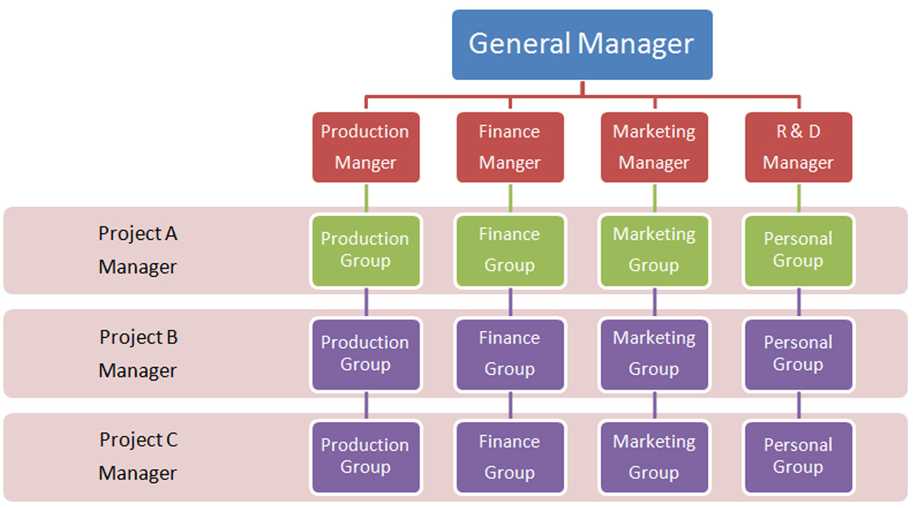

Slide 5
THE CASES STUDIED
Empirical data by Helsinki Univesity of Technology;
Two project portfolio management research projects;
Cross organizational units projects in matrix organizations;
Comparable in terms of project and process management.

Slide 6
PROJECTS CLASSIFICATION
External
Commercial development
Problem solving
Utility
Internal
Research
Maintenance
Notes:
Strategic or operational

Slide 7
PREVIOUSLY IDENTIFIED PROBLEMS IN PORTFOLIO MANAGEMENT
No link between strategy and project selection;
Poor quality portfolios;
Reluctance to kill projects;
Scarce resources and a lack of focus;
Selecting short-term and easy projects;
Information overflow and lacking quality of information;
Decision making basing on power.
Notes:
1 spending on R&D projects does not reflect the strategy and priorities 2 Too many new product projects are weak, unfit and mediocre. Low success launch rate
6 May not be able to identify the relevant information or realise the inaccuracy of information and estimates 7 Interdependencies; performance is more difficult to assess; uncertainty and disagreement are likely

Slide 8
5 STEP INDEPENDENT EMPIRICAL RESEARCH
RESEARCH PROCEDURE
What | How | Systems | Beta | Alpha
Company-specific pre- sent-state analysis | Interviews and familiarization with the organization | Data collection | 6 | 14
Overview of current problem in single and multiple project management | Open questionnaire to employees related to the management portfolios | Description of each problem; influence on everyday operations; suggestions for improvement; ranking | 13 response:12 | 17 response:6
Hierarchical grouping of survey data into preliminary problem areas | Was developed to reveal to the employees problems in the management of single projects | PPA integrated into 5 common problem areas

Slide 9
5 STEP INDEPENDENT EMPIRICAL RESEARCH
RESEARCH PROCEDURE
What | How | Systems | Beta | Alpha
Workshop for better understanding of company specific preliminary problem areas | By creating a cause– effect map for each preliminary problem area | Identify causes,new problems,study interrelation of problems, understanding the preliminary problem areas | 9 | 10
Data analysis | Combination of problems and causes to understand Existing problems in the management of internal development projects | Understanding of the problems existing in the management of internal development projects

Slide 10
RESULTS: PPA, AND RANKING
1.Inadequate definition, planning and management of single projects; particularly at the pre-project phase;
2.Resource shortage and allocating resources improperly; pursue more project than available resources;
3.Lacking commitment and unclear responsibilities; organizational responsibilities not clearly defined;
4. Inadequate portfolio level activities; overlapping projects, objectives not integrated to strategy;
5. Others; Inadequate information, strategic planning. Functional v. Organizational management.
Notes:
There were several PPA, however 4 were common to both companies.

Slide 11
ANALYSIS ON CAUSE OF PPA
Inadequate definition, planning and management of single projects:
Poorly defined project borders, roles and responsibilities, objectives; inadequate plans on the methods, guides on how to capitalize on projects, prioritization of operational over project work, incompetent management, few experts
2.Resource shortage and allocating resources improperly:
Poor prioritization which affects allocation, workload concentration in few experts, resources not optimized; no requirement for feedback.
3.Lacking commitment and unclear responsibilities:
Unclear roles, overlapping projects, rapid changes in roles and responsibilities
4. Inadequate portfolio level activities:
Improperly defined project borders; overlapping projects, no transparent data base for all projects, project information does not flow to all the units, decisions made without considering effect on the whole portfolio
5. Others:
Lack of a common database, uniform objective and continuity.

Slide 12
ANALYSIS OF PROBLEM AREAS
1.Project level activity; too long projects, poor implementation and monitoring
2.Management of project orientated business; rapid changes in organizational structure, priority not given to project work, no defined personnel for portfolio
3.Commitment,roles and responsibilities; unclear roles between decision makers and the rest of the organization, management not supporting project.
4.Portfolio level activities; overlapping projects, weak GO decisions, role of portfolio manager not clearly defined, no feedback to project level
5.Information Management; lack of and inadequate flow of information, no common data base
6.Resource competencies and methods; inadequate portfolio planning, evaluation and management, shortage of human resource and lack of competencies at project level, too extensive composition of project team and steering committee.
Notes:
Categorized into six areas.

Slide 13
CONCLUSION
The writers hope that the 6 problems areas derived from their study will be considered as a point for future studies based on its wider scope, and also that future research could identify and suggest solutions to these problems.

