Slide 1
In Martin Heidegger, Only a God can save us, 1981:
Spiegel: what takes the place of philosophy now?
Heidegger: Cybernetics.

Slide 2
Some people think that cybernetics is another word for automation; some that it concerns experiments with rats; some that it is a branch of mathematics; others that it wants to build a computer capable of running the country. My hope is that…people will understand both, how these wonderfully different notions can be simultaneously current, and also why none of them is much to the point.
Stafford Beer, Cybernetics and Management [1959, VI]

Slide 5
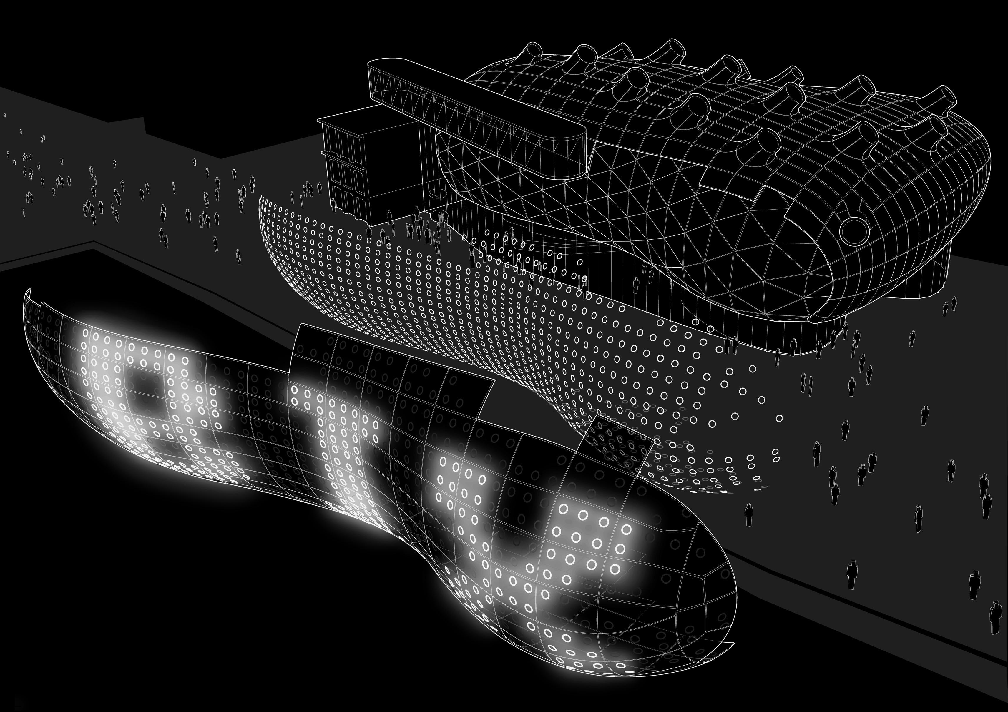
exceeding complex system [Stafford Beer] from design to managment
From representation to performance:
action, process, open object

