Slide 1
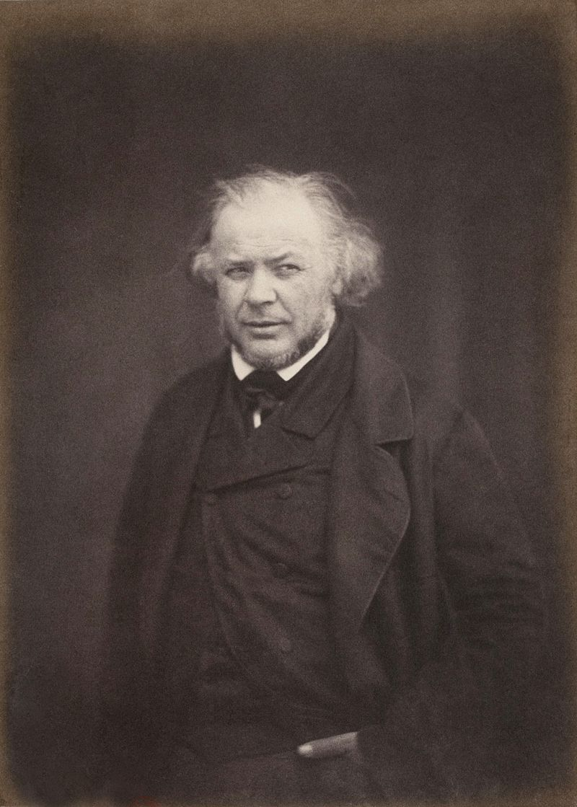
Honoré Daumier

Slide 2
Honoré-Victorin Daumier (February 26, 1808 – February 10, 1879) was a French printmaker, caricaturist, painter, and sculptor, whose many works offer commentary on social and political life in France in the 19th century.

Slide 3
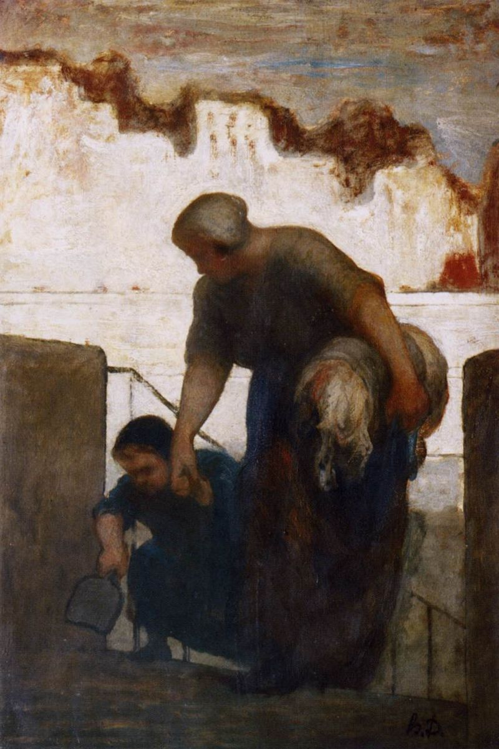
The washerwoman

Slide 4
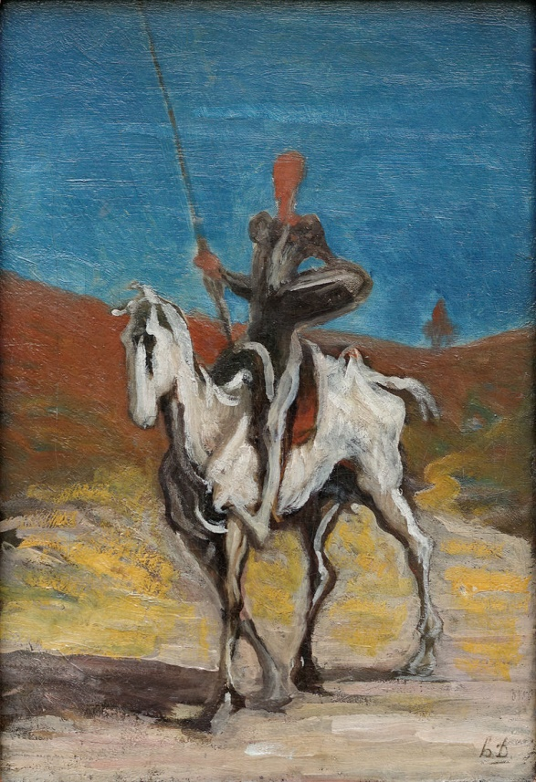
Don Quichotte

Slide 5
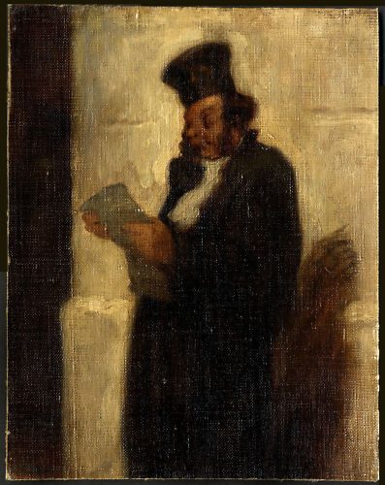
Avocat au placet

Slide 6
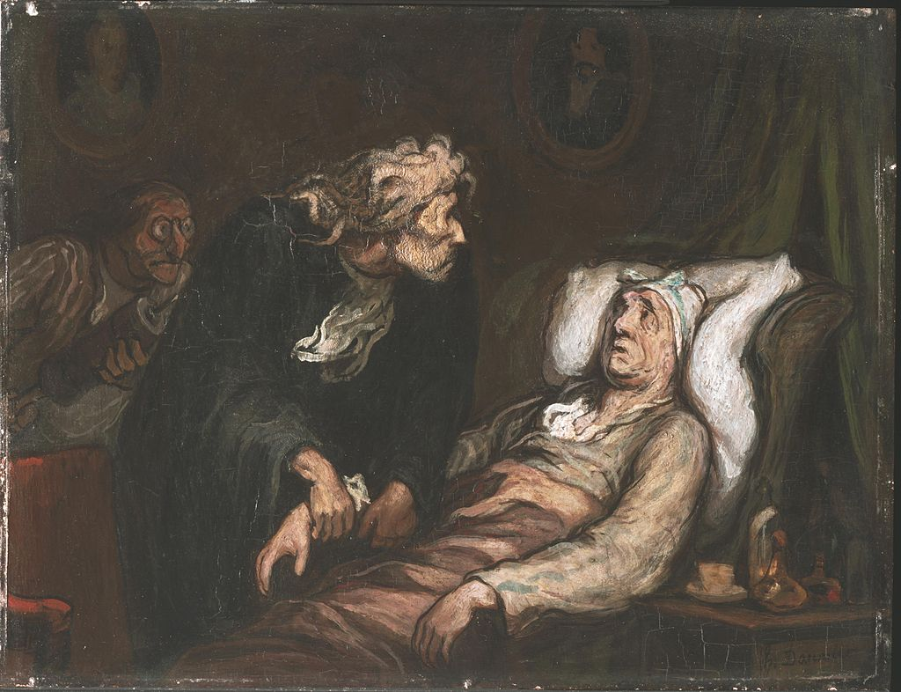
Le malade imaginaire

Slide 7
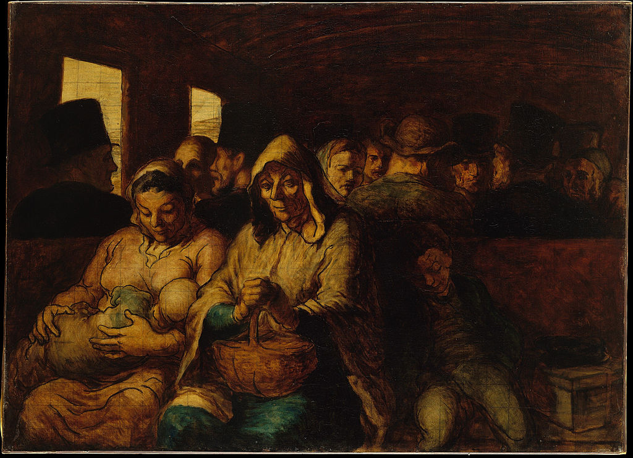
Le wgon de troisiême classe

Slide 8
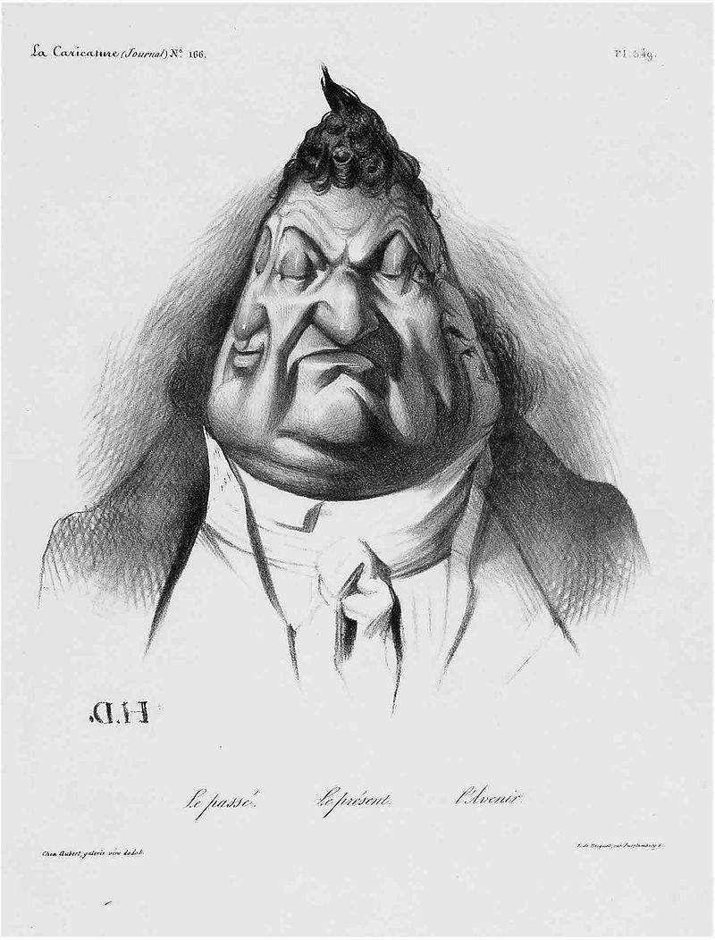
Passé, présent, avenir

Slide 9
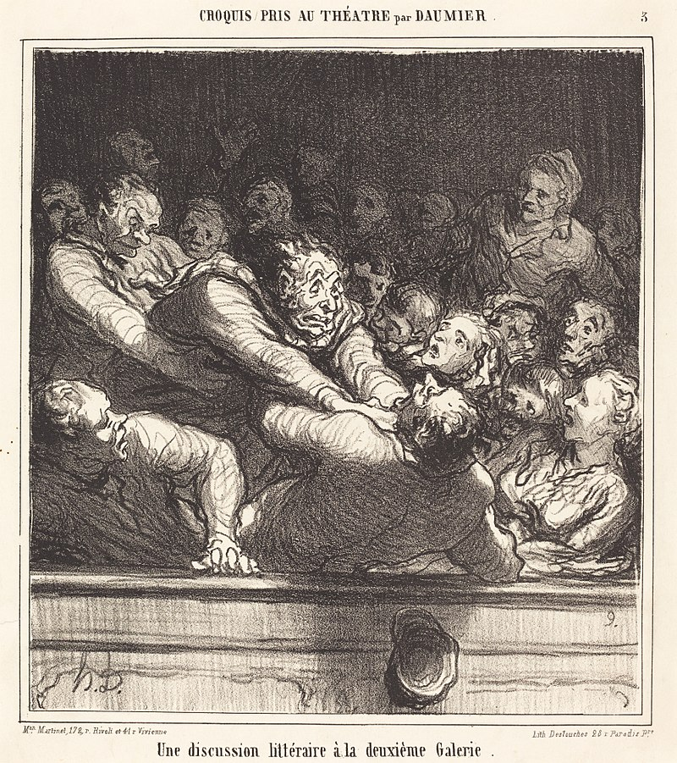
Une discussion litteraire à la deuxiême Galerie

Slide 10
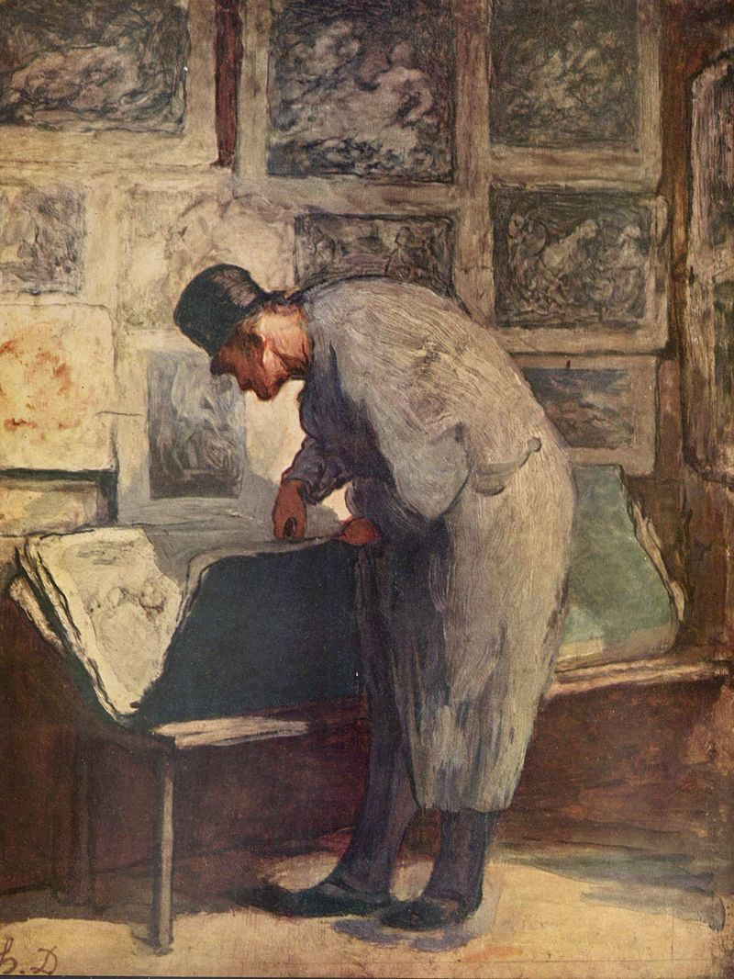
The print lover

Slide 11
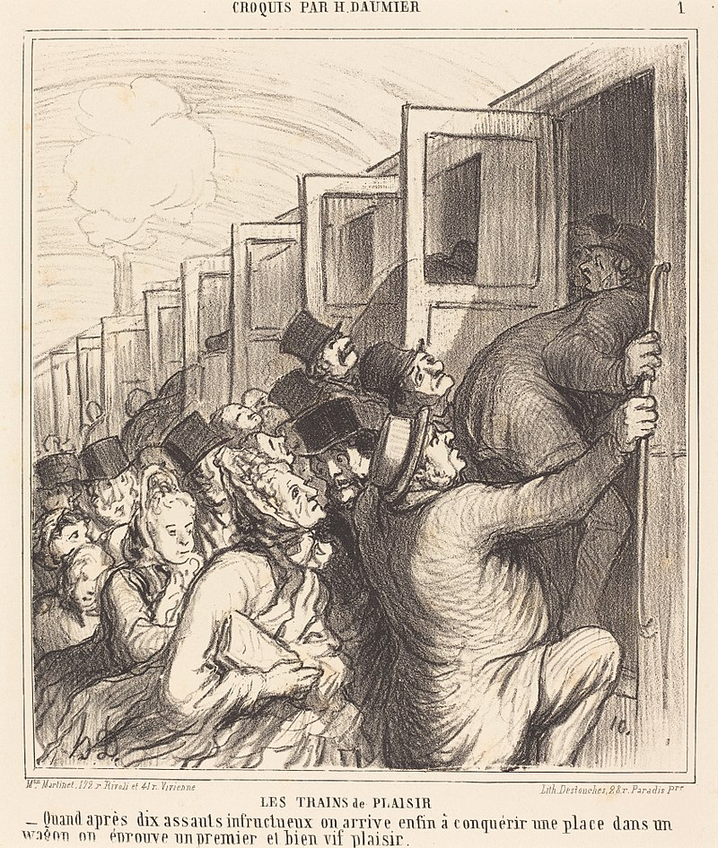
Les trains de plaisir

