Slide 1
Chapter 4:
Mechanics of Materials, 8th Edition SI Gere & Goodno
Shear Forces and Bending Moments

Slide 2
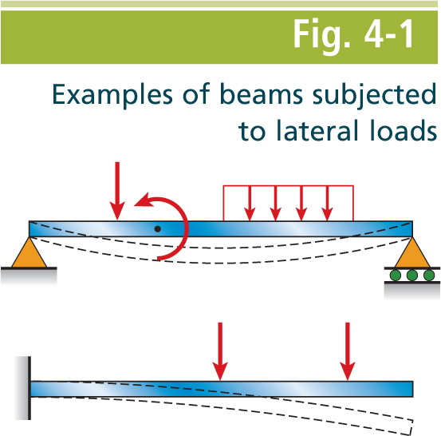
Mechanics of Materials, 8th Edition SI Gere & Goodno

Slide 3
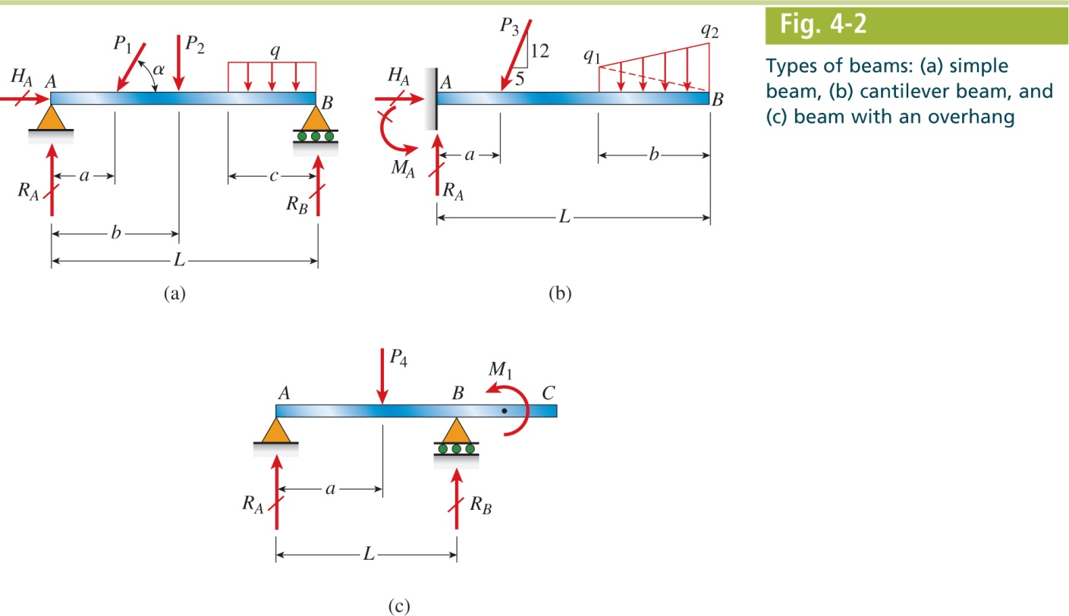
Mechanics of Materials, 8th Edition SI Gere & Goodno

Slide 4
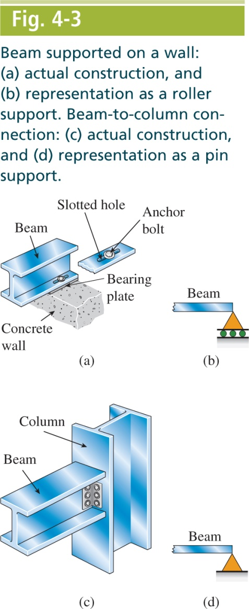
Mechanics of Materials, 8th Edition SI Gere & Goodno

Slide 5
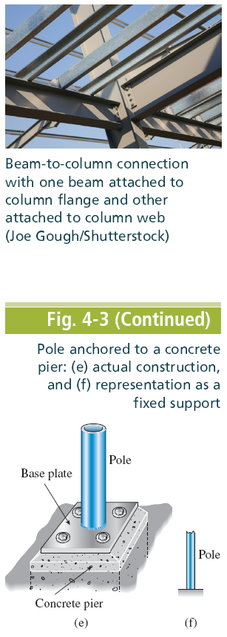
Mechanics of Materials, 8th Edition SI Gere & Goodno

Slide 6
Mechanics of Materials, 8th Edition SI Gere & Goodno

Slide 7
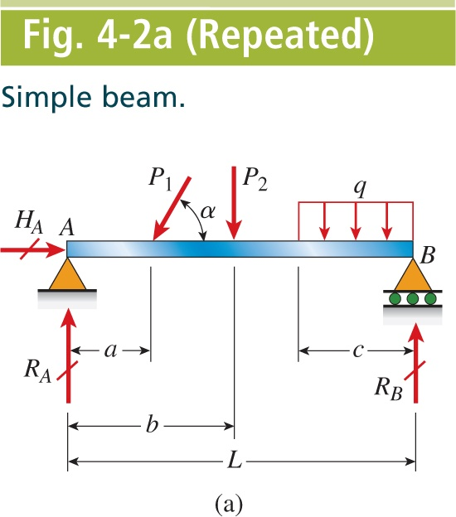
Mechanics of Materials, 8th Edition SI Gere & Goodno

Slide 8
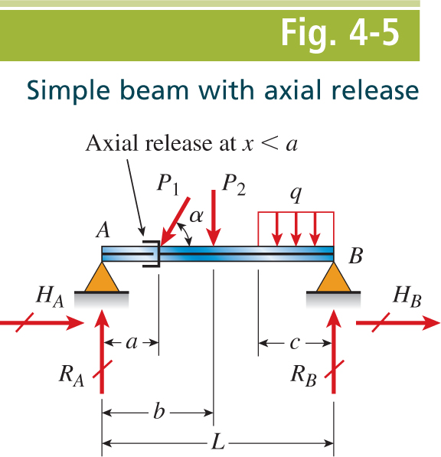
Mechanics of Materials, 8th Edition SI Gere & Goodno

Slide 9
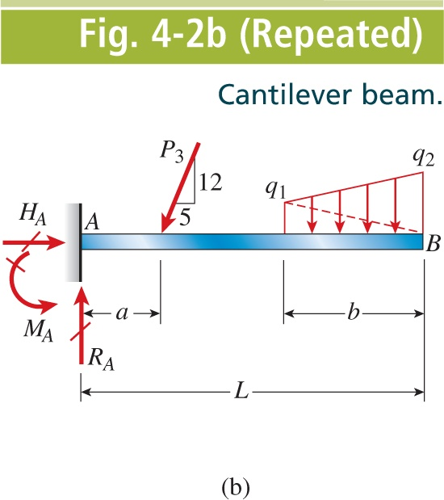
Mechanics of Materials, 8th Edition SI Gere & Goodno

Slide 10
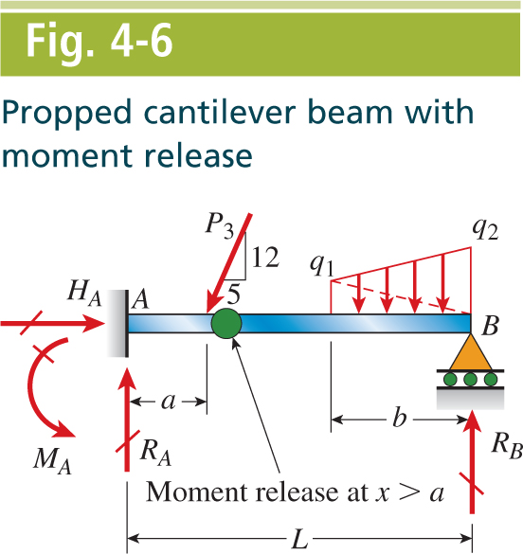
Mechanics of Materials, 8th Edition SI Gere & Goodno

Slide 11
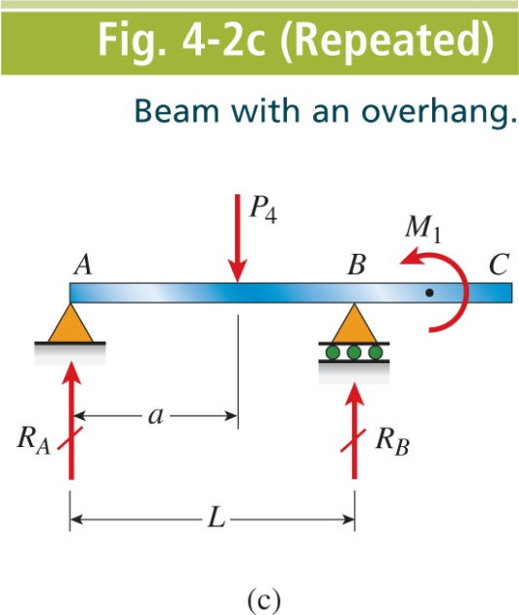
Mechanics of Materials, 8th Edition SI Gere & Goodno

Slide 12
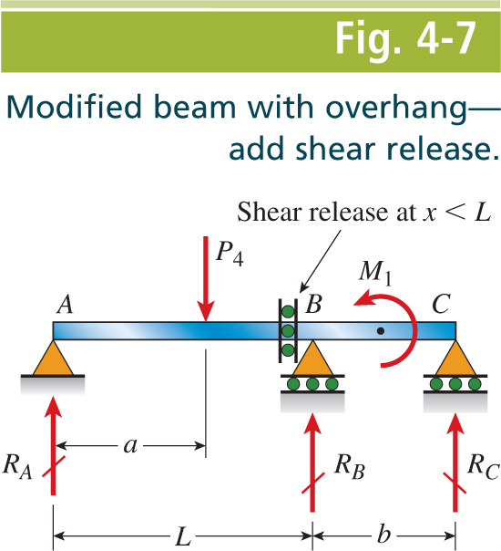
Mechanics of Materials, 8th Edition SI Gere & Goodno

Slide 13
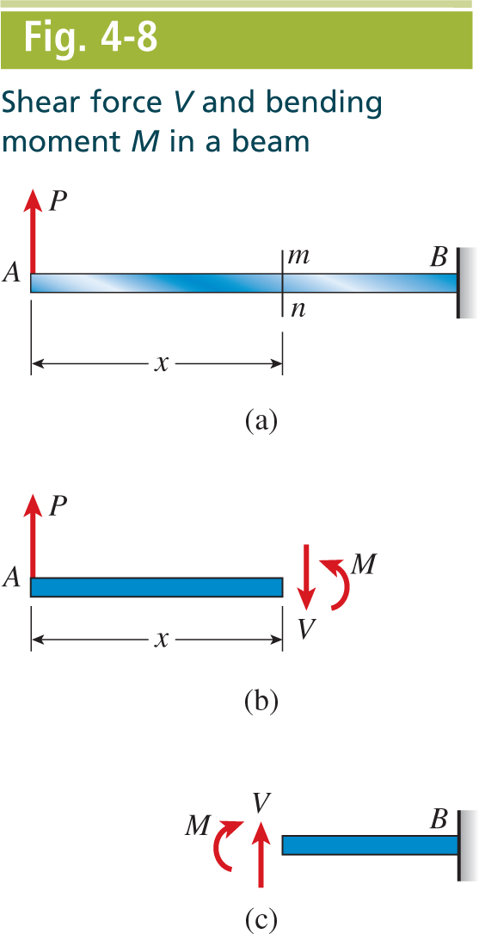
Mechanics of Materials, 8th Edition SI Gere & Goodno

Slide 14
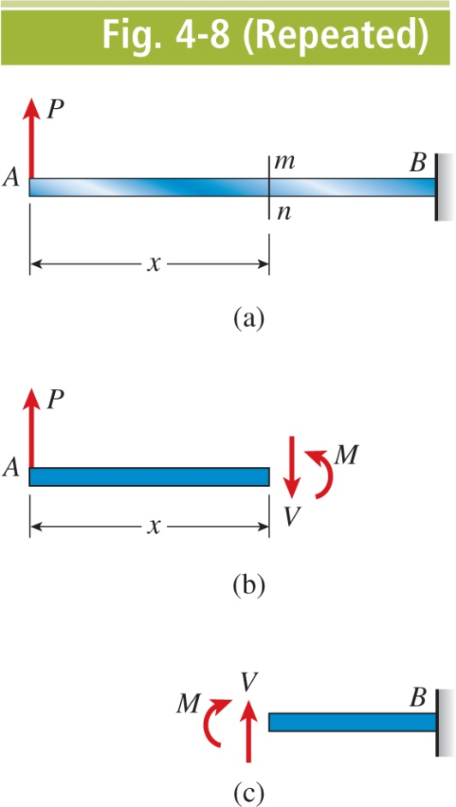
Mechanics of Materials, 8th Edition SI Gere & Goodno

Slide 15
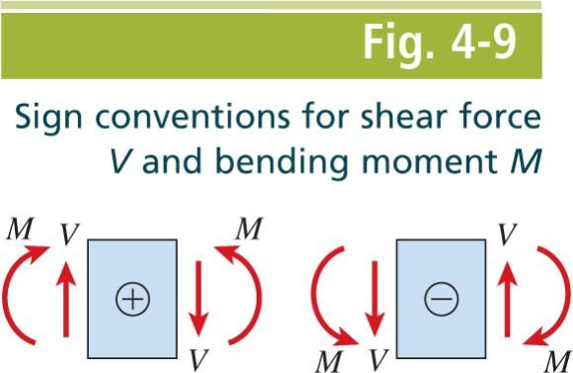
Mechanics of Materials, 8th Edition SI Gere & Goodno

Slide 16
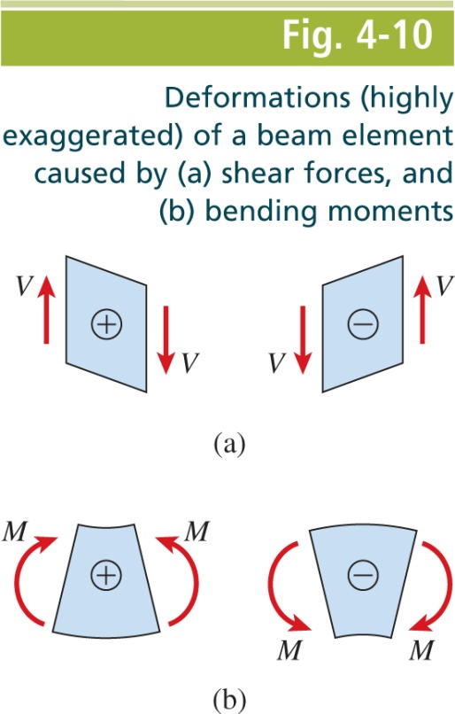
Mechanics of Materials, 8th Edition SI Gere & Goodno

Slide 17
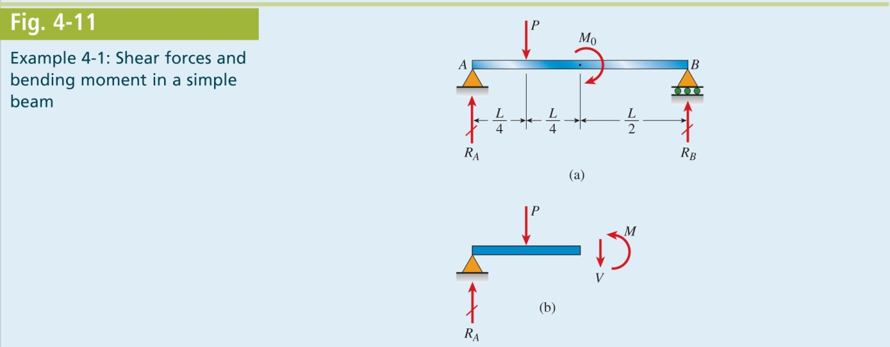
Mechanics of Materials, 8th Edition SI Gere & Goodno

Slide 18
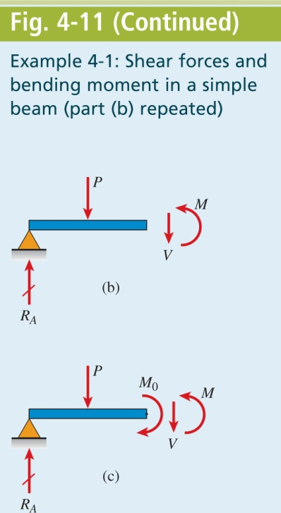
Mechanics of Materials, 8th Edition SI Gere & Goodno

Slide 19
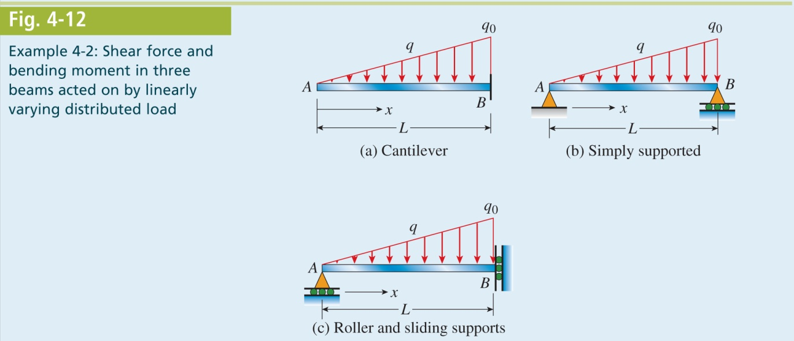
Mechanics of Materials, 8th Edition SI Gere & Goodno

Slide 20
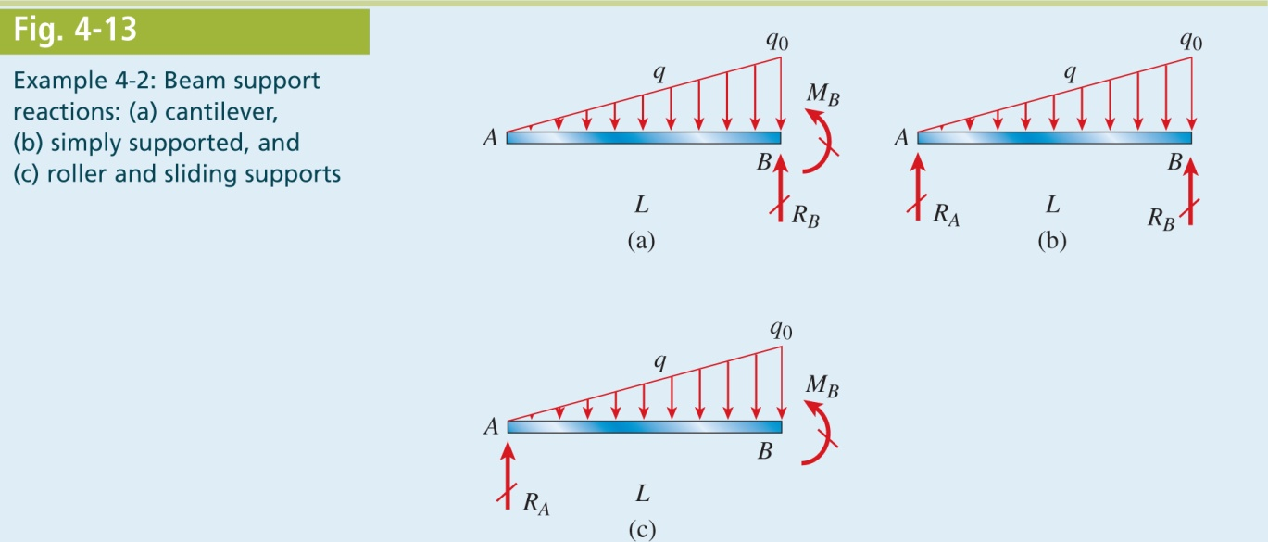
Mechanics of Materials, 8th Edition SI Gere & Goodno

Slide 21
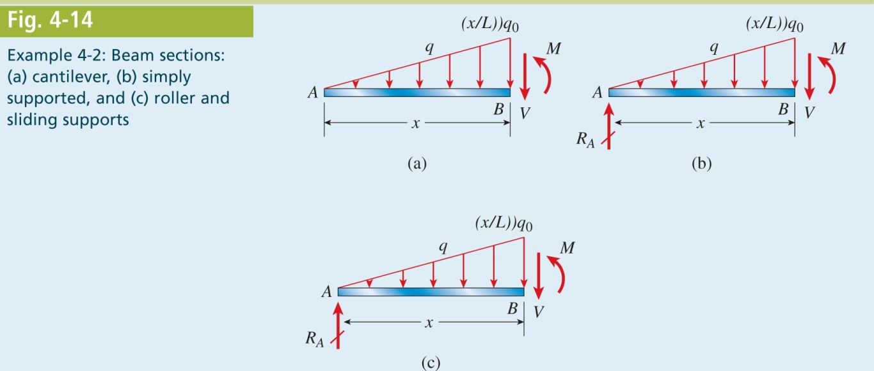
Mechanics of Materials, 8th Edition SI Gere & Goodno

Slide 22
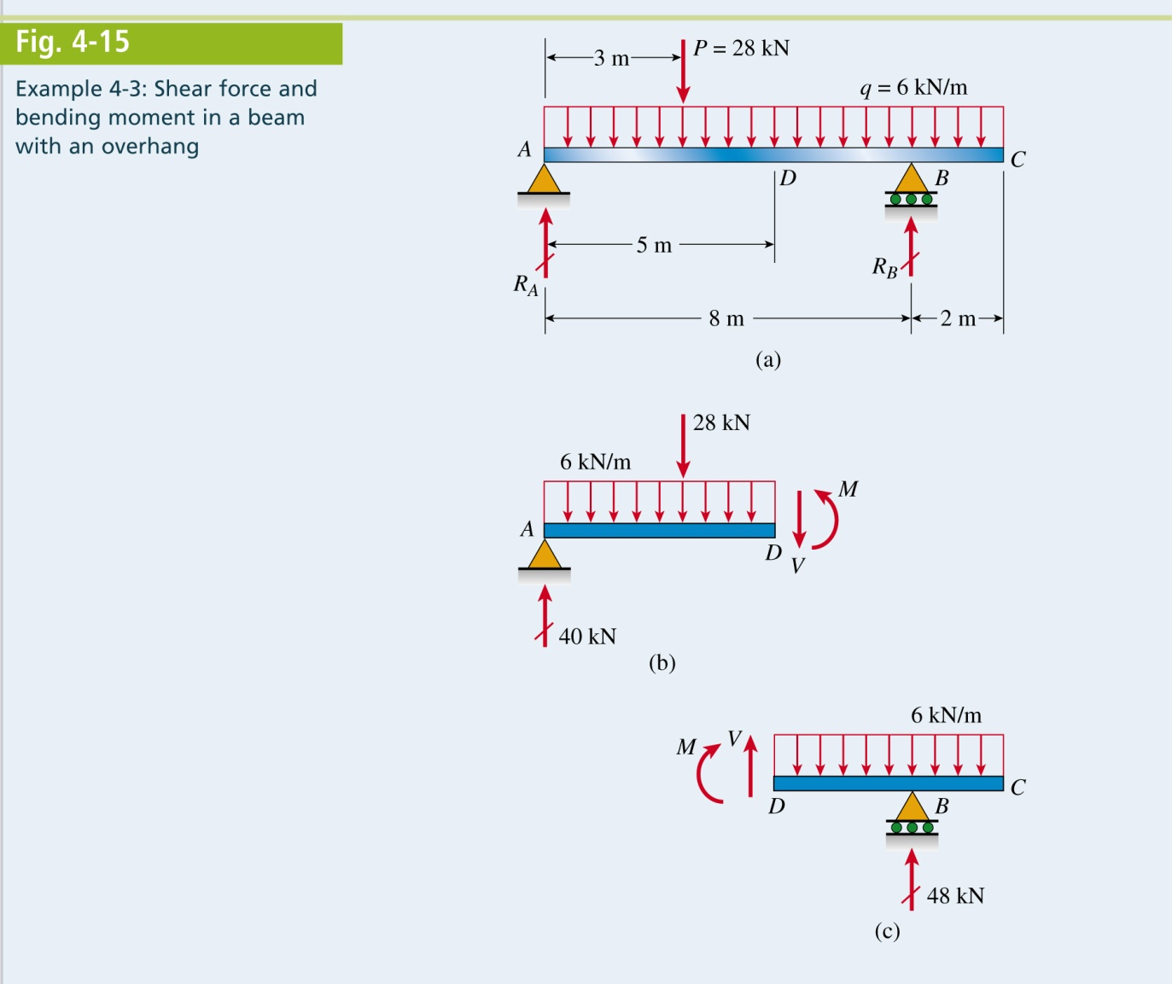
Mechanics of Materials, 8th Edition SI Gere & Goodno

Slide 23
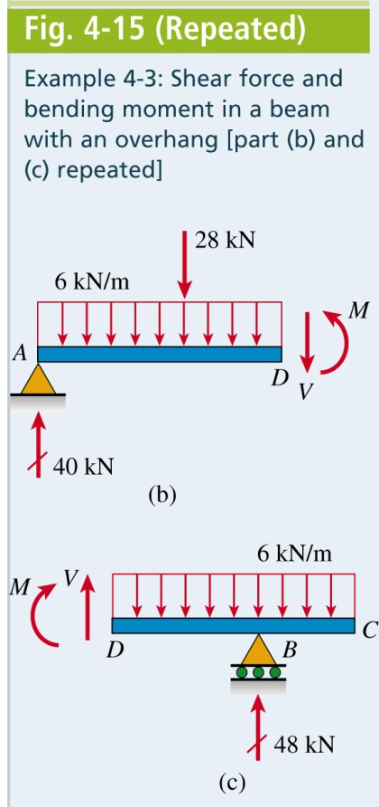
Mechanics of Materials, 8th Edition SI Gere & Goodno

Slide 24
Mechanics of Materials, 8th Edition SI Gere & Goodno

Slide 25
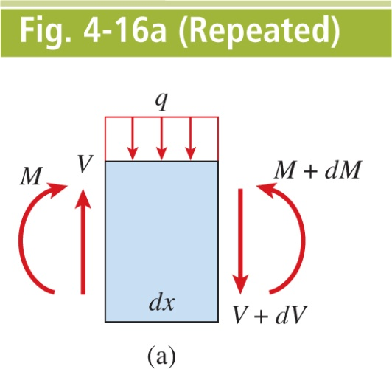
Mechanics of Materials, 8th Edition SI Gere & Goodno

Slide 26
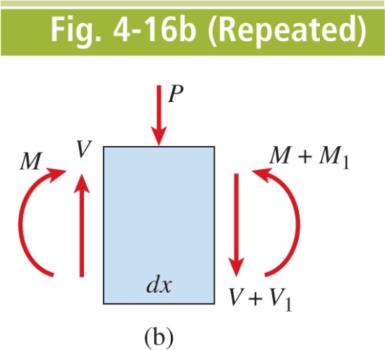
Mechanics of Materials, 8th Edition SI Gere & Goodno

Slide 27
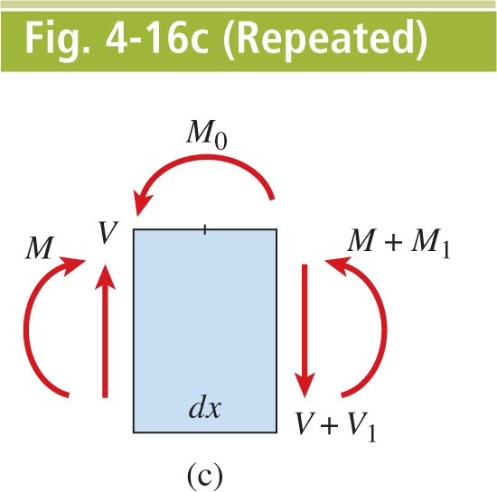
Mechanics of Materials, 8th Edition SI Gere & Goodno

Slide 28
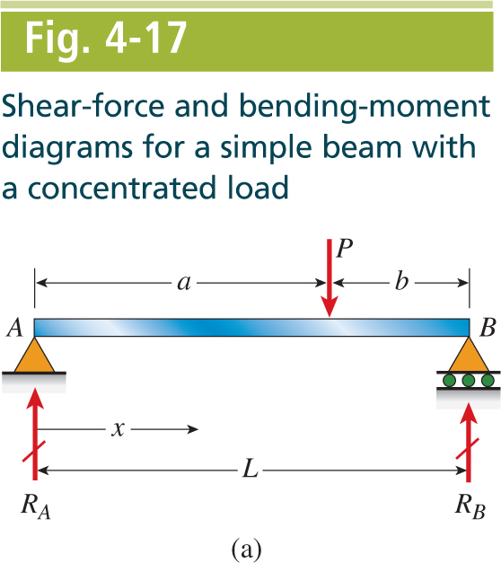
Mechanics of Materials, 8th Edition SI Gere & Goodno

Slide 29
Mechanics of Materials, 8th Edition SI Gere & Goodno

Slide 30
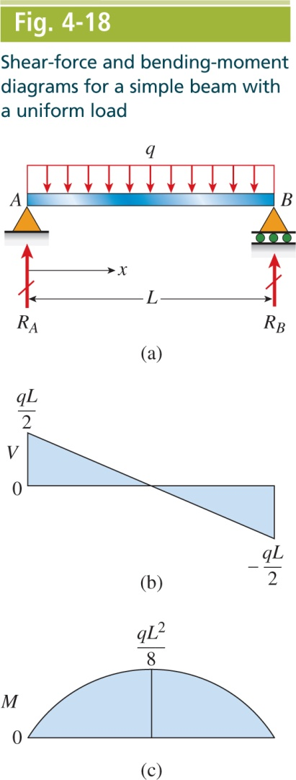
Mechanics of Materials, 8th Edition SI Gere & Goodno

Slide 31
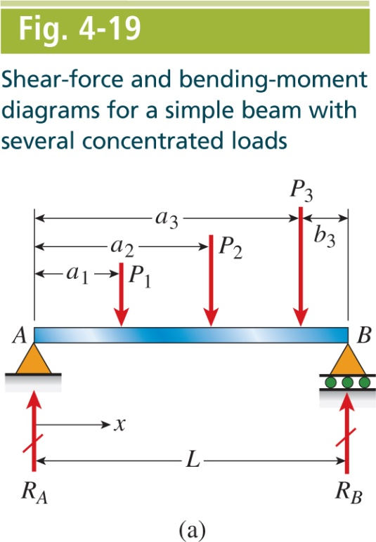
Mechanics of Materials, 8th Edition SI Gere & Goodno

Slide 32
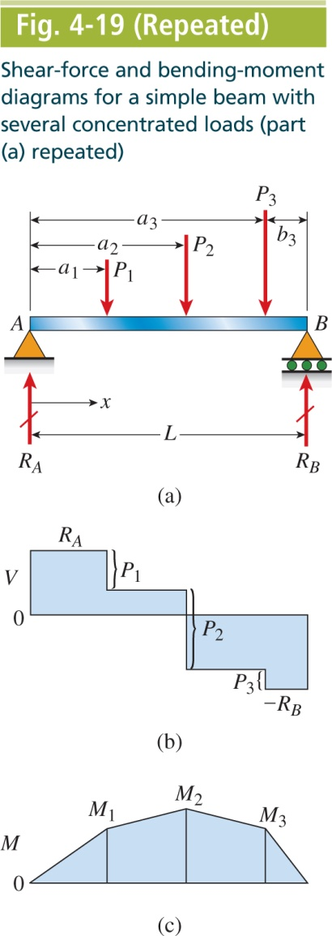
Mechanics of Materials, 8th Edition SI Gere & Goodno

Slide 33
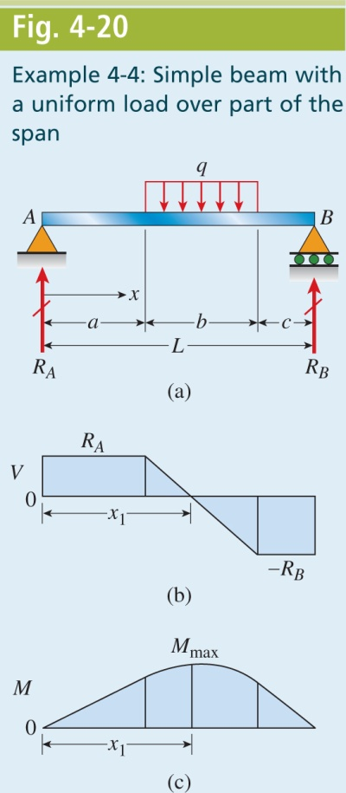
Mechanics of Materials, 8th Edition SI Gere & Goodno

Slide 34
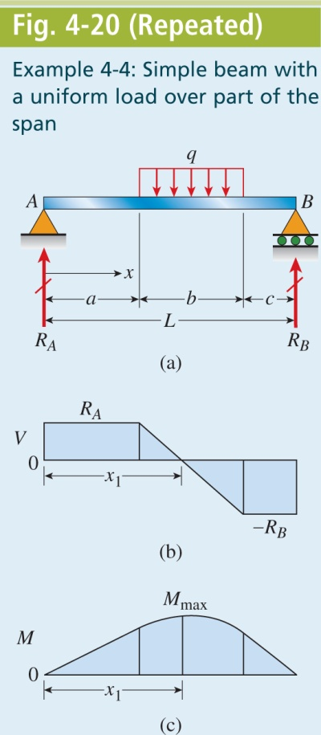
Mechanics of Materials, 8th Edition SI Gere & Goodno

Slide 35
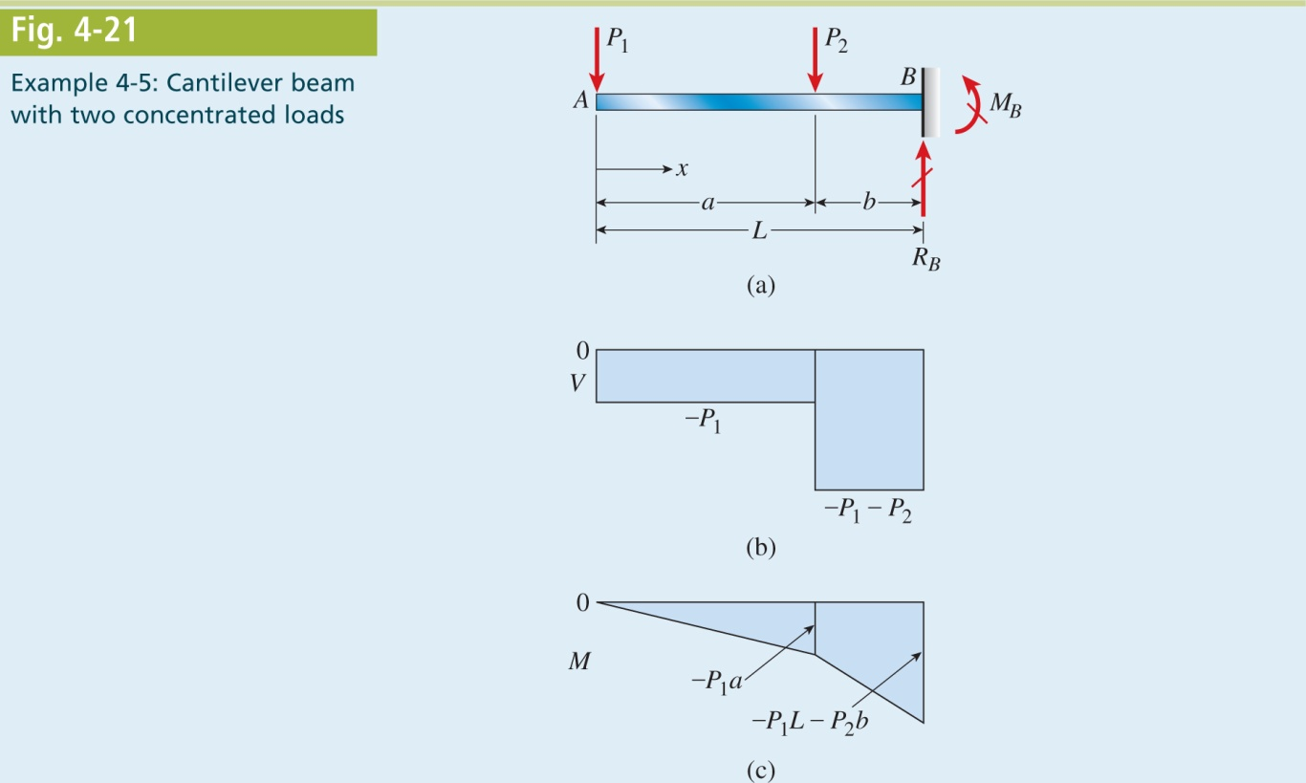
Mechanics of Materials, 8th Edition SI Gere & Goodno

Slide 36
Mechanics of Materials, 8th Edition SI Gere & Goodno

Slide 37
Mechanics of Materials, 8th Edition SI Gere & Goodno

Slide 38
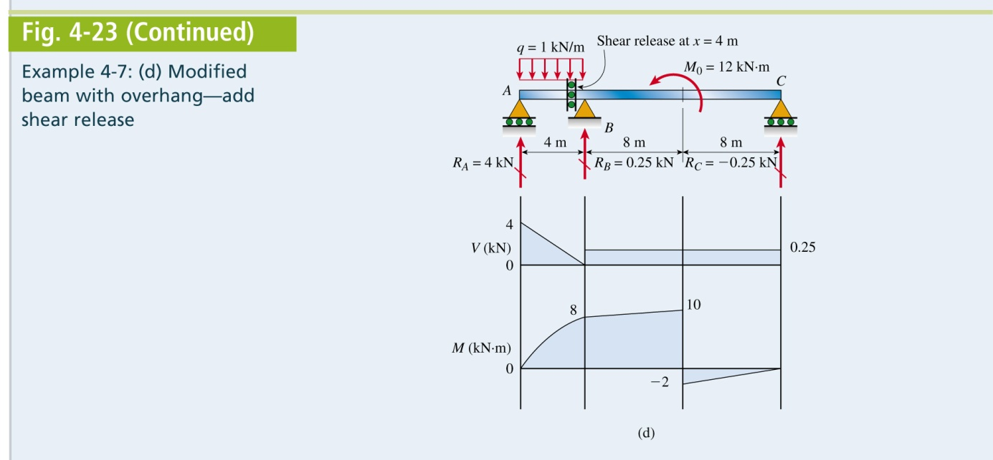
Mechanics of Materials, 8th Edition SI Gere & Goodno

