Slide 1
Utopian and Dystopian Realities

Slide 2
Utopia …
1516: Publication of Sir Thomas More‘s Utopia
Portrays a fictional island society, Utopia,
and its inhabitants, the Utopians
Social critique of contemporary European
societies
Imagining a different, a “better“ world

Slide 3
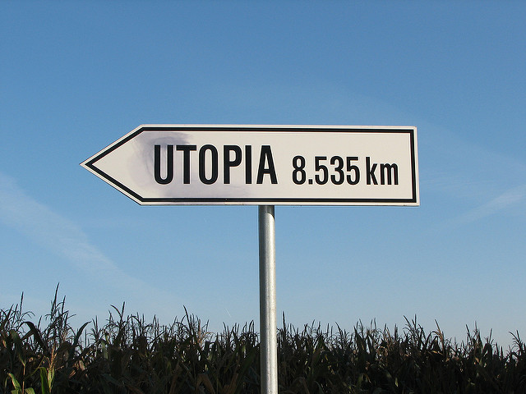
…ethymological origins
Thomas More derived the word Utopia
from the Greek eu-topos (nowhere)
BUT: there is a pun
ou-topos means “good place“

Slide 4
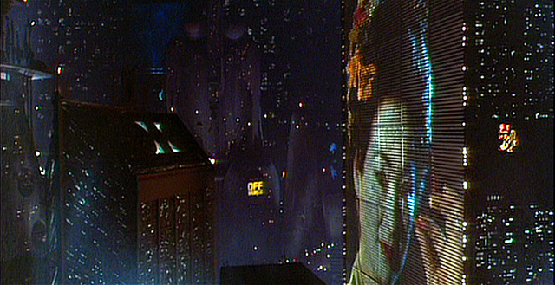
Dystopia …
The complete opposite: an imaginary dark and nightmarish place
https://www.flickr.com/photos/blile59/4952873419/in/photolist-8xELHi-8xHNKf-pY3SV6-rjHT6L-8xEM4X-9whCGa-8xHNVG-8xELBT-8xHPiL-8xHPcw-8xELv4-8xHPkL-eyGdJA-eHN7sD-eyDyM4-eyGy8Y-8ckaeD-8xEM8X-8xHPpJ-8xELZ6-8xELF8-8xHNRy-8xELDz-8xHPxN-8xHPtJ-eyD77P-eyD8eD-eyDp12-eyDdqr-ai77Sg-eyDEZg-eyGbY9-eyGQwU-eyD8MV-eyGzxm-eyGJWm-eyGhYh-eyGBs5-eyDmMZ-eyGFR9-eyDvLB-eyDgVv-eyDtcn-eyGrky-eyD7GK-8xEMcV-8xELNB-8xELq6-8xHNMo-eyGNtQ

Slide 5
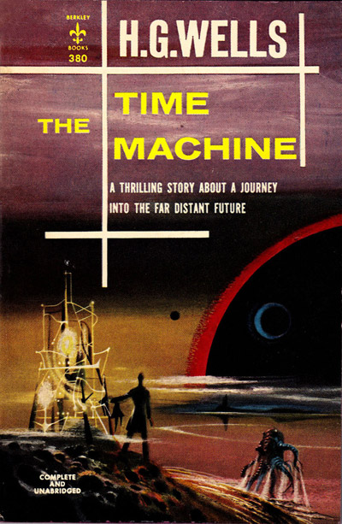
… dystopian literature
H. G. Wells, The Time Machine (1895)
Franz Kafka, Der Prozess / The Trial (1925)
Aldous Huxley, Brave New World (1932)
George Orwell, 1984 (1949)
Anthony Burgess, A Clockwork Orange (1962)

Slide 6
Science-Fiction
The major vehicle for depicting utopian and dystopian realities
Mirroring contemporary politics and everyday policymaking
Social and political critique
Star Trek
Mirroring US diplomacy / foreign policy
Reflecting ist major tensions and conflicts

Slide 7
Narrative of voyages and discovery (see Odysseus)
Major theme: establishing contact and dialogue
Dialogue is framed in religious and scientific terms
Narrative of progress
Imperial expansion (the Borg, the Founders)
Qualitative embetterment of societies (The Federation, Captain Picard)
Republican theme

Slide 8
Captain Picard
Picard's Speeches
Questions:
Which are Captain Picard‘s major themes?
Which principles does he defend and which actions does he condemn?
Name examples in US foreign policy which reflect Picard‘s statements!

Slide 9
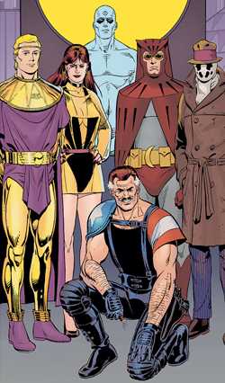
Watchmen
Dr Manhattan
Rorschach
Silk Spectre
Nite Owl
Adrian Veidt alias Ozymandias
The Comedian
Artwork for the cover of the Watchmen International Edition TPB. Art by Dave Gibbons. The art is originally from the Watchmen's profile in Who's Who: Update '87 #5

Slide 10
Chapter 12: A stronger loving world [00:00 – 21:00]
Questions:
Describe the main plot of Chapter 12! What is the message?
Who are the Ozymandiases / Veidt‘s of world politics?
Describe the role of terror in the plot!

Slide 11
Ozymandias, by Percy Bysshe Shelley

Slide 12
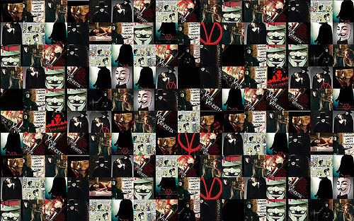
V for Vendetta
How does the protagonist try to realise his utopian dreams?
Explain the relationship between Utopia and Dystopia!
Who are the Vs of today‘s world politics?
https://www.flickr.com/photos/mary-lynn/222179375/in/photolist-kCJbT-5FE8ii-aZwjx-hWheiJ-NqmJj-8EfUJs-94eXGB-dR6Des-7wf931-7nEhQV-9tXqSq-6ymkUU-7nEoii-aajM4u-frD8xG-5LDGkJ-7nJh5s-2hQFYq-7nJfXL-7nJgHm-7nJeDy-7nEh4Z-iagwqq-D8GJ1m-5LfvE1-eGNb3h-pRSSwf-GCsrpE-aqPZDf-7nEmN2-7nEirv-7nJddb-7nJdxY-7nJhr3-7nJaDq-dTyYvp-7nJfJo-7nEqeX-9mWmWq-chy55U-7nJa7q-7nEkFr-7nJ9j7-7nJ8Uw-bhaie-NqmKb-7nEhtn-Ehg8rC-aET8KH-kWwseT

