Slide 1
Chapter 13 Diversification Strategy
Prof. Luciano Thomé e Castro

Slide 2
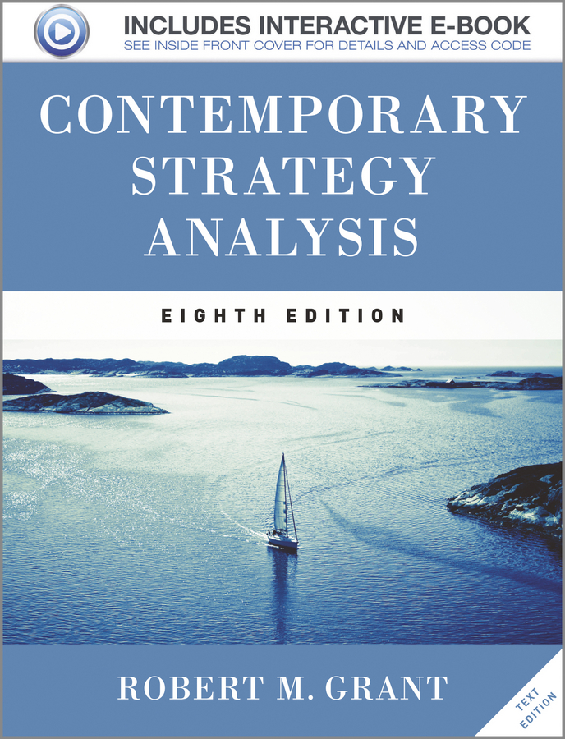
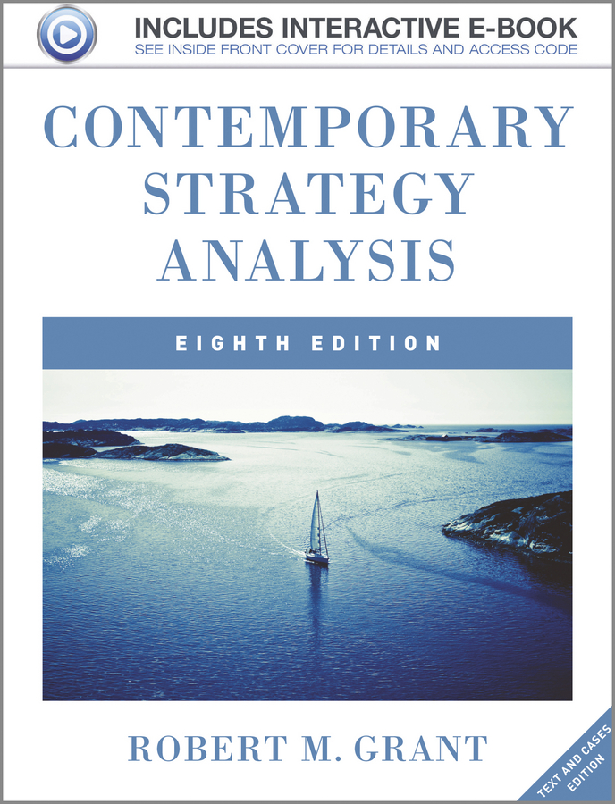
© 2013 Robert M. Grant
www.contemporarystrategyanalysis.com

Slide 3
Diversification Strategy
OUTLINE
Introduction: The basic issues
Trends in diversification over time
Motives for diversification
Competitive advantage from diversification
Diversification and performance
Relatedness in diversification
© 2013 Robert M. Grant
www.contemporarystrategyanalysis.com

Slide 4
The Basic Issues in Diversification Decisions
Superior profit derives from two sources:
Diversification decisions involve these same two issues:
How attractive is the industry to be entered?
Can the firm achieve a competitive advantage?
INDUSTRY
ATTRACTIVENESS
RETURN ON CAPITAL
> COST OF CAPITAL
COMPETITIVE
ADVANTAGE
© 2013 Robert M. Grant
www.contemporarystrategyanalysis.com

Slide 5
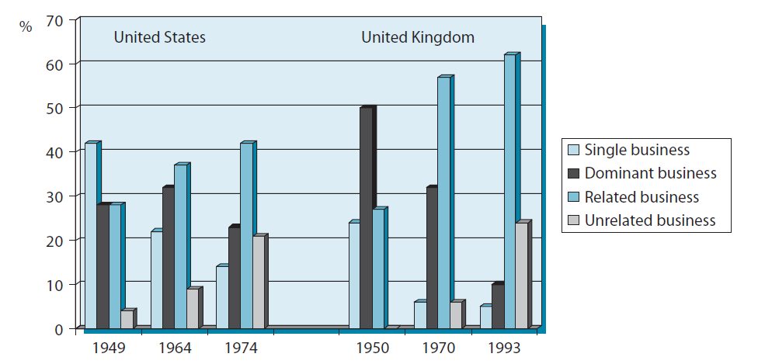
Diversification Strategies of US and UK Corporations During the 20th Century
© 2013 Robert M. Grant
www.contemporarystrategyanalysis.com

Slide 6
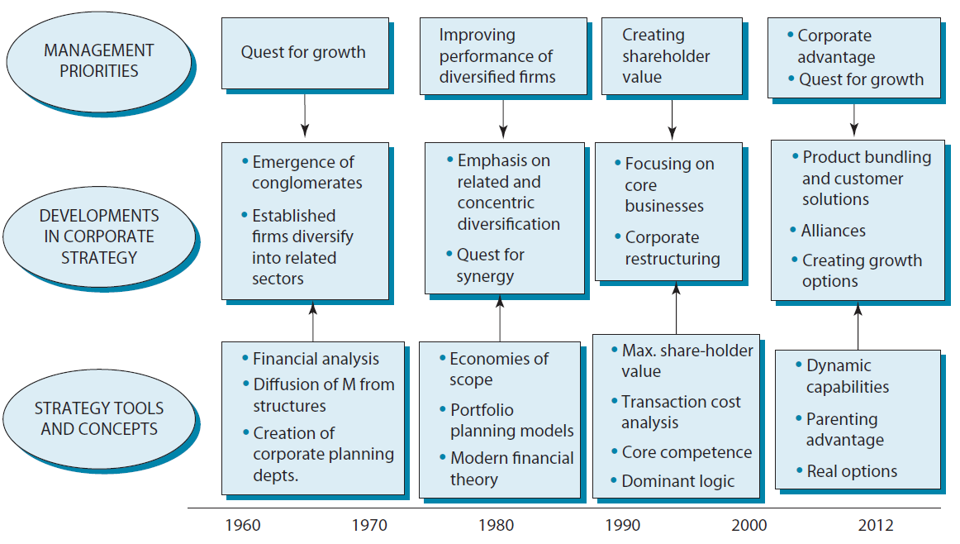
The Evolution of Diversification Strategies
1960-2012
© 2013 Robert M. Grant
www.contemporarystrategyanalysis.com

Slide 7
Motivations for Diversification
Growth
The desire to escape stagnant or declining industries a powerful motives for diversification (e.g. tobacco, oil, newspapers)
But, growth satisfies managers not shareholders Diversification in that achieves seeks growth (esp. by acquisition) tends to destroy shareholder value
Risk Spreading
Diversification reduces the variance of profit flows
But, doesn’t create value for shareholders—they can hold diversified portfolios of securities. (Capital Asset Pricing Model shows that diversification only lowers unsystematic risk not systematic risk)
Value Creation
For diversification to create shareholder value, then bringing putting different businesses under common ownership must increase their total profitability
© 2013 Robert M. Grant
www.contemporarystrategyanalysis.com

Slide 8
Diversification and Shareholder Value: Porter’s Three Essential Tests
If diversification is create shareholder value, it must meet three tests:
The Attractiveness Test
Diversification must be directed towards attractive industries (or have the potential to become attractive)
The Cost of Entry Test
The cost of entry must not capitalize all future profits
The Better-Off Test
Either the new unit must gain competitive advantage from its link with the company, or vice-versa. (i.e. some form of “synergy” must be present
© 2013 Robert M. Grant
www.contemporarystrategyanalysis.com

Slide 9
Competitive Advantage from Diversification
Economies of Scope
Sharing tangible resources (research labs, distribution systems) across multiple businesses
Sharing intangible resources (brands, technology) across multiple businesses
Transferring functional capabilities (marketing, product development) across businesses
Applying common general management capabilities to different businesses
Economies from Internalizing Transactions
Economies of scope not a sufficient basis for diversification—must be supported by transaction costs in markets for resources
Diversified firm can avoid external transactions by operating internal capital and labor markets
Diversified firm has better information on resource characteristics than external markets
© 2013 Robert M. Grant
www.contemporarystrategyanalysis.com

Slide 10
Relatedness in Diversification
Economics of scope in diversification derive from two types of relatedness:
Operational readiness
Synergies from sharing resources across businesses (common distribution facilities, brands, joint R&D)
Strategic readiness
Synergies at the corporate level deriving from the ability to apply common management capabilities to different businesses
Problem of operational relatedness:
The benefits in terms of economies of scope may be dwarfed by the administrative costs involved in their exploitation
© 2013 Robert M. Grant
www.contemporarystrategyanalysis.com

Slide 11
Diversification and Performance:
The Findings of Empirical Research
Do diversified firms outperform specialized firms? | No consistent relationship Some evidence of a curvilinear relationship: dn. first increases profitability, but beyond a point further dn. reduces profitability (increased complexity?) McKinsey & Co. identify benefits from moderate dn.—especially for firms that have run out of growth opportunities Question of direction of causation: does dn. drive profitability, or vice-versa?
What type of diversification is most profitable? Related dn. vs. unrelated dn. | Most studies (but not all) show related dn. outperforms unrelated dn. Related dn. offers greater synergies—but also imposes higher management costs But what is “related dn.”? Businesses can be related in many different ways (e.g. LMVH, GE, Virgin group)
© 2013 Robert M. Grant
www.contemporarystrategyanalysis.com

Slide 12
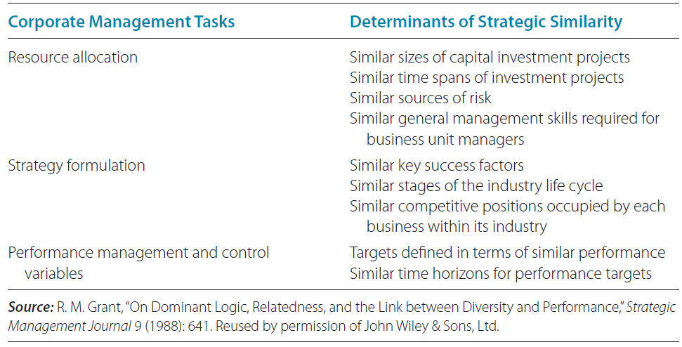
The Determinants of Strategic Relatedness Between Business
© 2013 Robert M. Grant
www.contemporarystrategyanalysis.com

