Slide 1
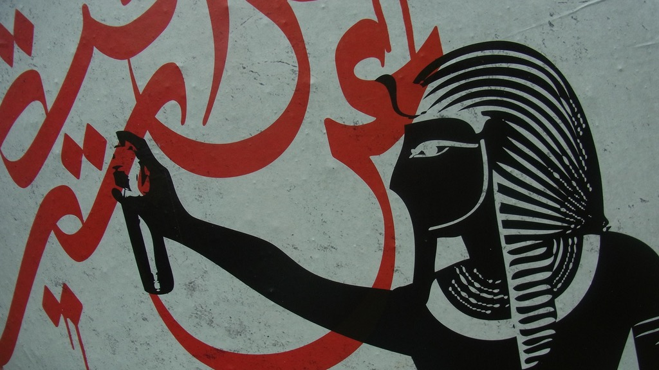
Major Themes in Contemporary Middle East
LECTURE 9.
POLITICS OF THE PERSIAN GULF

Slide 2
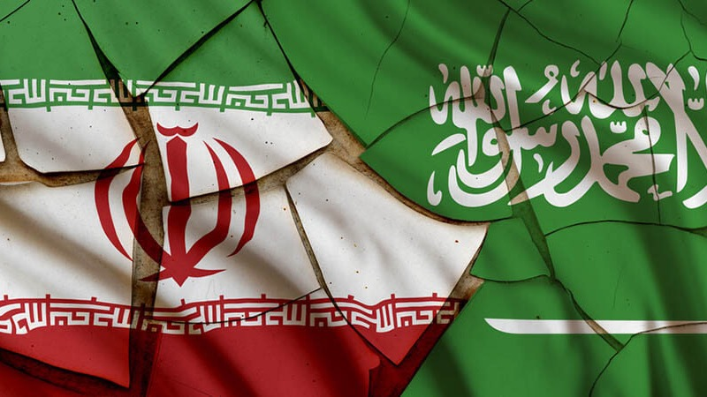
The Cold War in the Gulf

Slide 3
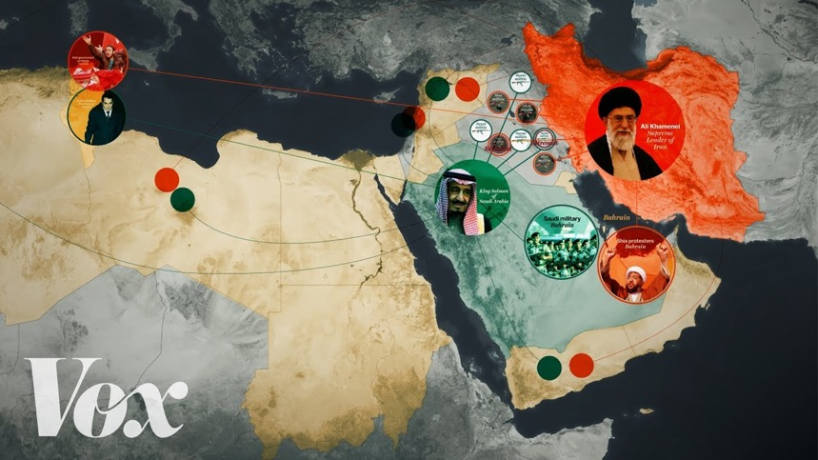
The Middle East's cold war, explained
Vox mini-documentary (2017)

Slide 4
Why is it a “cold war”?
Neither side is interested in direct confrontation.
They compete over proxy actors.
They exploit the domestic divisions of weaker states and seek to influence their political systems.
Is it the first regional cold war?
No: The ”Arab Cold War” of the 1950s and 60s.
Arab Socialists (Egypt) vs. Conservative monarchies (SA)
Proxy war in Yemen 1960s

Slide 5
What’s the main cause?
Ideology? (Islamism, revolution vs conservatism)
Nationalism? (Arab vs. Persian)
Sectarianism? (Sunni vs. Shia)
These are contributing factors to the rivalry and are used as weapons in the power struggle…
…but they are not the main cause!
The underlying reason is regime insecurity: both regimes are fearful of domestic and international challenges to their authority.
Counterintuitively, both SA and IRI foreign policies are essentially defensive.

Slide 6
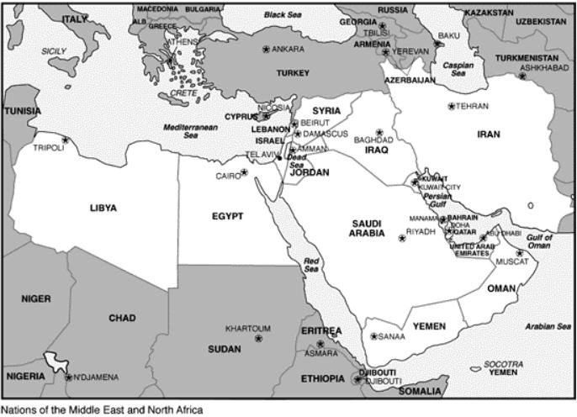
Foreign Policy of Saudi Arabia
Four Pillars
DOMESTIC: Maintain absolute control within Kingdom’s boundaries.
PENINSULAR: Maintain hegemony over the Peninsula (GCC).
REGIONAL: Maintain a balance of power vis-à-vis actors w/ larger populations or stronger armies.
GLOBAL: Maintain oil-for-security agreement with the US.

Slide 7
Foreign Policy of Saudi Arabia
Ultimate status quo power
Interests across pillars occasionally clash
Ex. Alliance with US and backlash by al-Qaeda
Still, for a long time, structural dynamics (high oil prices + US–Iran rift) and cautious and predictable f.p. under Kings Fahd (1982 – 96) and Abdullah (96 – 2015) allowed the pursuit of these interests.
But shifting structural dynamics over the past 10-15 years have been threatening Saudi interests on all four levels

Slide 8
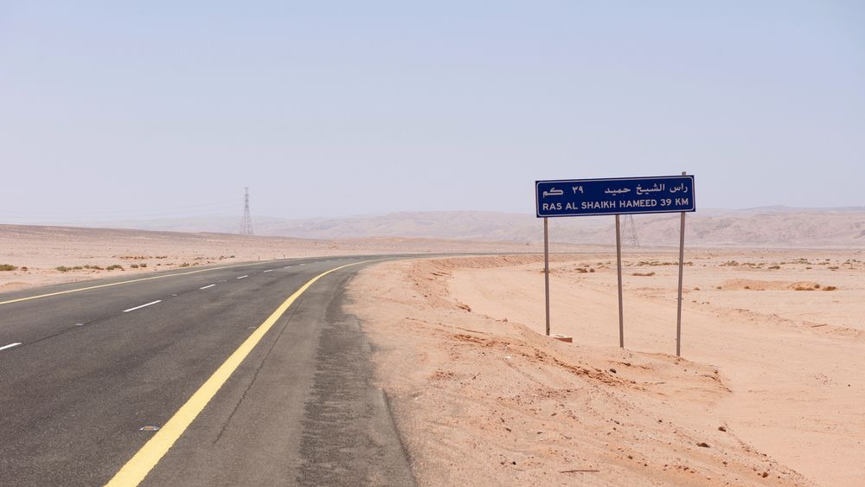
Foreign Policy of Saudi Arabia
Structural changes threatening Saudi regime
DOMESTIC: FALLING PETROL PRICES lead to growing discontent. Austerity measures on a population used to lavish state spending. Globally connected youth frustrated with extreme restrictions. In Eastern Province, economic discontent mixes with political and sectarian tensions lead to uprisings and growing repression. Number of executions have doubled since 2015.

Slide 9
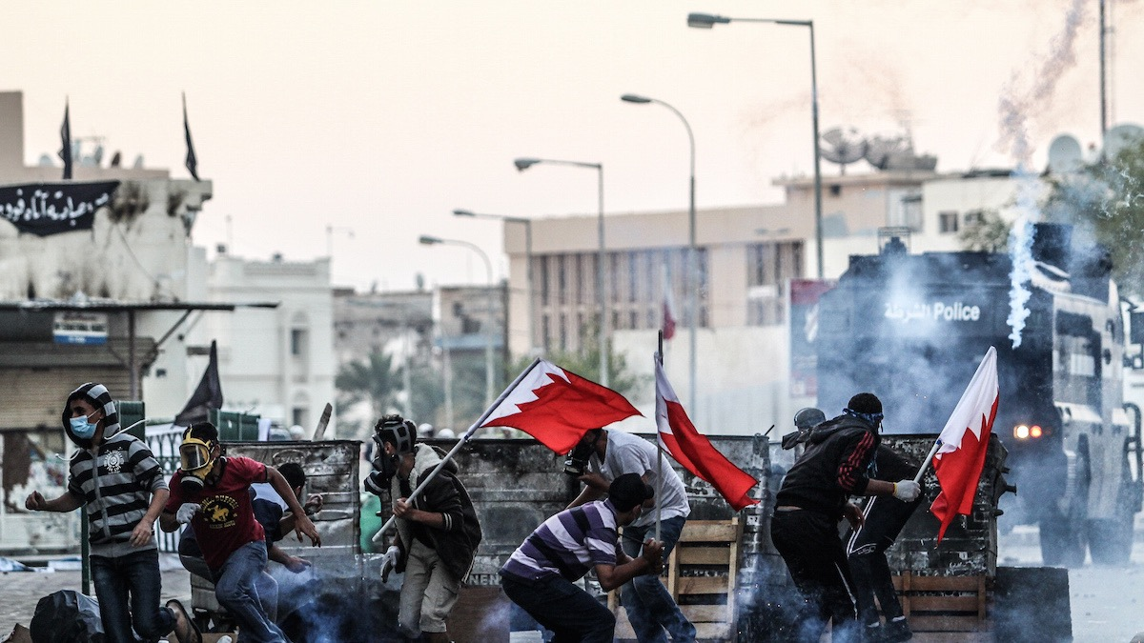
Foreign Policy of Saudi Arabia
Structural changes threatening Saudi regime
2. PENINSULAR: ARAB SPRING challenges Saudi peninsular hegemony. Uprisings and conflict against Saudi-backed governments of BAHRAIN and YEMEN. Gas-rich & media-savvy QATAR’s ambitious ruler pursues an independent path

Slide 10
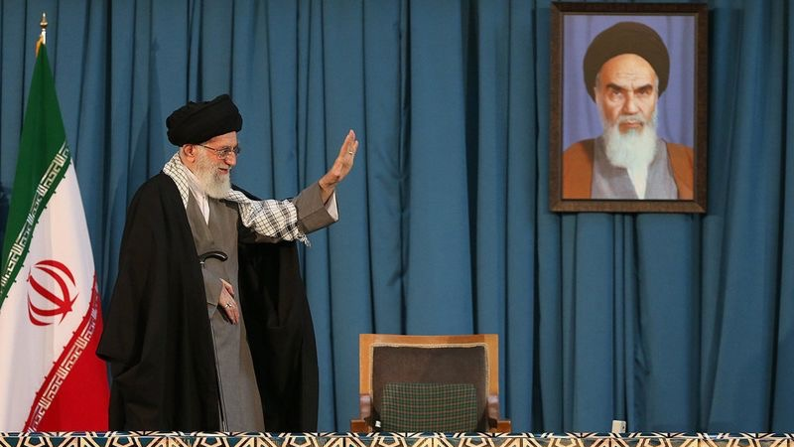
Foreign Policy of Saudi Arabia
Structural changes threatening Saudi regime
3. REGIONAL: IRAN’s growing regional influence since the mid-2000s
US invasions of Afghanistan and Iraq inadvertently open space for Iranian expansion...
Hizbullah becomes a key actor in Lebanon
The rise of MUSLIM BROTHERHOOD following Arab Spring uprisings.

Slide 11
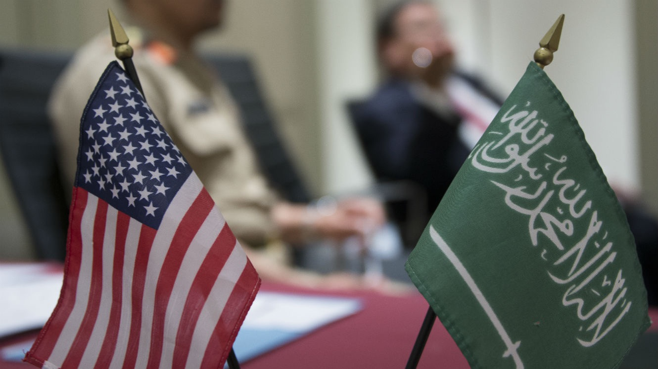
Foreign Policy of Saudi Arabia
Structural changes threatening Saudi regime
4. GLOBAL: DECLINING US DEPENDENCE on energy imports.
Growing opposition in US of over-dependence on Saudi Arabia (and Israel) – based on human rights record and strategic perspective.
Resulting in…
Obama administration efforts to resolve Iranian nuclear issue and bring back Iran from isolation, despite Saudi protests.

Slide 12
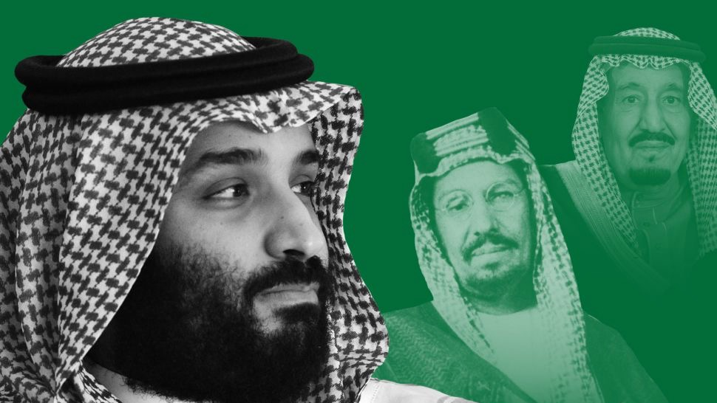
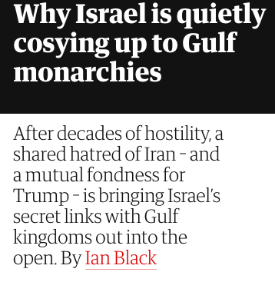
Foreign Policy of Saudi Arabia
Saudi reaction to existential challenges
Pour money into society to purchase consent + increase repression against dissent.
Aggressive policies to re-establish peninsular hegemony
Military suppression of uprising in Bahrain
Civil war and destruction in Yemen
Embargo against Qatar
Fund & support local rivals of Iran & Muslim Brotherhood across region (i.e. the Salafis).
Sabotage the Iran deal & lobby the Republican Party against the Obama administration – in unspoken alliance with Israel
Link to Guardian article

Slide 13
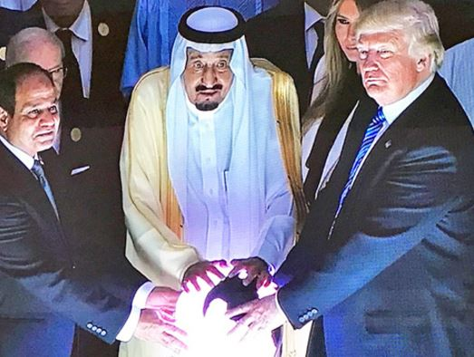

Slide 14
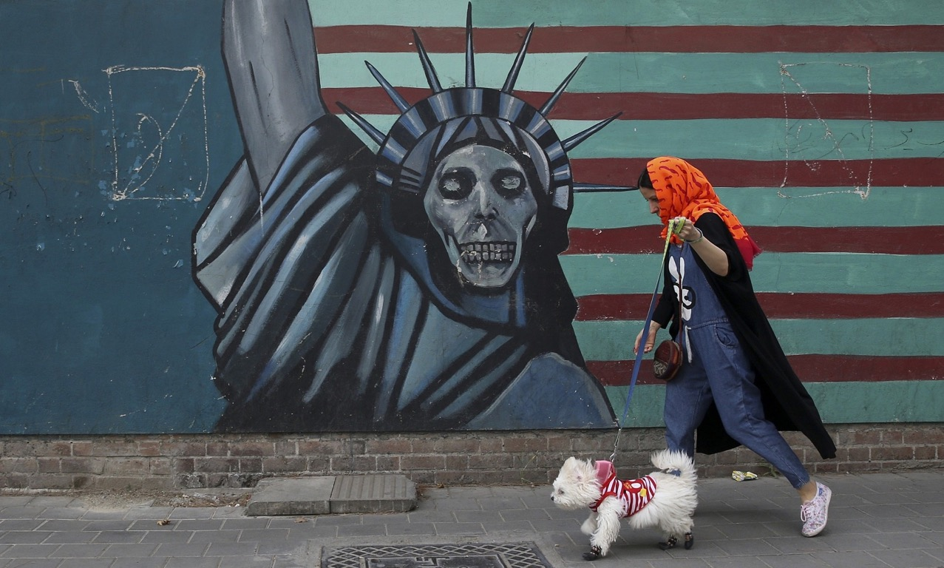
Foreign
Policy of
the
Islamic Republic
of Iran

Slide 15
Foreign Policy of the Islamic Republic of Iran
Revolutionary rhetoric:
Neither East nor West
Great Satan (USA), Little Satan (UK)
Exporting the Revolution
Until 1988, foreign policy followed revolutionary goals
Continued war against Iraq
Support for Islamist, anti-Israeli or Third World Revolutionary causes (Cuba, Angola, South Africa) around the world.
But since 1989 (end of the Iraq war + Khomeini’s death) Iranian foreign policy has turned pragmatic & defensive: ensuring regime security

Slide 16
Foreign Policy of the Islamic Republic of Iran
How is foreign policy made in Iran?
Hybrid regime: Islamic guardians watching over republican (electoral) institutions
Boundaries determined by the Islamic guardians
Elected presidents have limited control over f.p. making
Factional competition sets the tone of f.p. w/in established boundaries
“Hardliner” Traditionalists vs. “Softliner” Reformists
Supreme Leader Khamenei & President Rouhani

Slide 17
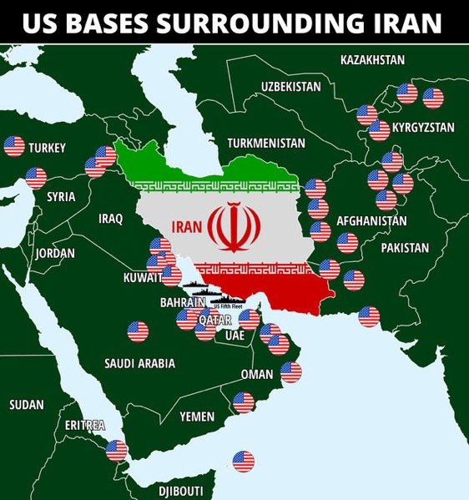
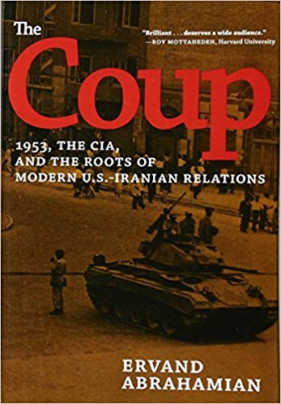
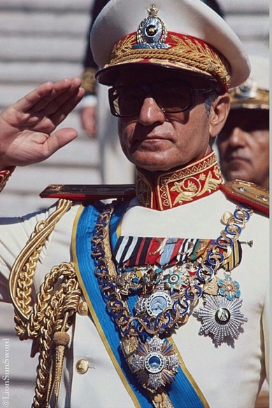
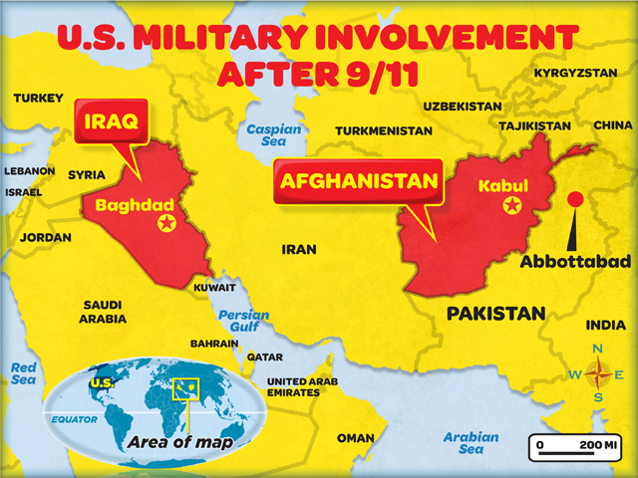
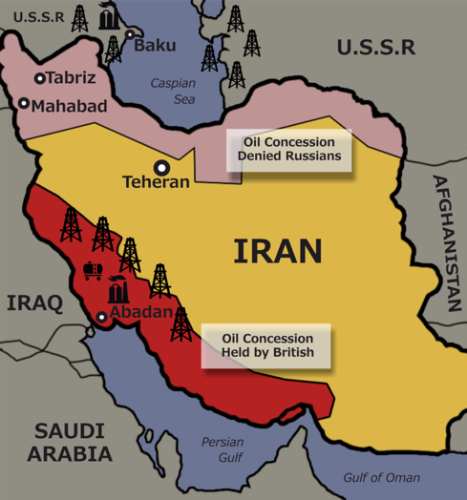
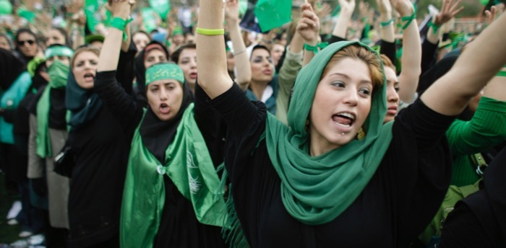
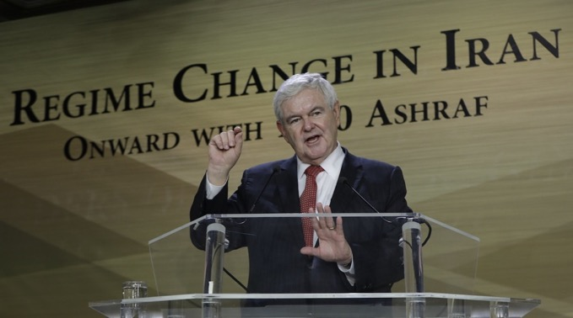
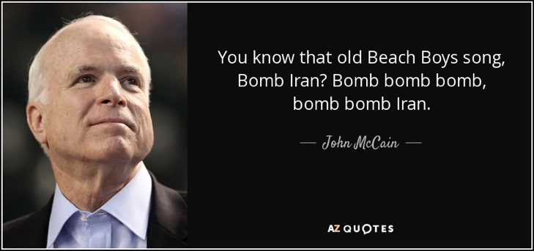
Foreign Policy of the Islamic Republic of Iran
Why so insecure?
History of imperial meddling
US & UK backing for 1953 coup
US support for the Shah regime
US funding for regime change
US threat of military action against Iran
US invasion of two neighbours
US military bases around Iran
Popular frustration with repressive regime

Slide 18
Dual Pillars of IRI Foreign-Security Policy
The “Shia Crescent”
A constellation of (mostly Shia) allies supported financially and militarily by Tehran.
Yemen (Houthis), Iraq, Syria (Assad), Lebanon (Hizbullah), Gaza (Hamas; until Arab Spring)
Used as leverage against regional rivals & shield Iran from direct aggression
Seen as an expansionist threat by US & GCC.
→ None of the local divisions are originally or purely Iranian making—but Iran takes advantage of them.

Slide 19
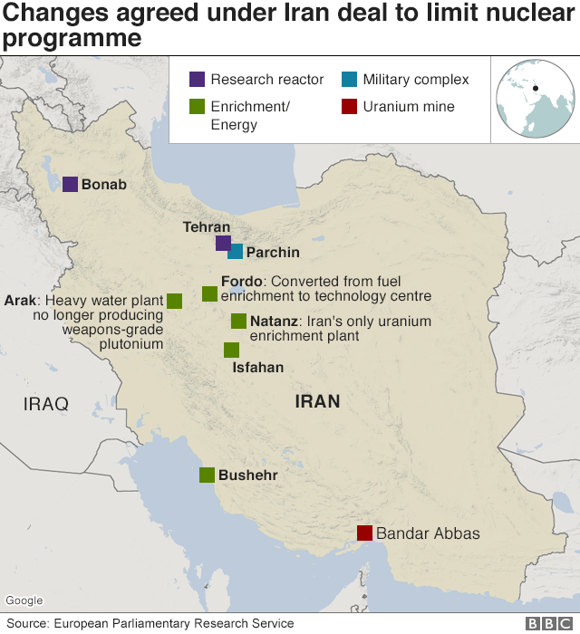
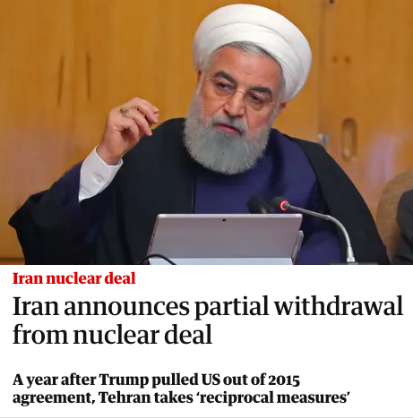
Dual Pillars of IRI Foreign-Security Policy
The Nuclear Programme
Fact: Nuclear capability is a deterrent against military action
North Korea, India, Pakistan
Libya, Iraq
Not entirely security related → Iranian attempt to break oil dependence.
Fears of a regional nuclear arms race.
2015 deal: Iran ends military-grade enrichment in exchange for sanctions relief
US double standard re: Iranian versus Israeli & Saudi nuclear capacity

Slide 20
Can the Cold War turn into a hot war?
Neither side is interested in direct confrontation
War of words =/= Readiness for conflict
Yet regional entanglements and domestic problems raise tensions & risk of things getting out of control
Presence of unpredictable ego-maniacs (Trump, MBS) complicates things further
Although for Trump, unpredictability goes both ways
ex. Firing of John Bolton

Slide 21
Homework
“How does the Cold War between Iran and Saudi Arabia impact the Israeli-Palestinian conflict?”
One paragraph or half a page.
Please email to me by end of Monday (midnight) 27 April

Slide 22
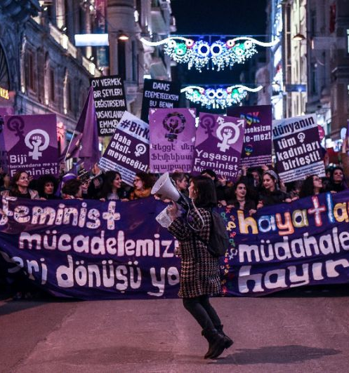
Next week Women’s & LGBTQ+ struggles

