Slide 1
Neglected and emerging infectious diseases

Slide 2
SARS (Severe Acute Respiratory Syndrome)
First infectious disease outbreak in the 21st century
SARS-coronavirus (SARS-CoV) – originally an animal virus
Coronaviruses are common throughout the world and can infect both animals and humans – affect the upper respiratory and gastrointestinal tract of mammals (including humans) and birds
Usually causes a high percentage of common colds (in human adults), pneumonia, bronchitis, etc.
Symptoms: very similar to influenza-like symptoms: fever, headache, diarrhoea, shivering, etc.

Slide 3
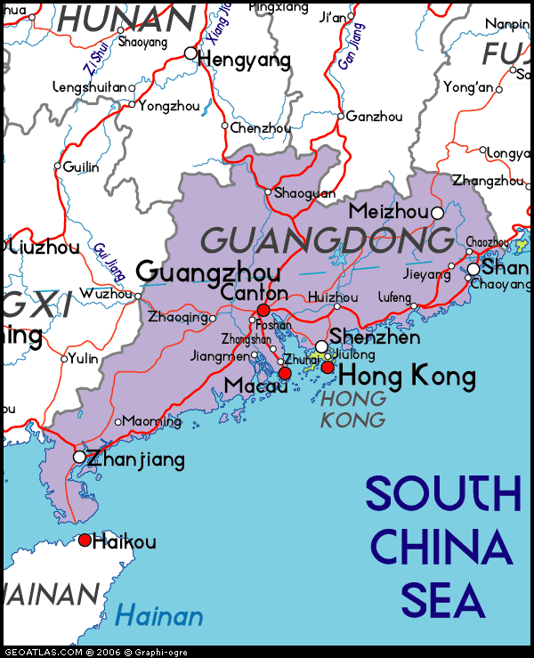
Chronology of the SARS outbreak:
Before November 2002: animal to human transmission in Guangdong Province, China
12 February: WHO reported 305 cases and 5 fatalities
19 February: WHO reported a case of H5N1 of a
nine-year old boy in Hong Kong (had travelled to Fujian
Province in January (mother and sister )
→ confusion about the virus
mid-Feruary: Dr Liu Jianlun, professor of nephrology at
Zhongshan University (Guangzhou) travels to HK
→ stays at the Metropole Hotel, 9th floor, room 911
→ dies one day later in a hospital in HK
→ he had infected at least 16 other guests at the 9th floor
(citizens from the US, Singapore, Canada)
→ start of a global epidemic

Slide 4
US-business man travels to Hanoi – admitted to hospital – infecting hospital staff
March: WHO receives reports of atypical respiratory disease from multiple countries and places (Vietnam, Singapore, Canada, China, Hong Kong, Indonesia, the Philippines)
15 March: WHO is notified of the case of a Singoporean national with symptoms of atypical pneumonia travelling from New York to Singapore via Frankfurt (arriving in Frankfurt, he is immediately isolated together with his family)
15 March: WHO issues an emergency travel advisory (providing information on symptoms at airports)
15 March: WHO names the disease Severe Acute Respiratory Syndrome (confirming the emergence of a new virus)

Slide 5
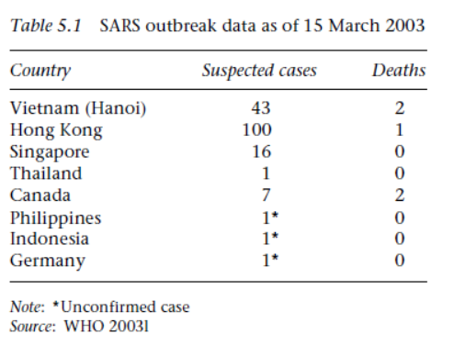
What is going on here?
Fidler (2004), Governance and globalisation of disease: SARS, p. 80

Slide 6
WHO tries to coordinate the international response to the virus outbreak through its Global Outbreak Alert and Response Network (GOARN).
- collecting information
- providing and sharing information
- tracing transmission patterns (Guangdong Province, Metropole Hotel HK, etc.)
- creating an epidemiological profile
GUANGDONG PROVINCE

Slide 7
Chinese government fails to cooperate / denies WHO health workers access
27 March: WHO issues recommendation to prevent travel-related spread (HK, Singapore, Vietnam and Canada)
1 April: WHO reports 1804 cases with 62 deaths in 15 countries
30 April: 5663 cases, 372 deaths, 26 countries
29 May: 8295 cases, 750 deaths, 28 countries
June: epidemic finally slows down with no new cases reported
WHO publicly criticises the Chinese government in May
Chinese government starts to cooperate
WHO`s global efforts to contain epidemic at major hot spots (GOARN)

Slide 8
Group Work:
What did actually happen during the SARS outbreak? /
How did a global epidemic reconfigure and reshape geopolitics in Asia?
Describe and explain the behaviour of the Chinese government during the SARS outbreak!
What does China‘s behaviour mean for traditional notions such as sovereignty, territory and nationalism in IR?

Slide 9
Neglected diseases
Neglected tropical disease (NTDs):
- diseases that occur within the tropical belt and include Chagas disease, malaria, dengue, leishmaniasis and others.
- diseases that affect a significant proportion of people in the global south with a clear economic burden on the country
Examples:
Chagas disease: 6 million to 7 million people worldwide affected (mostly in Latin America)
Leishmaniasis: annually between 700.000 and 1 million new cases (among them 20.000 to 30.000 new deaths) → over 1 billion people at risk / living in endemic areas
Dengue fever: estimated 390 million Dengue infections every year / 40% of the global population is at risk
Malaria: (in 2016 alone) 216 million cases worldwide / 445.000 deaths / African region is home to 90% of all Malaria cases

Slide 10
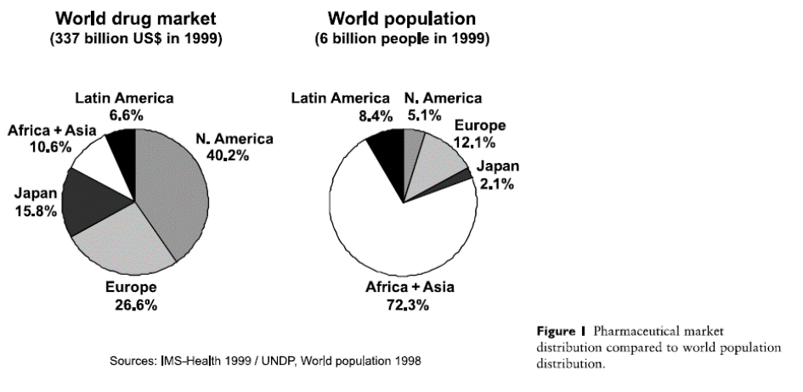
Lack of profitable market and efficient market mechanisms
1975 – 2014: only 21 out of 1,556 drugs
(1.3%) were developed to address
NTDs, even though NTDs account for
11.4% of the global disease burden.
Between 1975 and 1997: less than 1%
of the 1,223 new medicines launched
were destined for tropical diseases.
Trouiller et al, Drugs for neglected diseases, p. 90.

Slide 11
Barriers to drug development
- high cost of Research & Development (R&D)
- regulatory barriers
- protection of intellectual property (WTO, TRIPS, Free Trade Agreements)
Strategies to overcome these barriers
- technology transfer and capacity building
- improve legal and regulatory framework
- finance drug development and ensure access
The landscape has profoundly changed since the beginning of this century!

Slide 12
Group Work:
1) Analyse the websites of the following new mechanisms created to tackle the challenge of neglected diseases in global health governance:
TB Alliance (www.tballiance.org)
DNDi (Drugs for Neglected Diseases initiative (www.dndi.org)
Medicines for Malaria Venture (www.mmv.org)
Chagas Clinical Research Platform (www.dndi.org/strengthening-capacity/chagas-platform/)
Leishmaniasis East Africa Platform (www.dndi.org/strengthening-capacity/leap-platform/)
2) Describe the principal (founding) members, the decision-making logic, the key objectives and the fundamental strategies to find solutions to the problem of neglected diseases!
3) What do these new mechanisms tell us about how global health governance has changed the traditional notions of IR?

