Slide 1
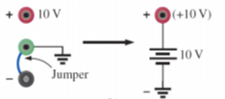
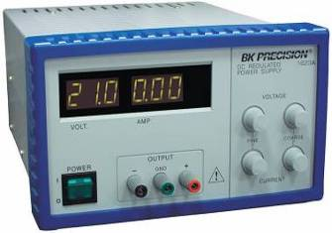
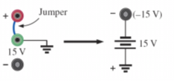
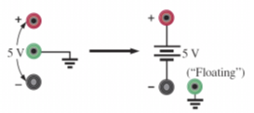
Power Supplies
available terminals
positive voltage with respect to ground
dc power supply
(0V - 60 V, 0 - 1.5 A)
negative voltage with respect to ground
floating supply

Slide 2
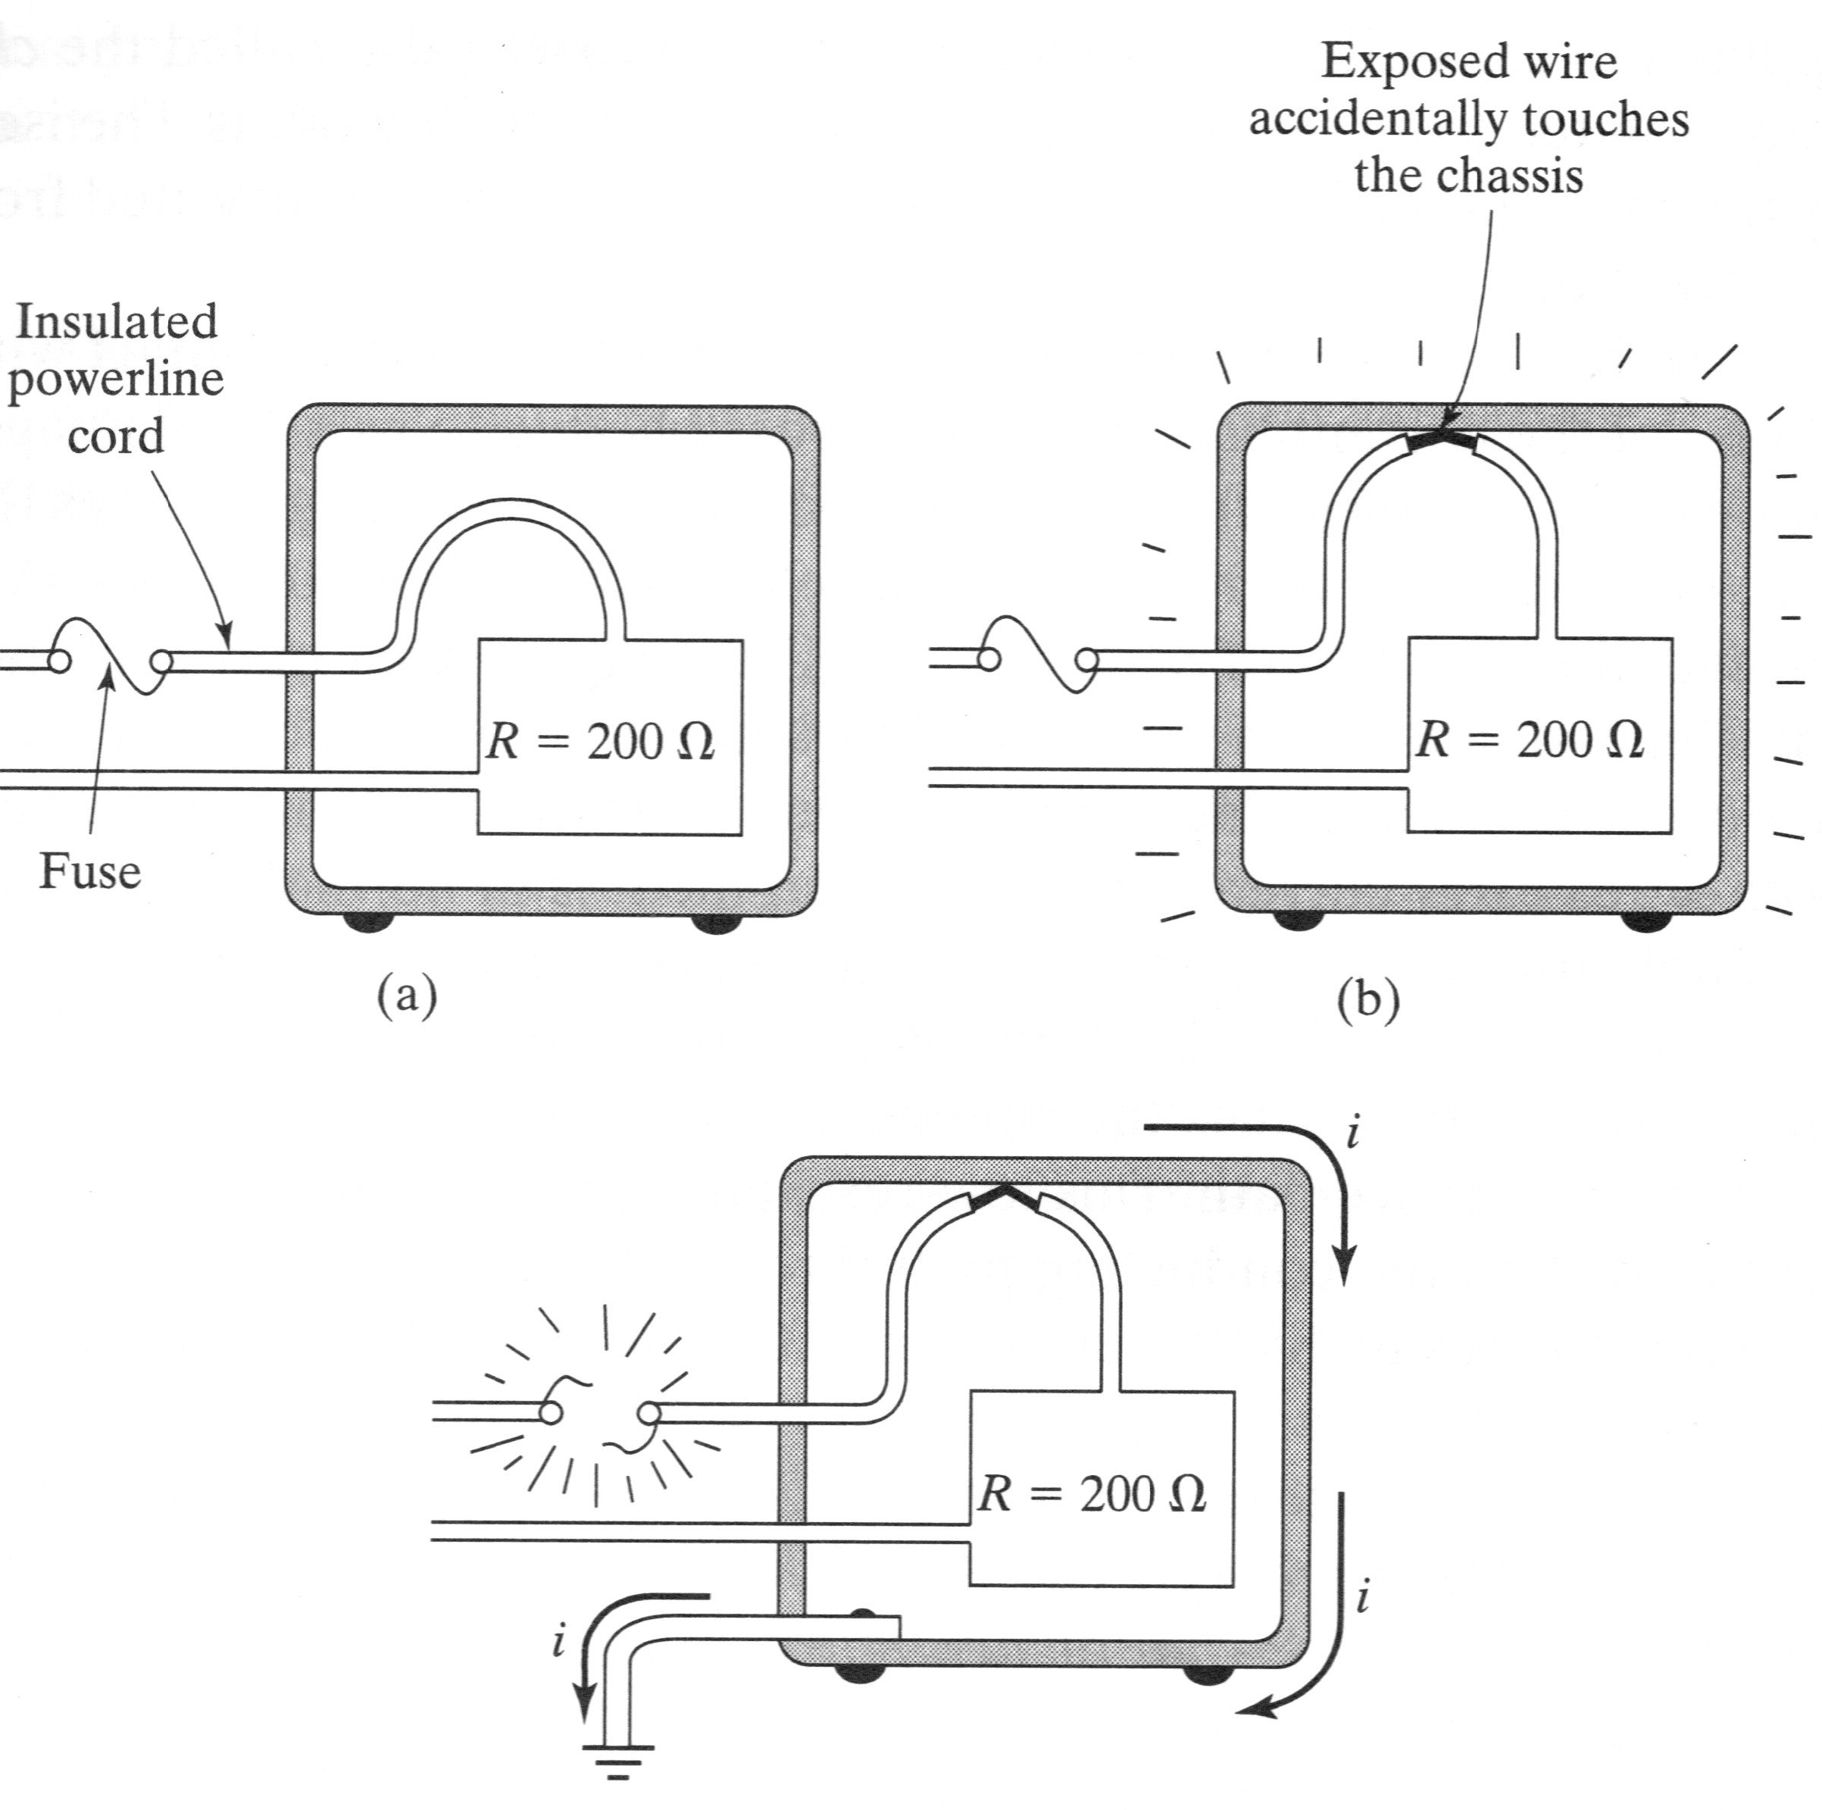
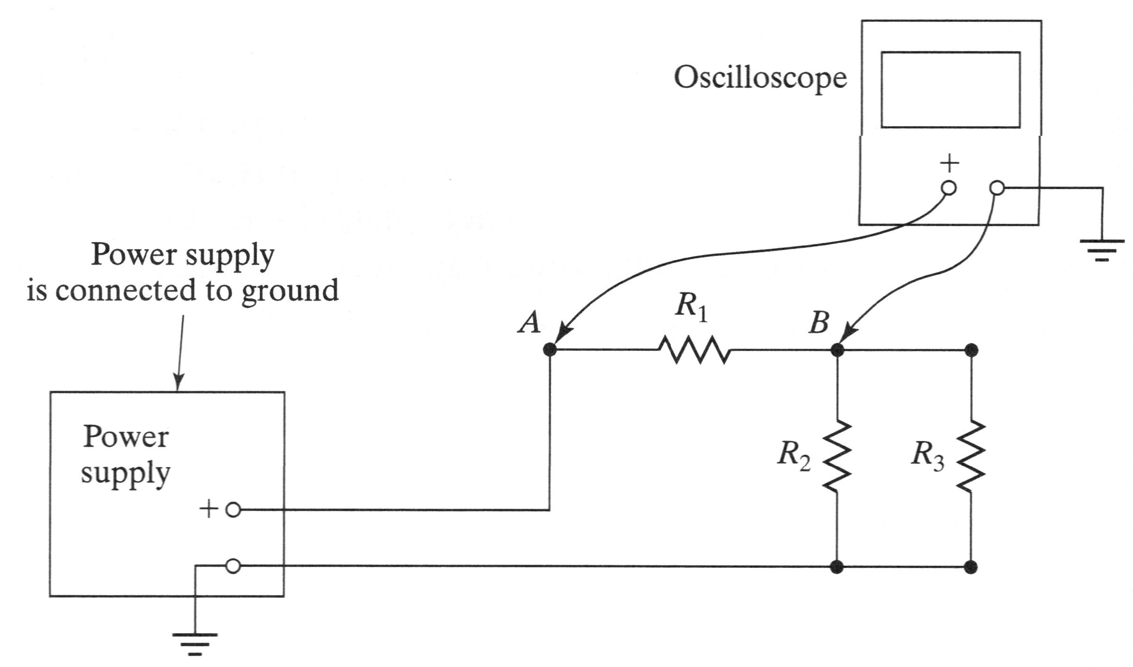
Grounding
Grounding Effect In Measurements
Protection with Grounding

