Slide 1
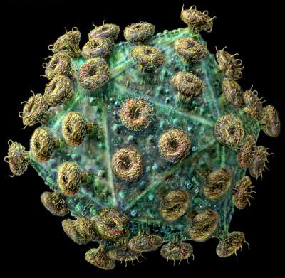
Universidade de São Paulo Faculdade de Medicina de Ribeirão Preto Disciplina de Medicina Preventiva
As origens do vírus HIV e a Epidemiologia da AIDS
Fernando Bellissimo Rodrigues

Slide 2
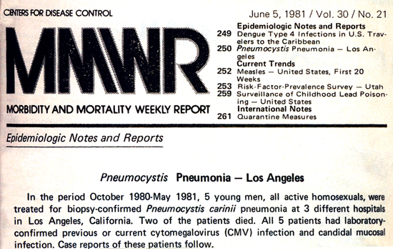
O primeiro alerta!

Slide 3
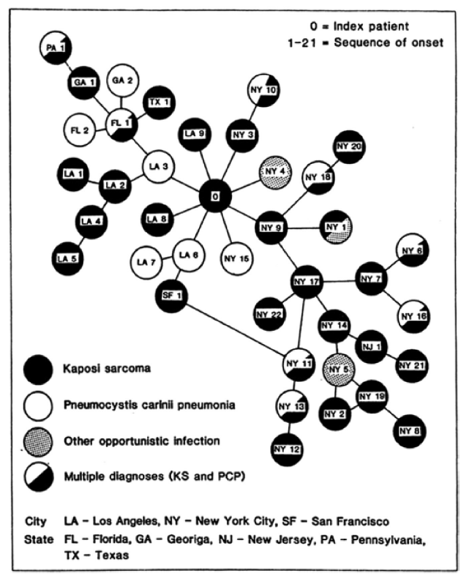
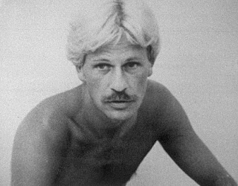
O paciente “zero”?
Gaëtan Dugas, também conhecido como “Diabo loiro” (1953-1984) foi inicialmente considerado o “paciente zero” da AIDS
The American Journal of Medicine, 76: 487-492, 1984

Slide 4
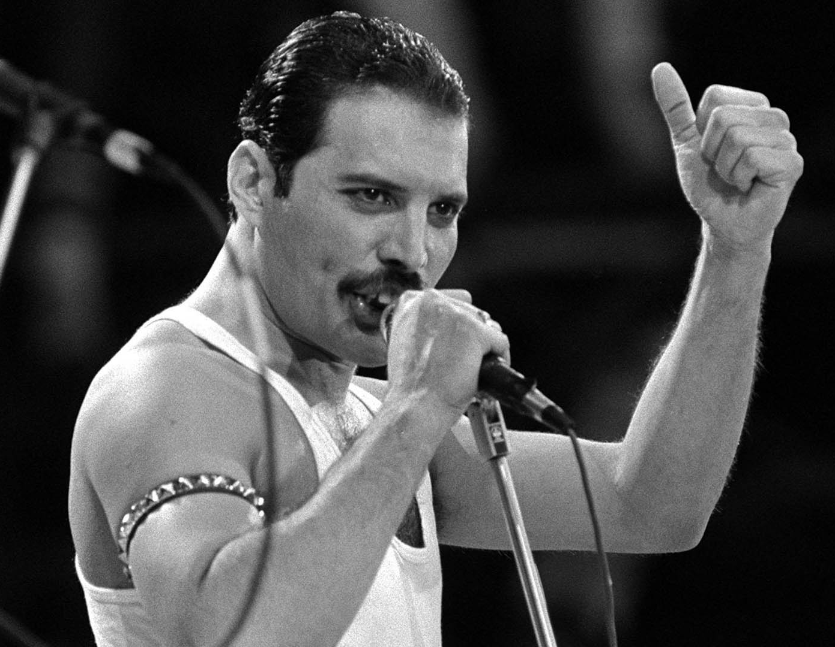
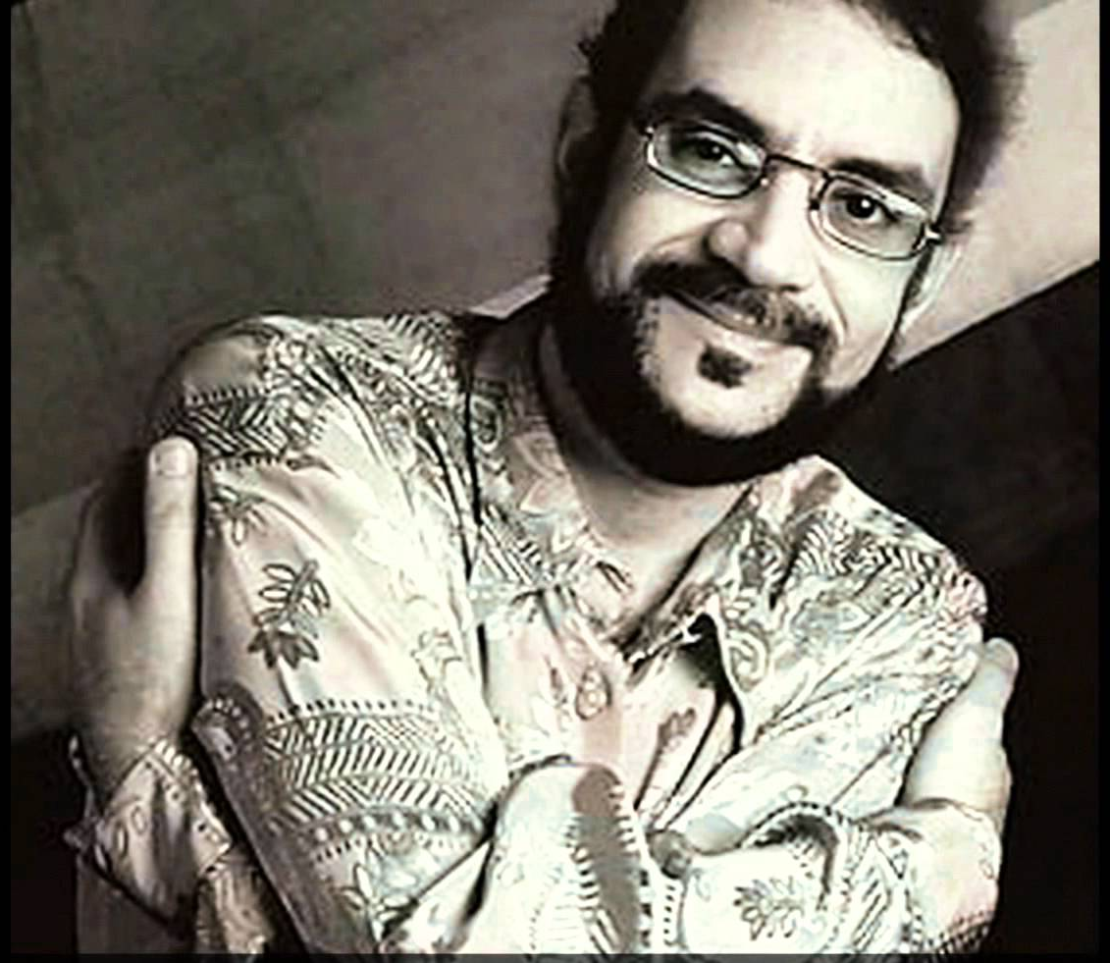
Celebridades que morreram de AIDS nos anos 80 e 90

Slide 5
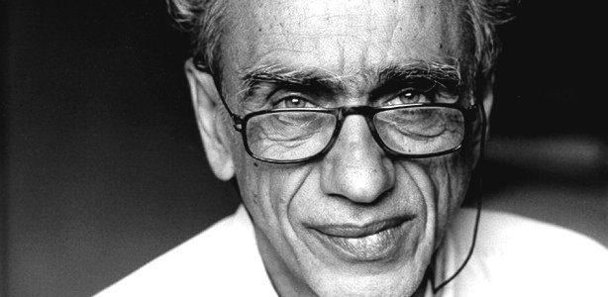
Celebridades que morreram de AIDS nos anos 80 e 90

Slide 6
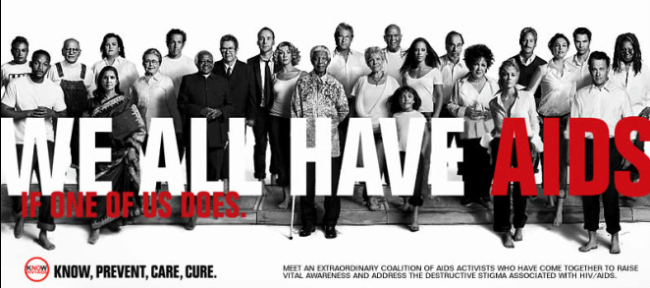
EUA, 1982: preconceito
Five H disease:
Homosexuals, Hemophilic, Haitians, Heroin users, and Hookers

Slide 7
1983, o vírus HIV é isolado

Slide 8
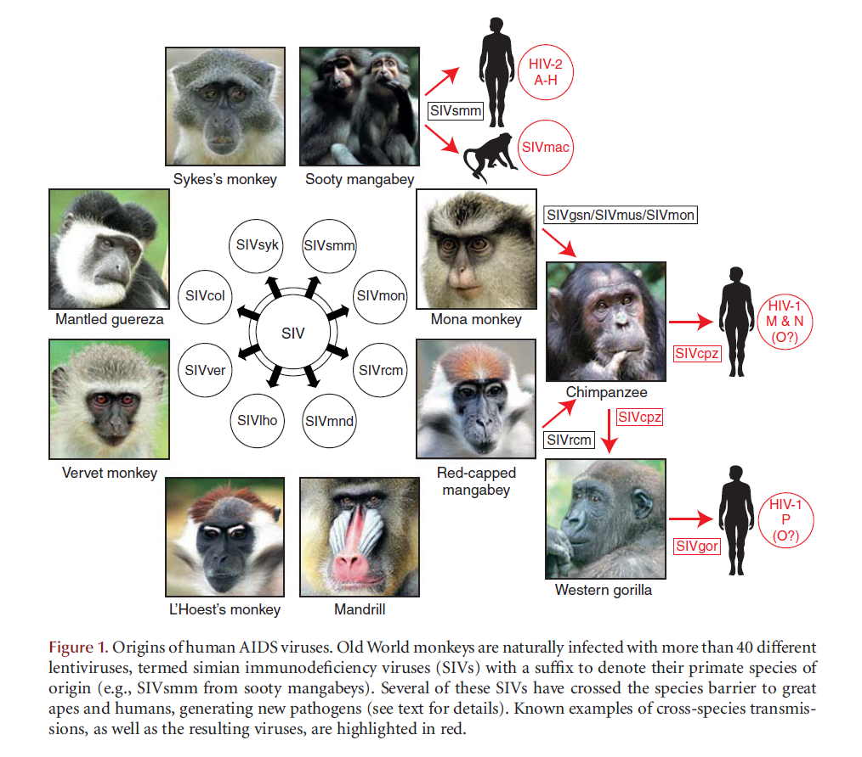
Do SIV ao HIV

Slide 9
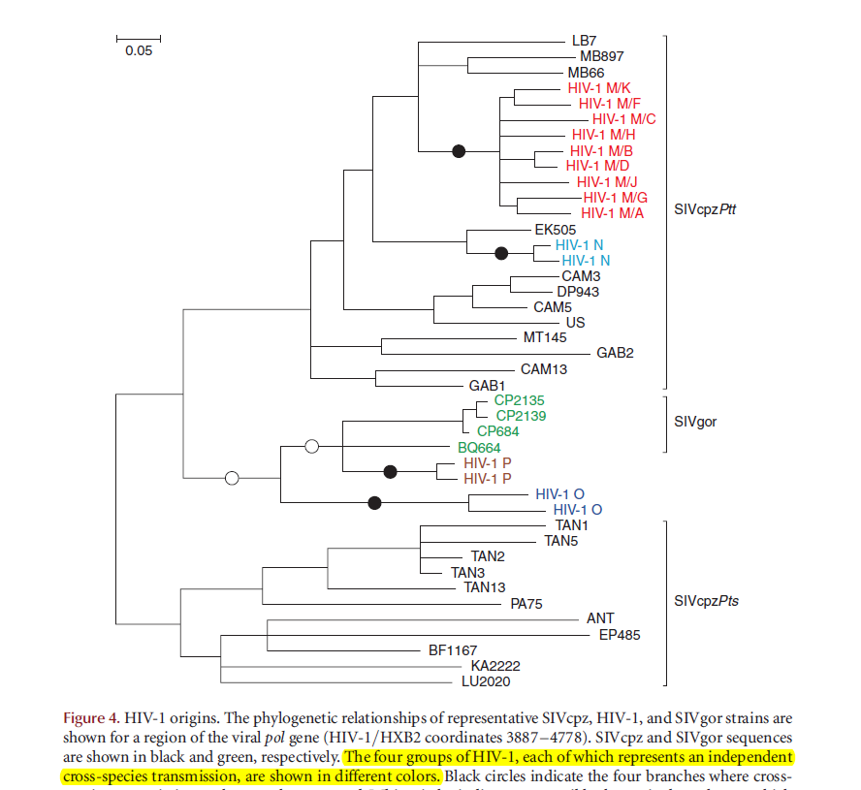
Do SIV ao HIV
O HIV-1 M (major) é o responsável pela pandemia de AIDS
Os demais grupos e subtipos são raros e encontrados praticamente restritos à África Central.

Slide 10
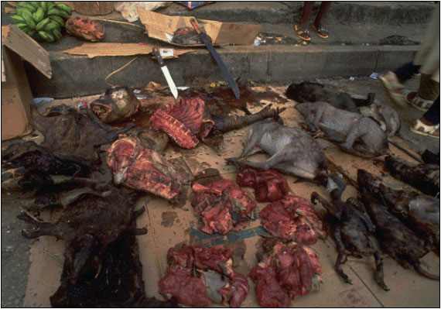
Do SIV ao HIV
“At this bush meat market in Pointe Noire, a butchered chimpanzee is shown in the middle of the photograph, along with other smoked and fresh meat”
(Photo courtesy of Karl Ammann)

Slide 11
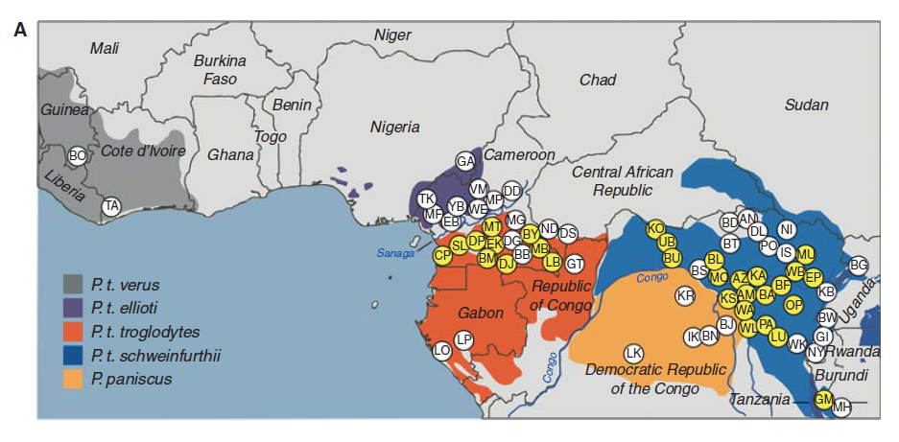
Dos Camarões até Kinshasa (Congo)

Slide 12
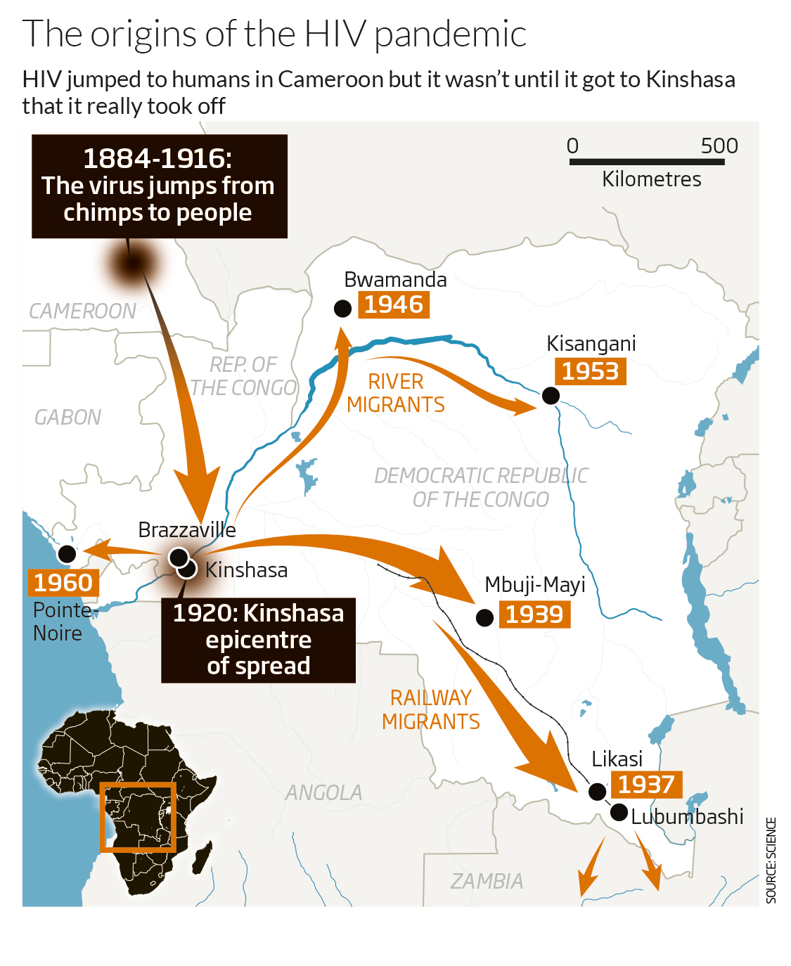
Dos Camarões até Kinshasa
Exploração de borracha e marfim
(Rio Sangha)
Science
doi:10.1126/science.12567.39

Slide 13
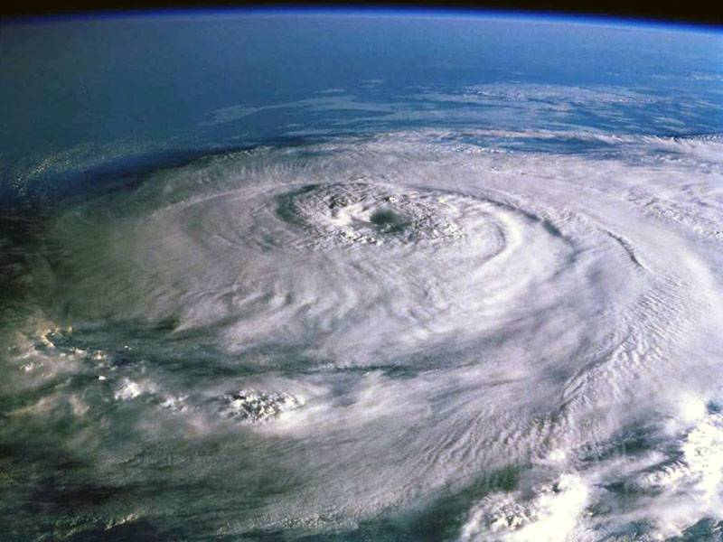
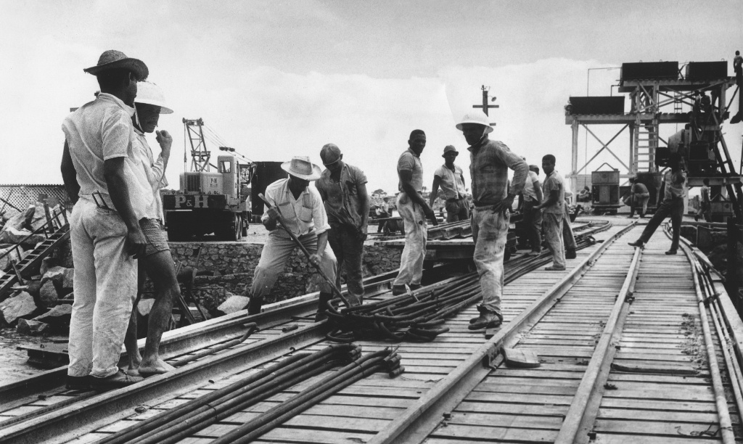
A amplificação inicial em Kinshasa, 1920-1960 The ‘Perfect storm’ turned HIV from local to global killer
Science
doi:10.1126/science.12567.39
Exploração de minérios pelos colonizadores Belgas
Uso de seringas não-estéreis nas clínicas de DST
Em 1955, a relação homem:mulher chegou a 5,4:1
Atração de milhares de homens para construção de ferrovias
Amplificação da prostituição

Slide 14
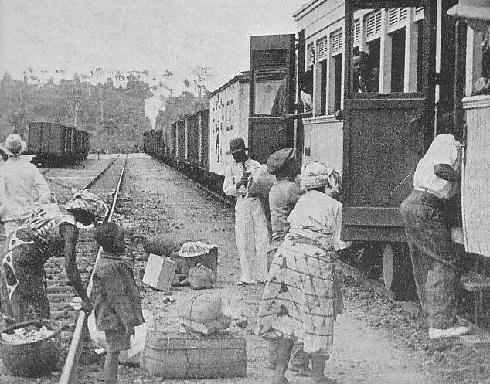
Kinshasa, 1930
“The railway system in Kinshasa in the 1930 meant Kinshasa was the best connected city in Africa”
(Shigemitsu Fukao/Creative Commons)
“Within the DRC, the railway network was used by >300,000 passengers per year in 1922, peaking at >1 million annual passengers in 1948” (Science) .

Slide 15
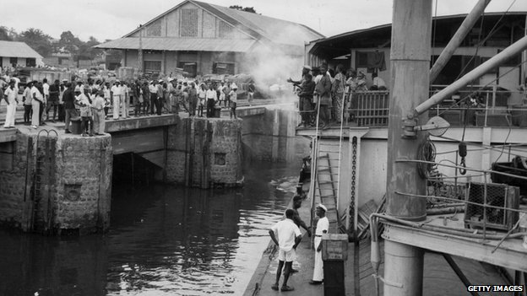
Kinshasa, 1955

Slide 16
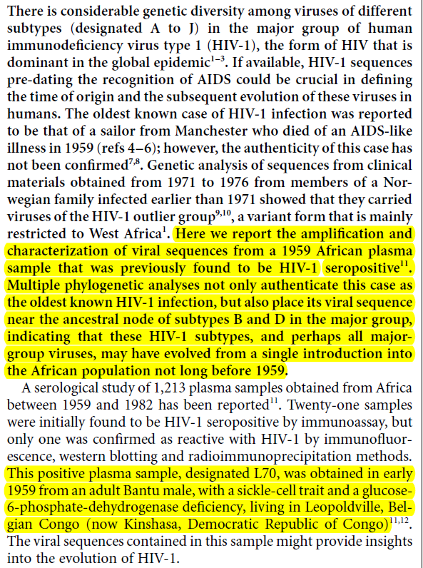
O paciente mais antigo (conhecido)

Slide 17
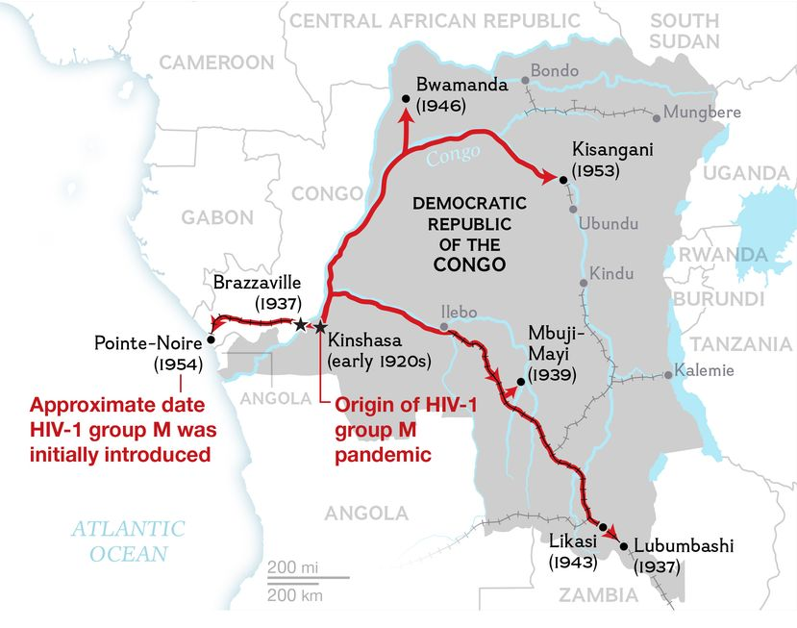
De Kinshasa para a África
Exploração de diamantes
(via ferrovia)
Early Spread of AIDS Traced to Congo's Expanding Transportation Network
In the 1960s AIDS spread rapidly across the Congo, riding a wave of social change as the region developed and its transportation network expanded.
Science 2014, vol. 346, Issue 6205, pp. 56-61

Slide 18
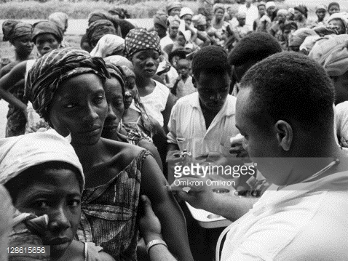
1960: o Congo Belga se liberta e funda a República Democrática do Congo
Importação de médicos do Haiti, intermediada pela OMS
Jacques Pepin. The origins of AIDS, 2011.

Slide 19
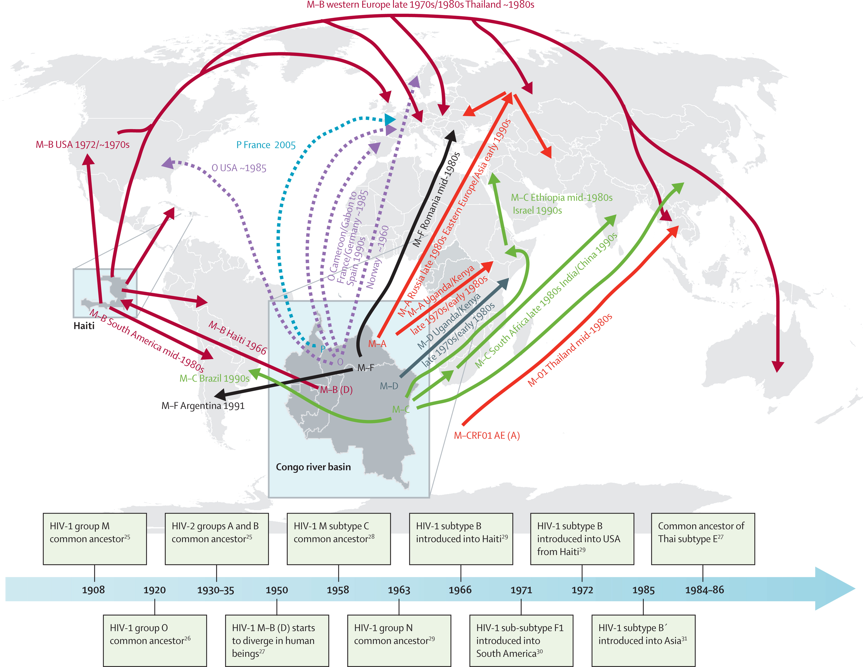
De Kinshasa para o Haiti
Lancet Infect Dis 2011; 11: 45–56

Slide 20
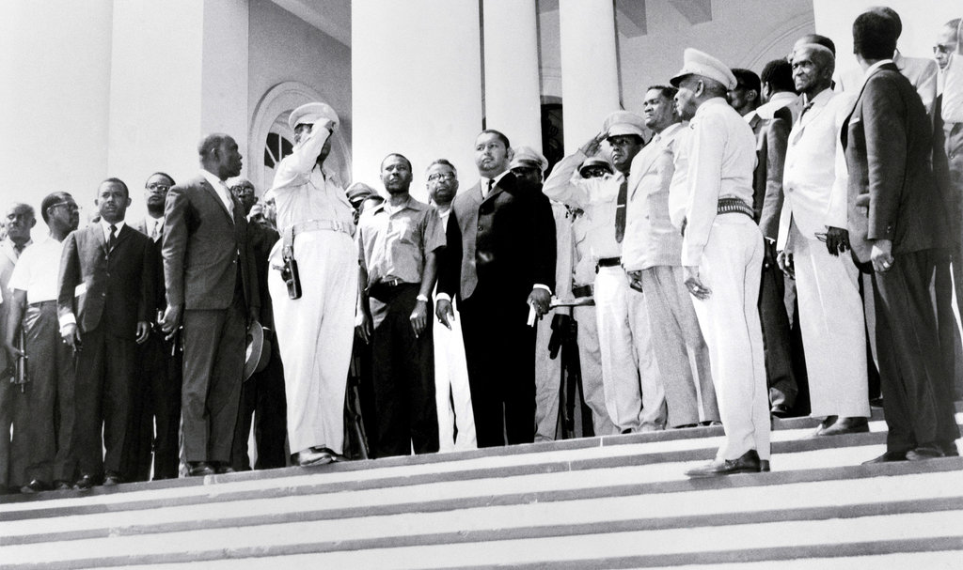
No Haiti, a máfia do sangue
HAITI. Jean-Claude Duvalier (Baby-doc) took power in 1971. At his right, in short sleeves, is Luckner Cambronne, the “Vampire of the Caribbean.” Credit Bettmann/Corbis

Slide 21
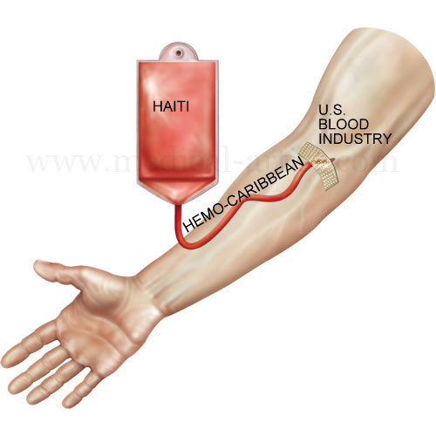
Nova amplificação no Haiti
Luckner Cambrone was known as the "Vampire of the Caribbean" for his profiting from the sale of Haitian blood and cadavers to the West for medical uses. Critics accused his forces of picking people to murder to provide bodies for such shipments.
Cambronne was co-owner of Hemo-Caribbean, a plasma center in Port-au-Prince that operated from 1971 to 1972 and had poor hygiene standards.
A 1972 New York Times story reported that Hemo-Caribbean exported 1,600 gallons of plasma to the United States a month.
Hemo-Caribbean was a major "amplifier" of the HIV/AIDS crisis, which he says had likely crossed over from Africa to Haiti through a single carrier around 1966.
Jacques Pepin. The origins of AIDS, 2011.

Slide 22
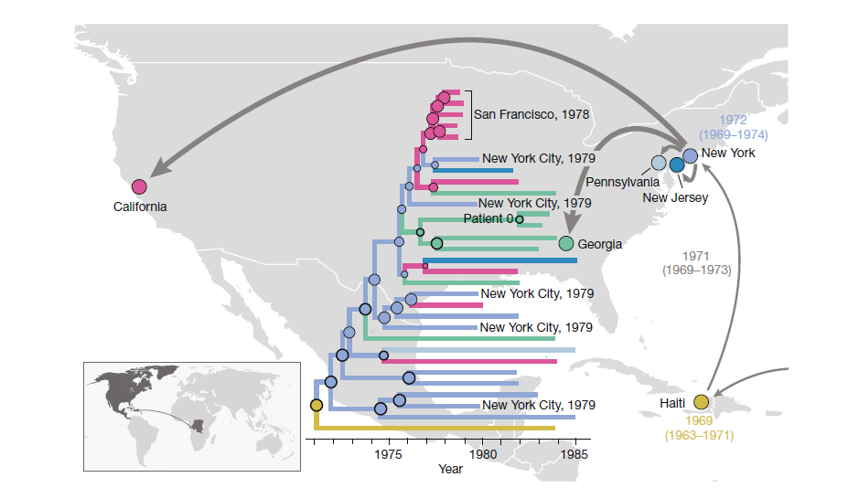
Do Haiti para os EUA
HemoderivadosTurismo gay

Slide 23
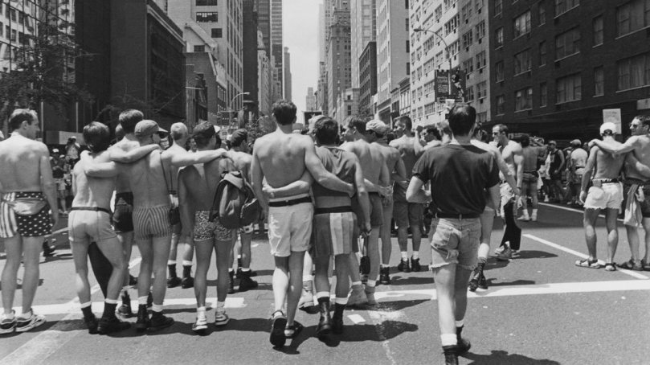
Nova amplificação nos EUA
Gay parade in the USA, 1971.

Slide 24
Dos EUA para o mundo
Lancet Infect Dis 2011; 11: 45–56

Slide 25
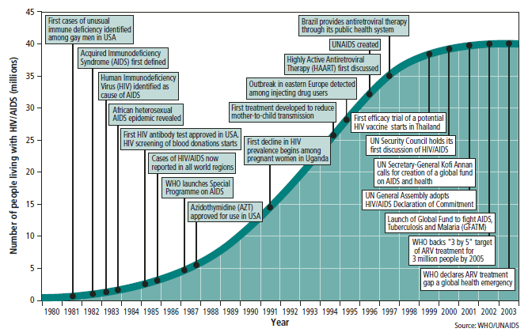
Linha do Tempo (1980 a 2003)
Histórico
2004

Slide 26
HIV: modos de transmissão
Relação sexual
Exposição a sangue/fluidos corporais
Transfusões de sangue
Agulhas compartilhadas
Instrumentos contaminados
Transmissão vertical (mãe → criança)
Gravidez
Parto
Aleitamento

Slide 27
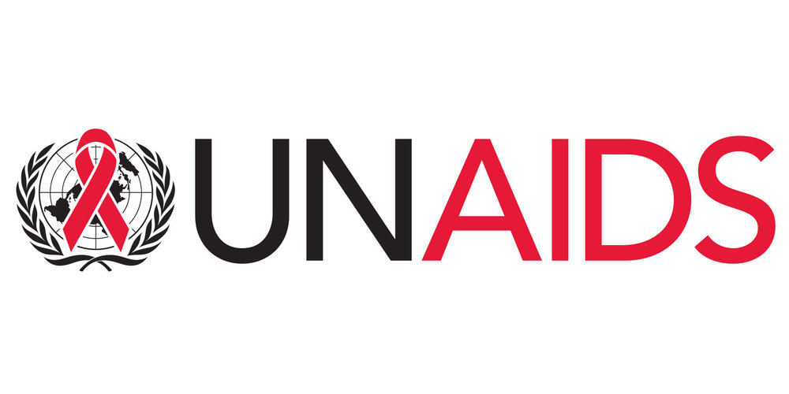
Epidemiologia mundial
People now estimated to be living with HIV  2018
Europe
2.5 millions
Western Pacific
1.9 millions
Eastern mediterranean
400,000
Americas
3.5 millions
Sub-Saharan Africa
25.7 millions
South-East Asia
3.8 millions
Total: 37.9 millions [32.7 million – 44.0 million]

Slide 28
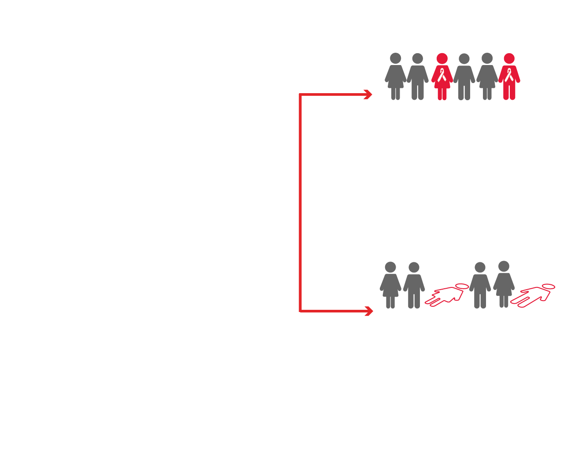
Summary of the global HIV epidemic (2018)
1.7 million
37.9 million
people newly infected
[1.4 million – 2.3 million]
people living with HIV
2018
[32.7 million – 44.0 million]
0.8 million
HIV-related deaths
[0.6 million –1.1 million]

Slide 29
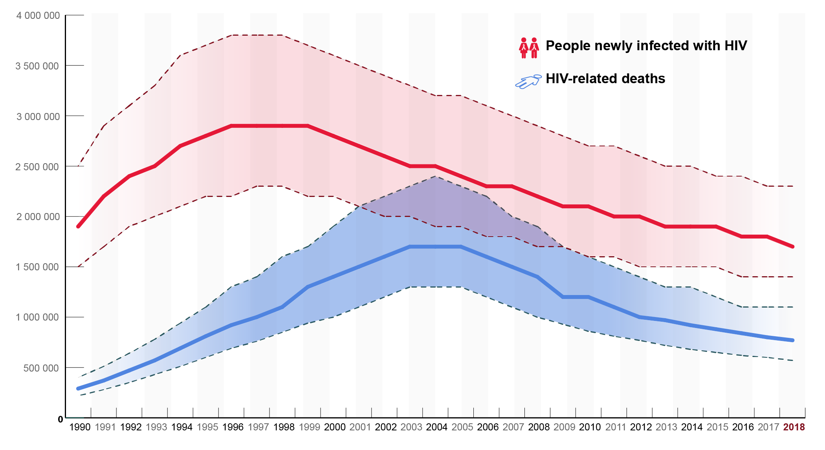
Decline in HIV incidence and mortality over time

Slide 30
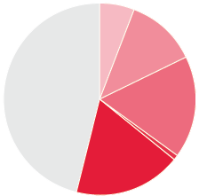
Distribution of new HIV infections by key population, global (2018)
Sex workers
6%
People who inject drugs
12%
Remaining population
46%
Gay men and other men who have sex with men
17%
Transgender women
1%
Clients of sex workers and sex partners of other key populations
18%

Slide 31
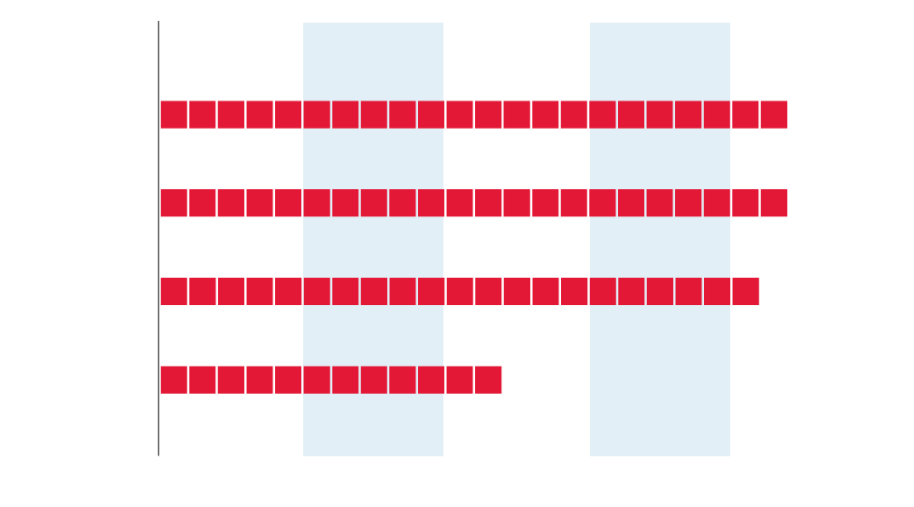
Increased risk of acquiring HIV among key populations, global (2018)
Among men who
have sex with men
(22 times)
Among people
who inject drugs
(22 times)
For sex workers
(21 times)
For transgender
people
(12 times)

Slide 32
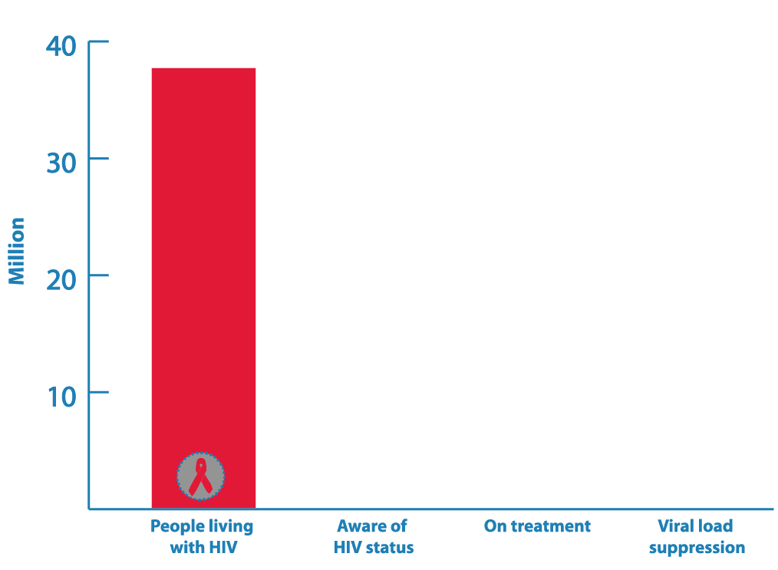
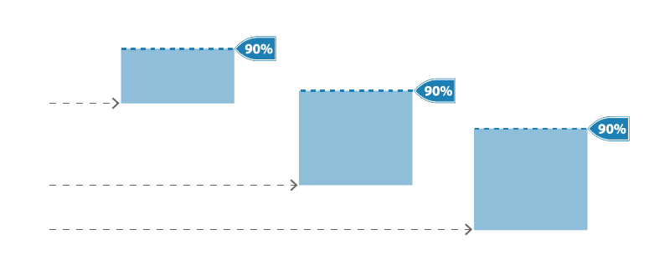
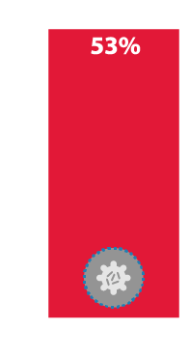
HIV testing and care continuum (2018)

Slide 33
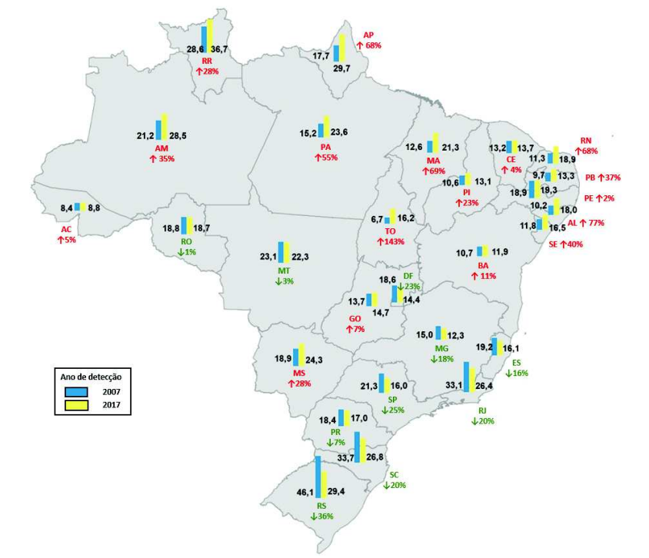
Epidemiologia no Brasil

Slide 34
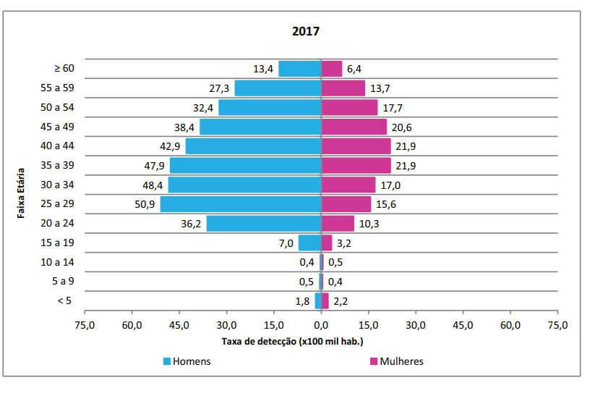
Epidemiologia no Brasil

Slide 35
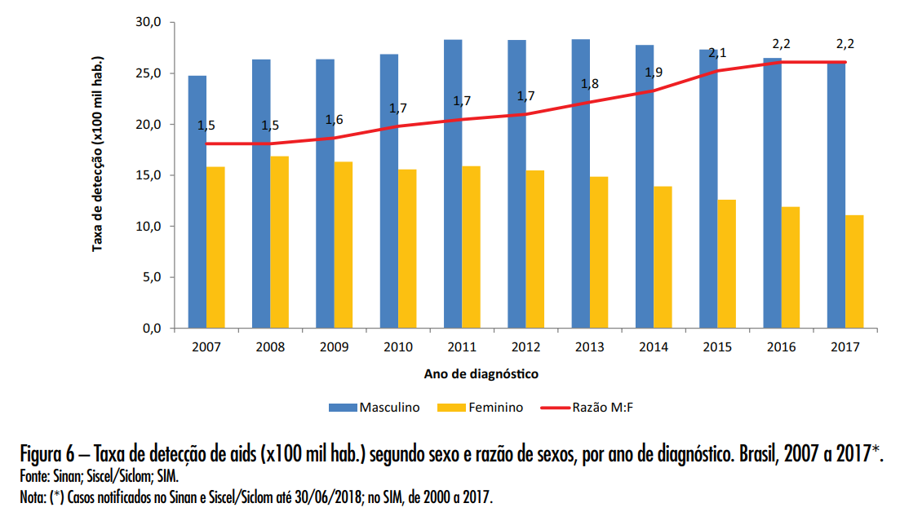
Epidemiologia no Brasil

Slide 36
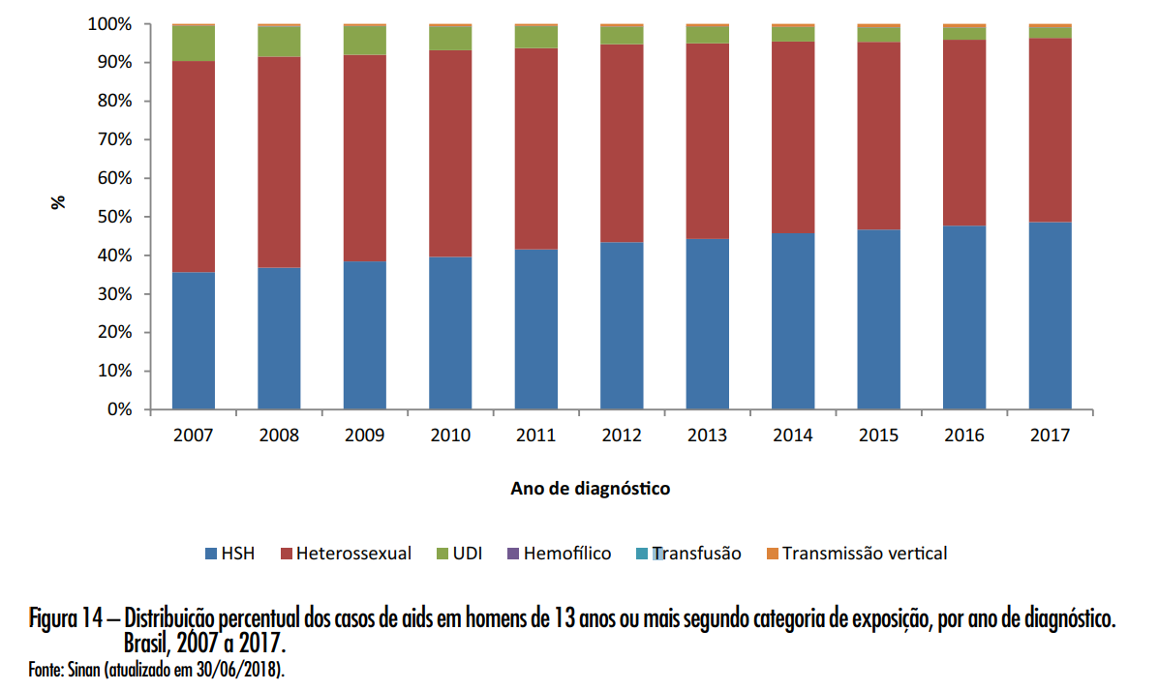
Epidemiologia no Brasil

Slide 37
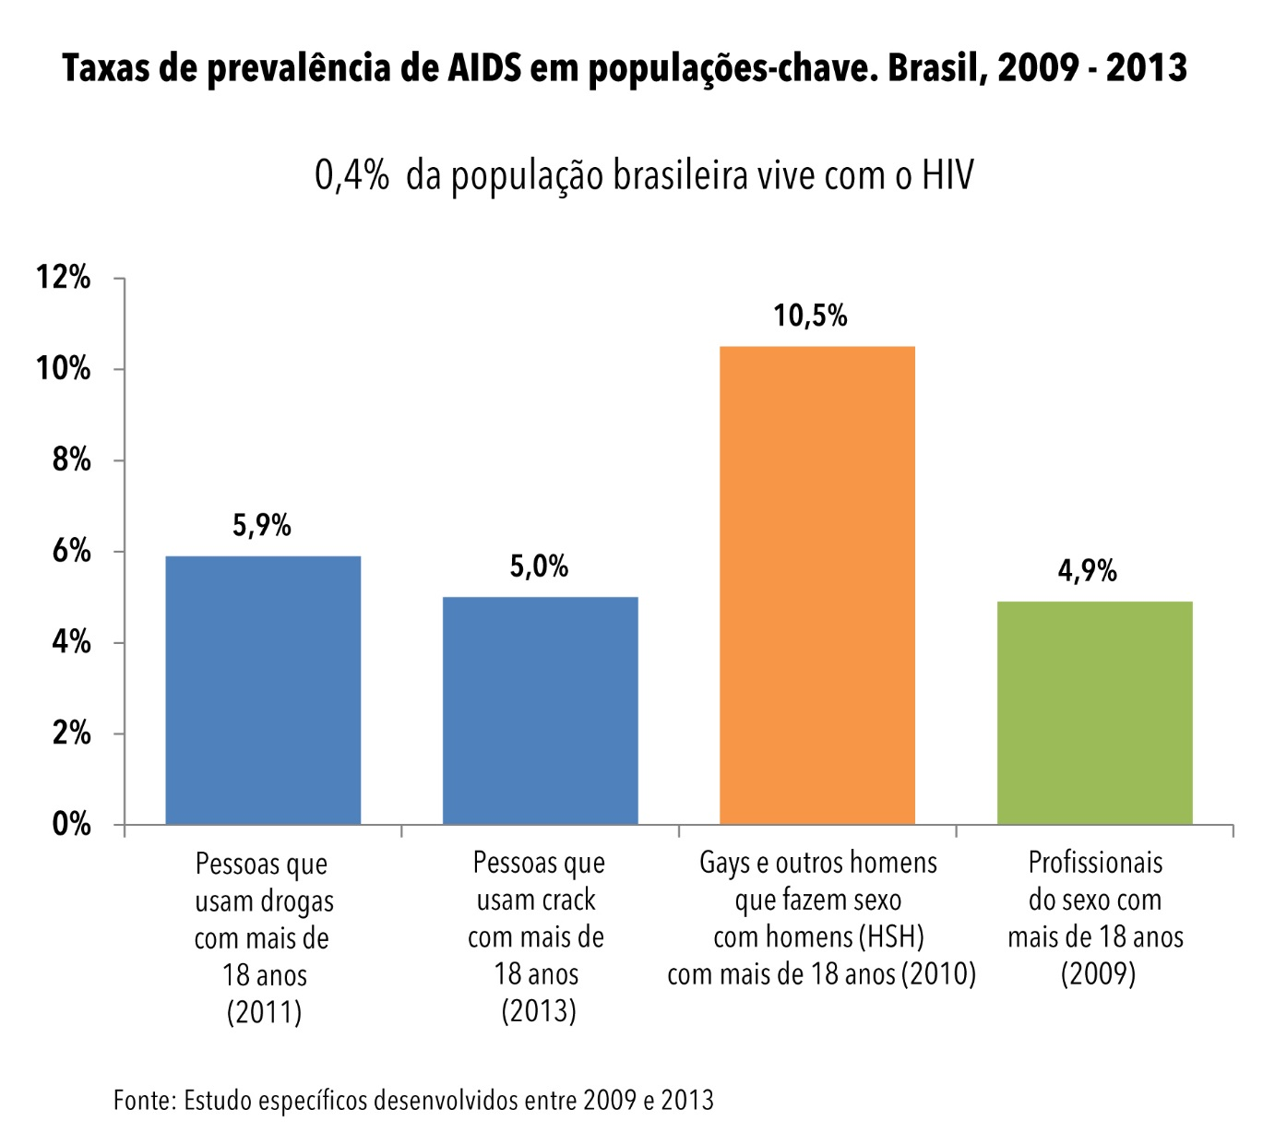
Epidemiologia no Brasil

Slide 38
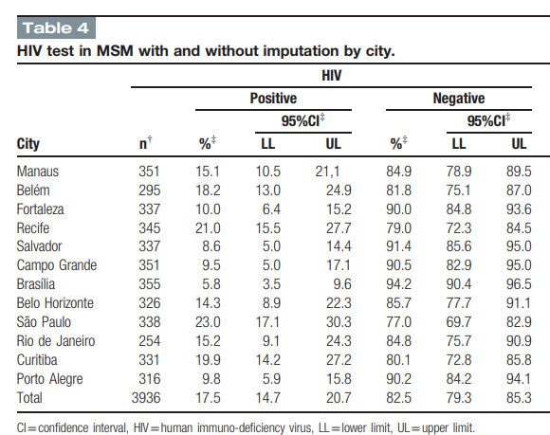

Slide 39
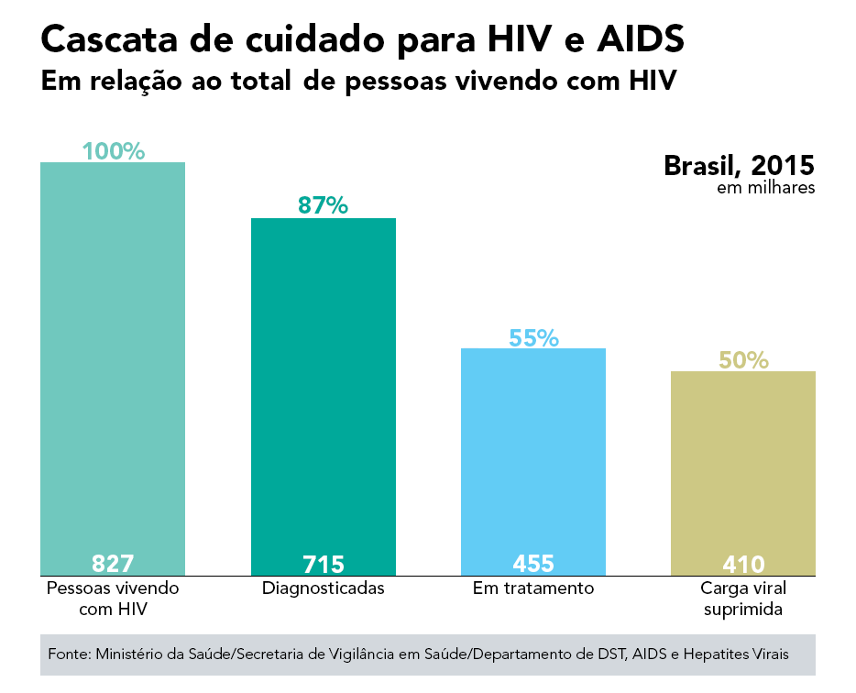
Epidemiologia no Brasil

Slide 40
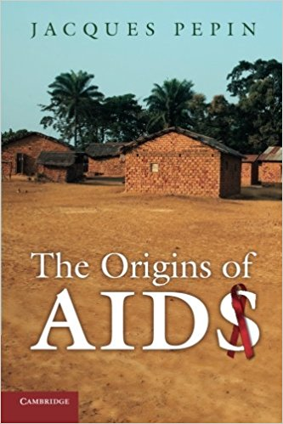
Para saber mais...

