Slide 1
FLC0284
Aula de Introdução
Aspectos da História da Escrita

Slide 2
I

Slide 3
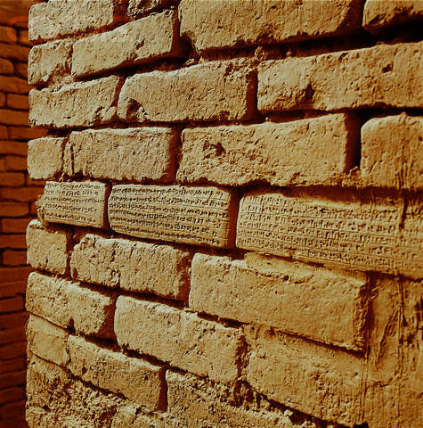
Choga Zanbil, Irã
Notes:
Brick Wall With Cuneiform Writing in the Ziggurat of Inshushinak and Napirisha in Choqa Zanbil, Iran.
Chogha Zanbil is an enormous ziggurat located in Iran. It is a UNESCO World Heritage Site, and has been since 1979. The site is more than three-thousand years old, and is in remarkably good condition. It is also one of the only ziggurats built outside of Mesopotamia.
Ziggurats were constructed by a number of the people who inhabited Mesopotamia, including the Babylonians, the Assyrians, and the Sumerians, all of whom constructed enormous examples. The oldest ziggurats reach back to the 4th millennium BCE, and they were no longer built after about the 6th century BCE. In that three-thousand year span of time, more than thirty known ziggurats were constructed, and Chogha Zanbil is one of the greatest examples of its kind, and the largest in modern-day Iran.
Ziggurats were built not as temples in the traditional sense, in that they weren’t meant for priests to reside in or perform rituals in. Instead, a ziggurat was viewed as a resting place for the gods. By building a ziggurat near a major city, the rulers could ensure that the gods stayed near, offering their aid in battle and keeping the crops growing. Ziggurats were essentially large pyramids, with anywhere from three to seven stories. The ziggurats were closed to all but the priests of these Mesopotamian societies, who made offerings at a shrine that was located at the top of the ziggurat.
Chogha Zanbil is one of the most intact ziggurats left in the world, and as such offers an excellent opportunity to view this fascinating bit of history from thousands of years ago. Chogha Zanbil was built sometime in the 13th century BCE, by king Untash-Napirisha. The ziggurat was constructed as a dwelling for Inshushinak, one of the three major Elamite go. Inshushinak was also known as the Father of the Week, and was looked at as a wise and generous god, judging the dead in the underworld along with the goddess Lagamal.
Inshushinak was also known as the Lord of Susa, where his major temple was. Some people believe that Untash-Napirisha constructed Chogha Zanbil in an effort to turn the region into a new religious hub, taking the place of Susa. The grand project was abandoned, however, upon Untash-Napirisha’s death, although Chogha Zanbil continued to be occupied and used until the 7th century BCE, when it was damaged by the Assyrians.
The entire complex of Chogha Zanbil contains eleven minor temples, in addition to the ziggurat of Inshushinak, a royal palace, various tombs, and a three-tiered wall guarding the area. Originally it appears the complex was meant to house a full twenty-two temples, each devoted to a various minor god of the Elamites. Because of the breadth of gods represented, it is possible Untash-Napirisha intended Chogha Zanbil to help unite the religions of the highlands and lowlands in Elam.
The ziggurat at Chogha Zanbil has five stories, and although it has collapsed over the years from wind and water, and from earlier attacks, it is still remarkably preserved. The entire shape can still be seen quite clearly from a distance, inscriptions are still found on many stones, water channels made of brick are still fully intact, and a number of carved visual elements are still found in situ.

Slide 4
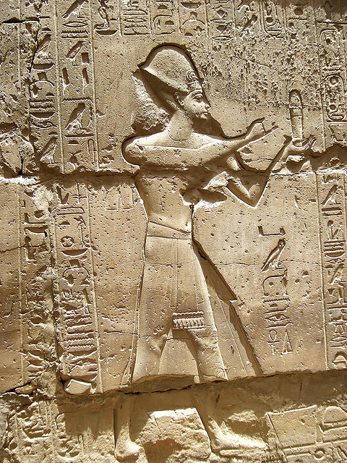
Luxor, Egito
Notes:
Hyerogliphs in The Temple of Luxor

Slide 5
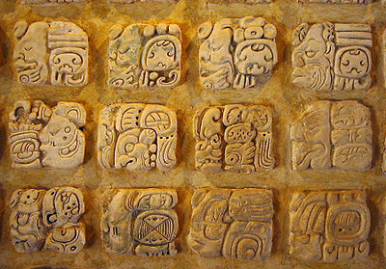
Palenque, México

Slide 6
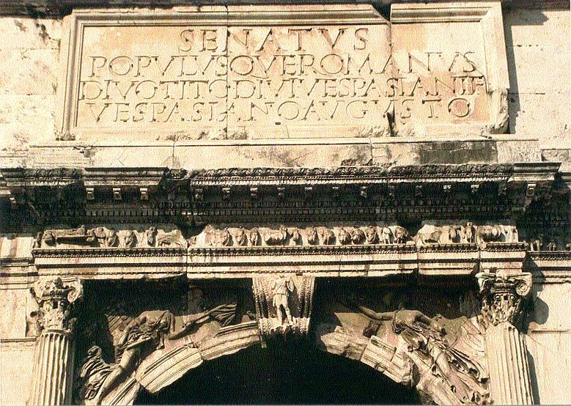
Roma, Itália

Slide 7
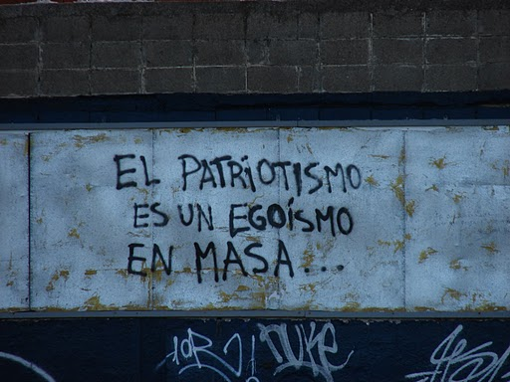
Montevidéu, Uruguai

Slide 8
II

Slide 9
Lasca de madeira, escrita kharosthie
Notes:
Niya wedge-tablet,
text in Kharoshthi script.
ca. 235-ca. 325 CE. The documents were written in the Kharosthi script in a version of the north Indian Prakrit language related to that used in Gandhara.
http://depts.washington.edu/silkroad/texts/niyadocts.html

Slide 10
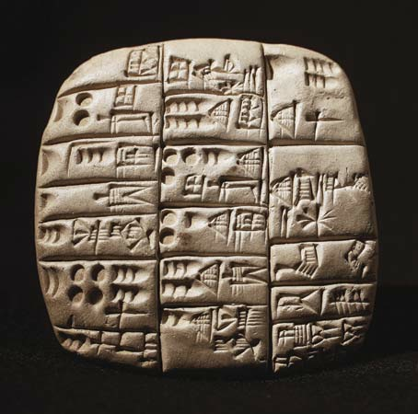
Placa de argila, escrita cuneiforme
Notes:
Sumerian cuneiform clay tablet - britannica.com

Slide 11
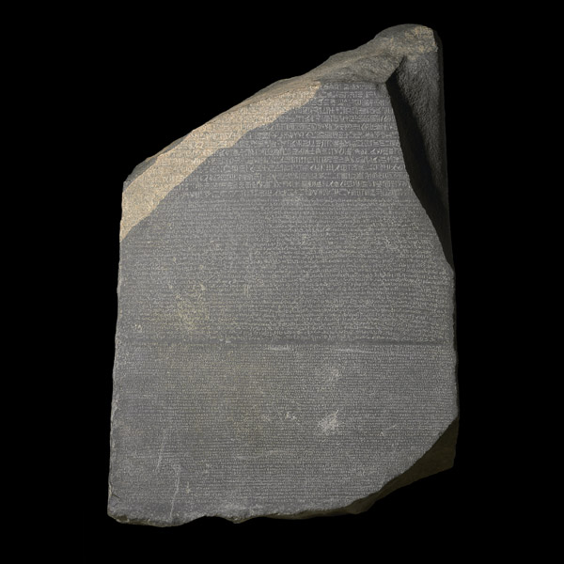
Lasca de pedra, escrita hieroglífica, demótica e grega (‘Pedra de Roseta’)
Notes:
hieroglyphic (suitable for a priestly decree), demotic (the native script used for daily purposes), and Greek

Slide 12
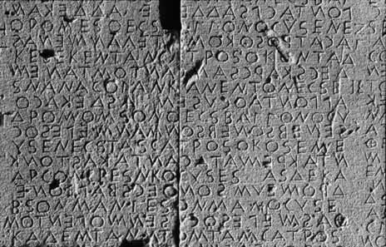
Lasca de pedra, capitais gregas (boustrophedon)
Notes:
Early Greek capitals carved in stone (c.600 B.C.E.). The inscription is also an example of boustrophedon writing (as the ox plows) in which lines alternated first in one direction and then in the other.

Slide 13
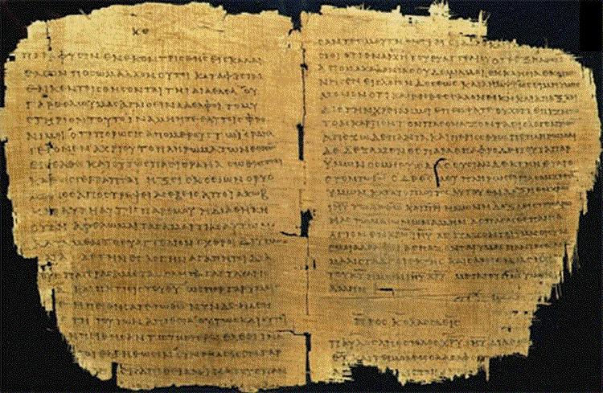
Folha de papiro, capitais gregas
Notes:
Westcott and Hort Greek Text, which is supported by only a small portion (5% or less) of existing manuscripts, including Codex Vaticanus, Codex Sinaiticus, Alexandrian Codex, Parisian Codex, and Codex Bezae.

Slide 14
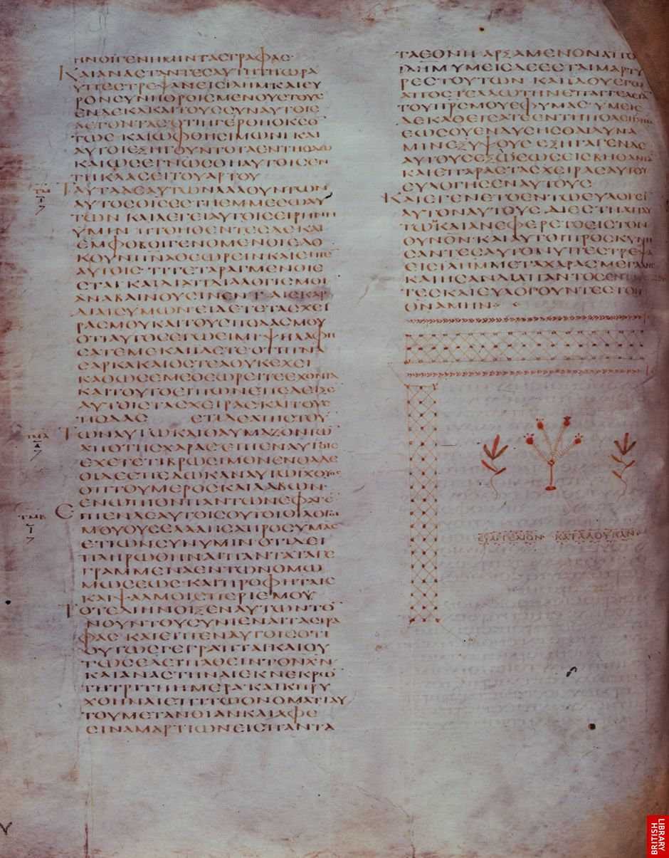
Pergaminho, capitais gregas
Notes:
Codex Alexandrinus, Constantinople or Asia Minor, fifth century. End of St Luke’s Gospel
BL Royal MS 1 D VIII, f. 41v
Copyright © The British Library Board

Slide 15
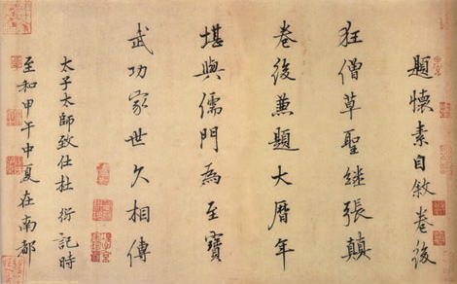
Folha de papel, escrita Han
Notes:
The earliest specimen of ancient Chinese character is as old as the Shang period (1200 BC). They are also knows as Oracle bones inscriptions. They were found near the present-day Anyang, Henan province, the last Shang capital.
These Oracle bones inscriptions were discovered in 1899. According to these inscriptions, the writing in ancient China by 1200 BC was a highly developed writing system.

Slide 16
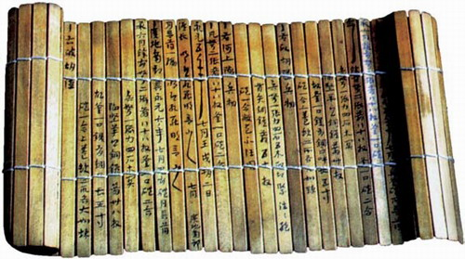
Lascas de bambu, escrita Han
Notes:
Anyang: The Anyang describes the famous Anyang archeological excavations of the oracle bones which comprised of Chinese character inscriptions. The oracle bones were considered to be dragon bones and the inscriptions when translated provided a new dimension to the history of ancient China. The book is a work of Dr. Li Chi.

Slide 17
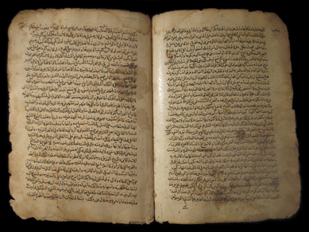
Folhas de papel – livro, escrita arábe medieval
Notes:
Ancient Arabic Manuscripts of the Christian New Testament
Hand-written 857 A.H. (1454 AD)

Slide 18
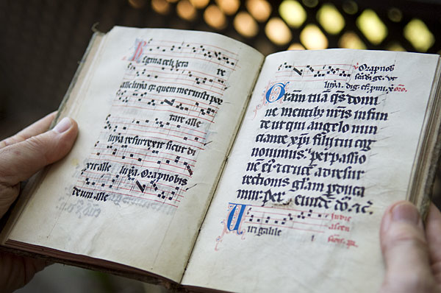
Folhas de papel – livro, escrita latina medieval
Notes:
A page from a 14th-century German manuscript processionary

Slide 19
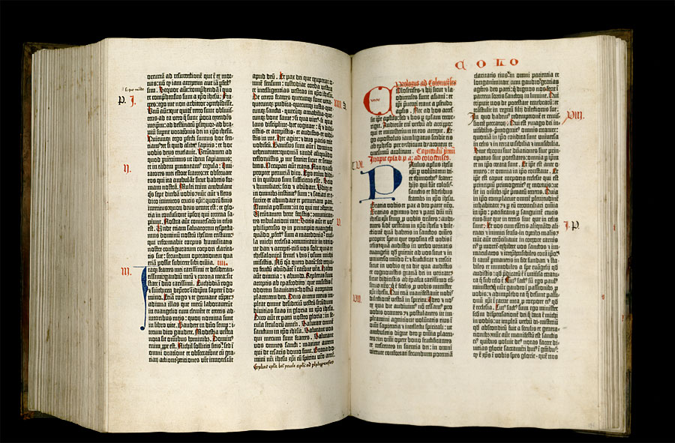
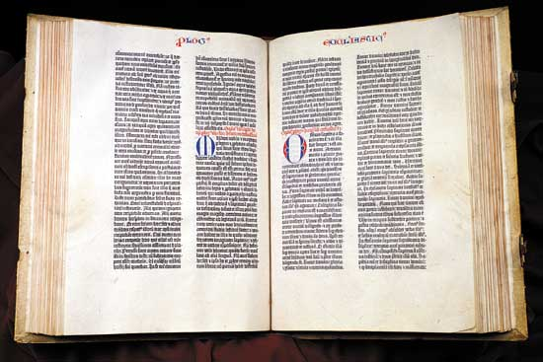
Folhas de papel – livro, escrita latina medieval impressa
Notes:
Latin. Biblia Latina [42-line Gutenberg Bible] (Mainz, Germany: Johann Gutenberg, 1454). An estimated 180 copies, 140 on paper and 40 on vellum, of the first printed Bible were manufactured in Mainz. Today, 49 complete and incomplete Gutenberg Bibles are known to exist worldwide, of which only 12 are printed on vellum. The four complete vellum copies are located in the State and University Library of Lower Saxony in Göttingen, the British Library, the Bibliothèque Nationale, and the Library of Congress.

Slide 20
III

Slide 21
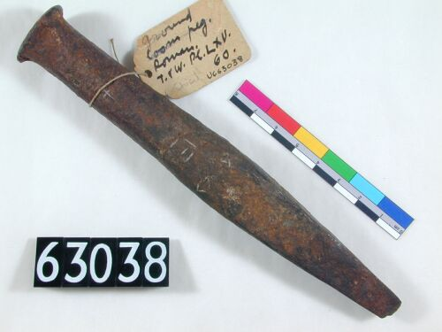
Cinzel romano
Notes:
http://www.digitalegypt.ucl.ac.uk/

Slide 22
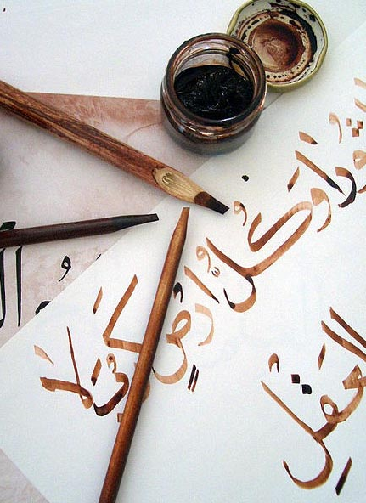
Qalam árabe
Notes:
kálamos: haste, cana, junco. Do latim «calamus». Em árabe, qalam.

Slide 23
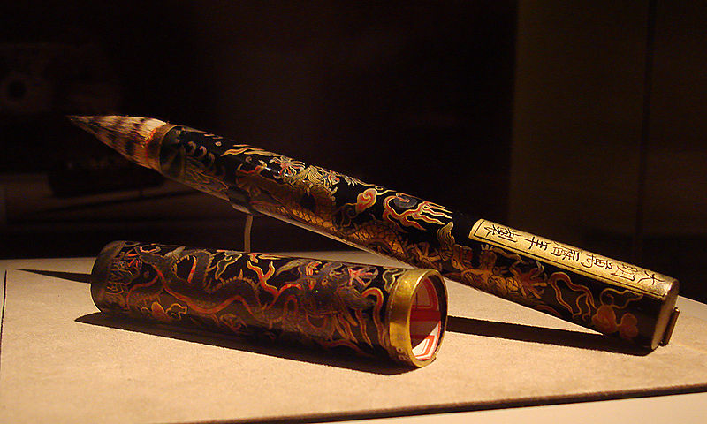
Pincel chinês (Ming)
Notes:
English: Calligraphy brush with golden dragon design.
Ming Dynasty, Wanli Period (A.D. 1573 - 1629)
Made of badger hair, this calligraphy brush is decorated with two dragons playing with a pearl; one is inlaid with gold foil, and the other with silver. The handle bears an inscription stating the year in which the brush was made. A magnificent piece, this work attests to the brush's place as one of the four treasures in a scholar's studio.

Slide 24
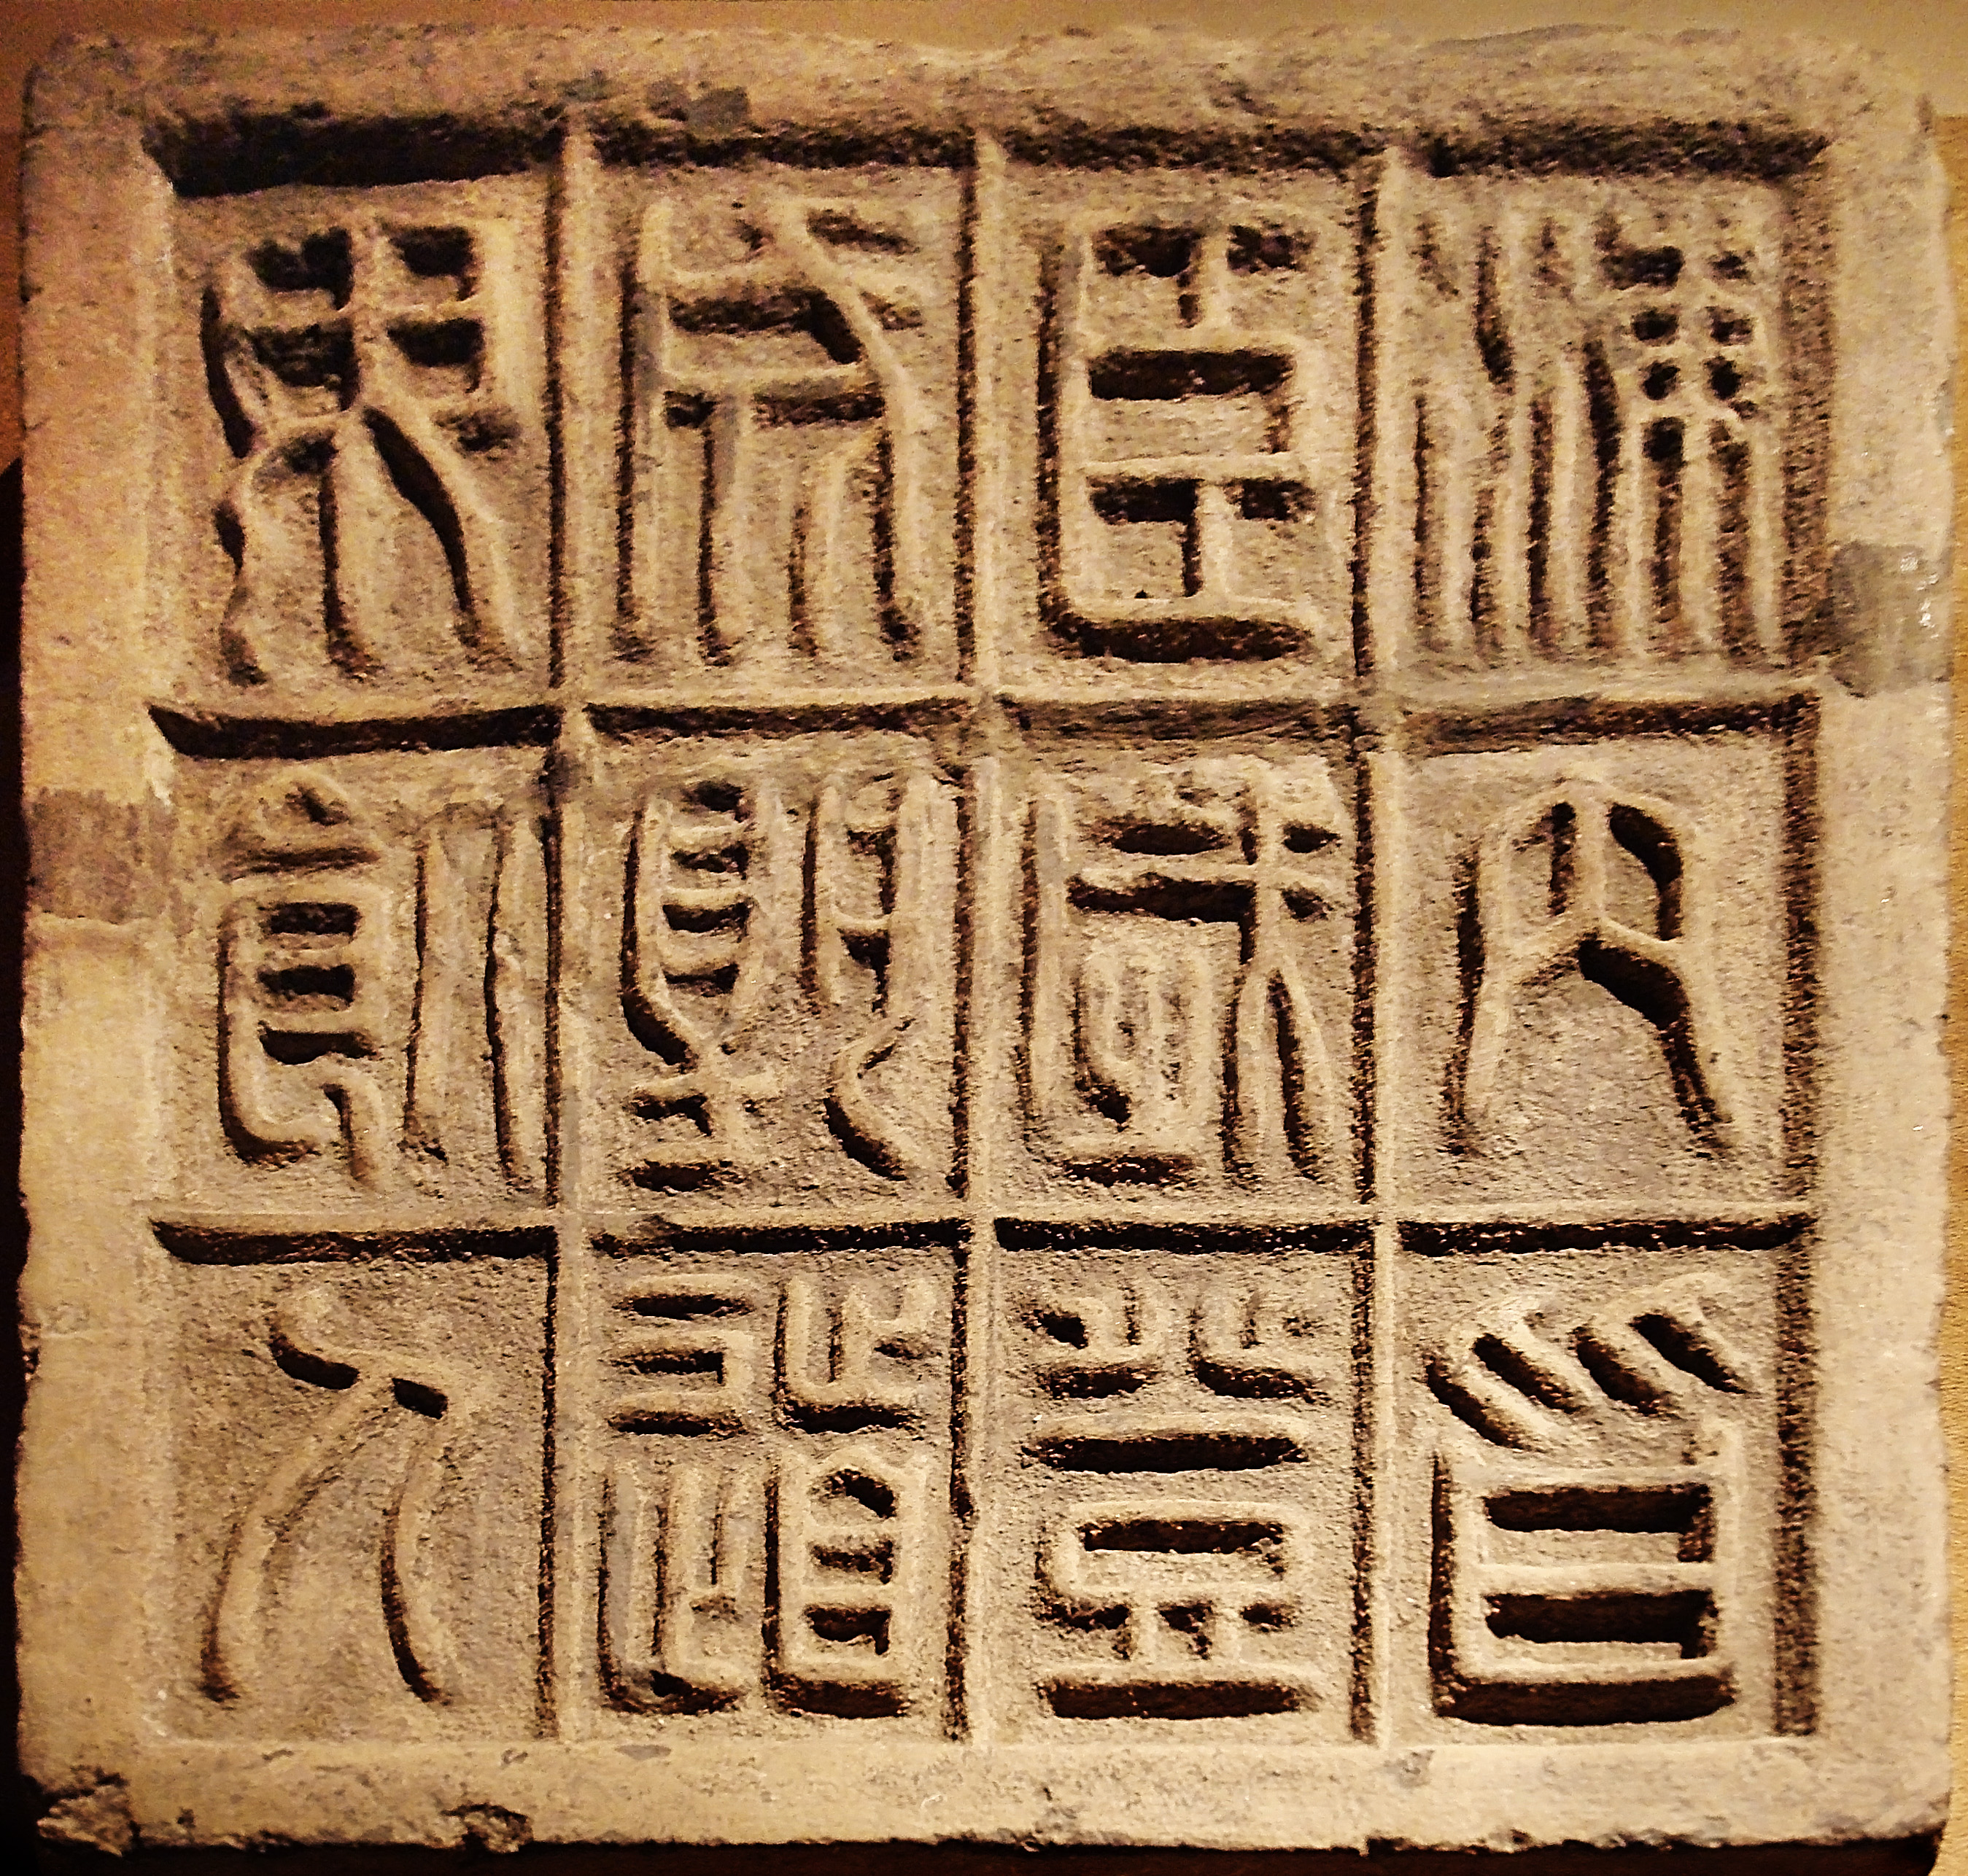
Carimbo de pedra chinês (Qin)
Notes:
Qin Dynasty (221 - 206 B.C.)
The 12 characters on this slab of floor brick affirm that it is an auspicious moment for the First Emperor to ascend the throne, as the country is united and no men will be dying along the road.
Small seal scripts were standardized by the First Emperor of China after he gained control of the country, and evolved from the larger seal scripts of previous dynasties

Slide 25
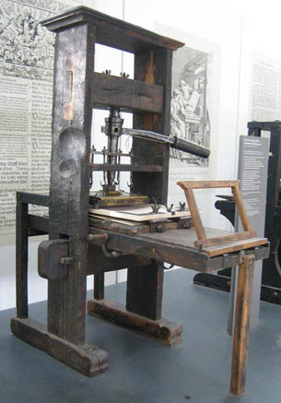
Prensa mecânica, século XV
Notes:
Mainz Gutenberg Druckerei 1450

Slide 26
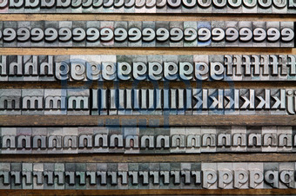
Tipos móveis

Slide 27
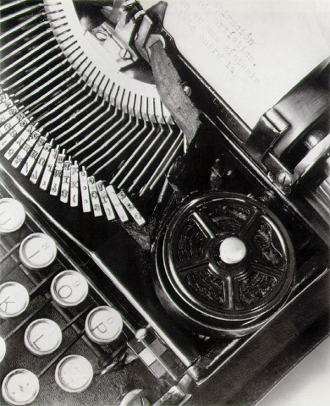
Máquina de escrever, século XX
Notes:
http://www.masters-of-photography.com/M/modotti/modotti_typewriter_full.html

Slide 28
IV

Slide 29
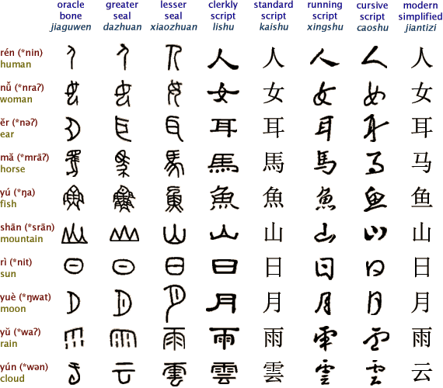
Ideogramas chineses

Slide 30
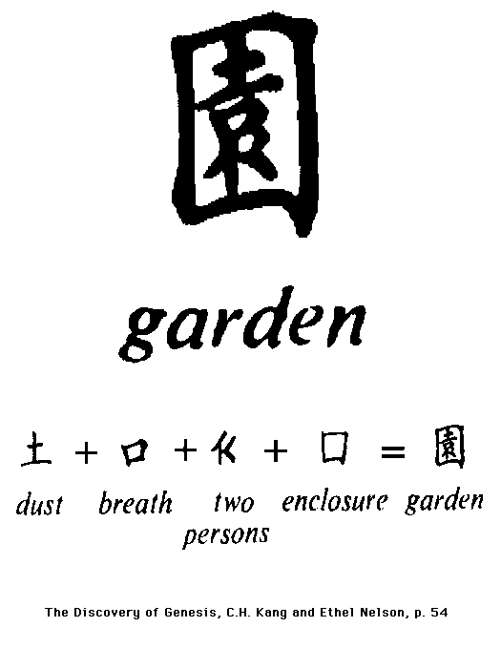
Agregado lógico

Slide 31
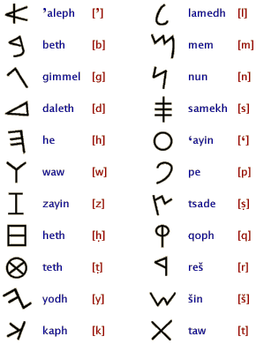
Alfabeto fenício

Slide 32
Do alfabeto fenício ao alfabeto latino
http://terpconnect.umd.edu/~rfradkin/latin.html
Notes:
http://terpconnect.umd.edu/~rfradkin/latin.html

Slide 33
V

Slide 34
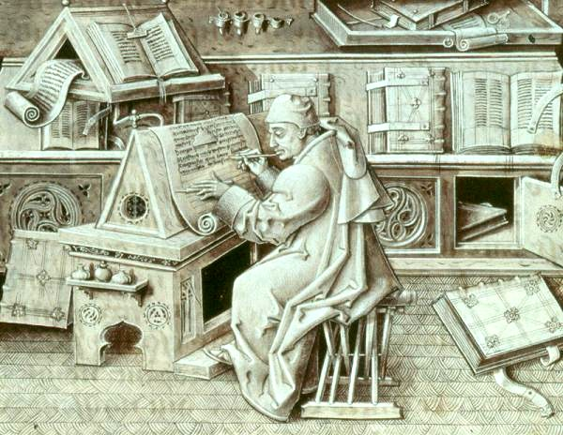
Scriptorium europeu, século XV
Notes:
portrait of Jean Miélot
Date
15th century
Notes
English: Burgundian scribe (portrait of Jean Miélot, secretary, copyist and translator to Duke Philip the Good of Burgundy, from a copy of his compilation of the Miracles de Notre Dame NOTE: NOT IN FACT A MONK AT ALL, NOR PROBABLY A SCRIPTORIUM!, though a canon of Lille Cathedral.), 15th century. The picture is greatly detailed in its rendering of the room's furnishings, the writer's materials, equipment, and activity.
Deutsch: Burgundischer Schreiber (Portät von Jean Miélot, Sekretär, Kopierer und Übersetzer von Herzog Philipp (III.) dem Guten von Burgund, von einer Kopie seiner Zusammenstellung der Miracles de Notre Dame ANMERKUNG: Tatsächlich weder ein Mönch, noch wahrscheinlich ein Skriptorium! trotz eines Domherr/Kanon? von Lille Kathedrale [Frankreich].), 15. Jahrhundert. Das Bild ist sehr detailliert in der Wiedergabe der Einrichung, dem Material des Schreibers, Ausrüstung und Tätigkeit. (Übersetzung der englischen Beschreibung oben.)

Slide 35
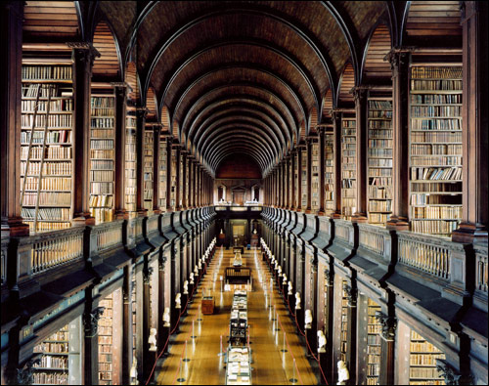
Biblioteca universitária europeia, século XIX
Notes:
Biblioteca do Trinity College - Dublin

Slide 36
Biblioteca particular, século XX

Slide 37
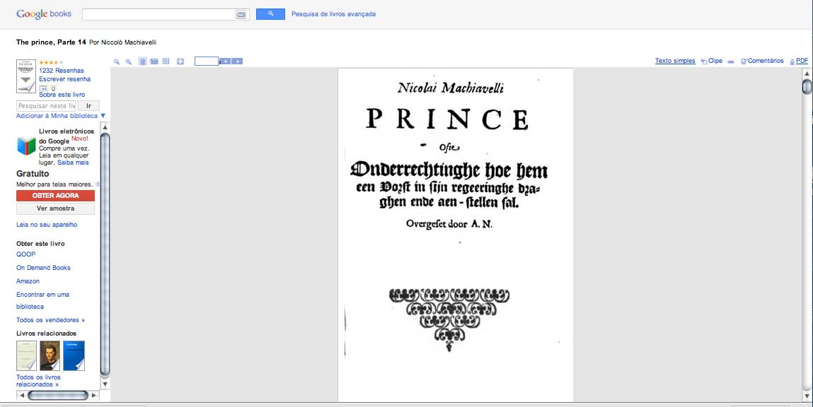
Biblioteca eletrônica, século XXI

Slide 38
Fontes das Imagens:
http://www.britishmuseum.org/ http://www.bl.uk/ http://www.britannica.com/ http://www.digitalegypt.ucl.ac.uk/ http://www.ancientresource.com/
http://www.ancientscripts.com/
http://hieroglyphs.net/ http://depts.washington.edu/silkroad/texts/niyadocts.html http://terpconnect.umd.edu/~rfradkin/latin.html
Notes:
http://news.softpedia.com/news/A-History-of-Writing-82610.shtml

Slide 40
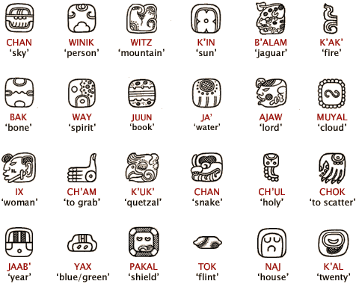

Slide 41
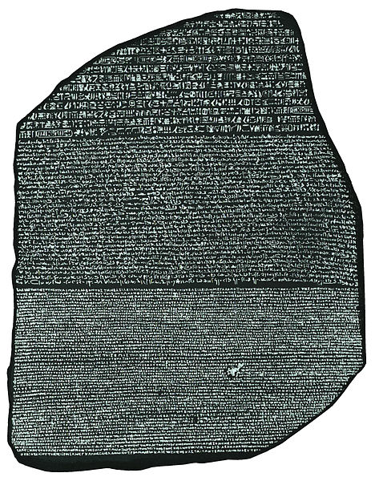
Notes:
Left and right sides of the Rosetta Stone, with inscriptions in English

Slide 42
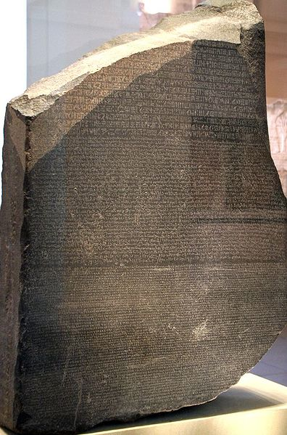
Notes:
Left and right sides of the Rosetta Stone, with inscriptions in English

Slide 43
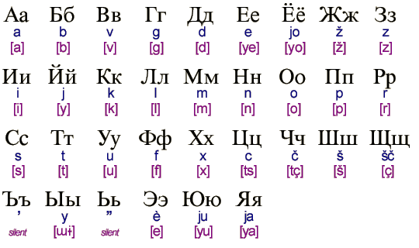
Alfabeto cirílico

