Slide 1
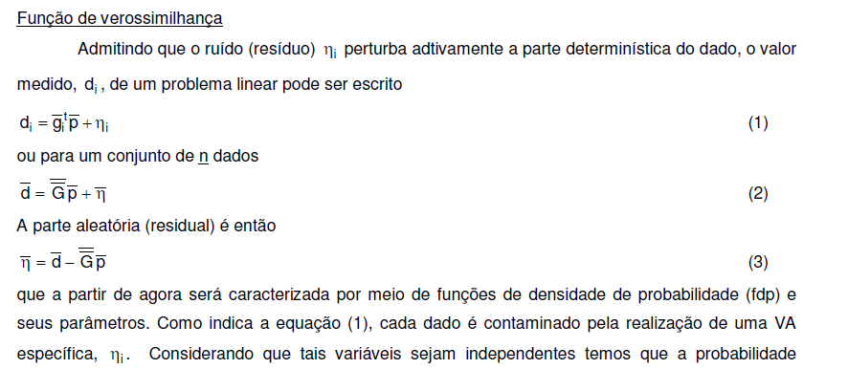

Slide 2
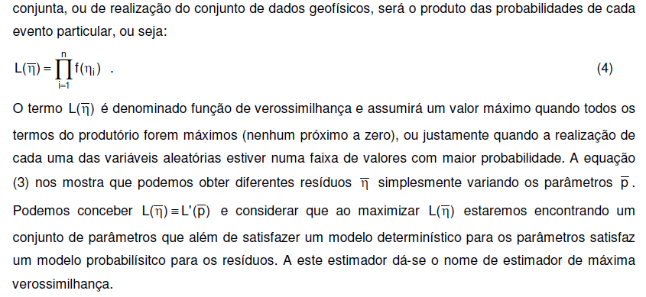

Slide 3
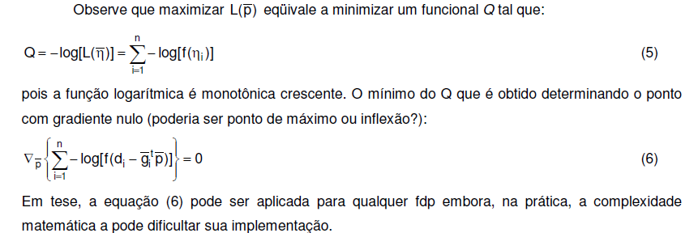
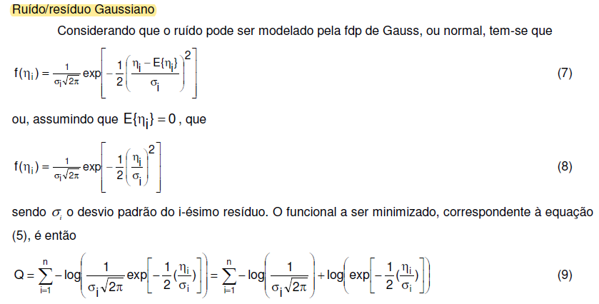

Slide 5
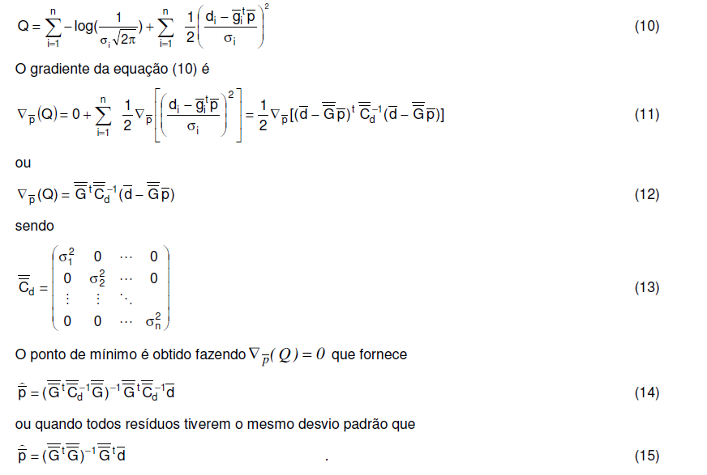

Slide 6
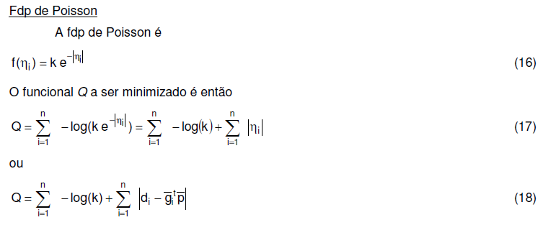
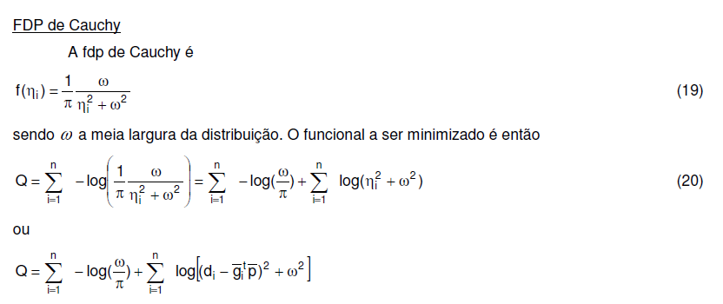

Slide 7
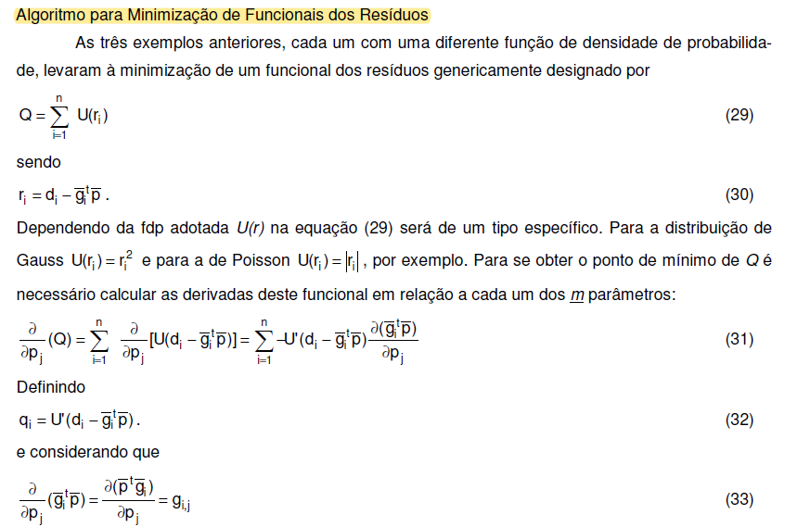

Slide 8
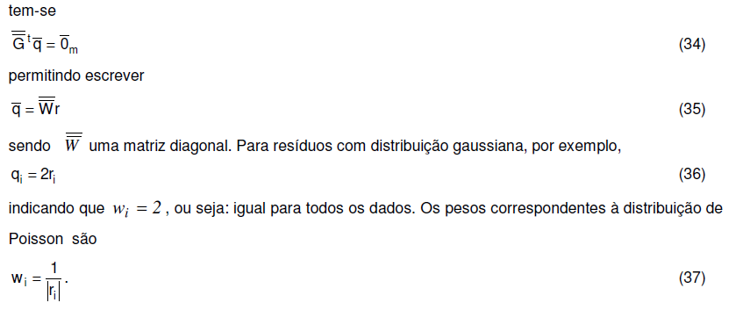

Slide 9
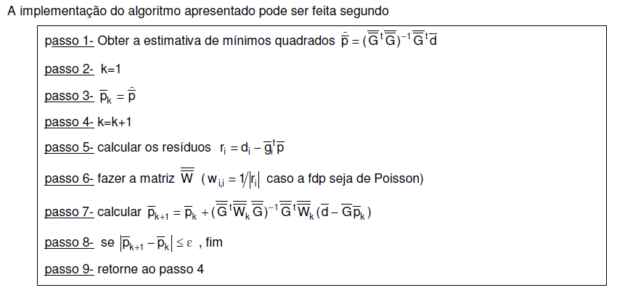
for k=1:nit;
r=d-g*p+0.0001*ones(size(x));
w=abs(r.^(-1));
m=(w*ones(1,n+1)).*g;
p=inv(g'*m)*g'*(w.*d);
n1=g*p;
figure
plot(x,d,'ok',x,n2,'-r',x,n1,'-b')
legend('verdadeiro','norma 2','norma 1');
axis square
xlabel('x')
ylabel('-1+0.9x')
title(['iteracao=' num2str(k)])
pause
end

