Slide 1
Location Matters
Innovation has become the defining challenge for global competitiveness.
To manage it well, companies must harness the power of location in creating and commercializing new ideas.
Michael E. Porter and Scott Stern

Slide 2
Introduction
Context
Research Question
Restructuring lower cost and raise quality X acquiring and deploying the best current technology
Companies must be able to innovate at the global frontier
What are the drivers of innovation?
Internal Factors: capabilities and process
External Factors: environment for innovation (local pool of resources)
How national circunstances would explain diferences in innovative outputs?
OECD and some Emerging Countries
Findings:
Relative small number of characteristics of nation´s business environment explain striking proportion of large diferences in innovative output
Location matters for success in innovative activity

Slide 3
Recommendations
Developing and commercializing innovation in the most attactive location, taking active steps to access locational strengths
Go there
Management Decisions
Location Matters for Innovation
Proactively enhancing the environment for innovation and commercialization in locations where they operate
Improve
there

Slide 4
National (Regional/Local) Innovative Capacity
It is a country´s potential to produce a stream of commercially relevant innovation
Political entity
Economic entity
Framework
Common innovative infrastructure
Public Policies (IP, Tax incentives, Antitrust policies, international trade and investment)
Cluster-specific environment for innovation >> see detail
Quality of linkages
Institutions for collaboration

Slide 5
Industrial Clusters and Innovation
Common innovation infrastructure, but companies introduce and comercialize innovations.
Clusters (Diamond multilevel Country/Local framework)
Inputs, competition and collaboration, supporting industries, demand.
Cluster (industrial and local) leads to externalities and spillovers

Slide 6
National Innovative Output
How measure the National Innovative Capacity
Measure of innovative output = number of international pattents granted by the US Patent and Trademark Office (by OECD county per capita).
17 countries – 25 years
Good: available
Bad: cannot caputure the full aspect
Using National Innovative Capacity Framework

Slide 7
Results
OECD Countries
Regional diferences within the USA
Innovative capacity has converges over the last 25 years
Improvements by countries are result of concented improvement along several dimensions
National innovative capacity is not the same as the competiveness capacity

Slide 8
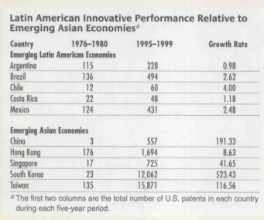
Emerging countries
Some remarkable countries
Some information on Latin America
Current: Singapore, Taiwan, South Korea and Israel.
Potential: Ireland, India, China, Malaysia
Weak: Latin America

Slide 9
Implications for Innovation Management
Innovation is strong affected by location
Recommendations
Location is not matter of traditional decision factors (cost and local incentives)
R&D investments shoud flow to the most fertile locations for innovation
Proactively access to the local activites (in innovation)
Enhance local innovative capacity improveng innovation environment
Locate R&D investments and comercialize new technologies in environments with strong innovative capacity
Managers must make R&D locational choices strategically to take benefits for competitive advantage
It is importante to companies that aspire global strategies
Compete and collaborate with cluster location development

Slide 10
Broader agenda
Managers can no longer simply manage the innovation process within their companies; they must also manage the process of how their companies enhance and take advantage of opportunities in the local environment.
Location-based advantages in innovation may prove more sustainable than simply implementing corporate best pratices.

