Slide 1
Mechanism of Action and Resistance to Plant Growth Regulators (Synthetic Auxins)
Dr. Scott Nissen, Professor
Colorado State University, Fort Collins, CO
Assistance from: Drs. Greg Kruger, Mithila Jugulam
Notes:
Fluridone,penoxsulam and triclopyr are all three herbicides registered for aquatic use. While these herbicides, especially fluridone and triclopyr, have been used for many years, there has been little work done to examine absorption and translocation in aquatic species.

Slide 2
Outline
Overview of current active ingredients and basic modes of action
Current status of PGR herbicides
Known mechanisms of resistance
Implications for production agriculture

Slide 3
≅
aminopyralid
amino-cyclopyrachlor
Pyrimidine-carboxylic-acid

Slide 4
Herbicides that Mimic Natural Plant Hormone (PGR)
Natural plant hormones control
growth, development
tissue differentiation
RNA and DNA synthesis
Herbicides with this mode of action can do the same things at low concentrations
At high concentrations these compounds are herbicides

Slide 5
PGR Mode of Action
Symptoms
abnormal growth resulting in twisted stems
stem swelling due to rapid and uncontrolled cell division
differentiated cells changing to immature cells

Slide 6
Mechanism of Selectivity
Hypothesis #1
Differential metabolism, grasses form amino acid conjugates, while broadleaves form sugar conjugates
Hypothesis #2
Auxin receptors in grasses do not recognize these synthetic auxins so the cascade effect is never initiated.

Slide 7
PGR Mode of Action
Mode of action
we understand symptoms
we don’t completely understand why grasses are resistant and broadleaf plants are susceptible
lack of ethylene response
differences in metabolism?

Slide 8
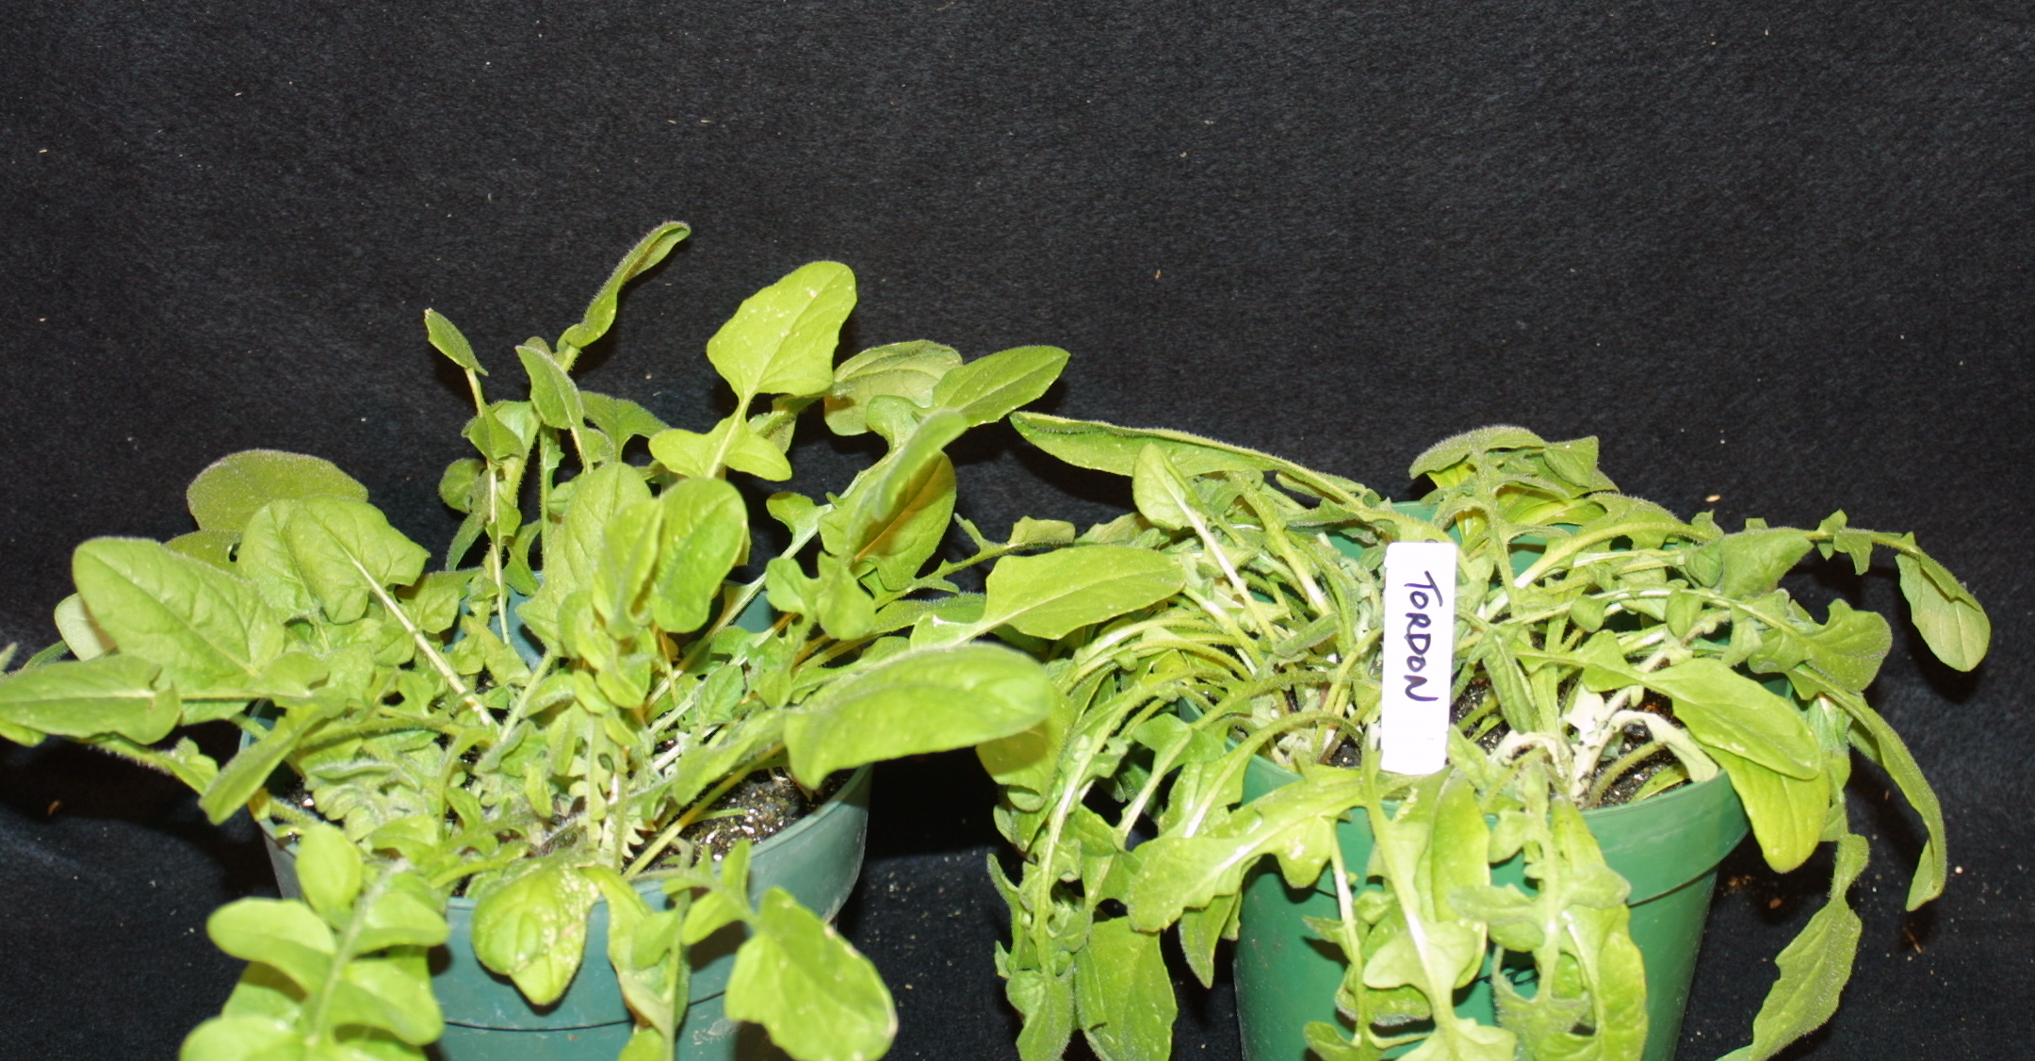
Effects of Picloram on Centaurea solstitalis
First symptom is downward bending or twisting of the stem, epinasty.

Slide 9
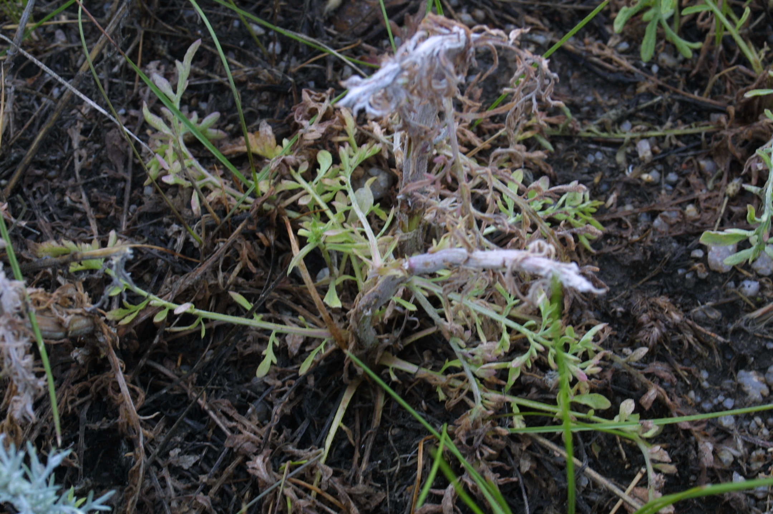
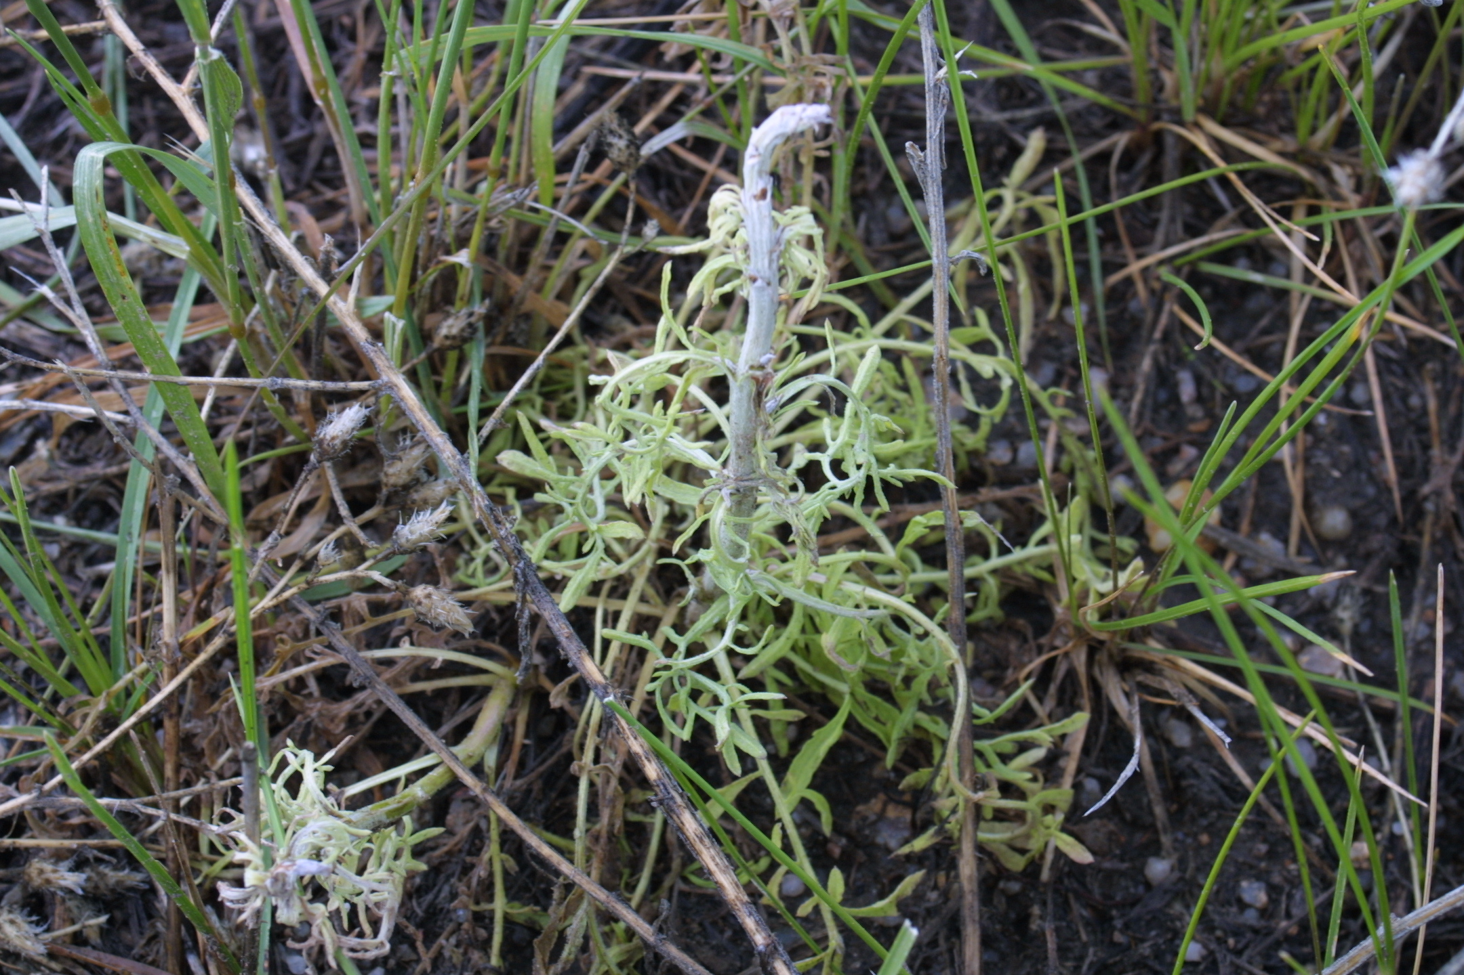
PGR symptoms on Centaurea diffusa
Aminopyralid
0.4 L/ha
Picloram L/ha

Slide 10
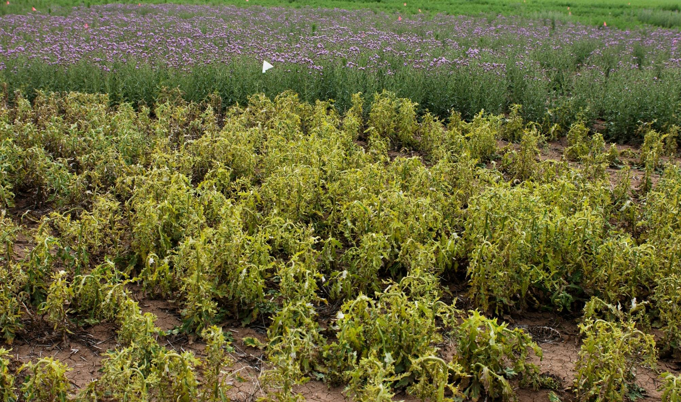
Cirsium arvense response to aminopyralid
7 DAT

Slide 11
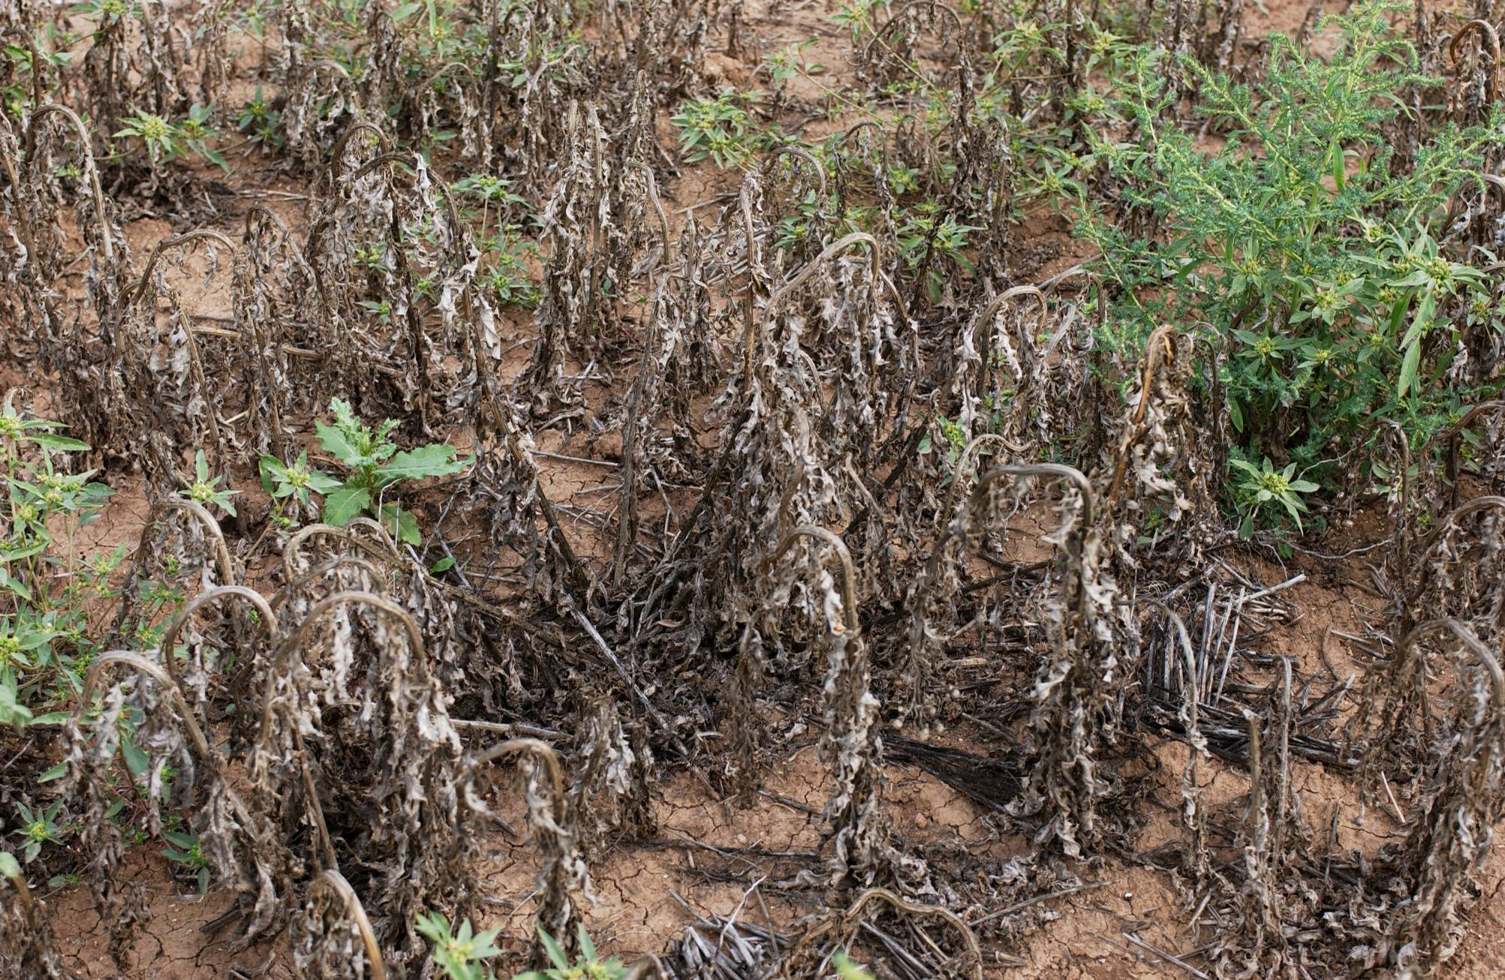
Cirsium arvense response to aminopyralid
14 DAT

Slide 12
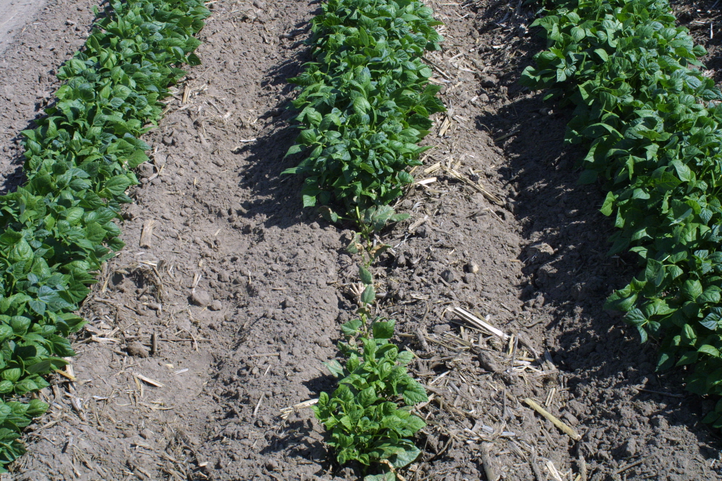
Figure 1. Injury symptoms in dry bean field following corn.

Slide 13
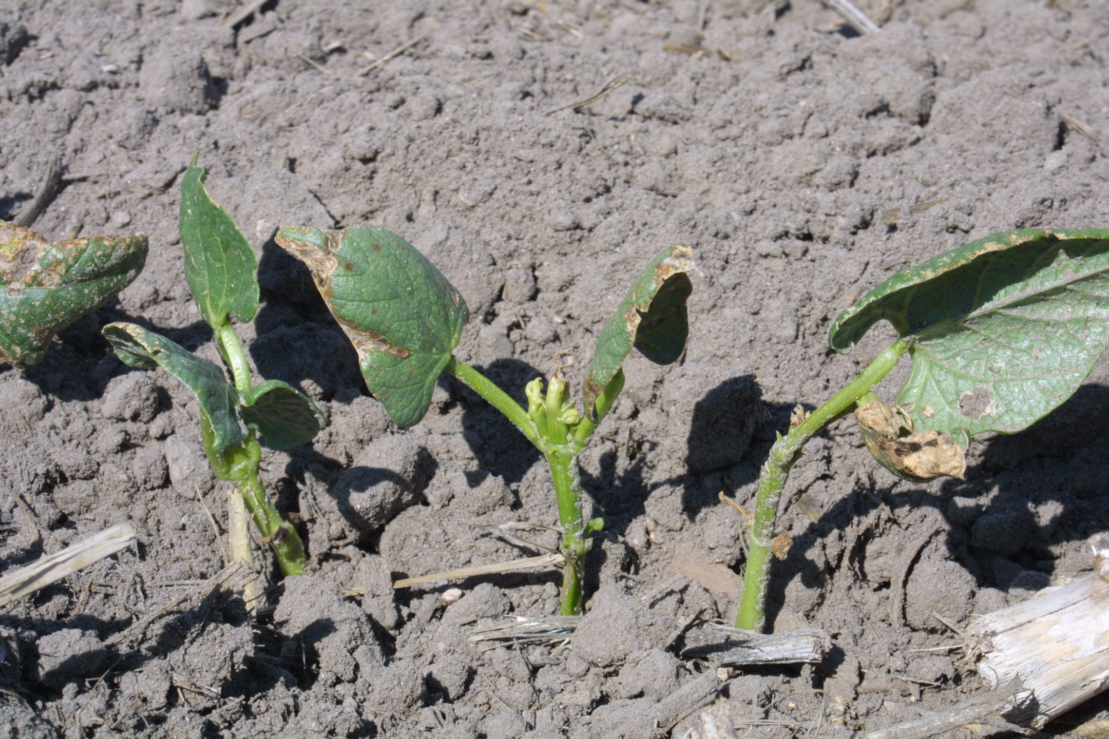
Figure 2. Closer look at dry bean injury scattered throughout the field.

Slide 14
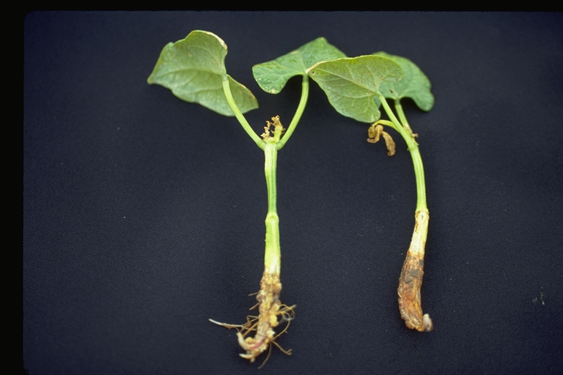
Root Absorption of PGR Herbicides
translocation to
growing point
swollen
hypocotyl
callus formation on roots
lack of root
development

Slide 15
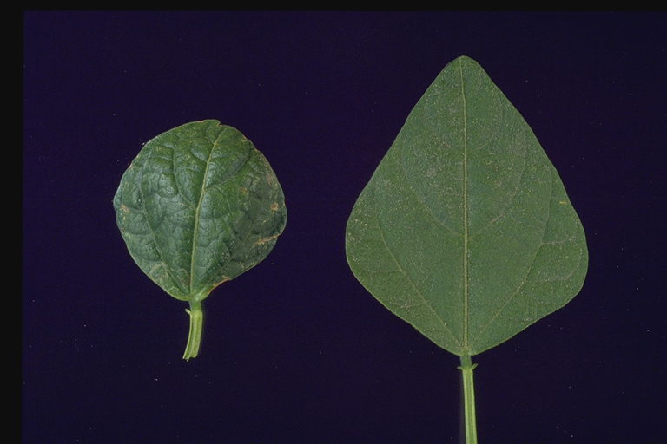
Common Leaf Symptoms
from PGR Exposure
normal
cupped and blistered from
PGR exposure

Slide 16
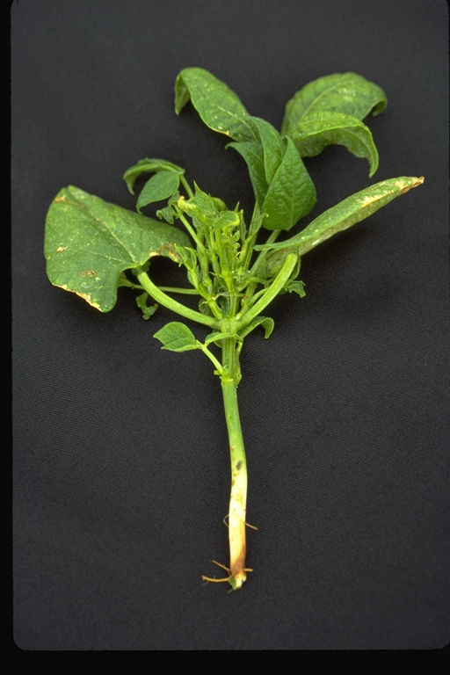
Foliar PGR Simulated Drift
short internode
accumulation
in apical meristem

Slide 20
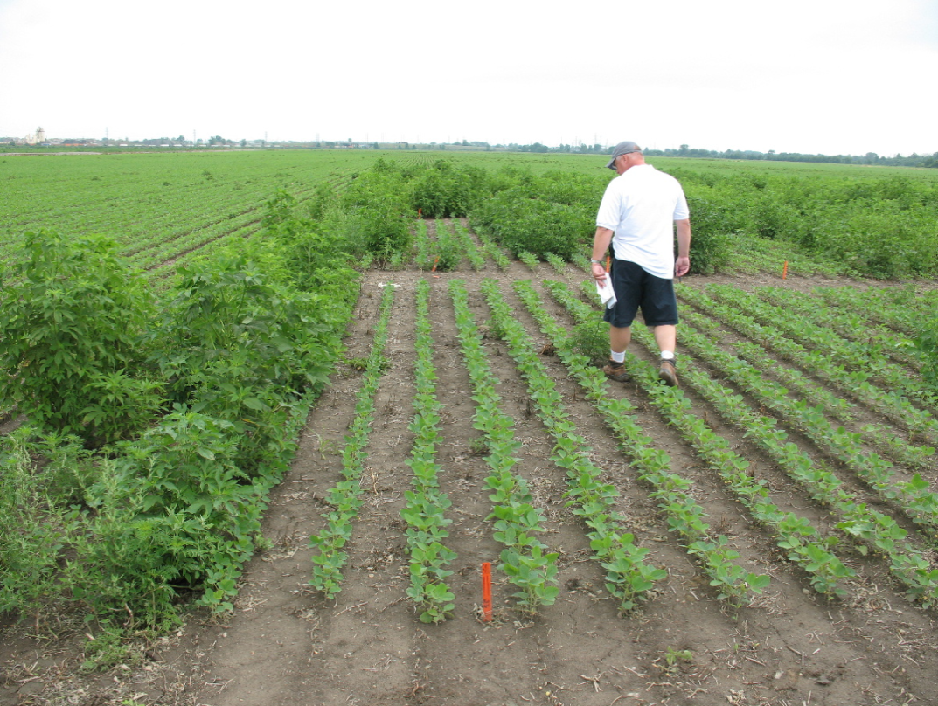
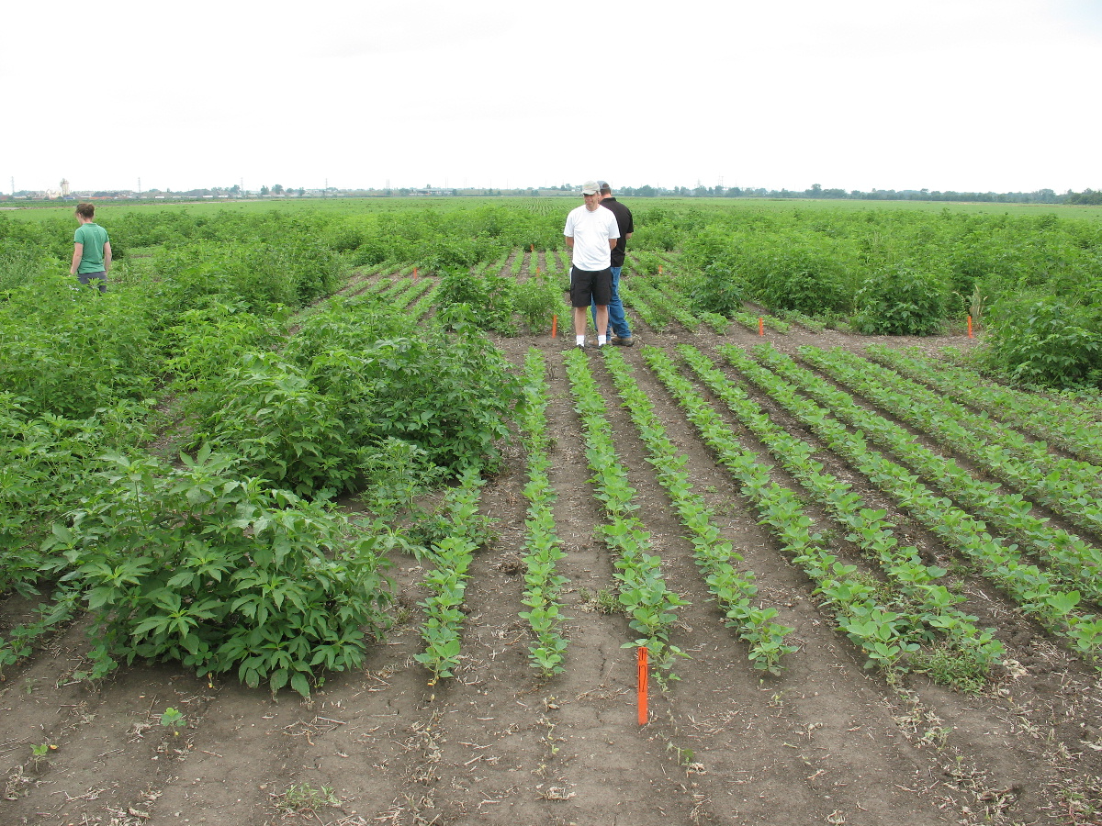
Enhanced Burndown Study
Sikkema, UG
Glyphosate (1 L/ha) + saflufenacil (0.07 L/ha) + Merge (1.0% v/v)
Sikkema, UG
Glyphosate (1 L/ha) + 2,4-D (1 L/ha)

Slide 21
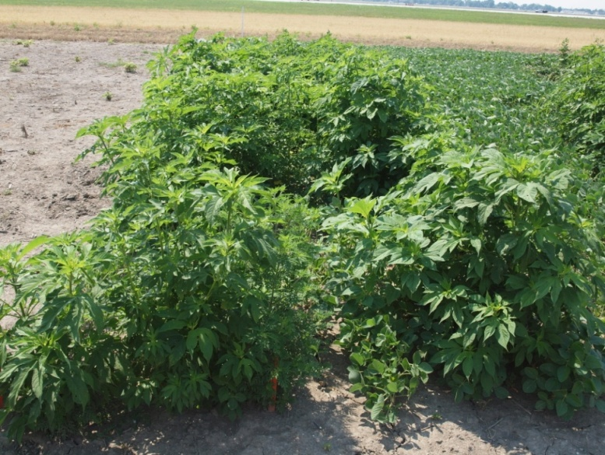
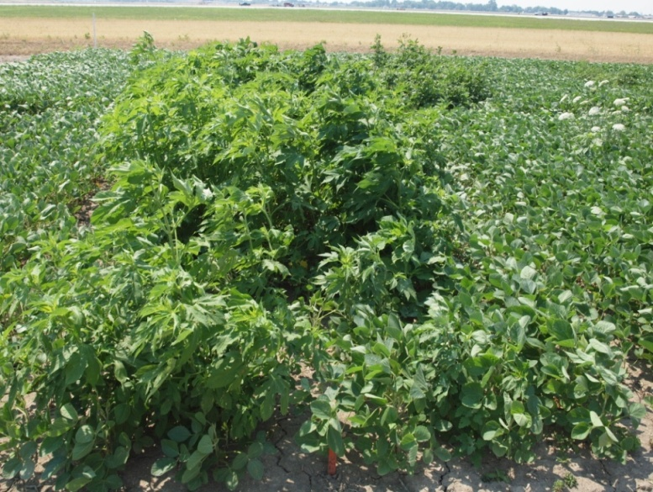
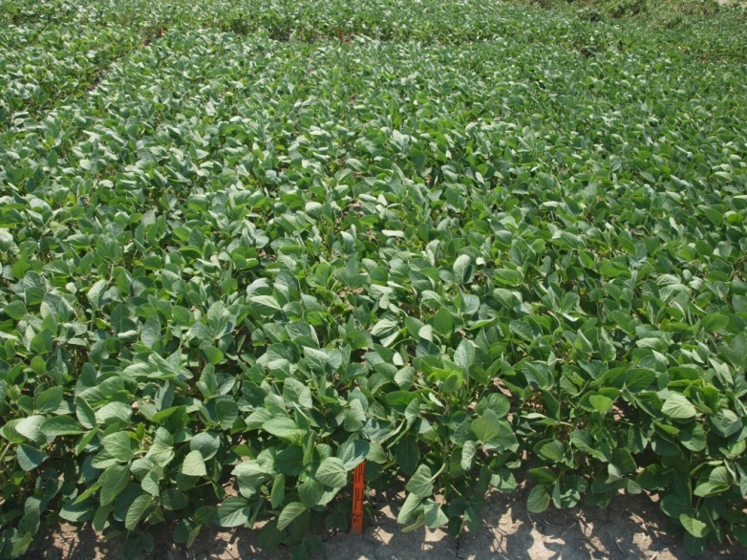
Dicamba Tolerant (DT) Soybean
Weedy check
Glyphosate
Glyphosate + dicamba

Slide 22
Characteristics of PGR Herbicides
Clopyralid
The most selective PGR herbicide
Trees, corn, grass seed, range, pasture, cane berries, sugar beets, rape
Annual weeds: wild buckwheat, cocklebur, jimsonweed, ragweeds
Perennial weeds: Canada thistle, knapweeds, biannual thistles, composites species in general

Slide 23
Characteristics of PGR Herbicides
Triclopyr
Specialized brush product and one of the best all around aquatic herbicides
Conifer release, non-crop, cut stump, basal bark applications, utilities,
Annual weeds: black medic, dandelions, ivy, burdock, plantian spp.
Perennial weeds: many tree and brush species

Slide 24
Characteristics of PGR Herbicides
2,4-D
First selective herbicide
Small grains, corn, turf, non-crop, butyl ester can be used in alfalfa, aquatic uses
Annual weeds: horseweed, dandelion, cocklebur, ragweeds, winter annuals, lambsquarters, pigweeds etc.
Perennial weeds: probably not the best generally only provides the in season control

Slide 25
Specific Characteristics of PGR Herbicides
Herbicide | Water Solubility | Translocation | Persistence
Clopyralid | Acid 1000 ppm Salt 300,000 ppm Weak acid pKa 2.3 | Excellent absorption and translocation | Avg 40 days Range 12-70 days
Tricolpyr | Acid 430 ppm Salt 2,000,000 ppm Ester 23 ppm Weak acid pKa 2.7 | Excellent absorption and translocation | Avg 30 days Range 10-46
2,4-D | Acid 900 ppm BEE 100 ppm Salt 796 Isooctyl ester 0.03 ppm Weak acid pKa 2.8 | Excellent absorption and translocation | Avg 10 days Range 7-32

Slide 26
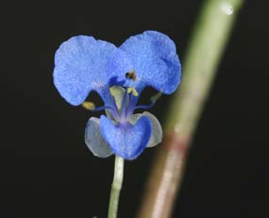
Status of Synthetic Auxin Resistance
Commelina diffusa
First reported in Hawaii in 1957
Selected in sugarcane
Worldwide there are 30 officially reported cases of auxin herbicide resistance (HRAC website).
Seven of thirty reports from US
Only two reported from Brazil

Slide 27
Examples of Auxin Resistant Weeds
Family | Species | Herbicides | Year/Location
Asteraceae | Carduus nutans C. pycnocephalus Cirsium arvense Lactuca serriola Matricaria perforata | 2,4-D 2,4-D MCPA 2,4-D, MCPA, dicamba 2,4-D | 1981/New Zealand 1979/New Zealand 1979/Sweden 2007/USA 1975/France
Brassicaceae | Raphanus raphanistrum Sisymbrium orientale Sinapis arvense | 2,4-D, MCPA 2,4-D, MCPA 2,4-D, MCPA, mecoprop, dicamba, picloram | 1999/Australia 2005/Australia 1990/Canada
Poeace | Digitaria ischaemum Echinocloa crus-galli E. crus-pavonis E. colona | quinclorac | 2002/USA 1999/Brazil 1999/Brazil 2000/Colombia

Slide 28
2,4-D Resistant Amaranthus tuberculatus
High level of resistance reported in 2009 from a grass seed field in Western Nebraska, USA
Herbicide use history was 12 years of 2,4-D use, sometimes multiple applications per year.
Dr. Pat Tranel (U of I) has already identified Amaranthus rudis populations with resistance to 4 herbicide modes of action.
Enlist™ (Dow Agro) stacked herbicide technology may provide only temporal solution

Slide 29
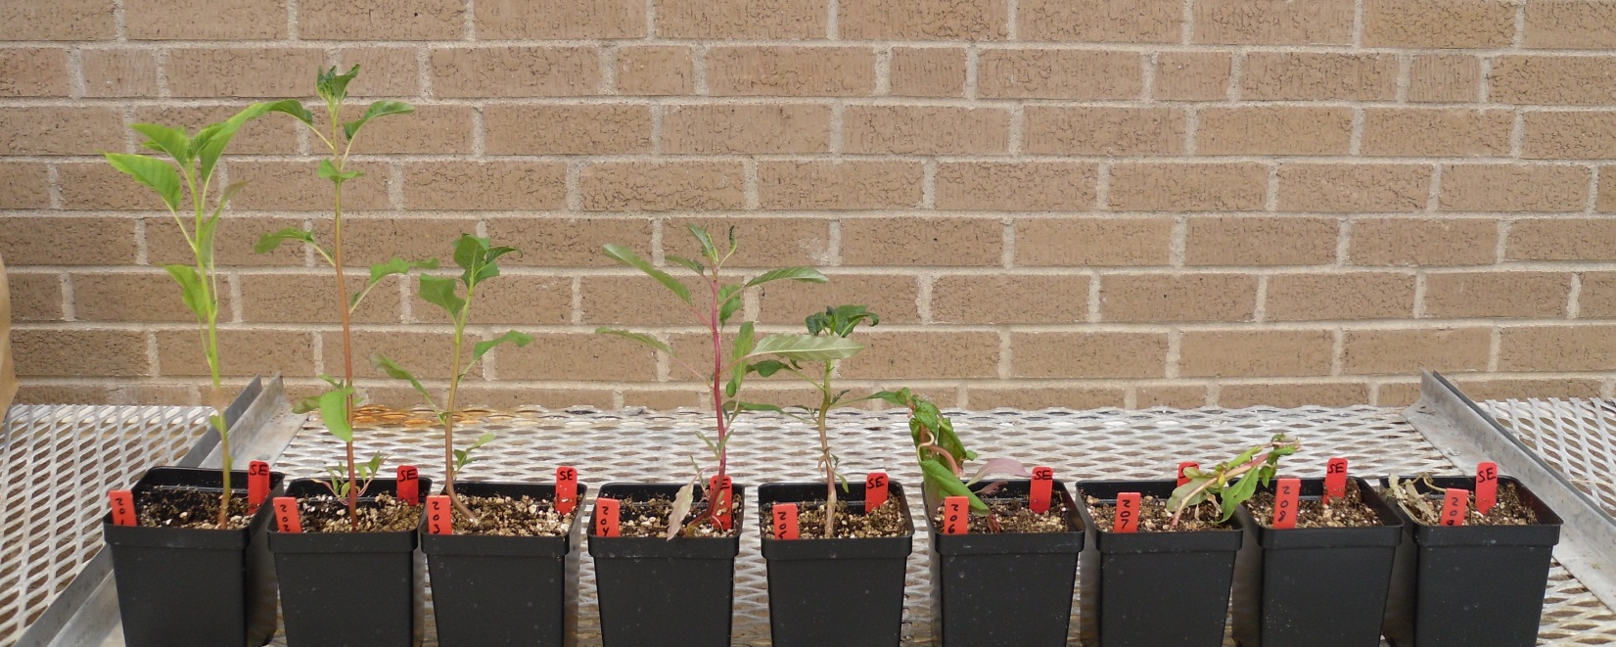
21 DAT
Susceptible
Resistant
0
18
35
70
140
280
560
1120
2240
2,4-D dose, g ae ha⁻¹
G. Kruger, UNL

Slide 30
Greenhouse Dose Response 21 DAT
ED50
R:S – 9.1
ED90
R:S – 111
G. Kruger, UNL

Slide 31
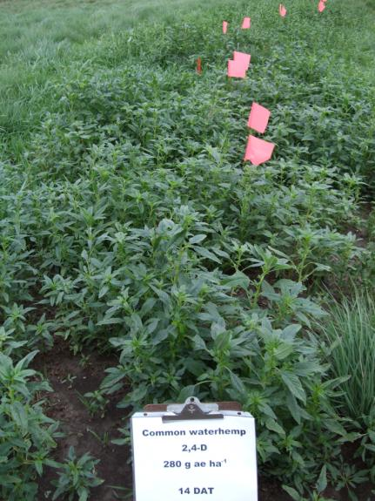
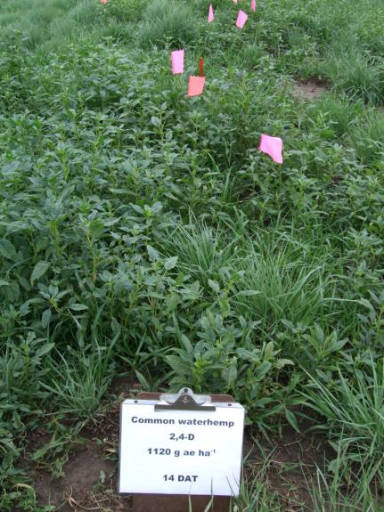
Field Evaluations 14 DAT
Untreated
280 g ha⁻¹
1,120 g ha⁻¹
G. Kruger, UNL

Slide 32
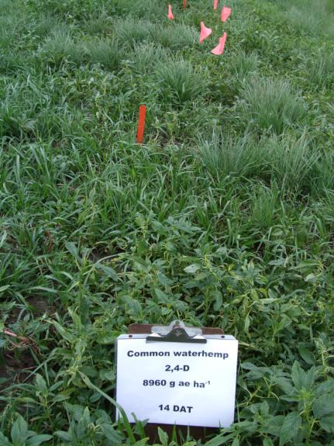
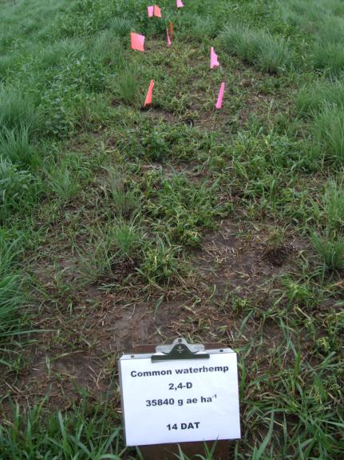
Field Evaluations 14 DAT
4,480 g ha⁻¹
8,960 g ha⁻¹
35,840 g ha⁻¹
G. Kruger, UNL

Slide 33
Recovery and Flowering 84 DAT
35,840 g ha⁻¹
1,120 g ha⁻¹
G. Kruger, UNL

Slide 34
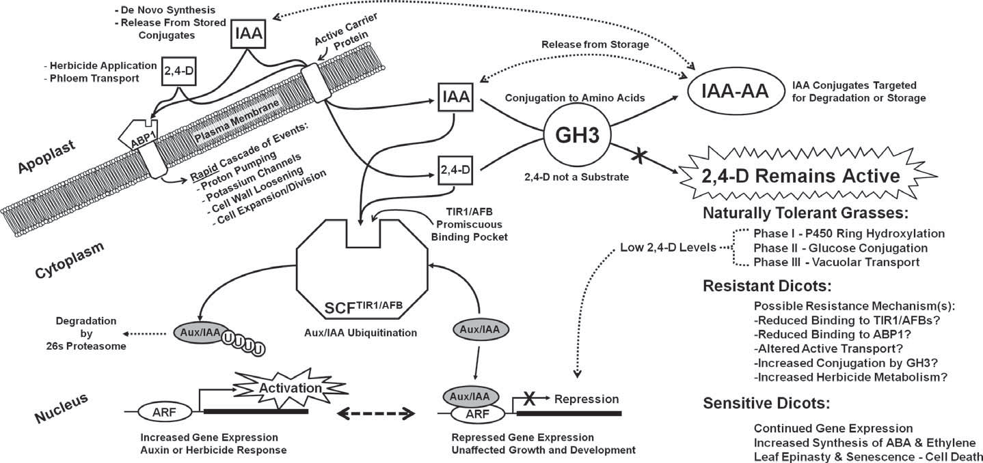
Proposed Resistance Mechanisms

Slide 35
Possible Mechanisms of Auxinic Herbicide Resistance
Reduced binding to the ABP1
Reduced binding to other receptors (TIR1, AFB)
Altered active transport
Increased conjugation
Increased metabolism

Slide 36
Implications For USA
A. tuberculatus could force significant changes in mid-west production systems. (Dr. Pat Tranel, UI)
A. tuberculatus is native species, there is no genetic bottle neck, massive amounts of genetic variability to select from.
Enlist™ (Dow Agro) stacked herbicide technology and Monsanto’s dicamba resistant varieties will provide a temporary solution.
Very high levels of 2,4-D resistance have been identified in Nebraska.
HPPD herbicides were thought to provide a bridge until new modes of action could be discovered, we already have the first case of resistance.

Slide 37
Implications for Brazil
Is there a A. palmeri or A. tuberculatus type plant lurking somewhere in Brazil or in surrounding country? (Blame it on Paraguay?)
Brazil has the advantage of watching the US and hopefully preventing the same things from happening here.
Coordination for resistance management efforts will be critical with university, industry and grower partnerships.

Slide 38
Acknowledgements
Dr. Greg Kruger, University of Nebraska-Lincoln
Dr. Mithila Jugulam, Kansas State University

