Slide 1
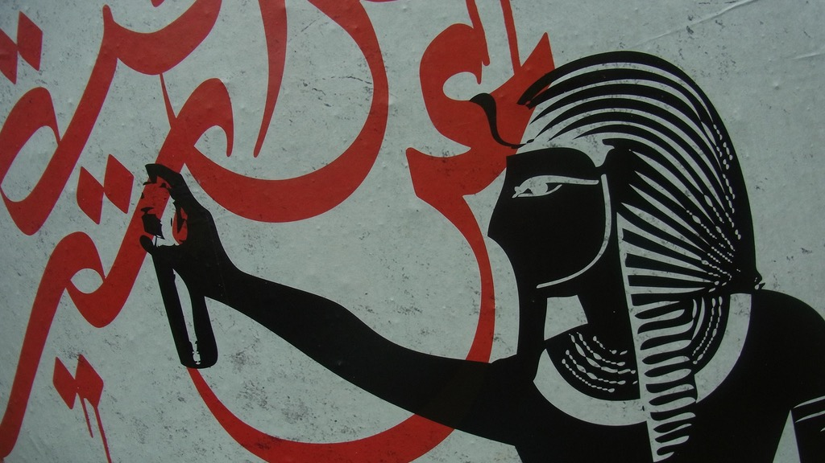
Major Themes in Contemporary Middle East
Dr. Karabekir Akkoyunlu
LECTURE 1: Conceptual & Historical Introduction

Slide 2
Course Convenor
Karabekir “Kara” Akkoyunlu
karabekir.akkoyunlu@uni-graz.at

Slide 3
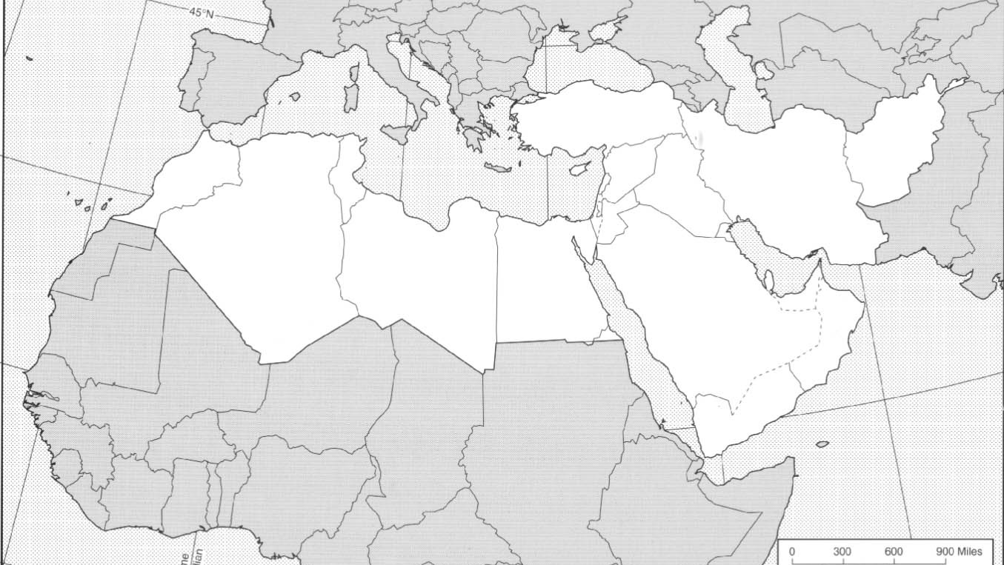
A quick test…
media

Slide 4
media

Slide 5
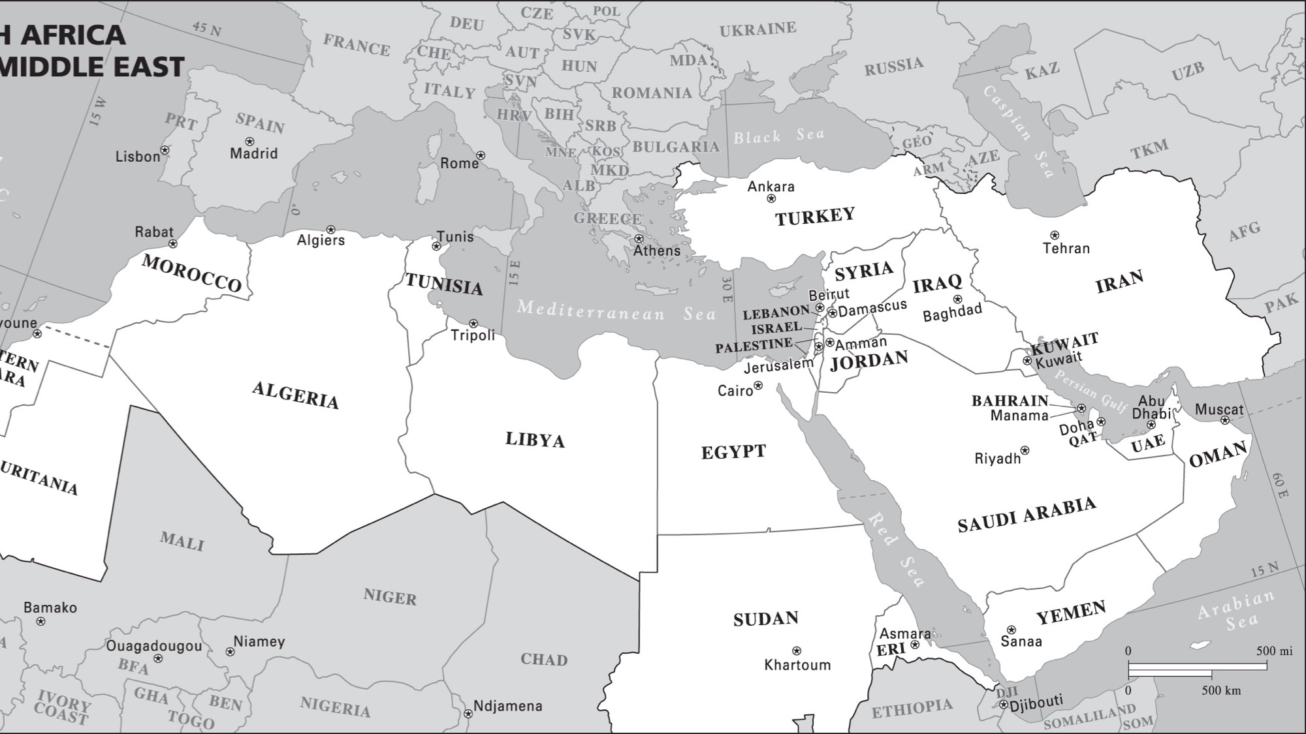
4. Always study with a map!

Slide 6
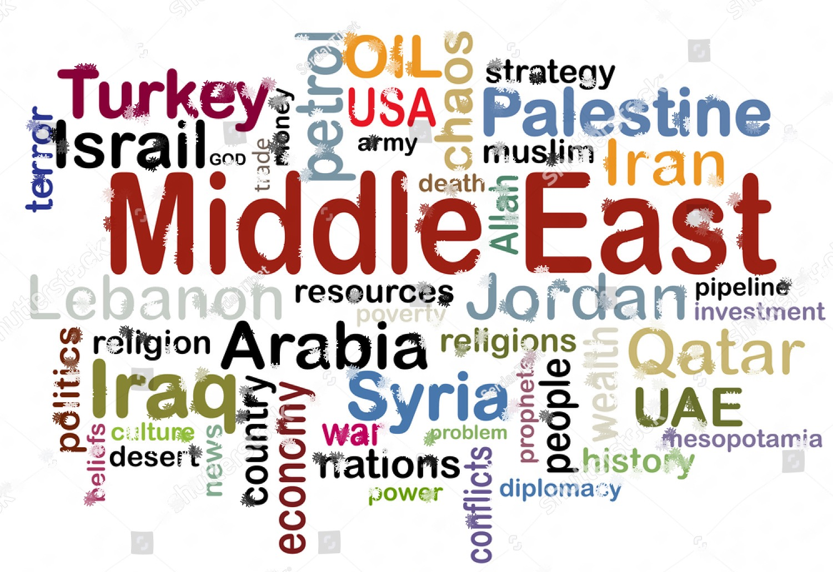
5. Question your biases, keep an open mind, come to learn!

Slide 7
Course objective
Critical understanding of the region’s key socio-political, geopolitical, historical and cultural dynamics and complexities…
…without resorting to crude generalisations, simplifications and exceptionalism.

Slide 8
Course outline
Week 1. Historical Background: Empire, Colonialism and Nationalism (28/02)
Week 2. Middle East during the Cold War (6/03)
Week 3. Political Islam (13/03)
Week 4. Geopolitics of Energy (20/03)
Week 5. Socio-Economic Transformations: Environment, Urbanisation & Migration (27/03)
Week 6. The Israeli-Palestinian Conflict (3/04)
Week 7. Movie: 5 Broken Cameras Deadline for Written Response No. 1

Slide 9
Course outline
Week 8. Politics of the Persian Gulf (24/04)
Week 9. Struggles for Social Justice (II): Women’s & LGBTQ+ Struggles (8/05)
Week 10. Movie: Persepolis (15/05) Deadline for Written Response No. 2
Week 11. The Kurdish Question (22/05)
Week 12. Struggles for Social Justice (I): From the Arab Spring to the Arab Winter (29/05)
Week 13. Regionalism and External Powers in the 21st c. (5/06)
Final Papers due midnight 19 June

Slide 10
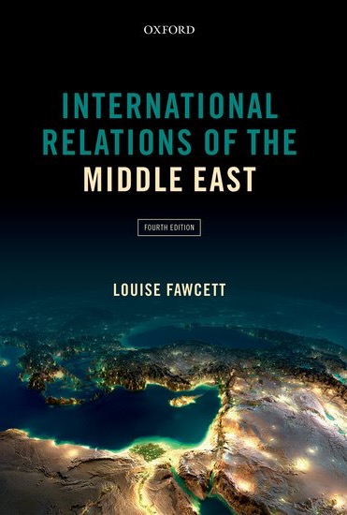
Course Textbook & Sources
Louise Fawcett (ed.) International Relations of the Middle East, Oxford University Press, 2016
Selected chapters, additional reading, lecture slides and other material will be uploaded to Moodle.
Recommended websites for updates, analyses and opinions:
al-monitor.com
jadaliyya.com
merip.org
ottomanhistorypodcast.com
You are expected to come to class having done the reading and ready to engage in discussion & answer questions.

Slide 11
Assessment
Attendance + Participation: 20%
Reading responses: 20% each
Final Paper: %40

Slide 12
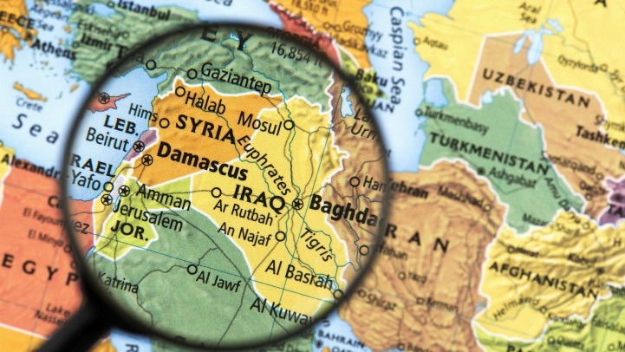
Conceptualising “The Middle East”

Slide 13
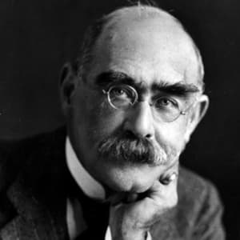
“The Middle East”
In Arabic: Mashriq & Maghrab
India & China: West Asia
Soviet Russia: Central East
Geopolitics of the term
British colonial concepts: Near East & Far East
US naval Admiral Alfred T. Mahan (1902)
“East is East, and West is West, and never the twain shall meet” – R.Kipling
Rudyard Kipling

Slide 14
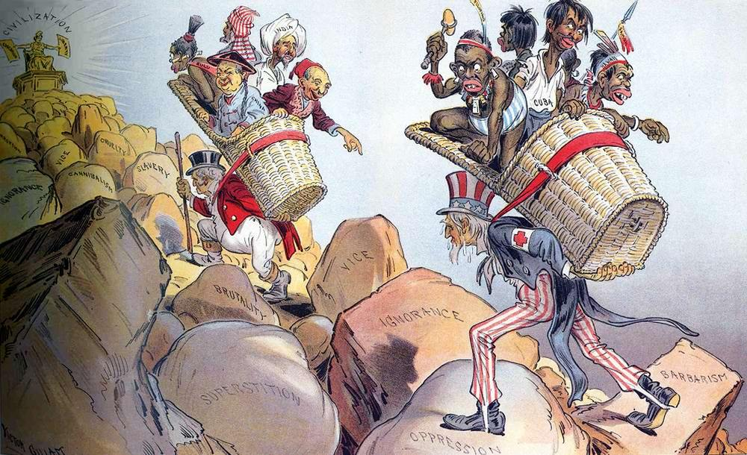
The White Men’s Burden
Take up the White Man’s burden
Send forth the best ye breed
Go send your sons to exile
To serve your captives' need
To wait in heavy harness
On fluttered folk and wild
Your new-caught, sullen peoples
Half devil and half child
…
Kipling (1899)
Judge magazine, 1 April 1899

Slide 15
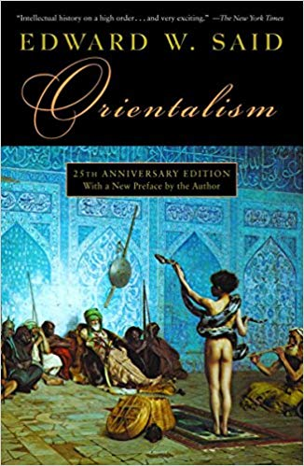
Orientalism
“The Orient and Islam have a kind of extrareal, phenomenologically reduced status that puts them out of reach of everyone except the Western expert. From the beginning of Western speculation about the Orient, the one thing the orient could not do was to represent itself. Evidence of the Orient was credible only after it had passed through and been made firm by the refining fire of the Orientalist’s work.”
Edward W. Said
https://www.youtube.com/watch?v=4QYrAqrpshw
Orientalism (1978)

Slide 16
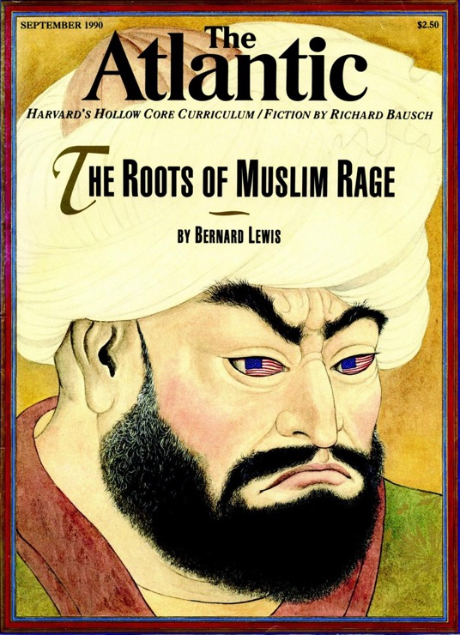
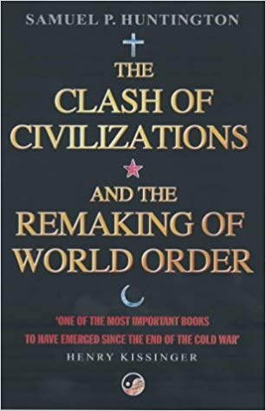
Orientalism
Essentialism: the idea that there are fixed and inherent properties of individuals and social groups. Essence (rather than complex, historically contingent factors) responsible for behaviour.
“…an explosive mixture of rage and hatred… This is no less than a clash of civilizations—the perhaps irrational but surely historic reaction of an ancient rival against our Judeo-Christian heritage, our secular present, and the worldwide expansion of both. It is crucially important that we on our side should not be provoked into an equally historic but also equally irrational reaction against that rival.”
“The fundamental problem for the West is not Islamic fundamentalism. It is Islam, a different civilisation whose people are convinced of the superiority of their culture and are obsessed with the inferiority of their power.”
1990
1996

Slide 17
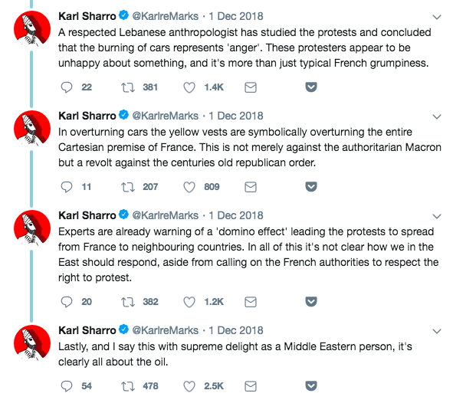
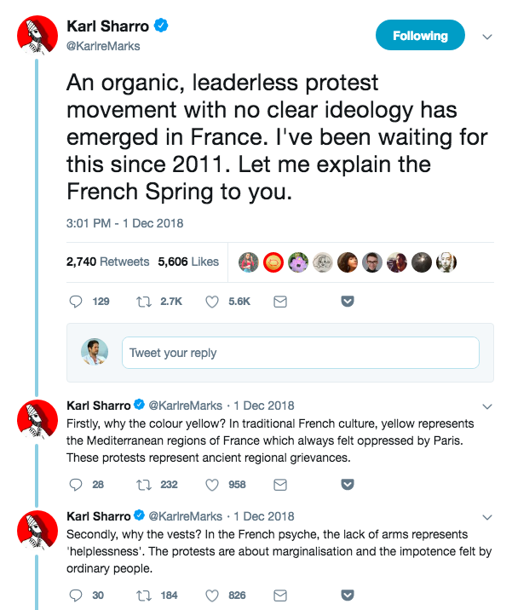
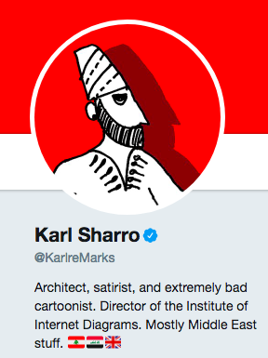
Orientalism

Slide 18
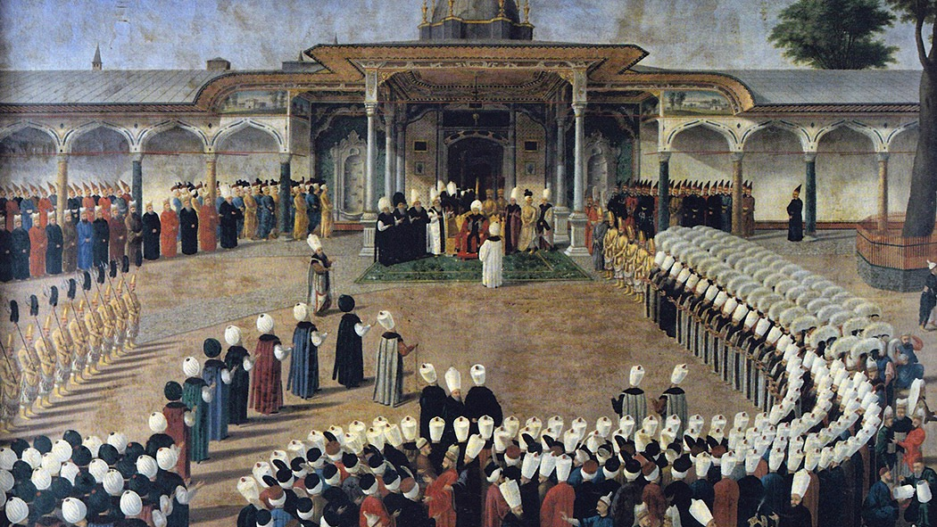
Historical Background From Empire to Nation-State

Slide 19
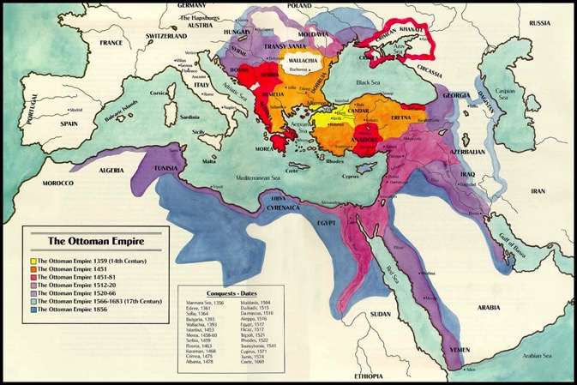
From Empire to Nation-State
How many sovereign states in the Middle East…?

Slide 20
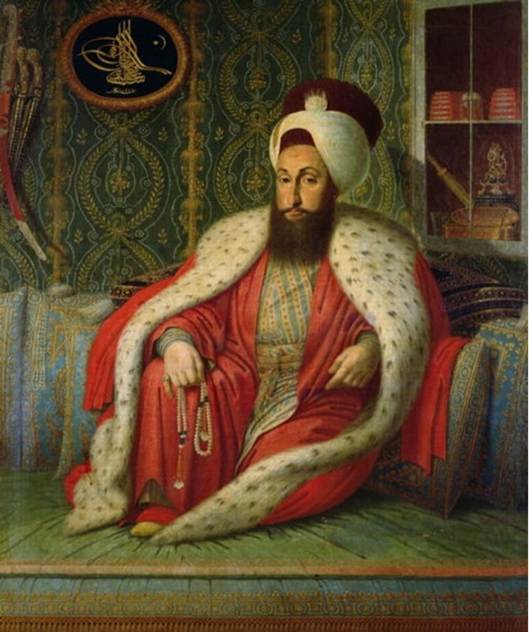
The Ottoman Empire
What was it?
An empire of only Turks and Muslims? No.
A multi-cultural, multi-religious, multi-ethnic, multi-lingual empire.
600 year rule in the Balkans, 400 years in the Middle East & North Africa.

Slide 21
The Ottoman Empire
How did it survive so long?
Just brutal force? No.
Effective central military & bureaucracy
Decentralised government
The millet system
each religion a self-governing community under the Sultan
Provision of security and stability in return for loyalty and taxes

Slide 22
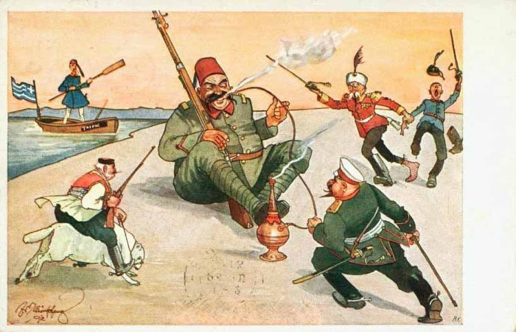
The Ottoman Empire
Why did it decline?
“The Sick Man of Europe”
Consistent inflation since 16th c.
Unsuccessful defensive wars (w/ Russia) after 17th c.
Twin Revolutions of Europe in 18th century
By 19th century facing…
Globalisation
Imperialism
Nationalism

Slide 23
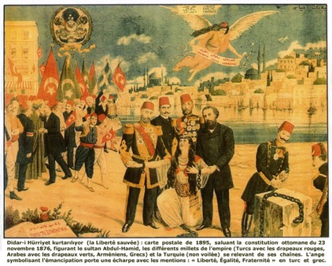
The Ottoman Empire
Ottoman Responses?
Reforms during 19th c.
“Tanzimat”
Reassert authority of central government vis-à-vis
Imperial powers
Revolting millets
Provincial governors
Formula
Centralisation
Modernisation
Modern identity formation
Happening all over the world
Russia, Japan, Latin America
The Imperial Edict of Reorganisation (Islahat) 1856
Constitutional Revolution 1908

Slide 24
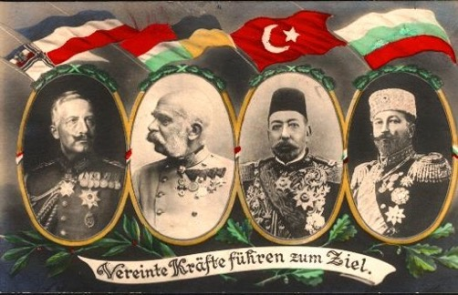
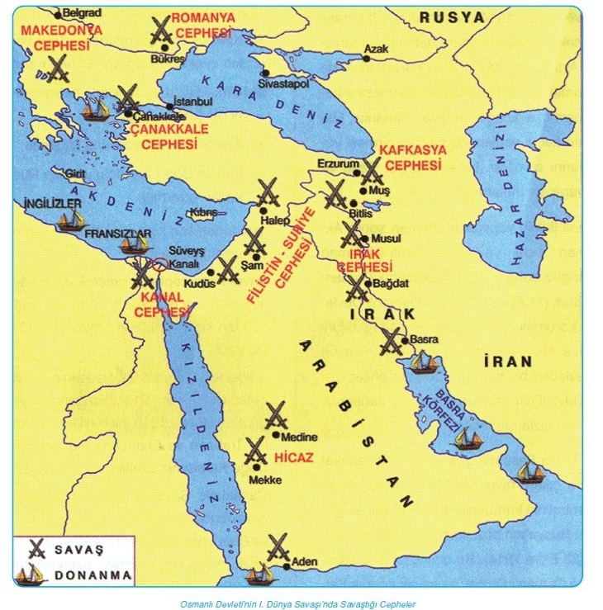
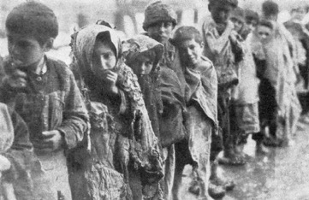
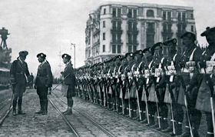
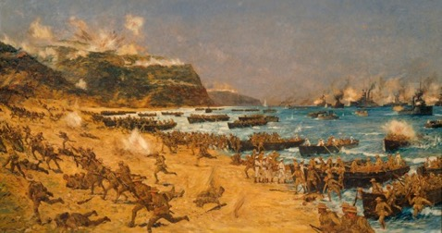
World War I
Ottomans join war along Central Powers
Gallipoli (1915)
Armenian Genocide (1916)
Defeat and occupation
Paris Peace Conference
Central Powers in WWI
Armenian children
Allied Landing at Gallipoli April 1915

Slide 25
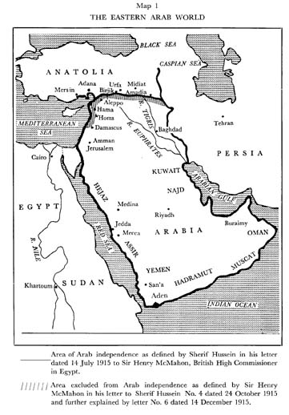
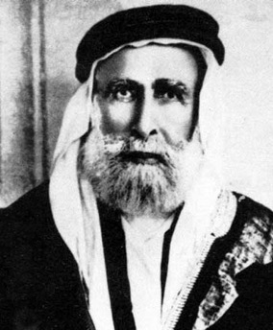
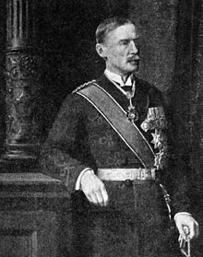
World War I
British Wartime Promises
Hussein - McMahon Correspondence 1915 -1916
Between Sharif of Mecca, Hussein bin Ali and Sir Henry McMahon, British High Commissioner in Egypt
British urge the Arabs to revolt against the Ottomans
In exchange for a promise of an independent Arab state in former Ottoman territories

Slide 26
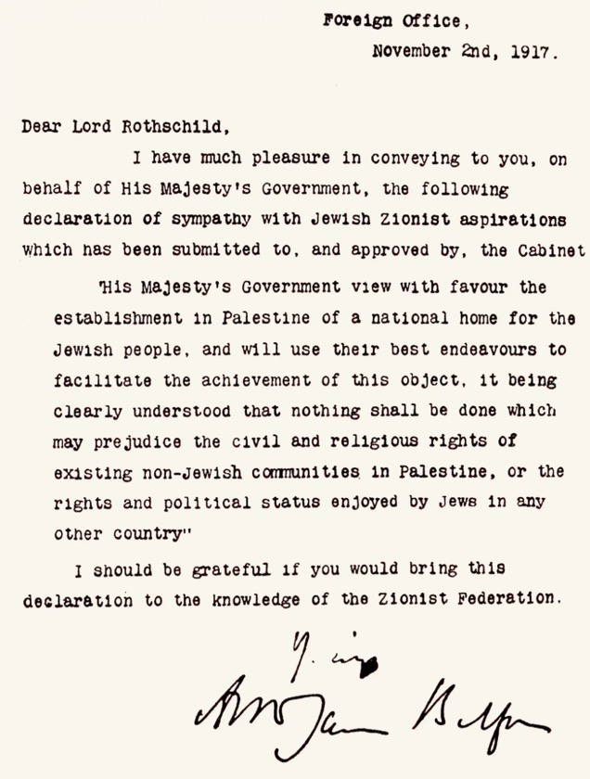
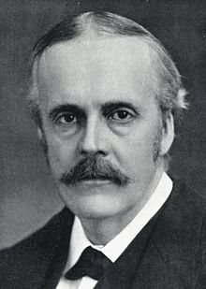
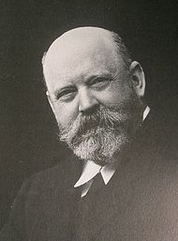
World War I
British Wartime Promises
Balfour Declaration 1917
Official British promise of ”the establishment in Palestine of a national home for the Jewish people”.
Recognition of the influence of the Zionist movement in Britain and Europe.
Jewish population a minority in the region at the time.
But Zionist movement active in advocating a Jewish state in Palestine.
Overlaps with McMahon’s promise to Sharif of Mecca
Arthur Balfour
Lord Rothchild

Slide 27
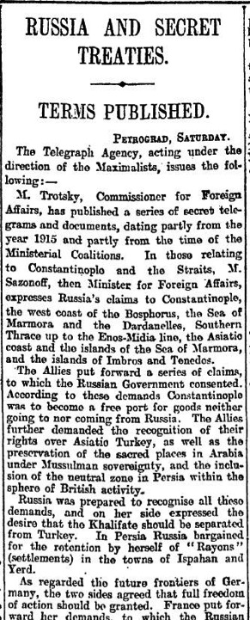
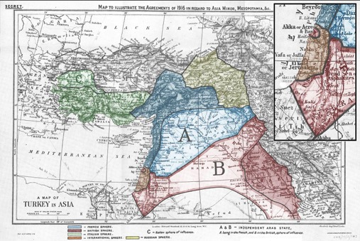
World War I
British Wartime Promises
Sykes-Picot Agreement 1916
Secret agreement between France, Britain & Russia to divide Ottoman Middle East.
Britain gets Jordan, Southern Iraq, Kuwait.
France gets Syria, Lebanon, North Iraq, Southeast Turkey.
Russia gets Istanbul, the Straits and Armenian provinces
Revealed by Bolsheviks after the revolution.
Arbitrary division of territories.
Source of resentment to this day.

Slide 28
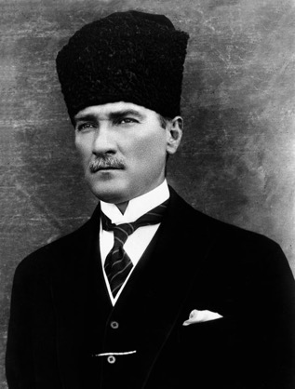
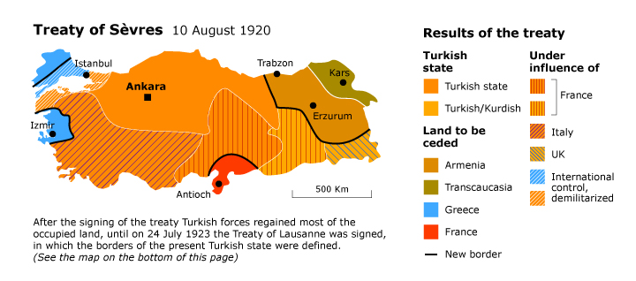
Outcomes of the War
Turkey
Nationalist resistance to occupation partition (1919– 1922)
Led by Mustafa Kemal (later Atatürk)
Victory and recognition of sovereign Turkey with capital in Ankara (1922)
Abolition of the monarchy (1922)
Declaration of republic (1923)
Abolition of the caliphate (1924)
Kemalist Reforms
Secularisation
Westernisation
Modernisation
Turkification
Mustafa Kemal Atatürk

Slide 29
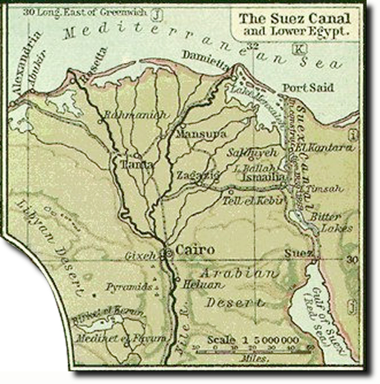
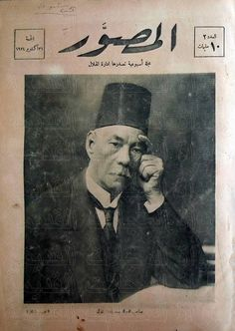
Outcomes of the War
Egypt
1882 - British occupation (nominally under Ottoman rule)
1914 - Declared British protectorate
1918 - Egyptian delegation (wafd) unsuccessfully seeking independence in Versailles
1922 Treaty - establishes nominal independence under restrictive British influence
British play b/w monarchy and the parliament (controlled by Wafd Party)
1952 - Free Officers’ revolution overthrows monarchy
British interests in the Suez Canal
Sa’d Zaghlul

Slide 30
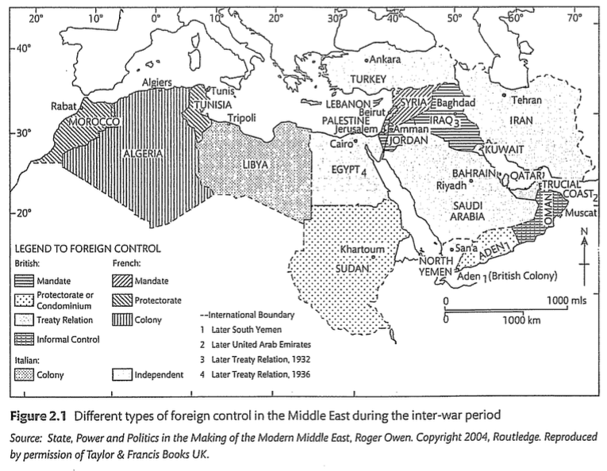
Post-War Middle East
Anglo-French domination
Turkey, Iran and Saudi Arabia only independent states
Contested and arbitrary boundaries
Contested regimes:
Colonial rule vs. Sovereignty
Monarchy vs. Republic
Nation-state vs. Arab nationalism

Slide 31
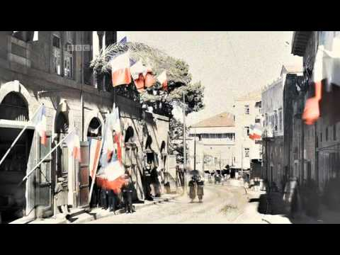
“The Birth of Nations – Middle East”
BBC Four Documentary (2011)
Examining Albert Kahn's Archives of the Planet project, in which he sent photographers around the world to document major events.
The making of post-war Lebanon, Palestine and Turkey.
Part 1: https://www.youtube.com/watch?v=9C6c_gUMecE
Part 2: https://www.youtube.com/watch?v=t-wG8u1ojeI
Part 3: https://www.youtube.com/watch?v=YMUAG7i5T7Y
Part 4: https://www.youtube.com/watch?v=9ew7-hgRneQ

Slide 32
Week 2.
Middle East during the Cold War (6 March)

