Slide 1
Analysis Mat: UV, IR
Patricia TARGON CAMPANA
Lecture 07

Slide 2
IR x RAMAN
Most important vibrational spectroscopy techniques: mid-infrared (IR) and near-IR absorptions and Raman scattering
mid-IR and Raman: provide characteristic fundamental vibrations employed for the elucidation of molecular structure
Near-IR spectroscopy: measures the broad overtone and combination bands of some of the fundamental vibrations and is an excellent technique for rapid, accurate quantitation

Slide 3
IR spectroscopy = measures electric dipole-mediated transitions (in a resonance condition) between molecular vibrational energy levels as a result of the absorption of radiation
Raman spectroscopy = is a two-photon inelastic light-scattering event, in an off-resonance condition involving the polarizability of the molecule.
Modulation of the μ

Slide 4
IR and Raman vibrational bands are characterized by:
their frequency (energy), intensity (polar character or polarizability), band shape (environment of bonds).
Vibrational energy levels are unique to each molecule: IR and Raman spectrum provide a “fingerprint” of a particular molecule.
Frequencies of molecular vibrations depend on:
the masses of the atoms, their geometric arrangement, the strength of their chemical bonds.
The spectra provide information on molecular structure, dynamics, and environment.

Slide 5
SYMMETRY: IR AND RAMAN ACTIVE VIBRATIONS
In general symmetric or in-phase vibrations and non-polar groups = Raman active asymmetric or out-of-phase vibrations and polar groups = IR active
Rule of mutual exclusion: if the molecule has a centre of symmetry then active Raman vibrations are infra-red inactive.
If not, some vibrations may be both IR and Raman active
With a centre of symmetry no vibration can be active in both the IR and Raman spectra

Slide 6
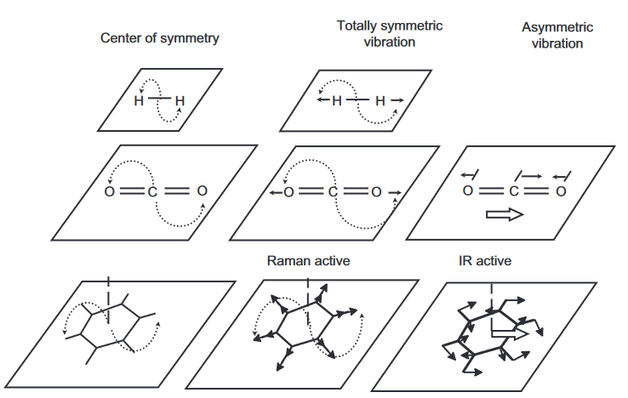
Vibrations that retain the centre of symmetry generate a change in the polarizability during the vibration but no change in a dipole moment.

Slide 7
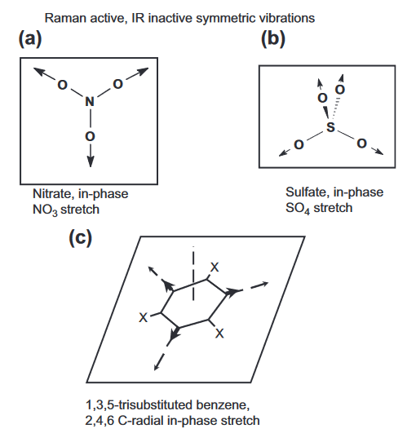
Vibrations that do not retain the centre of symmetry may display a change in the dipole moment and may have other suitable symmetry elements so that some vibrations will be active only in Raman or only in the IR.

Slide 8
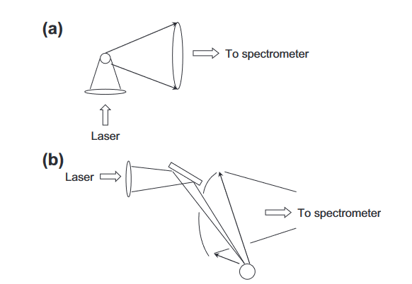
In a typical Raman experiment:
laser as excitation source (monochromatic): UV-visible,
near-IR (785 and 1064 nm)
reduced fluorescence interference, but can cause thermal decomposition of the sample
90° collection geometry (refractive optics)
(b) 180 ° backscattering collection geometry (reflective optics), common in FT-Raman

Slide 9
Environmental Dependence of Vibrational Spectra
The IR and Raman spectra are significantly different for molecules in the gaseous, liquid, or solid state.
Gaseous state: the molecules can be considered to be non-interacting and can rotate freely with a characteristic angular momentum.
Coupling of the vibrational transition with the rotational degrees of freedom of the molecule occurs resulting in band structure that is highly characteristic of the molecular structure and rotational e vibrational interactions (rotational fine structure can be observed)
hydrogen bonding to an X-H group results in a decrease in the X-H stretching frequency accompanied by a broadening and intensification of this band. Both OH and NH groups are found to show highly characteristic changes with hydrogen bonding.

Slide 10
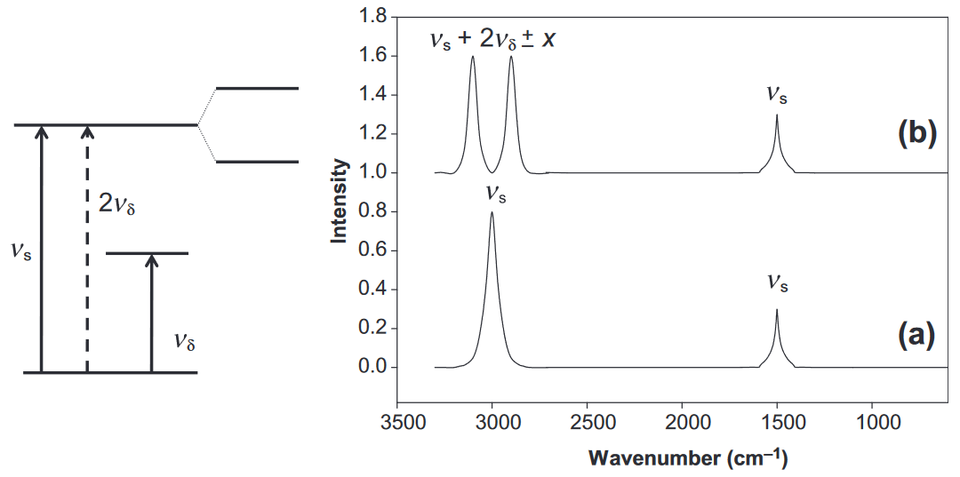
FERMI RESONANCE

Slide 11
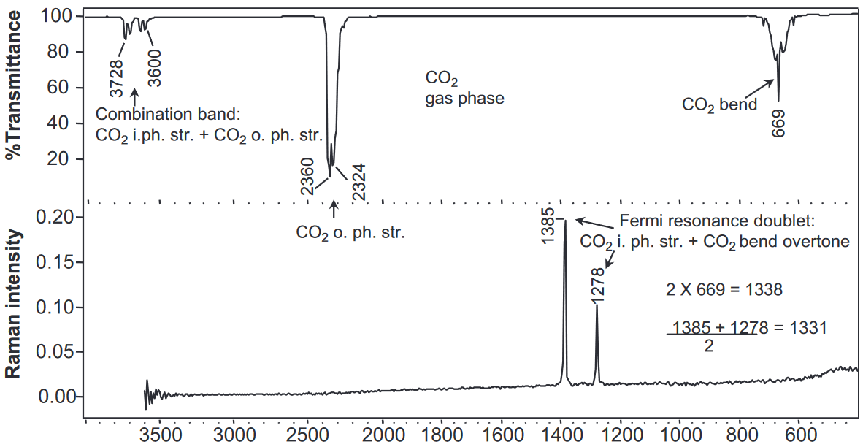
CO₂: a classic example of Fermi resonance
expected CO₂ in-phase stretch fundamental: 1332

Slide 12
IR and Raman Spectra-Structure Correlations: Characteristic Group Frequencies
When a molecule contains a bond or group with a vibrational frequency significantly different from adjacent groups, then the vibrations are localized primarily at this group and the characteristic IR and Raman bands are called “group frequencies”.

Slide 13
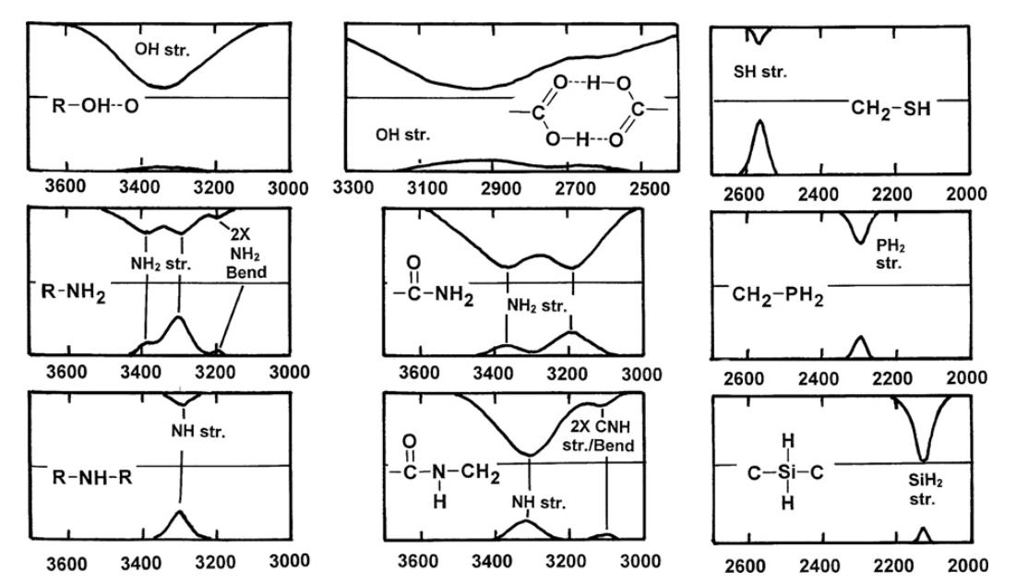
X-H STRETCHING GROUP (X=O, S, P, N, SI, B)

Slide 14
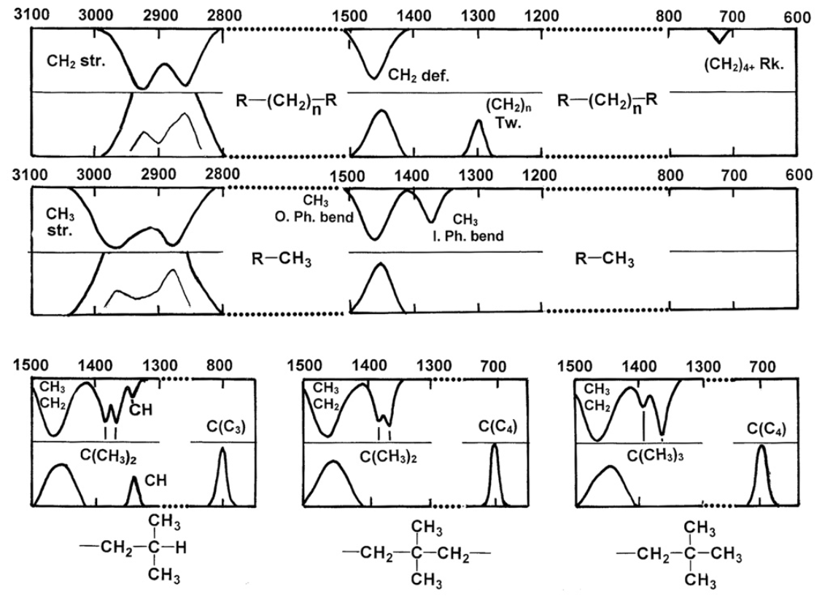
ALIPHATIC GROUPS
in-phase stretch of the C(C₃) and C(C₄) groups
Variation considerable due to strong mechanical coupling (attached C-C, C-O, C-N or C-S)
iso-propyl (gem-dimethyl)
tertiary-butyl group

Slide 15
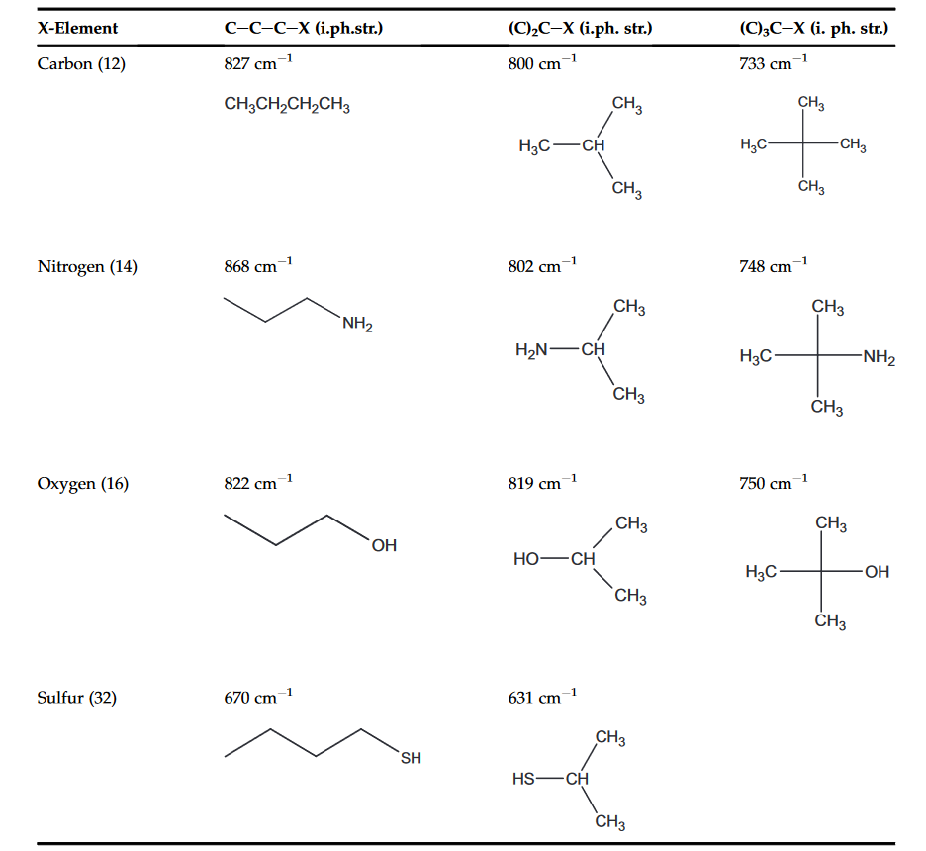

Slide 16
Vibrations involving the methyl and methylene stretches: strong and characteristic bands, but show greater complexity in the Raman spectra due to Fermi-resonance between the methylene CH stretching vibrations and the overtone of the methylene bending (deformation) vibrations
Additional bands observed in the 2900 cm⁻¹ region:
weak shoulder in the IR spectrum
more isolated and obvious bands in the Raman spectra

Slide 17
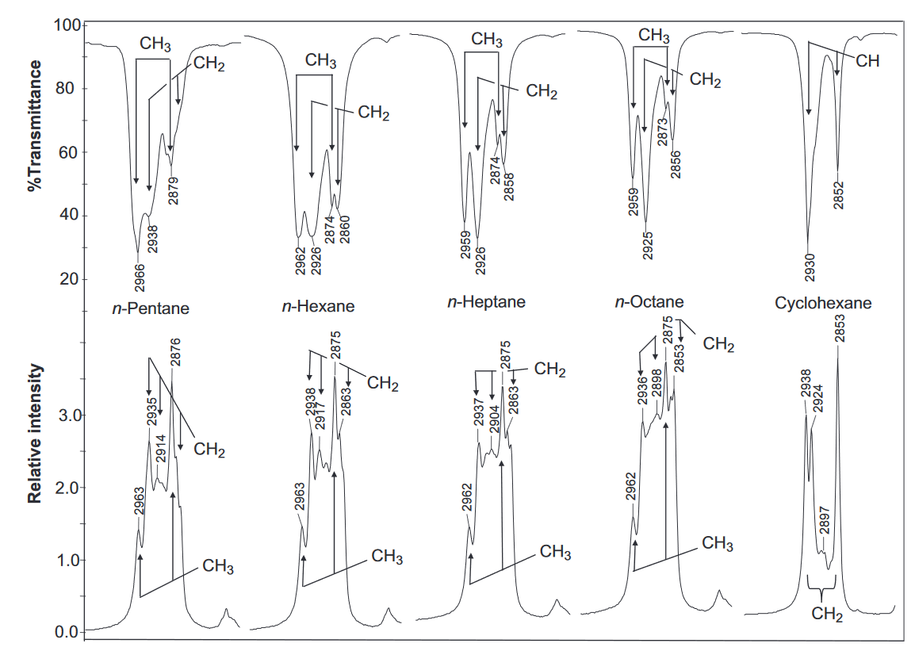
Multiple Fermi-resonance doublets associated with the methylene group
Conditions:
At least two almost equivalent neighbouring methylene groups;
The symmetry and frequency of the methylene CH₂ stretch and deformation overtone is suitable for Fermi resonance.

Slide 18
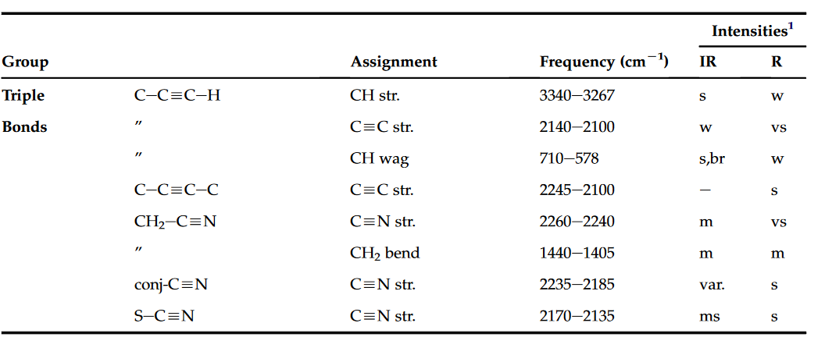
CONJUGATED ALIPHATICS AND AROMATICS

Slide 19
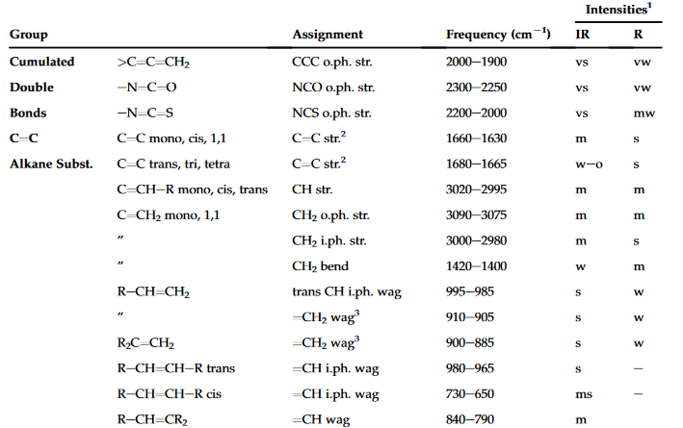

Slide 20
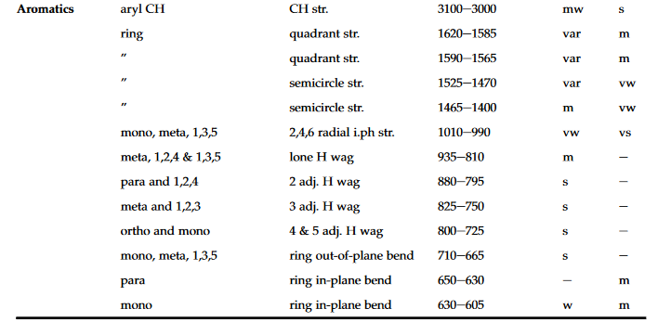
• CH stretch bands
• Ring stretch bands

Slide 21
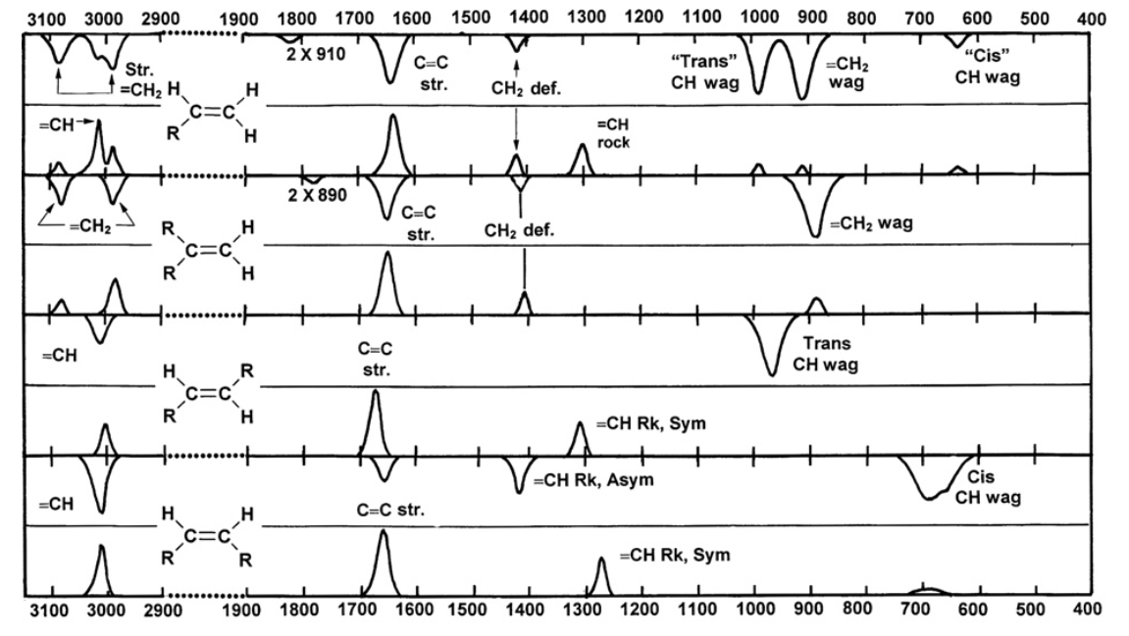

Slide 22
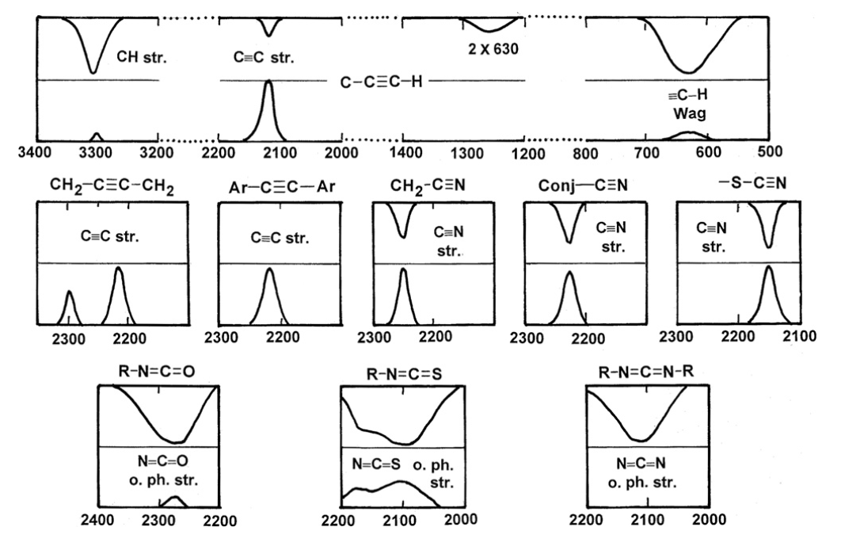

Slide 23
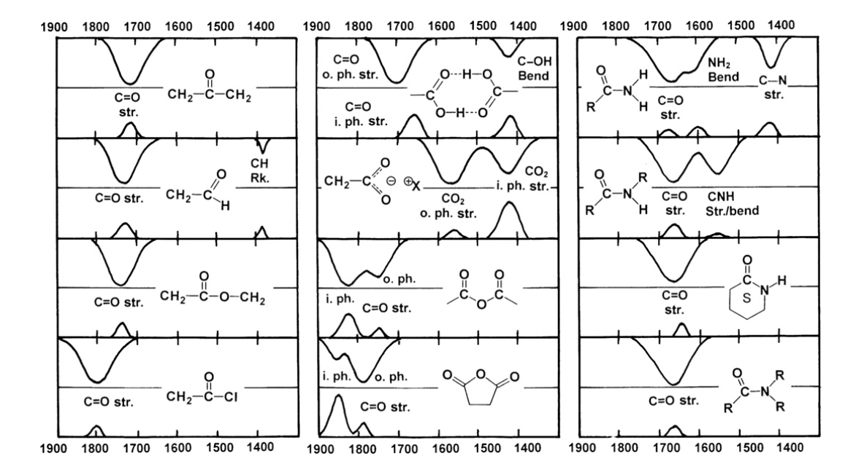
Carbonyls

Slide 24
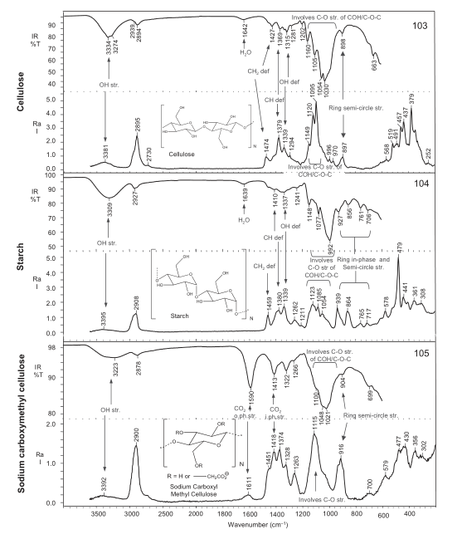
Complementarity

Slide 25
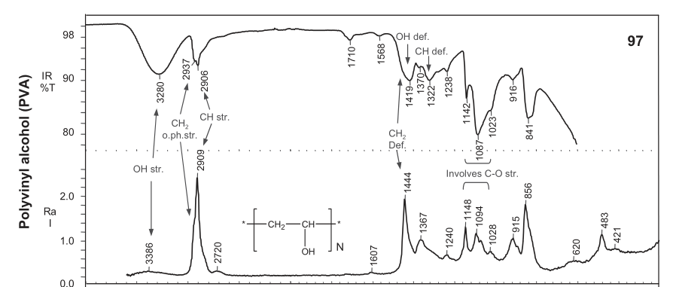

Slide 26
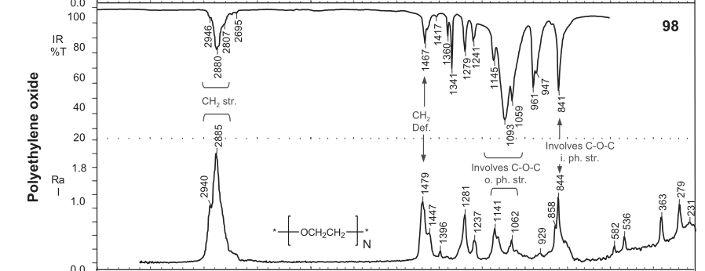

Slide 27
Absorption
(and emission) electronic
Absorption IR
Raman Scattering
Electronic transition
Vibrational transition
Inelastic scattering
Rotational force
μ and m
Variation of the intrinsic dipole moment
Radiation induces an electric dipole moment
Information on different variations in molecular structure
Different physical phenomena

Slide 28
References
Larkin, Peter. Infrared and Raman spectroscopy: principles and spectral interpretation. Elsevier, 2017.
Pavia, Donald L., et al. Introduction to spectroscopy. Cengage learning, 2014.
Banwell, C. N. Fundamentals of Molecular Spectroscopy: By CN Banwell. New York, McGraw-Hill, 1983.

