Slide 1
mi·cro·bi·ol·o·gy ˌmīkrōˌbīˈäləjē/ noun: microbiology the branch of science that deals with microorganisms.

Slide 2
Microbiology (from Greek μῑκρος, mīkros, "small"; βίος, bios, "life"; and -λογία, -logia) is the study of microscopic organisms, those being unicellular (single cell), multicellular (cell colony), or acellular (lacking cells).

Slide 3
Microbiology encompasses numerous sub-disciplines including virology, mycology, parasitology, and bacteriology.

Slide 4
Microbiology is the study of microscopic organisms, such as bacteria, viruses, archaea, fungi and protozoa. This discipline includes fundamental research on the biochemistry, physiology, cell biology, ecology, evolution and clinical aspects of microorganisms, including the host response to these agents.

Slide 5
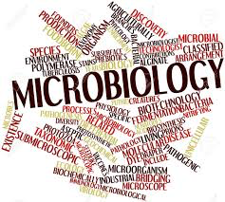

Slide 7
Related Subjects
Antimicrobials
Applied microbiology
Archaea
Bacteria
Bacteriology
Bacteriophages
Biofilms
Biogeochemistry
Cellular microbiology
Clinical microbiology
Microbial communities
CRISPR-Cas systems
Environmental microbiology
Fungi
Industrial microbiology
Infectious-disease diagnostics
Microbial genetics
Parasitology
Pathogens
Phage biology
Policy and public health in microbiology
Vaccines
Virology

