Slide 1
Chapter 11 Vertical Integration and the Scope of the Firm
Prof. Luciano Thomé e Castro

Slide 2
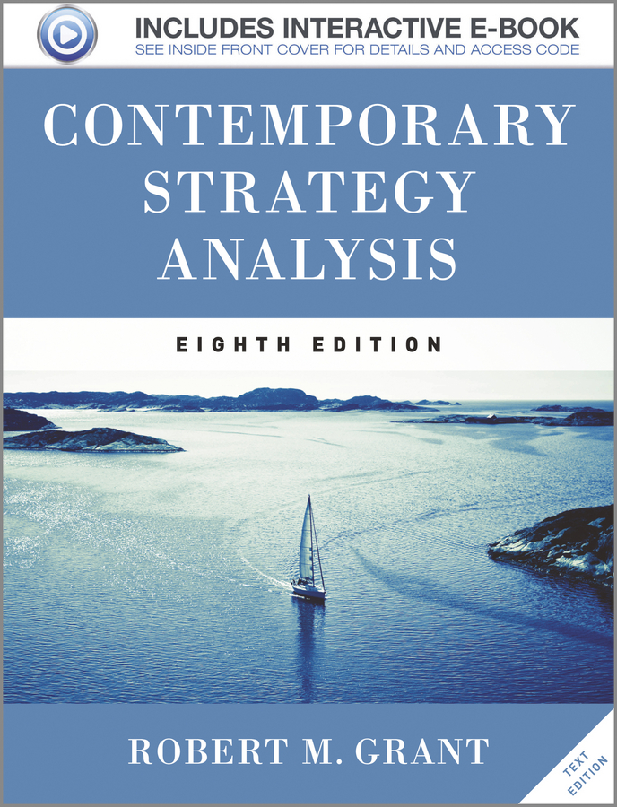
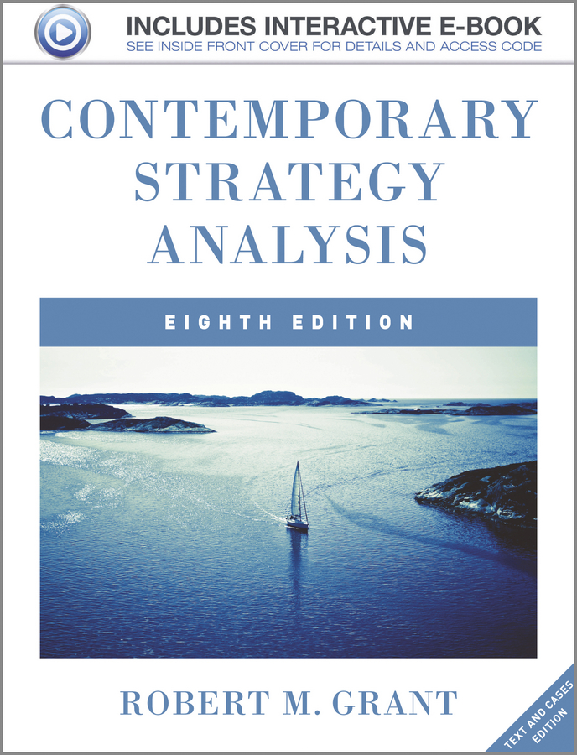
© 2013 Robert M. Grant
www.contemporarystrategyanalysis.com

Slide 3
Vertical Integration and the
Scope of the Firm
OUTLINE
Transactions costs and the scope of the firm
The costs and benefits of vertical integration
Designing vertical relationships
© 2013 Robert M. Grant
www.contemporarystrategyanalysis.com

Slide 4
From Business Strategy to Corporate Strategy: The Scope of the Firm
Business Strategy is concerned with how a firm competes within a particular market
Corporate Strategy is concerned with where a firm competes, i.e. the scope of its activities
The dimensions of the scope are:
Vertical scope
Geographical scope
Product scope
© 2013 Robert M. Grant
www.contemporarystrategyanalysis.com

Slide 5
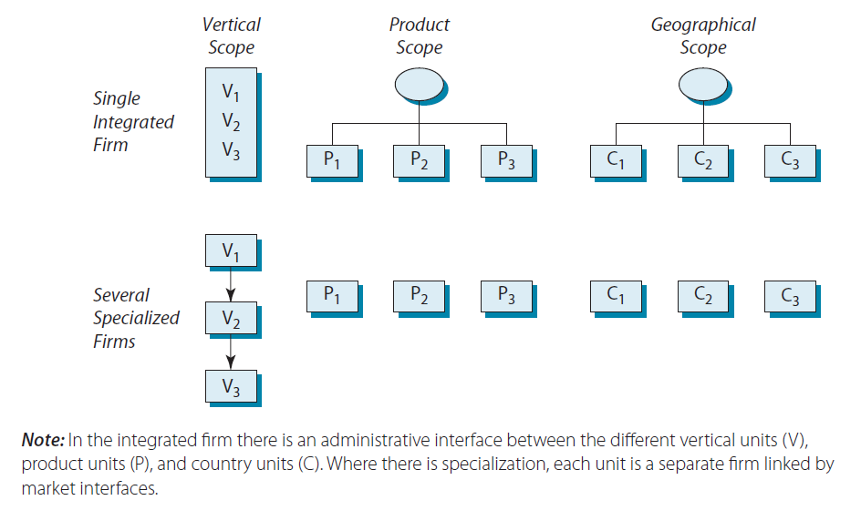
Transaction Costs and the
Scope of the Firm
In situation [A] businesses 1, 2 & 3 are integrated within a single firm.
In situation [B] businesses 1, 2 & 3 are independent firms linked by markets.
Which situation is more efficient? —Depends upon whether the administrative costs of the integrated firm are less than the transaction costs of markets?
© 2013 Robert M. Grant
www.contemporarystrategyanalysis.com

Slide 6
Aggregate Concentration in US Manufacturing, 1947-97
Key observation: Throughout the 20th century, firms grew in scale and scope. This trend went into reverse during the late 1970s
© 2013 Robert M. Grant
www.contemporarystrategyanalysis.com

Slide 7
The Shifting Boundary Between
Firms and Markets
Time Period | Main Trend | Factors Changing the Relative Efficiency of Firms and Markets
1800-1975 | Expanding the scale and scope of firms | Administrative costs of firms fall due to: Advancing technology in transport, communication, and IT Advances in management—accounting systems, scientific management, organizational innovations
1976-1995 | Biggest firms downsize: outsourcing; refocusing on core business | More turbulent external environment increases administrative costs of big firms. New digital technologies available to small firms and individuals as well as big corporations
1996-2007 | Global consolidation of many industries: (e.g. steel, oil, beer, banking) | Globalization of markets Big corporations more effective at reconciling complexity with responsiveness
© 2013 Robert M. Grant
www.contemporarystrategyanalysis.com

Slide 8
The Costs and Benefits of Vertical Integration:
Benefits
Technical economies from integrating processes e.g. iron and steel production
But doesn’t necessarily require common ownership
Avoids transactions costs of market contracts in situations where there are:
Small numbers of firms
Transaction-specific investments
Opportunism and strategic misrepresentation
Taxes and regulations on market transactions
Superior coordination
© 2013 Robert M. Grant
www.contemporarystrategyanalysis.com

Slide 9
The Costs and Benefits of Vertical Integration:
Costs
Differences in optimal scale of operation between different stages of production: prevents balanced vertical integration
Inhibits development of distinctive capabilities
Difficulties of managing strategically different businesses
Incentive problems: lack of “high-powered” incentives
Limits flexibility:
In responding to demand fluctuations
In responding to changes in technology, customer preferences, etc.
Compounding of risk
© 2013 Robert M. Grant
www.contemporarystrategyanalysis.com

Slide 10
Vertical Integration vs. Outsourcing
Key Considerations
How many firms are available to transact with? | The few the companies, the more attractive is VI
Is transaction-specific investment needed? | If yes, VI more attractive
Does limited information permit cheating? | VI can limit opportunism
Are taxes or regulation imposed on transactions? | VI can avoid them
Are future market conditions uncertain? | Uncertainty favors VI
Do the different stages have similar optimal stages of operation? | Greater the similarity, the more attractive is VI
Are the two stages strategically similar? | Strategic similarity favors VI
Is entrepreneurial initiative required? | If so, VI may blunt high-powered profit incentives
How uncertain is market demand? | Greater the unpredictability – the more costly VI
Are risks compounded by linkages between vertical stages? | VI increases risk
© 2013 Robert M. Grant
www.contemporarystrategyanalysis.com

Slide 11
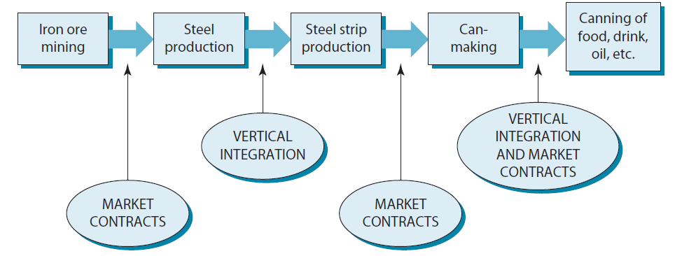
The Value Chain for Steel Cans
What factors explain why some stages are vertically integrated, while others are linked by market transactions?
© 2013 Robert M. Grant
www.contemporarystrategyanalysis.com

Slide 12
Designing Vertical Relationships: Long-Term Contracts & Quasi-Vertical Integration
Choices not limited to vertical integration or arms’-length contracts:
Several intermediate types of vertical relationship: these may combine benefits of both market transactions and internalization
Key issues in designing vertical relationships:
No generic solution: depends upon the resources, capabilities and strategy of the individual firm
How is risk to be allocated between the parties?
Are the incentives appropriate?
© 2013 Robert M. Grant
www.contemporarystrategyanalysis.com

Slide 13
Recent Trends in Vertical Relationships
From competitive contracting to supplier partnerships, e.g. in autos
From vertical integration to outsourcing (not just components, also IT, distribution, and administrative services)
Diffusion of franchising
Technology partnerships (e.g. IBM- Apple; Canon- HP)
Inter-firm networks
General conclusion: Boundaries between firms and markets becoming increasingly blurred
© 2013 Robert M. Grant
www.contemporarystrategyanalysis.com

Slide 14
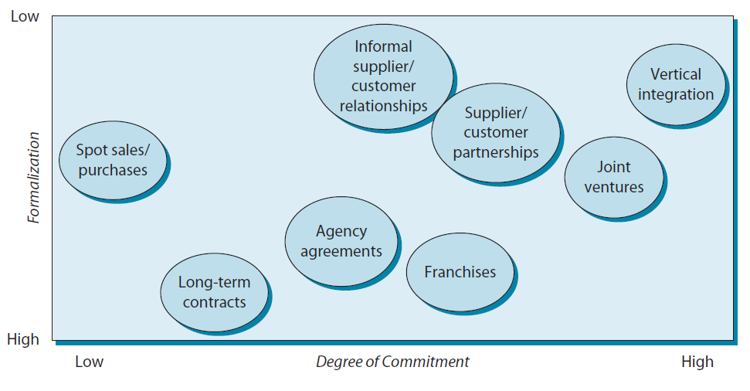
Different Types of Vertical Relationship
© 2013 Robert M. Grant
www.contemporarystrategyanalysis.com

