Slide 1
Chapter 2 : Goals, Value & Performance
Prof. Luciano Thomé e Castro

Slide 2
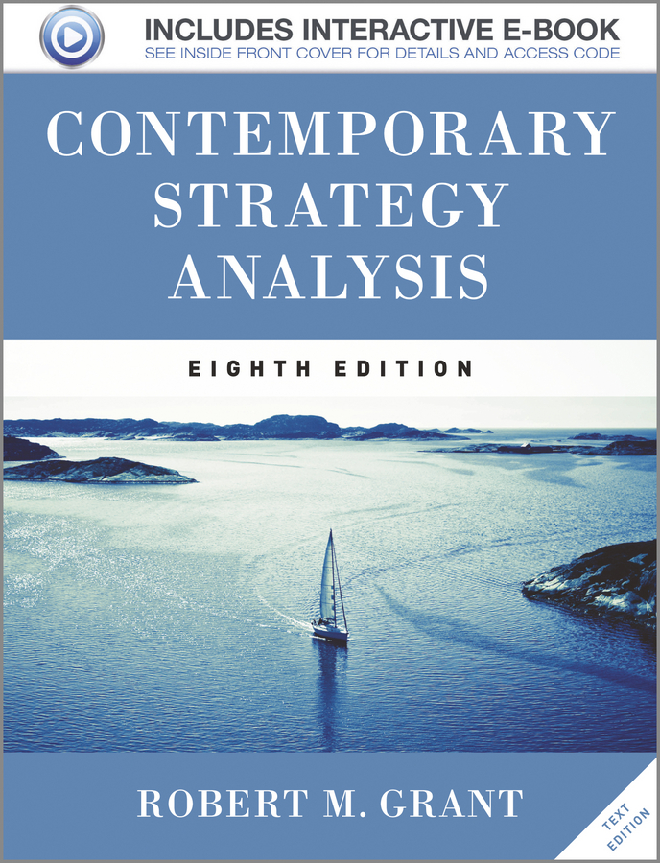
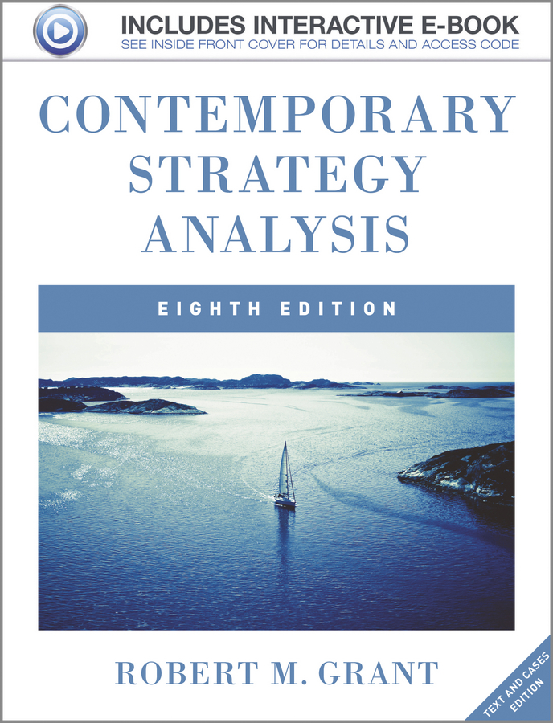
© 2013 Robert M. Grant
www.contemporarystrategyanalysis.com

Slide 3
Goals, Value & Performance
OUTLINE
Strategy as a quest for value
Putting performance analysis into practice
Beyond profit: Values and corporate social responsibility
Beyond profit: Strategy and real options
© 2013 Robert M. Grant
www.contemporarystrategyanalysis.com

Slide 4
Strategy as a Quest for Value
The stakeholder approach
The firm is a coalition of interest groups – it seeks to balance their different objectives
The shareholder approach
The firm exists to maximize the wealth of its owners
= max. present value of profits over the life of the firm
For the purposes of strategy analysis we assume that the primary goal of the firm is profit maximization.
Rationale:
Boards of directors legally obliged to pursue shareholder interest
To replace assets firm must earn return on capital > cost of capital (difficult when competition strong)
Firms that do not max. stock-market value will be acquired
Hence: Strategy analysis is concerned with identifying and accessing the sources of profit available to the firm
© 2013 Robert M. Grant
www.contemporarystrategyanalysis.com

Slide 5
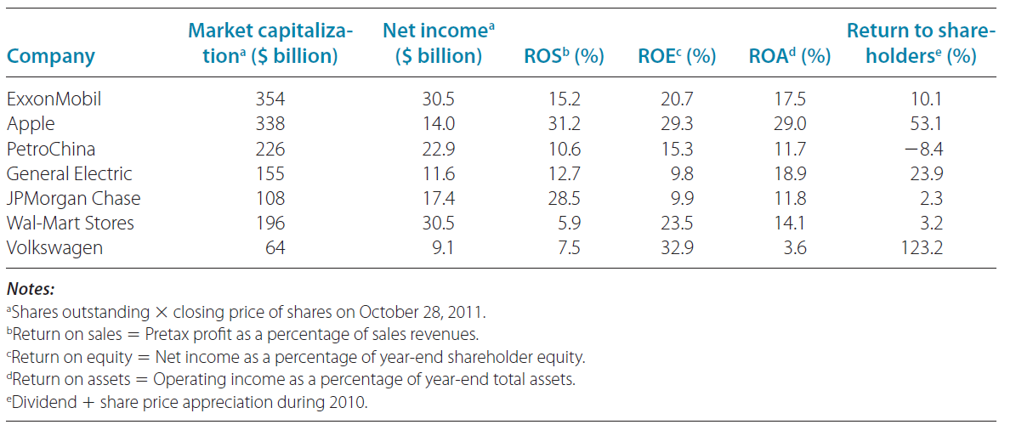
How do the World’s Leading Companies Perform Using Different Profitability Measures?
© 2013 Robert M. Grant
www.contemporarystrategyanalysis.com

Slide 6
From Profit Maximization to Value Maximization
Profit maximization an ambiguous goal
Total profit vs. rate of profit
Over what time period?
What measure of profit?
Accounting profile vs. economic profit (e.g. Economic Value Added: Post-tax operating profit less cost of capital
Maximizing the value of the firm
Max. net present value of free cash flows:
Where:
V = market value of the firm
C_{t} = free cash flow in time t
r = weighted average cost of capital
© 2013 Robert M. Grant
www.contemporarystrategyanalysis.com

Slide 7
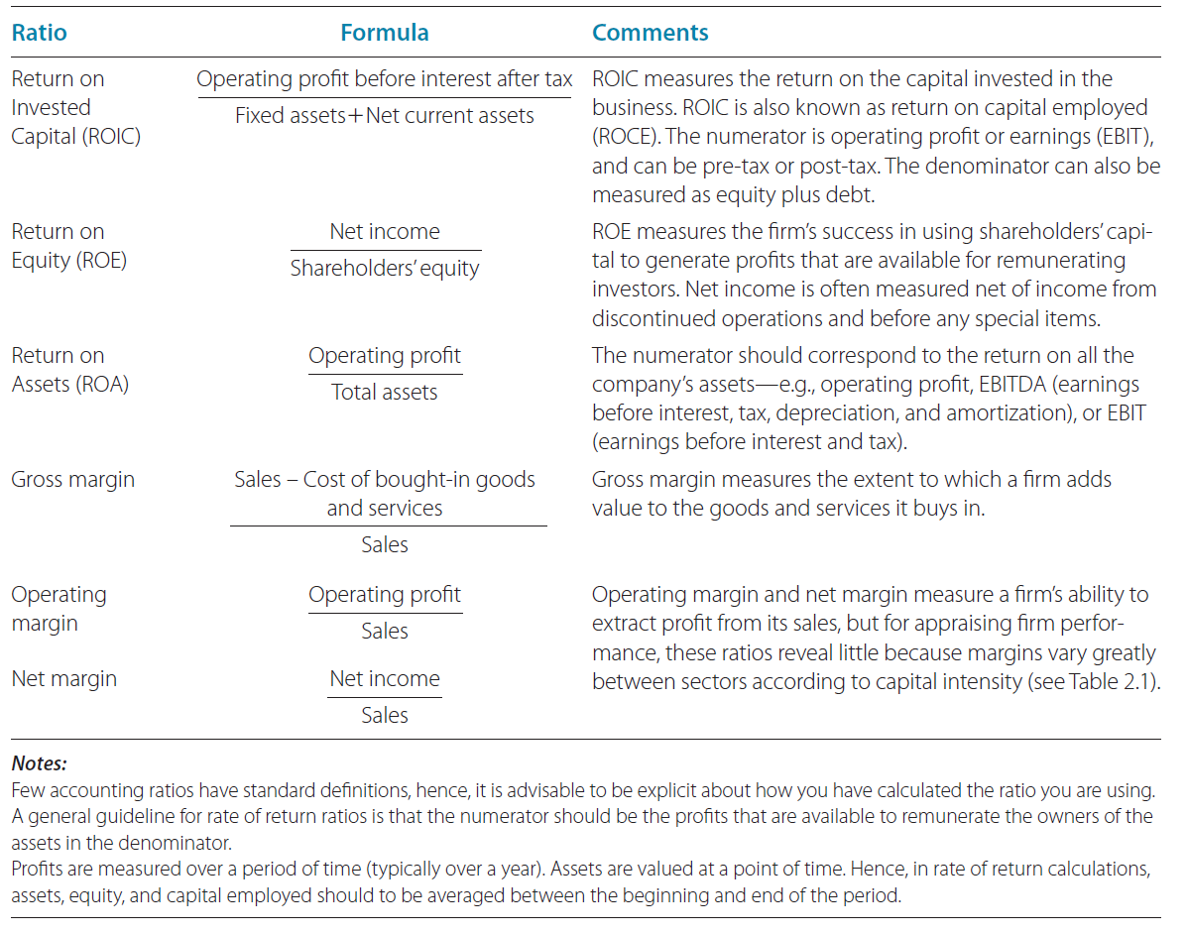
Profitability Ratios
© 2013 Robert M. Grant
www.contemporarystrategyanalysis.com

Slide 8
Shareholder Value Maximization and Strategy Choice
The value maximizing approach to strategy formulation
Identifying strategy alternatives
Estimate cash flows associated with cash strategy
Estimate cost of capital for each strategy
Problems:
Estimating cash flows beyond 2-3 years is difficult
Value of firm depends on option value as well as DCF value
Implications for strategy analysis
Some simple financial guidelines for value maximization:
On existing assets: Maximize after-tax rate of return
On new investment: Seek rate of return > cost of capital
Utilize quantitative strategy analysis to evaluate future profit potential
© 2013 Robert M. Grant
www.contemporarystrategyanalysis.com

Slide 9
Value Companies and Business Units
If net case flow growing at constant rate (g)
V = C₁ _
( r - g )
With varying cash flows which can be forecasted for 4 years:
V = C₀ + C₁ + C₂ + C₃ + V_{H} __
(1 + r ) (1 + r )² (1 + r )³ (1 + r )³
Where V_{H} is the horizon value of the firm after 4 years
© 2013 Robert M. Grant
www.contemporarystrategyanalysis.com

Slide 10
The Six Layers of Financial & Real Options
Financial options
Real options
Comments
Present value of
returns to the
investment
The greater the NPV, the
higher the option value
Stock price
=
Exercise price
=
Investment cost
The higher the cost, the
lower the option value
OPTION
VALUE
Uncertainty
=
Uncertainty
Higher volatility
increases option values
Time to expiry
Duration of option
Time = opportunity to
learn about outcomes
=
Dividends
Value lost over
duration of option
Loss of cash flow to fully
-committed competitors
lowers option value
=
Risk-free
Interest rate
Risk-free
interest rate
Higher interest rate
increases option value
by increasing value of
deferring investment
=
© 2013 Robert M. Grant
www.contemporarystrategyanalysis.com

Slide 11
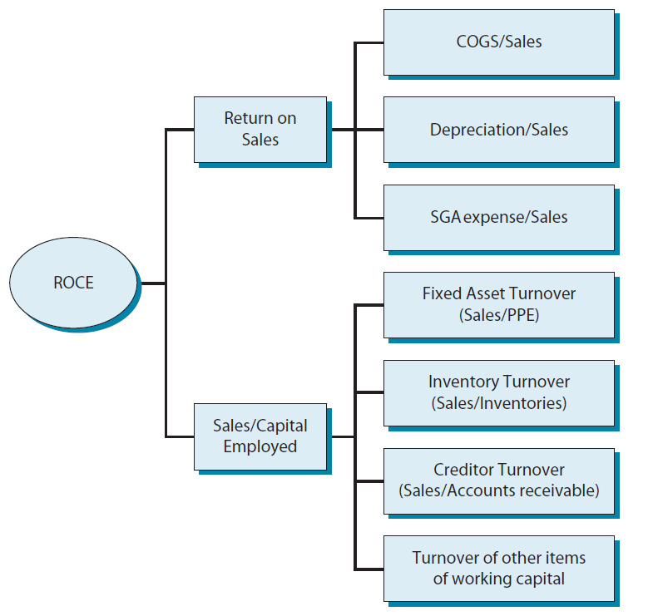
Performance Diagnosis:
Disaggregating Return on Capital Employed
© 2013 Robert M. Grant
www.contemporarystrategyanalysis.com

Slide 12
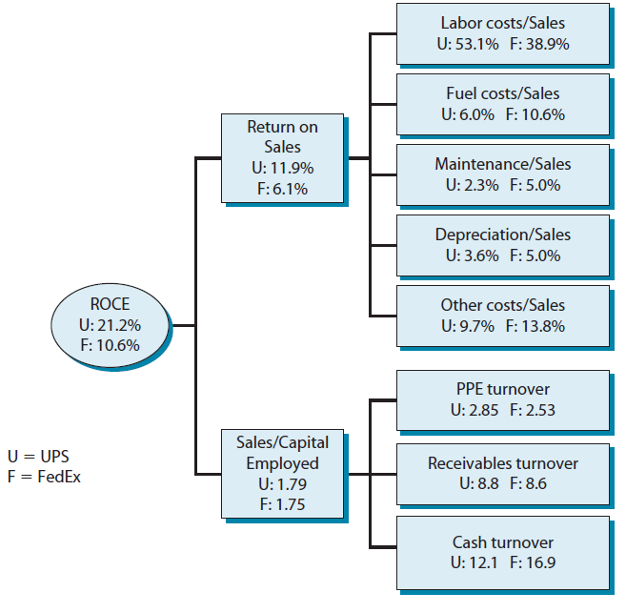
Example of Performance Diagnosis: Disaggregating ROCE for UPS (U) & FedEx (F)
© 2013 Robert M. Grant
www.contemporarystrategyanalysis.com

Slide 13
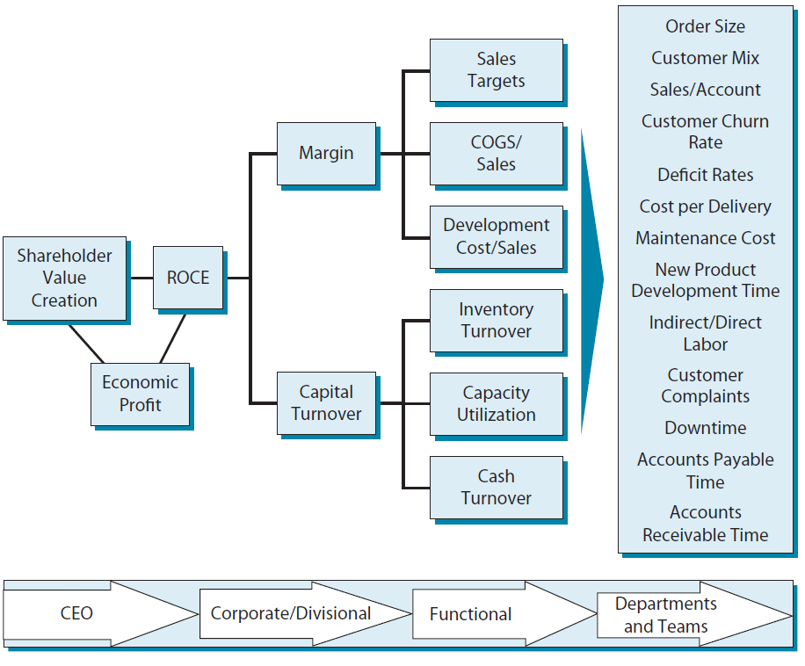
Setting Performance Targets: Linking Value Drivers to Performance Targets
© 2013 Robert M. Grant
www.contemporarystrategyanalysis.com

Slide 14
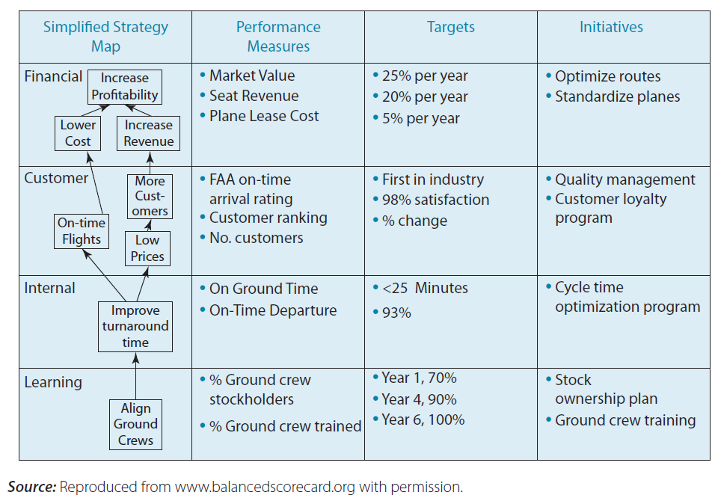
Setting Performance Targets: Balanced Scorecard for a Regional Airline
© 2013 Robert M. Grant
www.contemporarystrategyanalysis.com

Slide 15
Pitfalls of Pursuing Financial Targets:
The Paradox of Value
Empirical research shows that firms which are most successful in creating long-term shareholder value
Have a mission – They give precedence to goals other than profitability and shareholder value
Have strong, consistent, ethical values
Examples:
“Visionary” companies studied by Collins & Porras, e.g. Merck, Wal-Mart, Proctor & Gamble, Disney, HP
Boeing
Focus pre-1996: “To build great planes”, weak financial controls, yet high profitability
Focus 1997-2003: “Creating shareholder value”. Outcome: loss of market leadership, declining profitability
Lesson:
Profit is created not by pursuing profit but by pursuing the factors that create profit
© 2013 Robert M. Grant
www.contemporarystrategyanalysis.com

Slide 16
Beyond Profit:
Corporate Social Responsibility
Even if we believe that the primary objective of the firm should be long-run profit maximization, no firm can ignore its relationship with society. For survival and success a firm needs to:
Maintain its reputation
Ensure that it has a license to operate
Be sensitive to its external environment – including its social, political and natural environments
Michael and Mark Kramer argue that firms should re-conceptualize their businesses towards the creation of “Shared Value”: “creating economic value in a way which also creates value for society” This requires the firm to recognize its co-dependence with its natural and social environment.
© 2013 Robert M. Grant
www.contemporarystrategyanalysis.com

Slide 17
Beyond Profit:
Strategy as Options Management
In an uncertain world, strategy is increasingly about creating and managing options
Two major types of option:
Growth options: Small investments to create opportunities for bigger investments
Flexibility options
Valuing options:
Black-Scholes formula for valuing financial options can also be applied to real options (e.g. option value rises with greater volatility, more time, higher project value, higher interest rates)
Binomial pricing model creates an event tree for a project that can be converted into a decision tree which allows project value to be calculated subject to options to abandon the project
© 2013 Robert M. Grant
www.contemporarystrategyanalysis.com

