Slide 1
Chapter 5 Analysing Resources & Capacities
Prof. Luciano Thomé e Castro

Slide 2
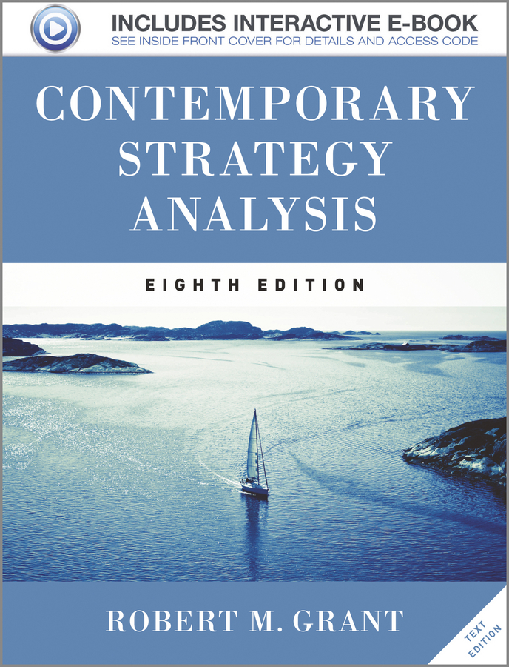
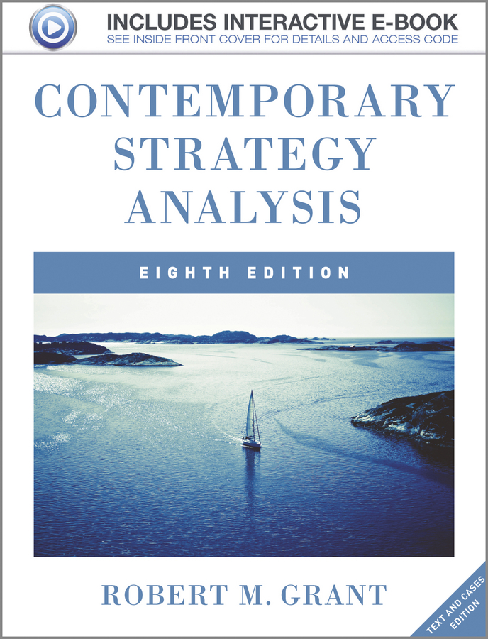
© 2013 Robert M. Grant
www.contemporarystrategyanalysis.com

Slide 3
Analysing Resources & Capacities
OUTLINE
The role of resources and capabilities in strategy formulation
Identifying resources and capabilities
Appraising resources and capabilities
Developing strategy implications
© 2013 Robert M. Grant
www.contemporarystrategyanalysis.com

Slide 4
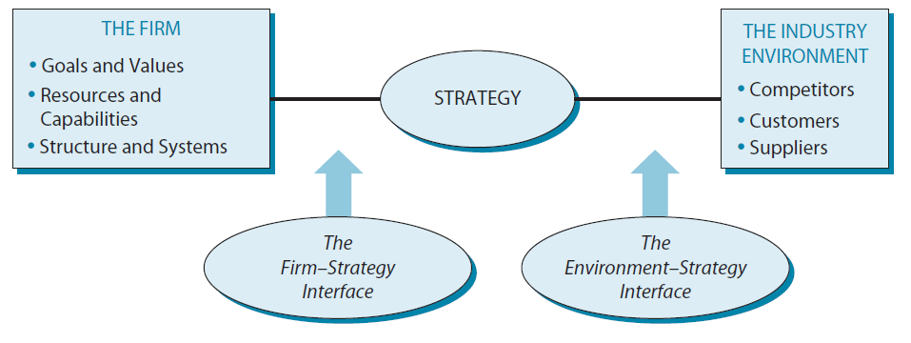
Shifting the Focus of Strategy Analysis: From External to Internal Environment
© 2013 Robert M. Grant
www.contemporarystrategyanalysis.com

Slide 5
Rationale for Resource-Based
Approach to Strategy
When the industry environment is volatile, internal resources and capabilities offer a more stable basis for strategy than an industry or market focus
Resources and capabilities are the primary sources of profitability
© 2013 Robert M. Grant
www.contemporarystrategyanalysis.com

Slide 6
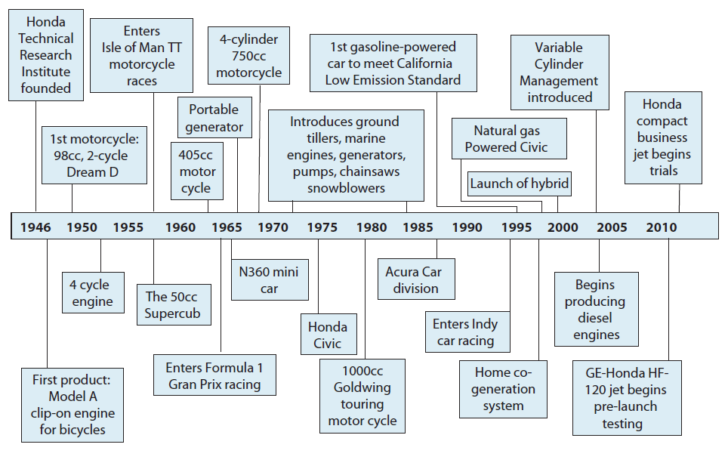
Project-Based Evolution at Honda Motor Company
© 2013 Robert M. Grant
www.contemporarystrategyanalysis.com

Slide 7
Canon: Products & Core Technical Capabilities
Precision
Mechanics
Fine
Optics
35mm SLR camera
Compact fashion camera
EOS autofocus camera
Digital camera
Video still camera
Video security systems
Camcorders
Plain-paper copier
Color copier
Color laser copier
Laser copier
Basic fax
Laser fax
Scanners
Mask aligners
Excimer laser aligners
Stepper aligners
Binoculars
Inkjet printer
Laser printer
Color video printer
Digital commercial
printer
Micro-
Electronics
Calculator
Notebook computer
© 2013 Robert M. Grant
www.contemporarystrategyanalysis.com

Slide 8
3M: Evolution of Products & Capabilities
Sandpaper
Road signs
& markings
Videotape
Carborundum
mining
Floppy disks &
data storage
products
Scotch tape
Audio tape
PRODUCTS
Acetate
film
Post-it notes
Housewares/kit-
chen products
Surgical tapes
& dressings
Pharmaceuticals
Materials sciences
CAPABILITIES
Flexible
circuitry
Health sciences
Microreplication
Thin-film
technologies
New-product
development &
introduction
Abrasives
Adhesives
© 2013 Robert M. Grant
www.contemporarystrategyanalysis.com

Slide 9
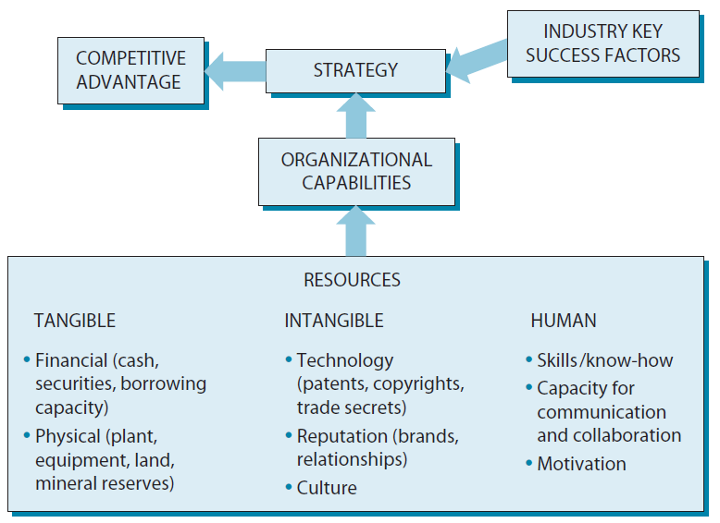
The Links Between Resources, Capabilities & Competitive Advantage
© 2013 Robert M. Grant
www.contemporarystrategyanalysis.com

Slide 10
Appraising Resources
Resource |  | Characteristics | Indicators
Tangible Resources | Financial | Borrowing capacity Internal funds generation | Debt/Equity ratio Credit rating Net cash flow
 | Physical | Plant and equipment: Size, location, technology flexibility. Land and buildings Raw materials | Market value of fixed assets. Scale of plants Alternative uses for fixed assets
Intangible Resources | Technology | Patent, copyrights, know how, R&D facilities Technical and scientific employees | No. Of patents owned Royalty income R&D expenditure R&D staff
 | Reputation | Brands. Customer loyalty, company reputation (with suppliers, customers, government) | Brand equity Customer retention Supplier loyalty
Human Resources |  | Training, experience, adaptability, commitment and loyalty of employees | Employee qualifications, Pay rates, turnover
© 2013 Robert M. Grant
www.contemporarystrategyanalysis.com

Slide 11
Large Companies with the Highest Ratios of Market Capitalization to Book Value, March 2012
Company | Ratio | Country of Listing
Hindustan Unilever | 31.51 | India
Colgate Palmolive | 19.25 | USA
Yum! Brands | 17.54 | USA
Altria | 16.76 | USA
Boeing | 15.4 | USA
Priceline | 13.36 | USA
Coach | 11.90 | USA
Amazon | 10.88 | USA
B.Sky Broadcasting | 10.83 | UK
GlaxoSmith Kline | 9.02 | UK
Tingyl | 8.49 | Hong Kong
Starbucks | 8.42 | USA
Company | Ratio | Country of Listing
Intuitive Surgical | 7.81 | USA
Br. American Tobacco | 7.71 | UK
Diageo | 7.37 | UK
Medco Health Solutions | 6.63 | USA
Infosys | 6.43 | USA
Apple | 6.22 | USA
Celgene | 5.99 | USA
Shire | 5.89 | UK
Nike | 5.25 | USA
SAP | 5.23 | Germany
Coca-Cola | 5.04 | USA
PepsiCo | 4.96 | USA
© 2013 Robert M. Grant
www.contemporarystrategyanalysis.com

Slide 12
The World’s Most Valuable Brands, 2011
Rank | Brand | Value $bn | Change from 2010 | Country of Origin
1 | Coca-Cola | 71.86 | + 2% | US
2 | IBM | 69.91 | + 8% | US
3 | Microsoft | 59.09 | - 3% | US
4 | Google | 55.32 | + 27% | US
5 | General Electric | 42.81 | + 0% | US
6 | McDonald’s | 35.59 | + 6% | US
7 | Intel | 35.22 | + 10% | US
8 | Apple | 33.49 | + 58% | US
9 | Disney | 29.02 | + 1% | US
10 | Hewlett-Packard | 28.48 | + 6% | US
11 | Toyota | 27.76 | + 6% | Japan
12 | Mercedes Benz | 27.45 | + 9% | Germany
13 | Cisco | 25.31 | + 9% | US
14 | Nokia | 25.07 | - 15% | Finland
15 | BMW | 24.55 | + 10% | Germany
16 | Gillette | 23.99 | + 3% | US
17 | Samsung | 23.43 | + 20% | South Korea
18 | Louis Vuitton | 23.17 | + 6% | France
19 | Honda | 19.43 | + 5% | Japan
20 | Oracle | 17.26 | + 16% | US
© 2013 Robert M. Grant
www.contemporarystrategyanalysis.com
Source: Interbrand

Slide 13
Identifying Organizational Capabilities:
A Functional Classification
Functional Area | Capability | Exemplars
CORPORATE FUNCTIONS | Financial control | ExxonMobil, PepsiCo
 | Management development | General Electric, Shell
 | Strategic innovation | Google, Haier
 | Multidivisional coordination | Unilever, Shell
 | Acquisition management | Cisco Systems, Luxottica
 | International management | Shell, Banco Santander
 | Corporate Social Responsibility | Johnson & Johnson, Danone
INFORMATION MANAGEMENT | Integration of IT with decision making | Wal-Mart, Capital One, Cemex
RESEARCH & DEVELOPMENT | Research capability | IBM, Merck
 | New product development | Apple, 3M
 | Fast-cycle new product development | Canon, Inditex (Zara)
OPERATIONS | Operational efficiency | Briggs & Stratton, UPS
 | Continuous improvement | Toyota, Wal-Mart
 | Flexibility and speed of response | Four Seasons Hotels
DESIGN | Product design capability | Apple, Alessi
MARKETING | Brand management | Procter & Gamble, Altria
 | Building reputation for quality | Johnson & Johnson
 | Responding to consumer requirements | L'Oréal, Amazon
SALES AND DISTRIBUTION | Effective sales promotion and execution | PepsiCo, Pfizer
 | Efficient, fast order processing | L. L. Bean, Dell Computer
 | Speed of distribution | Amazon.com
SERVICE | Customer service | Singapore Airlines, Caterpillar
© 2013 Robert M. Grant
www.contemporarystrategyanalysis.com

Slide 14
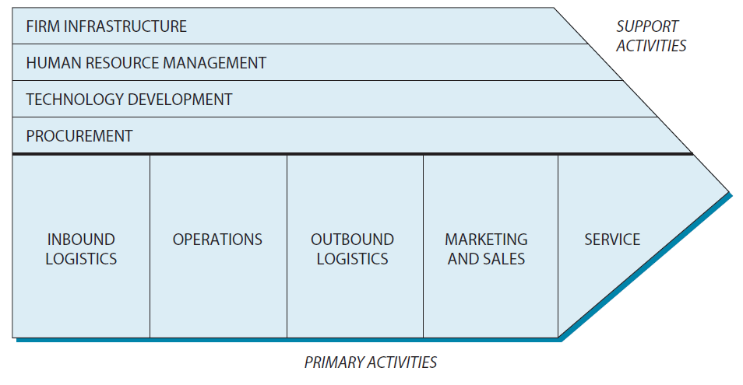
The Porter Value Chain
© 2013 Robert M. Grant
www.contemporarystrategyanalysis.com

Slide 15
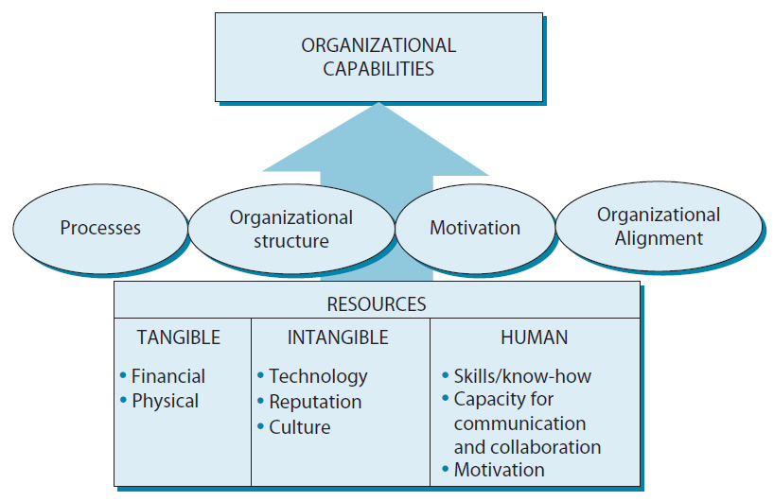
Integrating Resources to Create Organizational Opportunity
© 2013 Robert M. Grant
www.contemporarystrategyanalysis.com

Slide 16
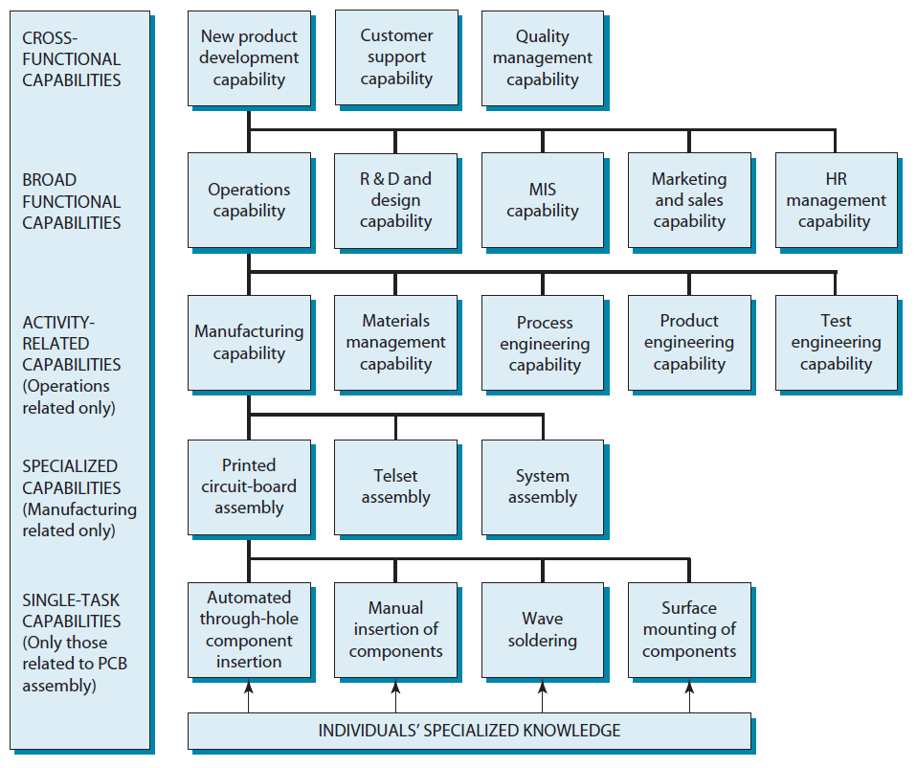
A Hierarchy of Capabilities:
A Telecom Manufacturer
© 2013 Robert M. Grant
www.contemporarystrategyanalysis.com

Slide 17
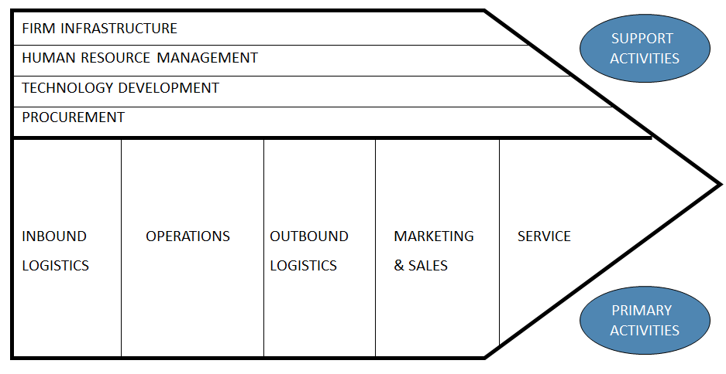
Two Approaches to Identifying an Organization’s Resources & Capabilities
Starting from the inside
Starting from the outside
Key Success factors
How do customers choose?
What do we need to survive competition?
What resources & capabilities do we need to deliver these KSFs?
© 2013 Robert M. Grant
www.contemporarystrategyanalysis.com

Slide 18
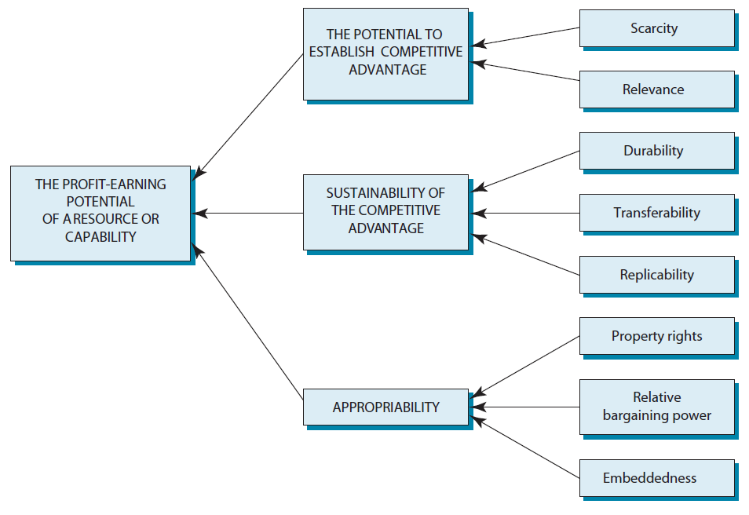
Appraising the Strategic Importance of Resources & Capabilities
© 2013 Robert M. Grant
www.contemporarystrategyanalysis.com

Slide 19
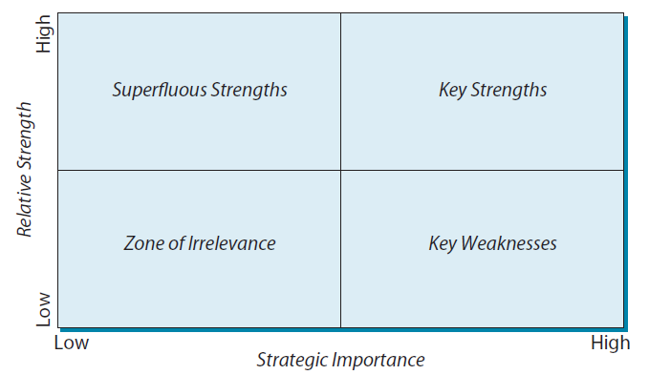
The Framework for Appraising
Resources & Capabilities
© 2013 Robert M. Grant
www.contemporarystrategyanalysis.com

Slide 20
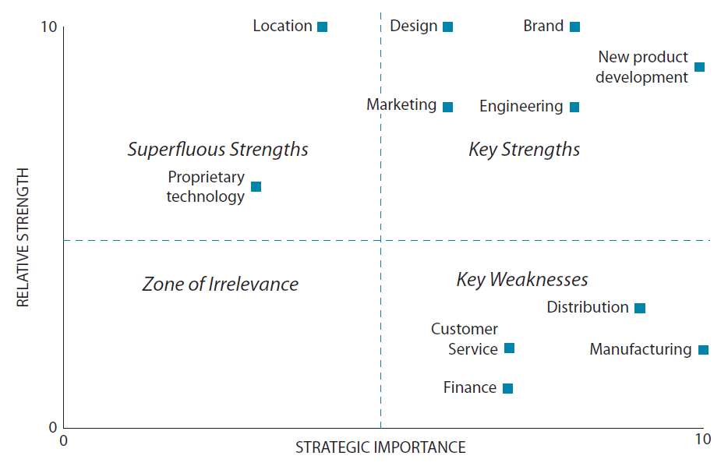
The Resources & Capabilities of
Ducati Motor
© 2013 Robert M. Grant
www.contemporarystrategyanalysis.com

Slide 21
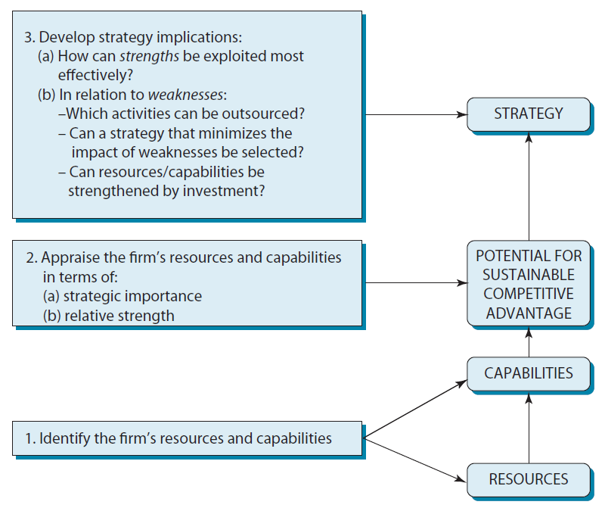
Summary: The Framework for Analyzing Resources and Capabilities
© 2013 Robert M. Grant
www.contemporarystrategyanalysis.com

