Slide 1
Chapter 15: Scenario planning: an alternative way of dealing with uncertainty
Decision Analysis for Management Judgment
Goodwin e Wright (4 ed.)

Slide 2
Introduction
Scenario planning is an alternative way of dealing with uncertainty than that encapsulated in decision analysis.
This chapter outlines the conceptual approach, step-by-step guide to scenario construction and we can evaluate decisions against scenarios of plausible futures.
How scenario planning can be combined with SMART approach to decision making with multiple objectives.
Notes:
Obs: They had a list of predictions (arranged in order of probability), none had as first option the prediction that he would attack, others believed he was bluffing, only a few said the opposite but kept their silence cuz of bureaucratic pressures.
Consideration was only devoted to those events seen as most likely. In the groupthink decision makers made up their minds what was going to happen.

Slide 3
Introduction
The practice of scenario planning implicitly accepts that managers are not able to make valid assessments of the likelihood of unique future events and that “best guesses” of what the future holds may be wrong.
A scenario is not a forecast of the future. Multiple scenarios are pen-pictures of a range of plausible futures.
Scenario focus on key uncertainties and on certainties about the future, and they use this information to construct pen-pictures in an information-rich way to provide vivid descriptions of the future.
Essentially, scenarios highlight the reasoning underlying judgments about the future and give the explicit attention to sources of uncertainty without trying to turn an uncertainty into a probability (So, it’s important to consider trends and the behavior of actors in the future)

Slide 4
Scenario construction: the extreme world method
Steps:
Identify the issue of concern and the horizon year which will be captured in the scenarios.
Identify predetermined trends that have some degree of impact on the issue of concern.
Identify critical uncertainties; when resolved (one way or other) have some degree of impact on the issue of concern.
Identify the degree to which trends and resolved uncertainties have a positive or negative impact on the issue of concern.
Create extreme words by putting all positively resolved uncertainties in one scenario and all negatively resolved uncertainties in the other.
Notes:
Obs: Key issues often concern the survival and viability of an organization, or one of its division, in an environment that is known to be changing (and which may change in a way as to be inhospitable to that organization with its current competencies and core abilities).

Slide 5
Scenario construction: the extreme-world method
Steps:
Add the predetermined trends to both scenarios.
Check for internal coherence. Could the trends and resolved uncertainties coexist in a plausible future scenario?
Add in the actions of individuals and/or organizations who will be impacted by the future described in a scenario. What actions would they take/have taken to satisfy their own interests?

Slide 6
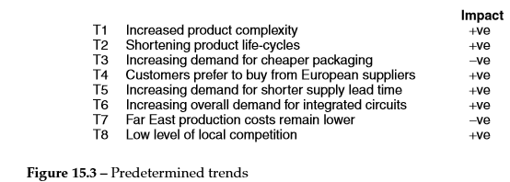
Scenario construction: the extreme-world method
Ex: The key issue of concern is the survival and profitability of a European-based semiconductor manufacturing co.
Decision Analysis for Management Judgment Goodwin e Wright (4 ed), page 381.
Notes:
Predetermined elements and trends as seen by the company’s key personnel and their impacts on the survival and profitability of the semiconductor manuf. Co.

Slide 7
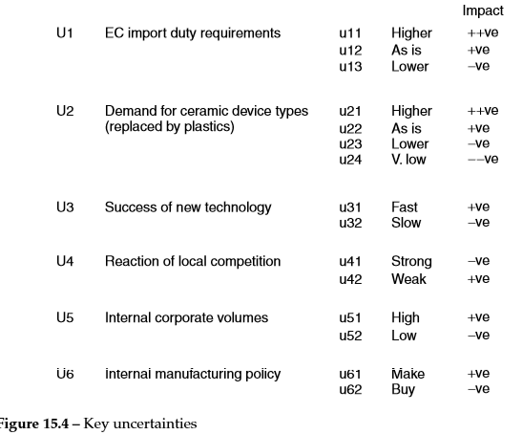
Scenario construction: the extreme-world method
Decision Analysis for Management Judgment Goodwin e Wright (4 ed), page 381.
Notes:
Note that uncertainty u11 and u42 are to some degree internally incoherent (incompatible) with one another. If EC import duties were high then reaction of local competition (i.e. from within EC) will not be weak! Therefore, this particular combination of resolved uncertainties is not described in the scenarios since it’s plausible.

Slide 8
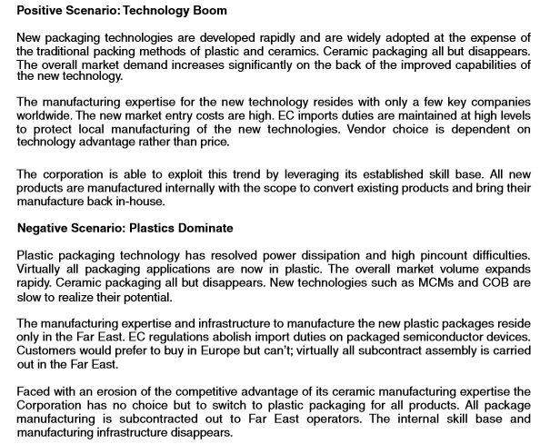
Decision Analysis for Management Judgment Goodwin e Wright (4 ed), page 382.
Notes:
Positive impact uncertainties and all the predetermines are clustered together and a ‘storyline’ is developed, that interlinks as many of these elements as possible. The focus is on developing a plausible chain of events that is, in some degree, causally related and which shows how the future will unfold to result in the end-state captured within the horizon year of the particular scenario. The same is repeated for the negative scenario.
This example scenarios aren’t fully developed since the reaction of the Far East producers of plastic packing to the “Technology Boom” scenario has not been thought trought and incorporated.

Slide 9
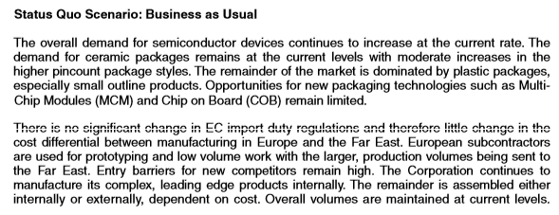
Scenario construction: the extreme-world method
Decision Analysis for Management Judgment Goodwin e Wright (4 ed), page 382.
Notes:
It’s an extrapolation of the present

Slide 10
Using scenarios in decision making
First to test the viability of a current business idea against the plausible futures represented in the scenarios.
Business idea: the systemic linking of the business competencies and strengths. Overall, a business idea should specify three major elements of a business’s attempt to be successful:
The competitive advantage which is aimed to (a product that is differentiated from its competitors).
The distinctive competences on which 1 is based (i.e. an ability to attract top national academics).
The growth mechanism (a positive feedback loop).
Notes:
We can built the strengths summarized in a short statements. The impact of deployment of these strengths produces revenue and the reinvestment of the revenue produced into a self-reinforcing cycle or positive feedback loop that would in a stable environment, be a robust business idea that would be less and less replicable by competitors over a period of time.
Business idea is like a design of a airplane. Scenarios are like wind conditions (some are more extreme but all are plausible). Under some wind conditions the airplane may be harder to keep airborne than other, but essentially the business idea should be robust.

Slide 11
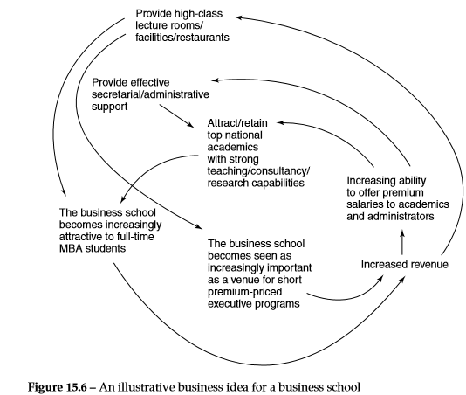
Decision Analysis for Management Judgment Goodwin e Wright (4 ed), page 384.
Notes:
Some aspects can weaken the positive feedback loop for the school (utilization of school’s revenue to support financially weaker academics areas)
But other external environment, like the technological developments enabled students to engage in video conferencing with internationally recognized academics across the world and that new technologies were easy to deploy into the students’ own homes then, perhaps, the current business idea would appear less robust (with its emphasis on employing full-time academics and providing attractive learning environments for students who are able to physically attend the business school).

Slide 12
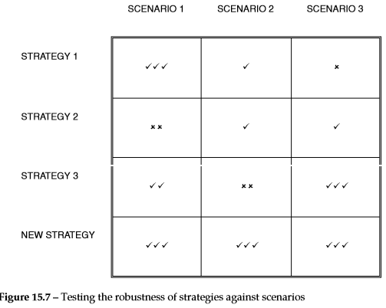
Using scenarios in decision making
The second way to use scenarios in a decision process is to evaluate lower-level strategies or decisions.
Essentially, a current strategy, a contemplated strategy or a range of strategies can be evaluated for robustness against constructed scenarios. Often no one strategy performs well against the whole range of constructed scenarios.
Notes:
Ex: Business school (might be an evaluation of decision to focus on R&D investment in producing CDs versions of course materials. For the semiconductor manufacturing co. it might be a decision to maintain or increase the investment in new ceramic packaging strategy production tech.
We can see that strategy 1 maximizes the minimum payoff (the maximin criterion, Chpt 5) and would be the most robust choice if we consider that it was not possible to say that one scenario was more likely than another

Slide 13
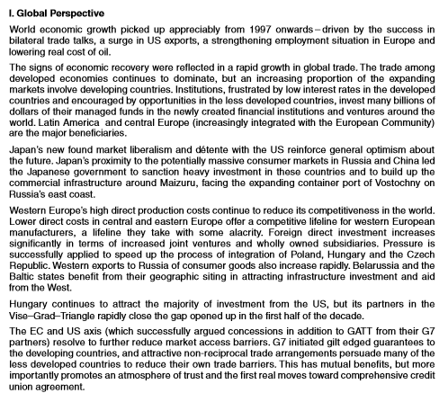

Slide 14
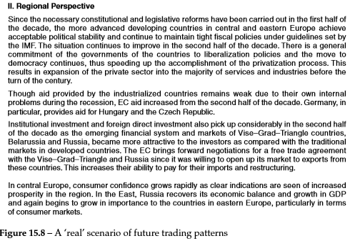
Decision Analysis for Management Judgment Goodwin e Wright (4 ed), page 386.
Notes:
This Real Scenario was one of several constructed for a corporation which was involved in moving raw materials and finished goods around the globe. Obs: The company was concerned with the (re)alocation of its major depots, so that they would be at the hubs of future trading network.

Slide 15
Using scenarios in decision making
The corporation tested the robustness of choice of alternative countries and cities against the scenarios.
Several cities which were not in the choice set prior to the scenarios construction became favorites in the subsequence decision process, since they were found to be robust against a range of plausible future world trading patterns.
Obs: These trading patterns were encapsulated and bounded by the scenarios that were constructed to capture the range of plausible futures.

Slide 16
Using scenarios in decision making
So far we have described one method to bound these futures, using an extreme positive scenario and an extreme negative scenario, a neutral, status quo or “business ass usual” scenario.
The problem is that presenting the decision maker with such extreme worlds since their very extremeness may cause doubts among their clients (the business managers) about their plausibility.

Slide 17
Scenario construction: the driving forces method
As before, we have that the critical elements in the decomposition process are predetermined and uncertainties.
However, in the driving forces method, degrees of predictability and uncertainty are allowable and the outputs of the scenario construction are not, usually, extreme scenarios.
Notes:
The output scenarios from this method also bound the perceived uncertainties in a similar way to the scenarios produced in the last method (extreme-world scenario construction)

Slide 18
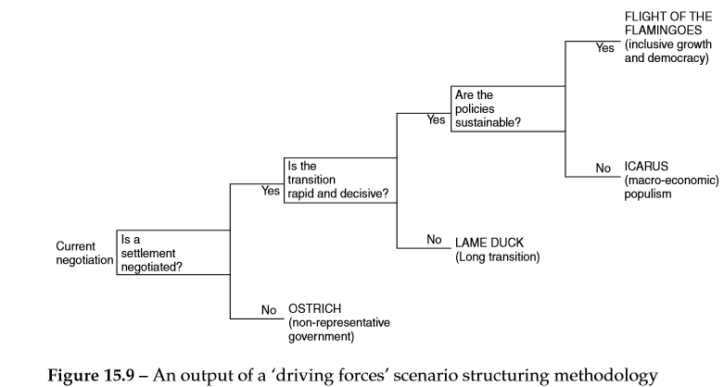
Decision Analysis for Management Judgment Goodwin e Wright (4 ed), page 388.
Notes:
This is an example of four scenarios for the (then) future of South Africa, which are driven by the forces whether or not there’s a negotiation settlement:
-whether or not the transition to majority rule is rapid
-whether or not the economic policies of majority government are short or long term.
The horizon year of the scenarios is 2002.

Slide 19
Scenario construction: the driving forces method
These scenarios of the social and political environment in South Africa would be useful to an international company which was considering three decision options:
Whether to maintain/reduce or increase its investments and overall presence in South Africa.

Slide 20
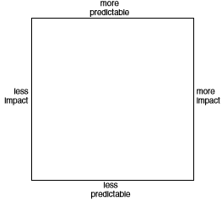
Key steps in the driving forces method
Identify the issue of concern and the horizon year which will be captured in the scenarios.
List all elements related to the issue of concern (“post-it”), including the names of stakeholders.
Post each “post-it” on the scenario structuring space, in a relation to its perceived predictability/unpredictability and low/high impact on the issue of concern.
Notes:
Obs: Many of the elements that emerge will address the external environment (predetermined and uncertainties) and they are not under the control of the individual, group or organization whom they’ll affect. These are the elements that it may be appropriate to incorporate in the scenarios and they should be carried forward to step 3. The elements individual, group or organization can control are decision or strategy options. Since decisions and strategies are to be evaluated against the scenarios at the final step, these decision options should be removed at step 2. They will be reconsidered in the final step when evaluated for robustness against the range of construced futures.

Slide 21
Key steps in the driving forces method
Focus on the “post-it” in low/high impact predictability events (bottom right-hand corner). Try to cluster these into groups of interrelated events such that all the “post-its” in one grouping are interrelated among themselves but unrelated to other groupings.
From these clusters try to identify a smaller number of underlying “driving forces” that link these uncertainties/events at a deeper level.
From the “driving forces” identified which two or three would really make a difference to the decision maker and his/her business?

Slide 22
Key steps in the driving forces method
For each “driving force” try to capture the range of outcomes by two extremes.
Try to think combinations one by one of the extremes of the driving forces. From these, develop the skeletons of three or four scenarios. Then select short “catchy” names to identify the essence of the scenarios.
Inspect each “post-its” in the three other quadrants of the scenario structuring space. Place these elements into one or more of the skeletons scenarios created, to flesh them out. Note that elements in the top left quadrant could, in principle, appear in any skeleton scenarios, if not consider their coherence in each scenario.

Slide 23
Key steps in the driving forces method
Develop each scenario “storyline”. To get started you can place all the elements within a scenario along a “timeline” considering today’s point in time and ends at the point in time captured in the scenario horizon year. Storylines are more plausible when (some) elements are causally related. Time precedence is often a good cue to potential causality.
Review the scenarios in light of their utilization of the original elements. Are all the high/low impact predictability elements bounded by the range of scenarios that have been constructed? If not, consider building more scenarios to capture and structure the remaining elements in the quadrant.
Evaluate the business idea or strategic options against the futures represented in the scenarios.

Slide 24
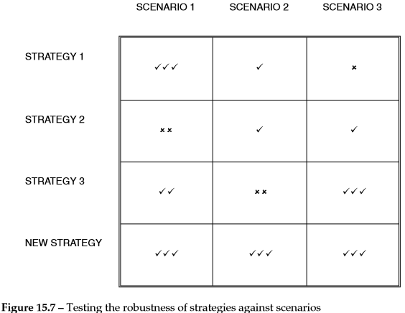
Outputs in the driving forces method
The outcome of the decision process in scenario planning is not the selection of option with the highest expected value or utility, but the selection of the most “robust” decision in face of an unpredictable future.

Slide 25
Outputs in the driving forces method
An additional focus is on the generation of more robust decision options in order to reduce uncertainty. It is psychologically important for decision makers who tend to prefer certainty choice between risky options.
‘Trigger events’ will be seen as information among the stream of data that impacts upon the decision maker. World views can be communicated easily in an organization via the medium of the scenario ‘stories’. Once a story has been read and the reasoning underlying its unfolding understood, a future has been ‘rehearsed’.
Early recognition and reaction to an emerging future is seen, by some practitioners, as more useful than the creation of robust strategic options.
Notes:
Such sensitivity can lead to early contingency action towards unfavorable future.

Slide 26
Typical outcomes of the scenario planning process
Confirmation that business idea is sound or that new strengths need to be added to create more robustness
Confirmation that lower-level business choices are sound or that alternative new options are more robust
Recognition that none of the business options are robust, and, therefore, contingency planning against unfavorable futures is necessary
Sensitivity to the ‘early warning’ elements that are precursor of desirable and unfavorable futures

Slide 27
Case study of a scenario intervention in the public sector
Futures facing a local council in the UK. The issue of concern was identified as the role of the council in developing ‘information age’ and the horizon year for the scenario was 5 years hence.
The council was being directed by central government to provide ‘joined-up’ services. This meant that the service information and provision (such as education, health service, taxation, etc) would be provided in a customized way, rather than, as currently, where citizen has, herself, to achieve the joining up of service provision by initiating contact with the each provider.
Notes:
This is to show that scenario thinking can invoke early contingency action towards avoiding unfavorable futures. At the time of the scenario planning the public was increasingly expecting information and services to be structured and accessible to suit them, not the service providers! Also, there’s an increasing volume of electronic transations taking place between the public and private sector businesses (Internet baking and selling from local and distant vendors).
In this context the council was considering introducing call centers to attend the influx of telephone calls.

Slide 28
Case study of a scenario intervention in the public sector
During the scenario intervention, 5 clusters of high/low impact predictability events were identified:
Partner agendas – whether partner organizations share the values of the council, the commitment to involvement, willingness to share resources, etc
Information mapping and understanding the basics of business – how current systems relate knowledge management, can duplicate systems be integrated/eliminated?
Public ownership - is the commitment to involvement a solution or an ideology? Will the public be with the council? How does it relate to cultures of youth and the underclasses? Will participation be accepted by pressure groups?

Slide 29
Case study of a scenario intervention in the public sector
(iv) Central agencies as help hindrance – What’s the real agenda of central government? Does system centralization conflict with democracy?
(v) The opportunities and constraints offered by new technologies – What resource implications are there for the change process? What will be the macro-economic factors of relevance? How change will be managed and what will be the new organization design required to implement joined-up government in the future?

Slide 30
Case study of a scenario intervention in the public sector
For additional information, they interviewed a small number of external experts to present views on the limits of the future of information and communication technology (ICT), their application to public sector management and the nature of the governance and society.
The driving forces and polar outcomes were recorded separately and related by number coding, so they were clustered by the participants as a group with open discussion.
The participants defined the higher-level concepts encapsulated for each cluster, then ranked according to relative impact on the business. Also, they consider the perceived relative degree of unpredictability

Slide 31
Case study of a scenario intervention in the public sector
Then scenarios were created related with the fields of:
Created 4 plausible futures.
Develop the storyline over time for one of the scenarios.
Notes:
Obs: about the democratic process, participants saw unpredictability of impacts (like if the society will move to collectivism or not), and also if the new tech with the value creation would be adapted to human needs or not.

Slide 32
Case study of a scenario intervention in the public sector
The scenario approach to decision making in face of uncertainty contrasts with decision analytic approaches, because participants were able to consider plausible future scenarios prior to evaluating strategic options.
In decision analysis, options for action are determined first and outcomes are predicted upon the selected options (‘If we do this, what might happen?’)

Slide 33
Combining scenario planning and decision analysis
Decision analysis techniques based on methods like SMART and SMARTER can usefully complement scenario planning by formalizing the process of evaluating strategies (we avoid incomplete evaluation, too much attention to particular objectives, etc).
This may yield deeper insights and enhance the ability of planners to create and design strategies.

Slide 34
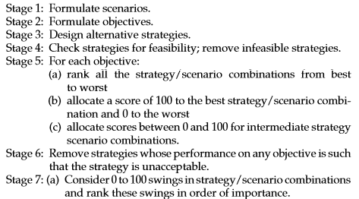
Combining scenario planning and decision analysis
The main stages of the approach:

Slide 35
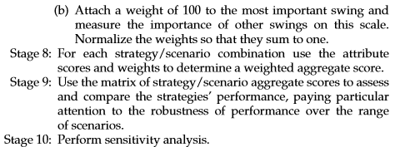
Combining scenario planning and decision analysis

Slide 36
Illustrative Case Study
This case study concerns a newly privatized national mail company that needs to formulate strategies with a 10-year planning horizon. Currently, it operates as a monopoly, but there is a possibility that in the future it will lose its monopoly position, while technological aspects pose long-term threats to the volume of letter mail.
Step 1: Formulate scenarios
Scenario 1: (DOG FIGHT) The company loses its monopoly. Rival companies take several years to develop their own delivery systems, but within five years there is keen competition on price, delivery times and reliability. Growth in the usage of electronic communications, particularly by direct marketing organizations leads to a large reduction in the total volume of paper mail which needs to be delivered. This reduction is exacerbated by poor economic conditions.
Scenario 2: (MAIL MOUNTAIN) The company retains its monopoly on letter delivery. Despite increases in the use of electronic communications, taxes levied on e-mail messages mean that paper mail remains popular. Buoyant economic conditions lead to increases in the volume of mail generated by direct marketing organizations. Increased ‘home working’ also leads to increases in the number of paper documents which need to be delivered by mail.

Slide 37
Illustrative Case Study
Step 2: Formulate objectives
The five objectives are identified:
short-term profit
(ii) long-term profit
market share
Growth
the flexibility of any strategy (adptation to the different conditions)
Step 3: Design alternative strategies
A - Continue with the current strategy of specializing in letter delivery, continuing to take advantage of increased mechanization where appropriate, by buying the technology from foreign suppliers (STATUS QUO).
B - Continue specializing in letter delivery, but allocate very large amounts of investment to R&D with the objective of becoming a world leader in letter sorting technology (R&D).
C - As A, but also diversify into electronic communications by becoming an Internet service provider and by seeking to merge with a telecommunications company (DIVERSIFY).

Slide 38
Illustrative Case Study
Step 4: Check strategies for feasibility
Strategies need to be screened to check that they are feasible (e.g. capable of being funded or capable of being supported logistically and technologically). In this case it is assumed that all three strategies are feasible.
Step 5: For each lower-level objective in the objectives hierarchy
rank all of the strategy-scenario combinations from best (1) to worst (6) in terms of performance against that objective
Objective: Maximize long-term profit
Objective: Maximize share of letter market
0 80
100
50 60
0 100
80 100
0 100
(b) Allocate a score of 100 to the best strategy-scenario combination and 0 to the worst.
(c) Allocate scores between 0 and 100 to represent the performance of intermediate
strategy-scenario combinations against the objective.

Slide 39
Illustrative Case Study
Step 6: Remove strategies whose performance on any objective, in any scenario, renders the strategy to be unacceptable
Note that removal of a strategy will necessitate a reallocation of scores
Step 7: (a) Compare 0 to 100 swings in strategy-scenario combinations for the objectives. Rank these swings in order of importance
b) Attach a weight of 100 to the most important swing and compare it with the importance of the other swings on a 0 to 100 scale
Weight Normalized weights
50
40 20
30 15
20 10
10 5
200 100

Slide 40
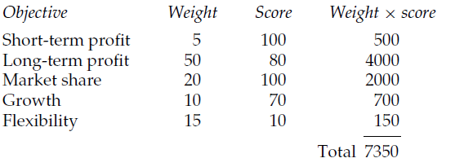
Illustrative Case Study
Step 8: Obtain an aggregate score for each strategy-scenario combination
Example considering the strategy STATUS QUO and MAIL MOUNTAIN scenario
It means, the aggregate score = 7350/100 = 73.5
Normalized
Step 9: Use the matrix to compare the strategies’ performance
Step 10: Perform sensitivity analysis

Slide 41
Conclusion
Scenario thinking can be used as a way to evaluate decision options and avoids the need to think probabilistically. It also allows a variety of viewpoints about the future (especially when dealing with uncertainty) with a range of plausible futures.
There’s two methods that can be applied: the extreme-world and the driving forces.
Construction of causal ‘storylines’ (more attractive to managers than decision trees and expected values or utilities).
The use of methods based on multi-attribute value analysis is likely to reduce the complexities of evaluating strategies against multiple objectives in multiple scenarios.
As a result we can have a more insightful approach to strategic decision making.

