Slide 1
A5-Metabolismo Bacteriano
Diferenciar anabolismo e catabolismo
ATP
Enzimas
Vias metabólicas

Slide 2
Chemical processes that form the basis of all cellular metabolism
Enzyme-mediated catalysis
Reaction coupling
Energy harvesting by redox reactions
organic substrates
inorganic substrates
photochemical reactions
Use of membranes to form charge gradients and chemical concentration

Slide 3
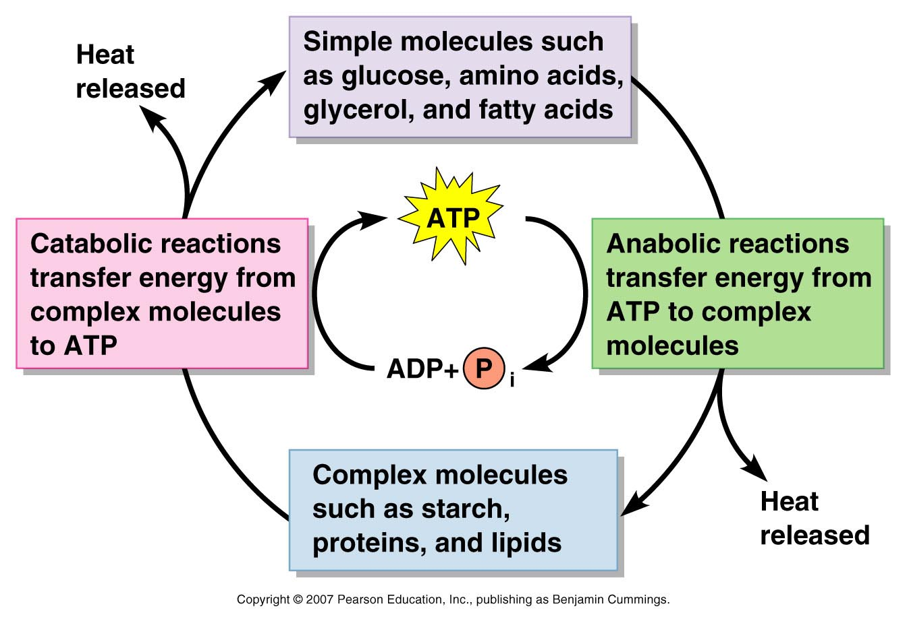
The role of ATP in coupling anabolic and catabolic reactions

Slide 4
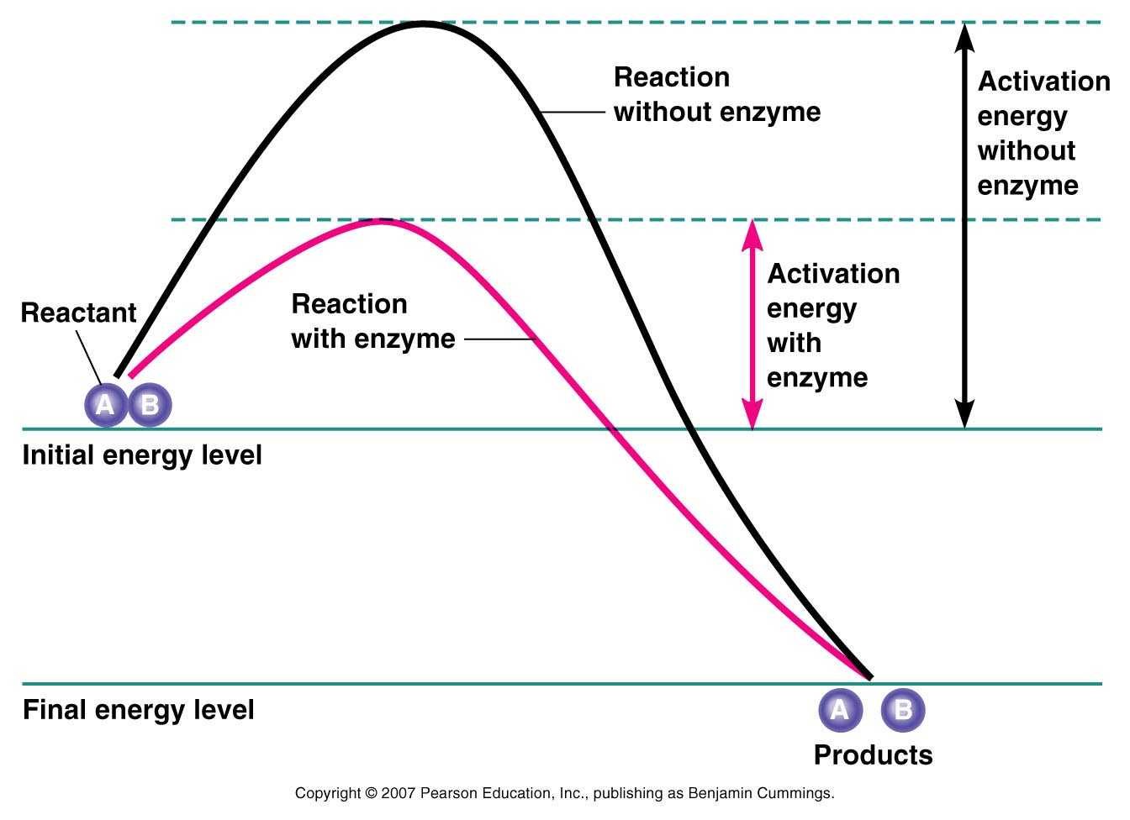
Energy requirements of chemical reaction

Slide 5
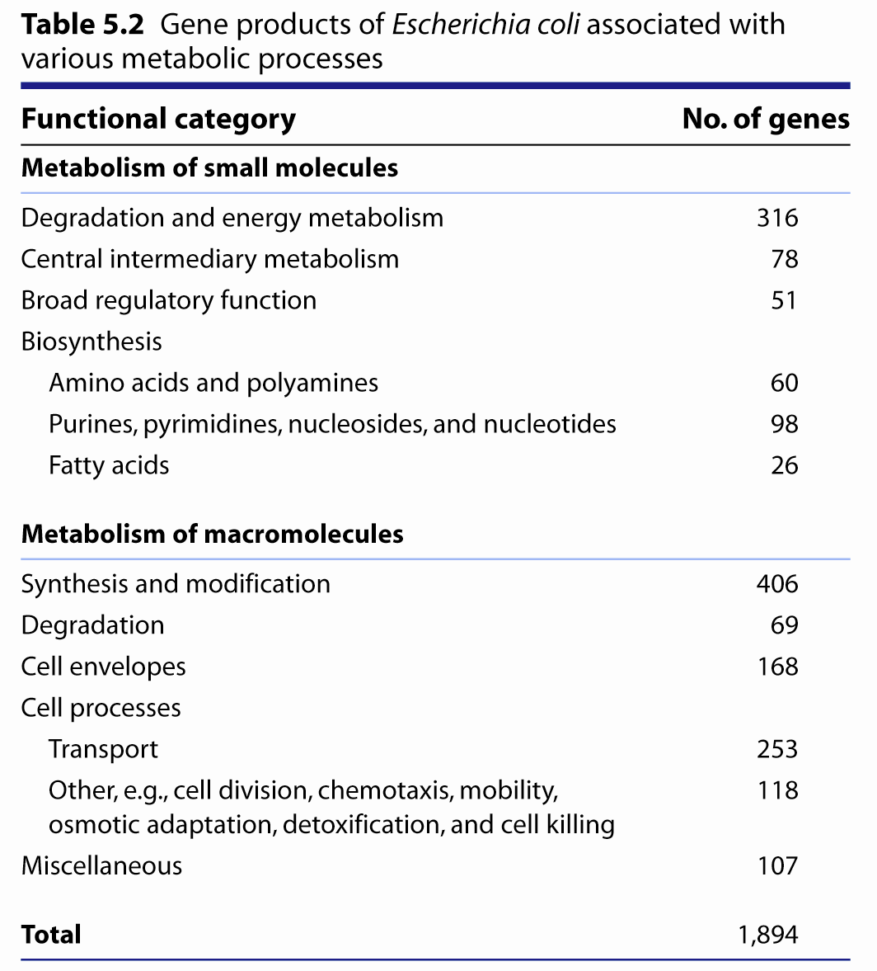

Slide 6
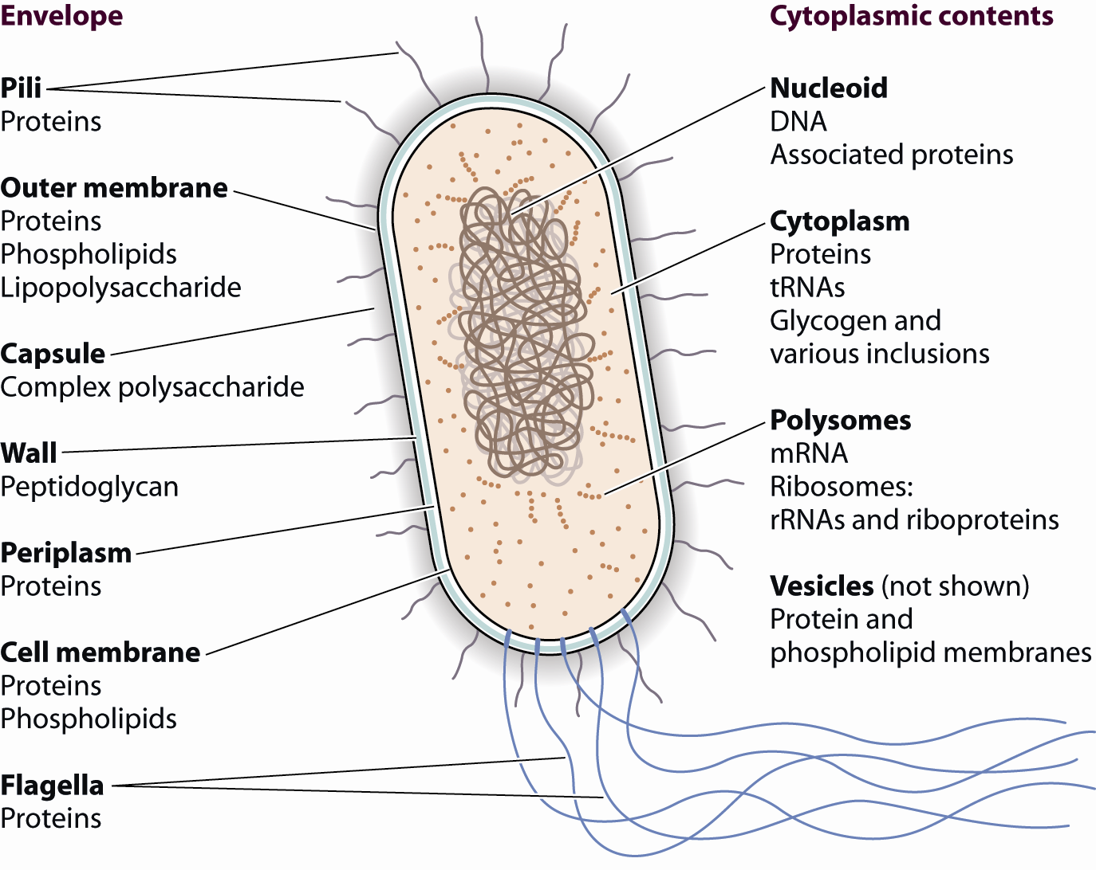

Slide 7
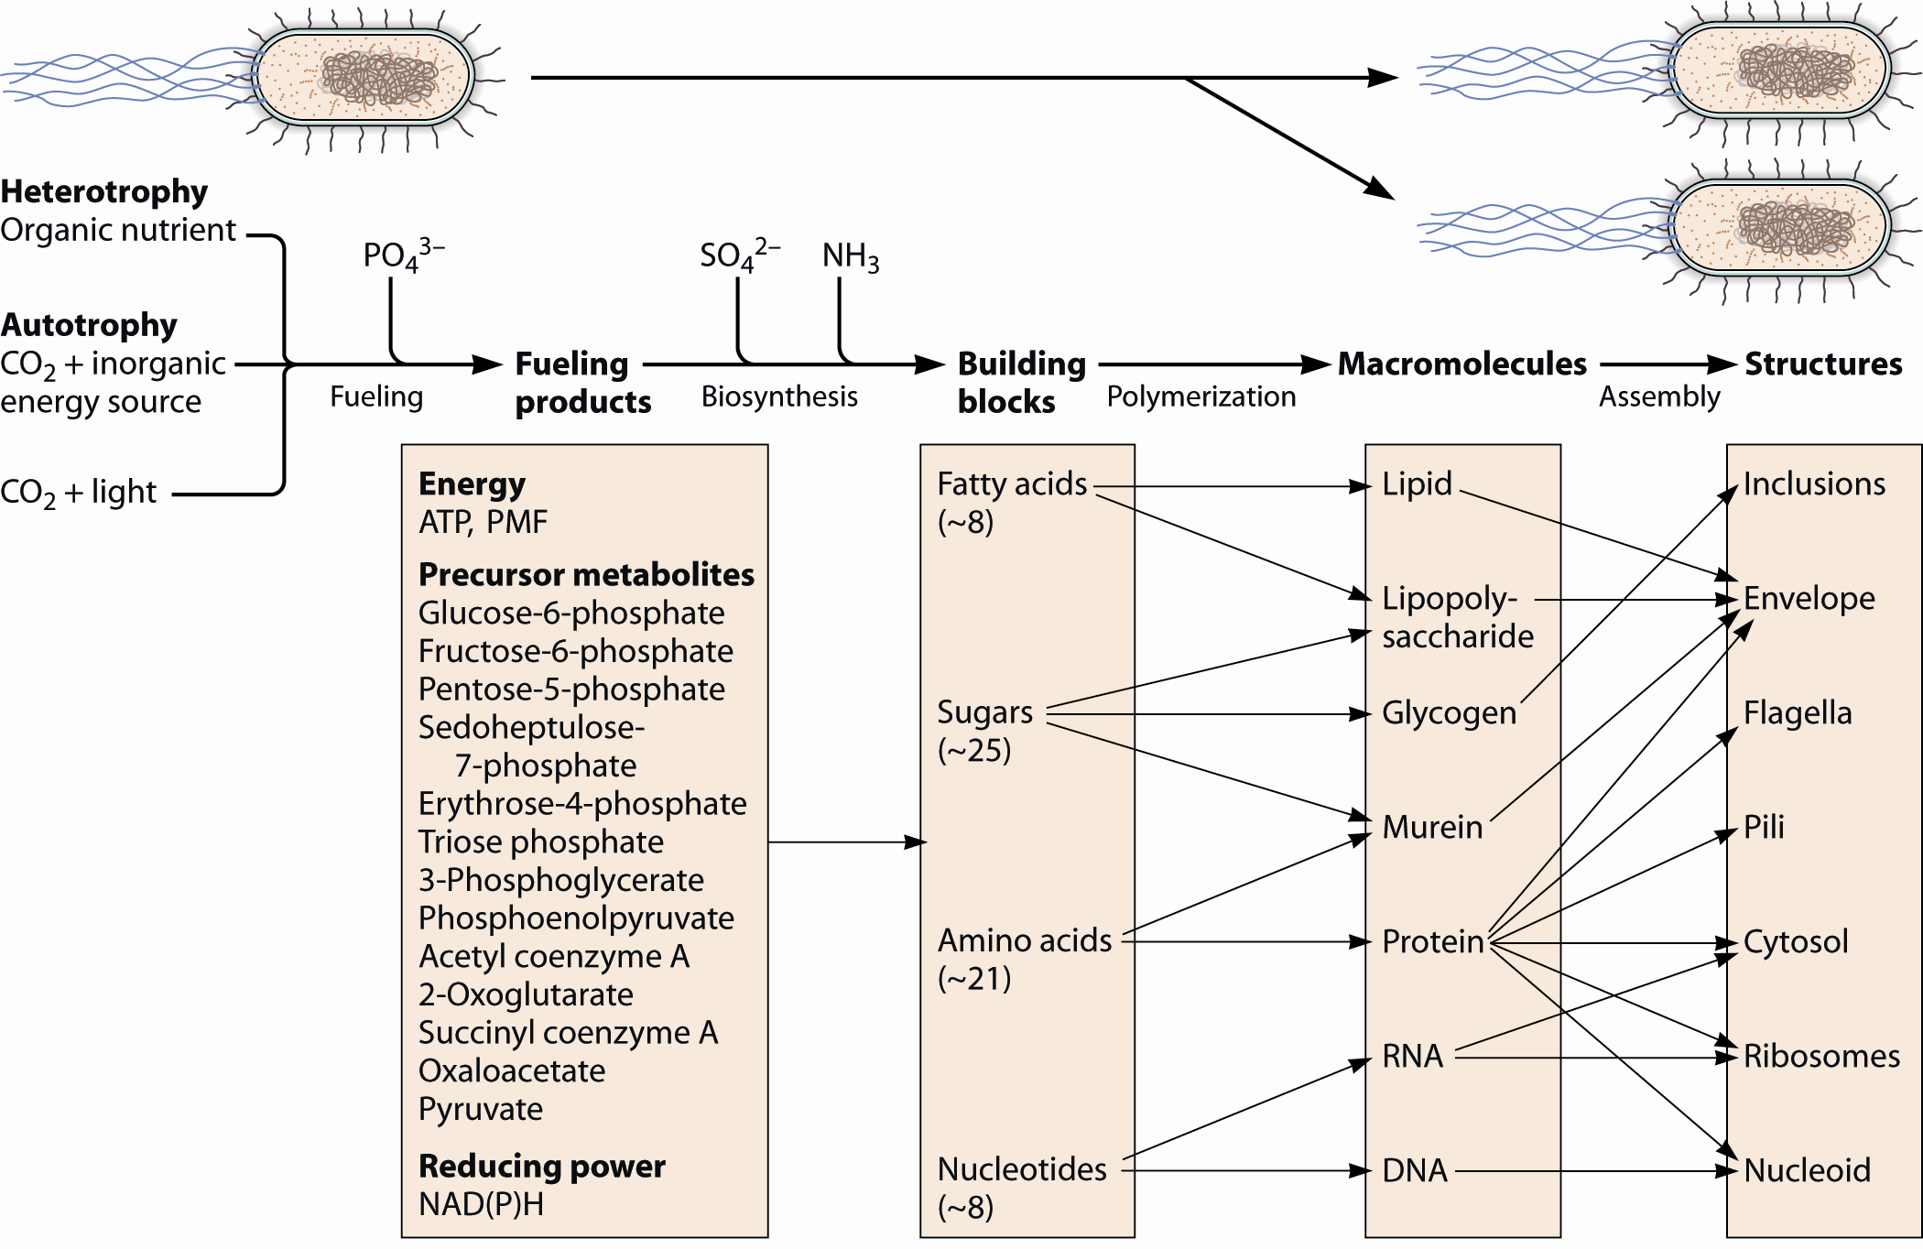

Slide 8
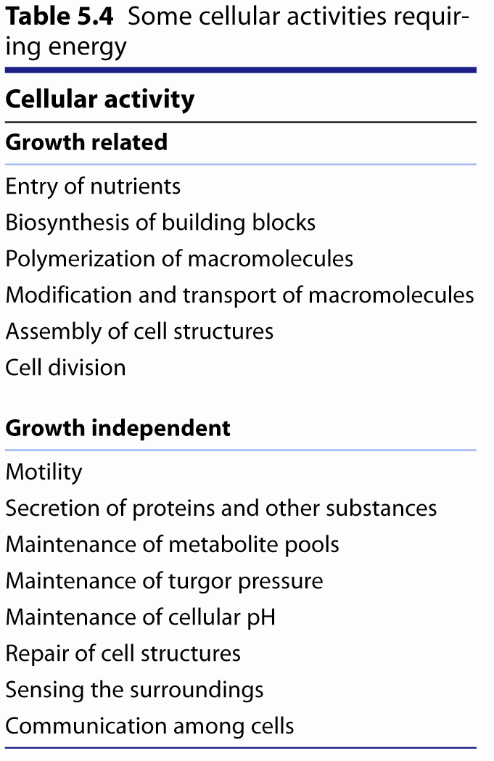

Slide 9
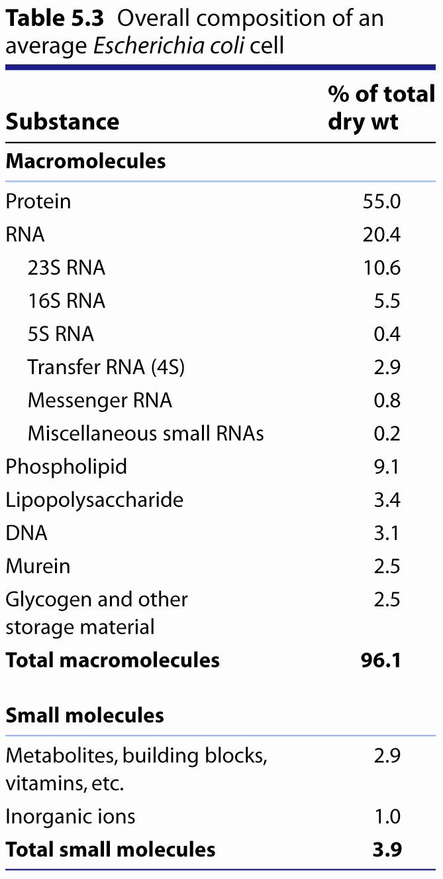

Slide 10
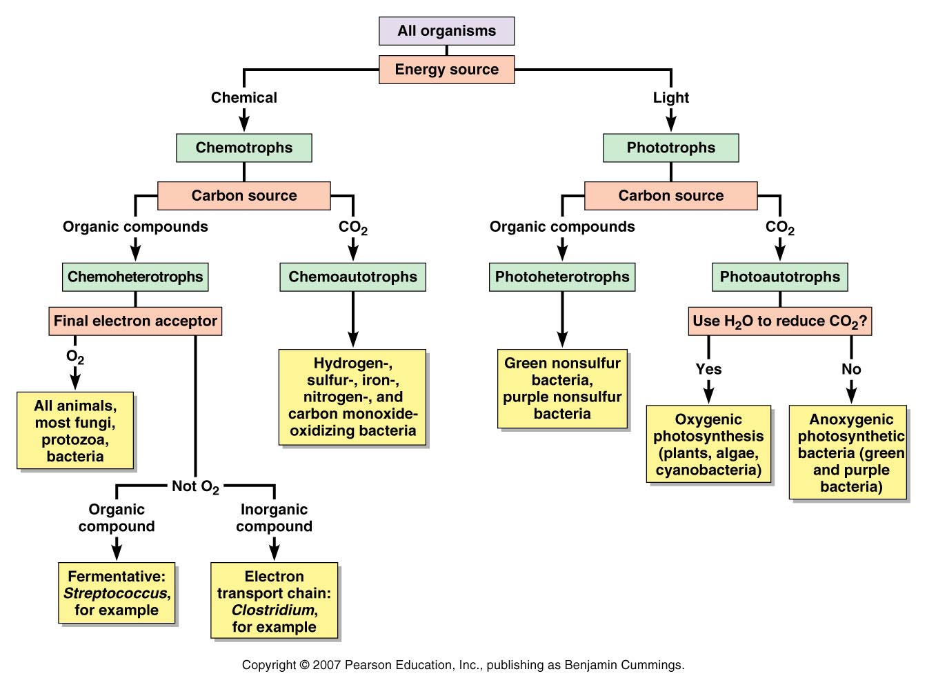

Slide 11
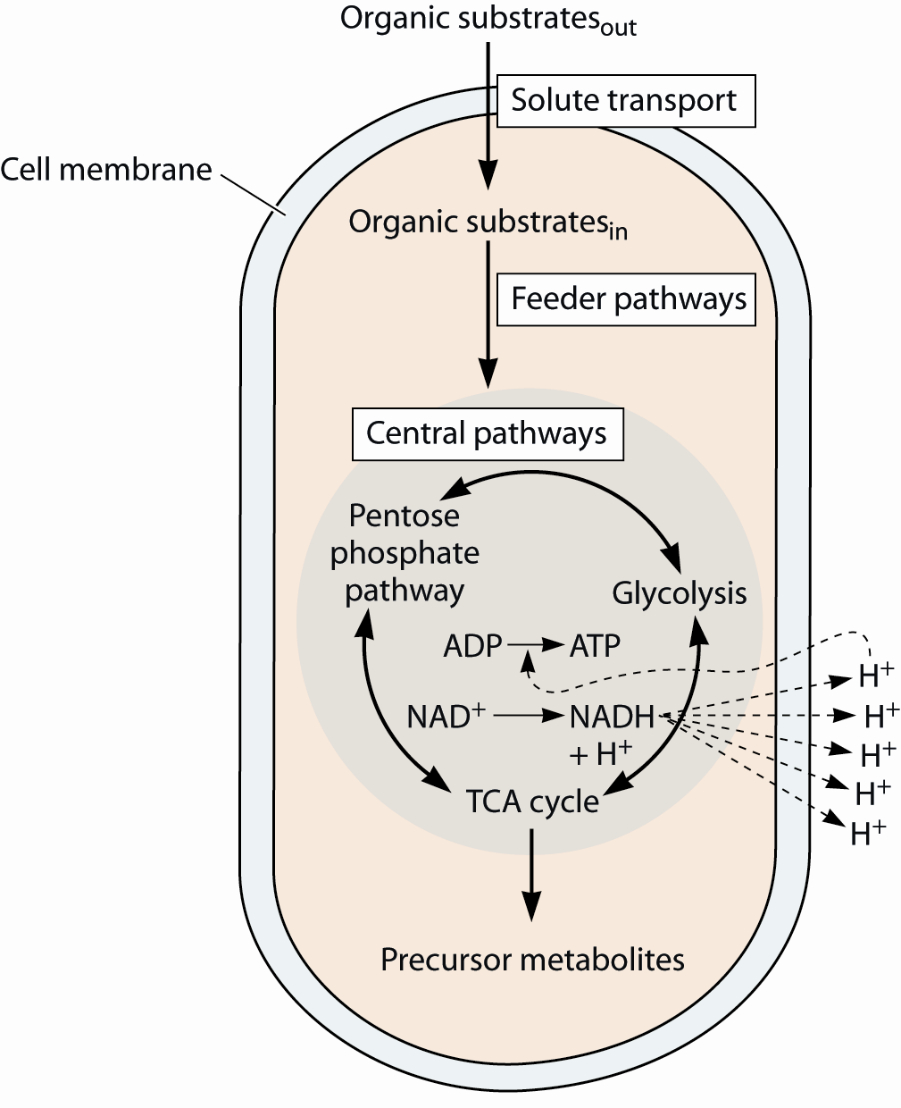
Fueling processes in heterotrophs

Slide 12
Fueling processes in autotrophs

Slide 13
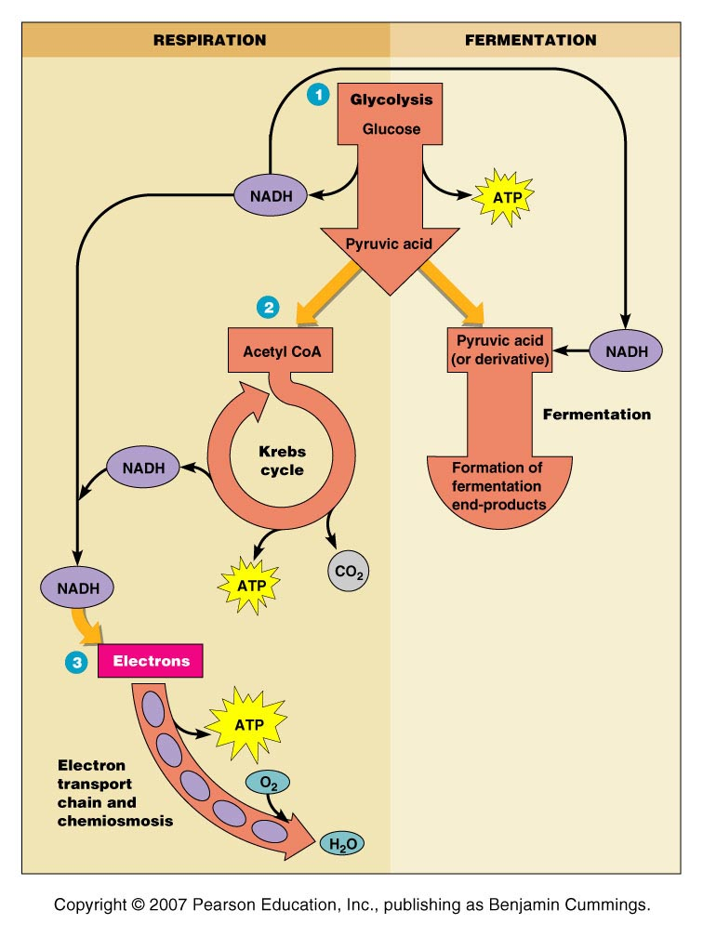
An overview of respiration and fermentation

Slide 14
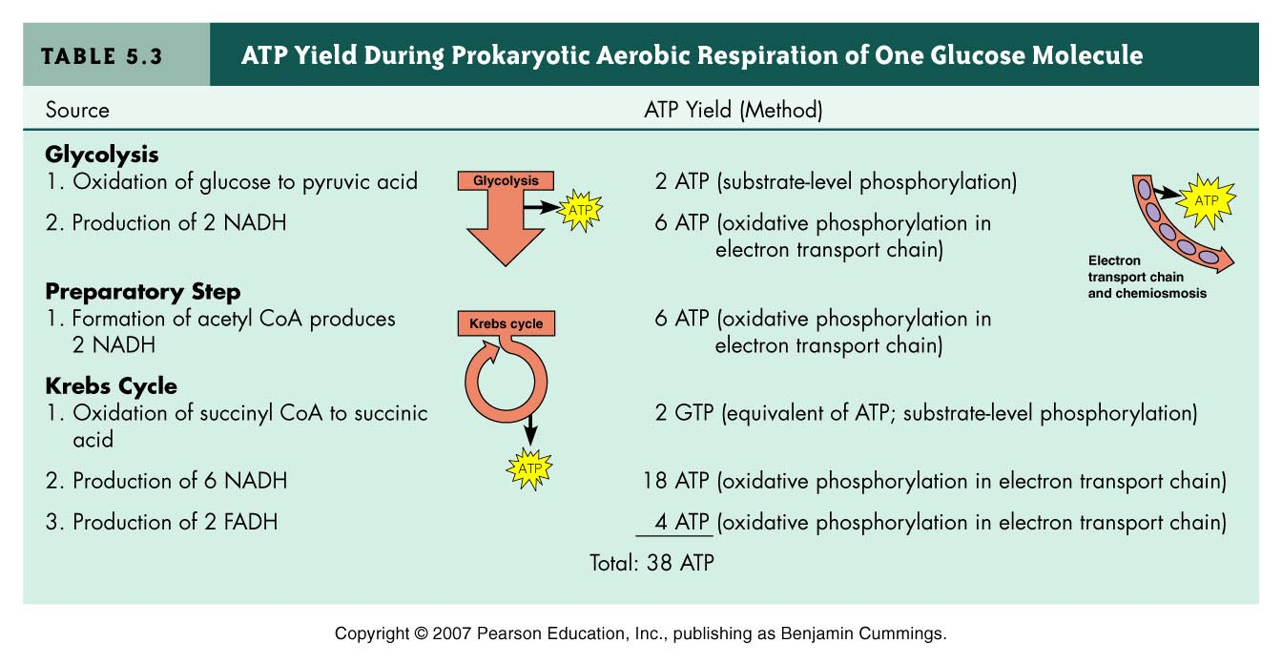

Slide 15
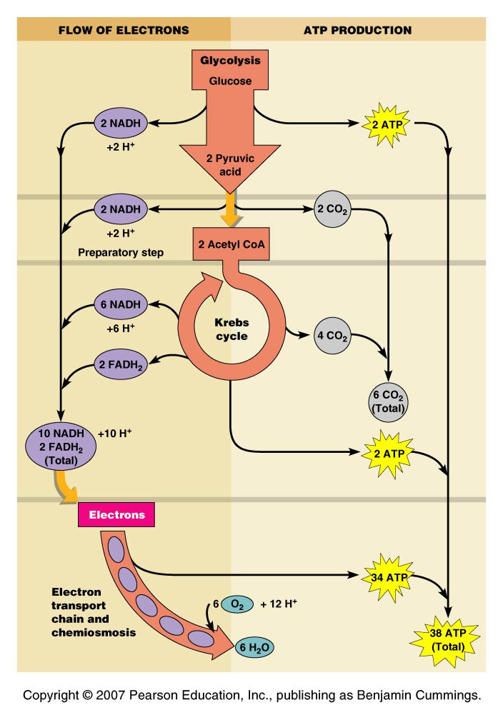

Slide 16
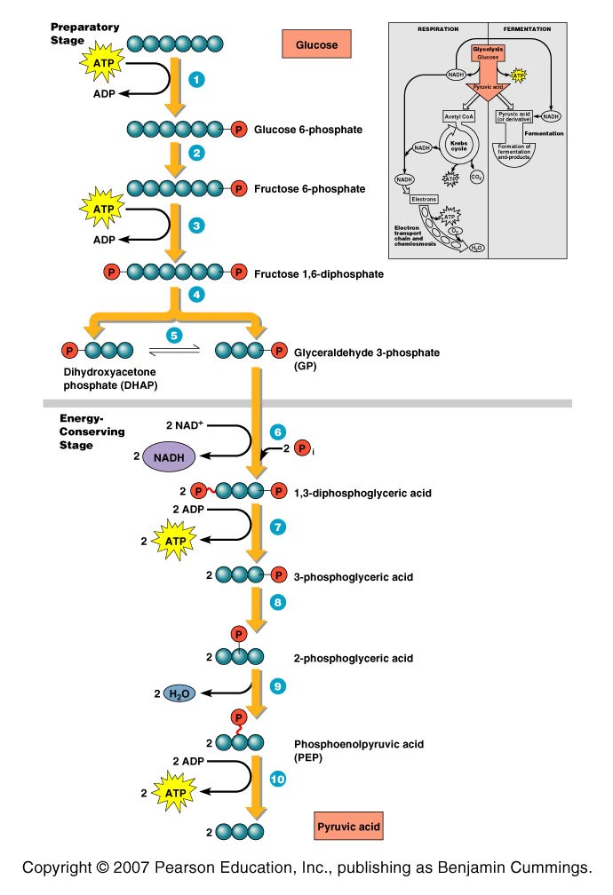
Reactions of glycolysis Embdenm-Meyerhof pathway

Slide 17
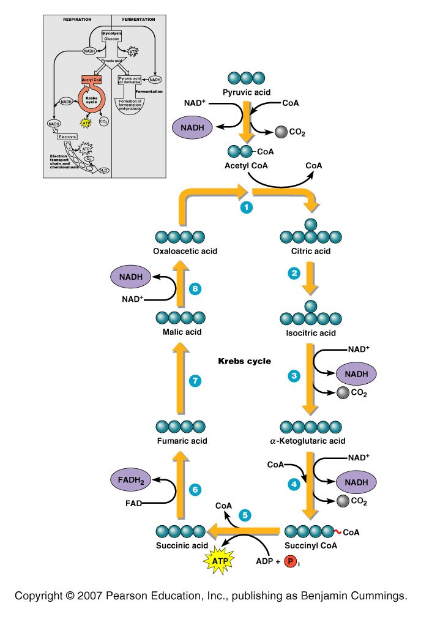
The Krebs cycle

Slide 18
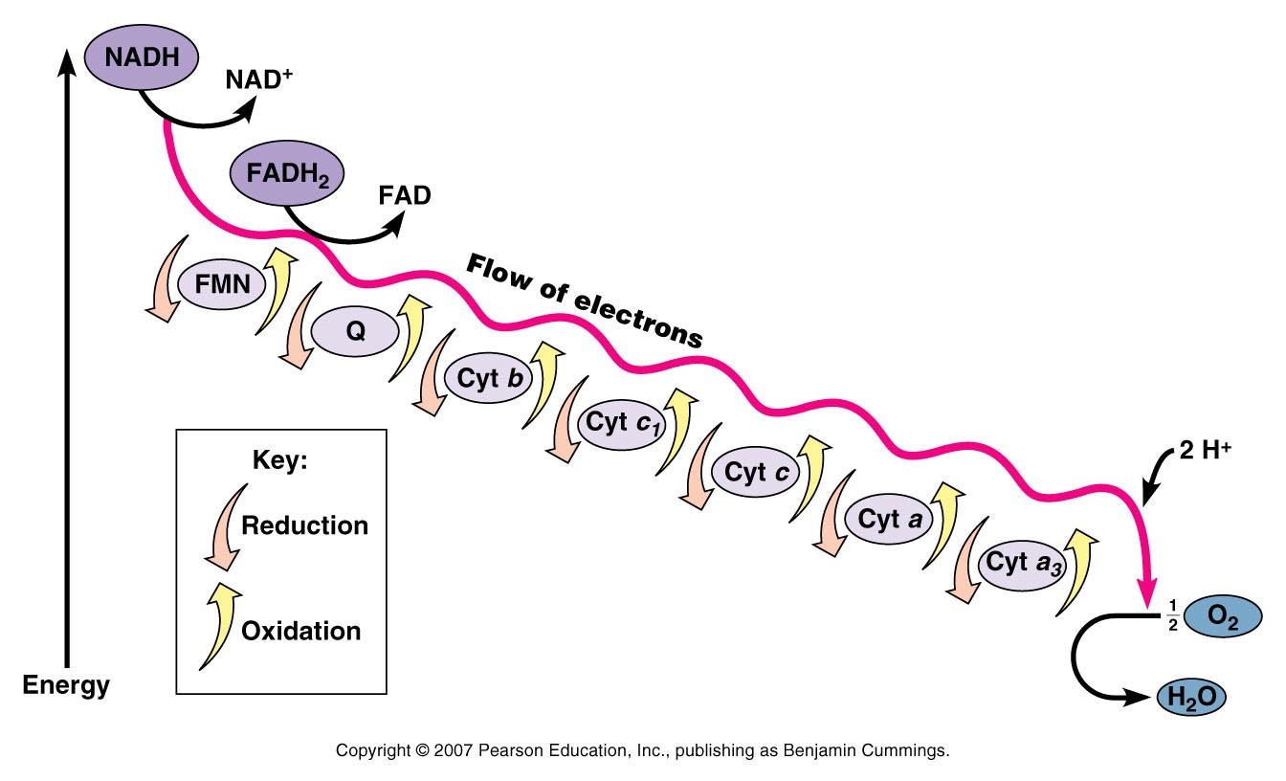
Electron transport chain

Slide 19
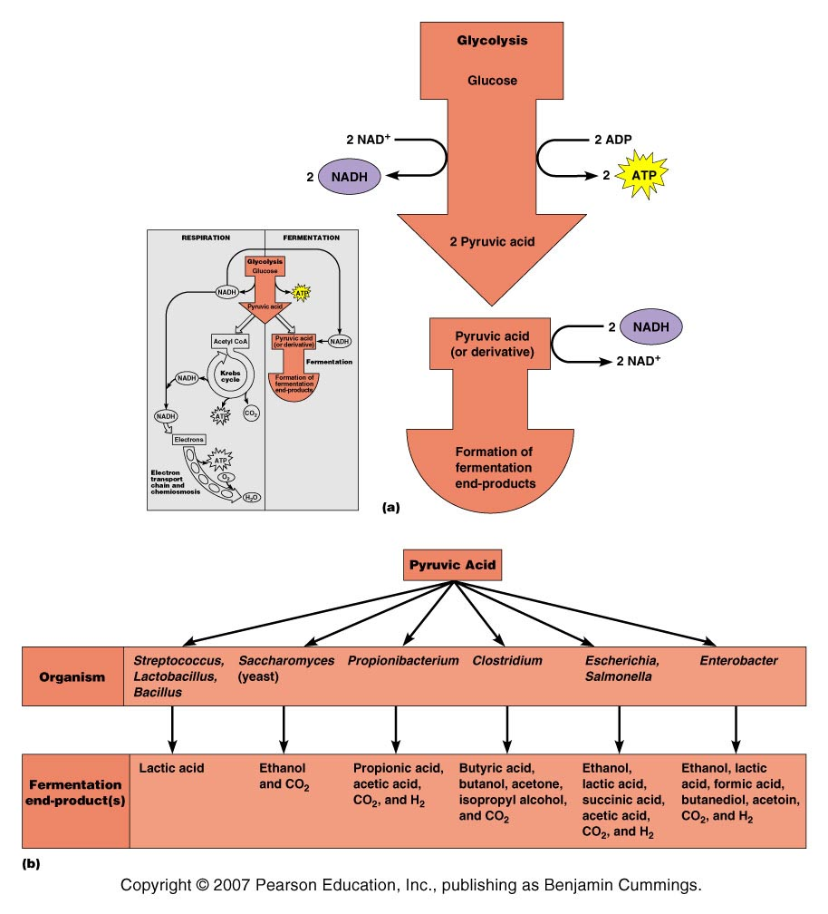

Slide 20
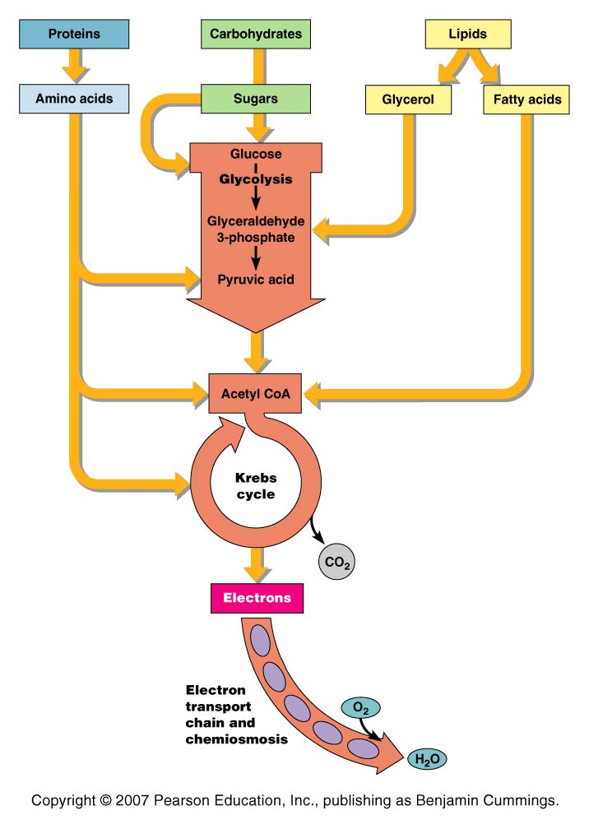
Catabolism of organic food molecules

Slide 21
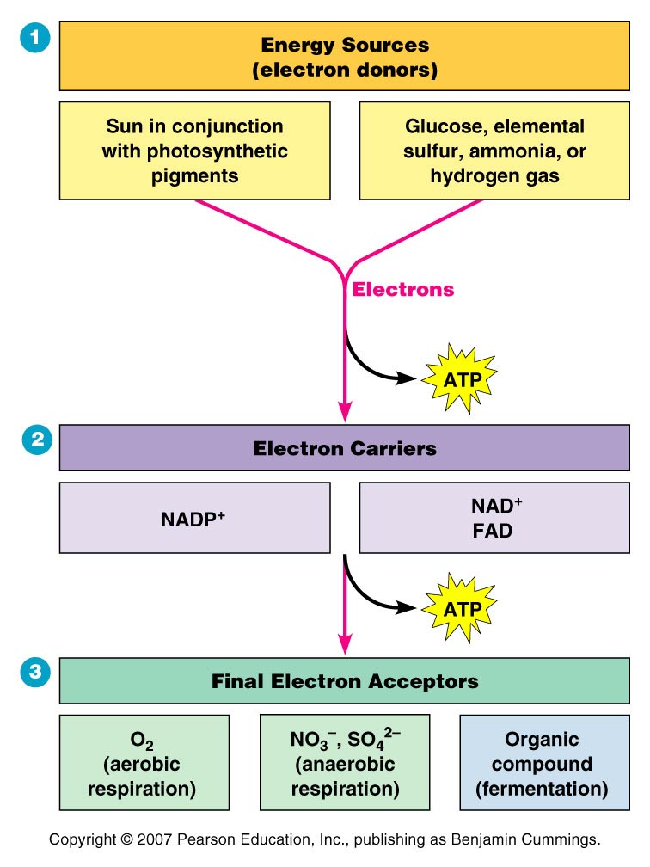
Requirements of ATP production

