Slide 1
Disease Narratives

Slide 2
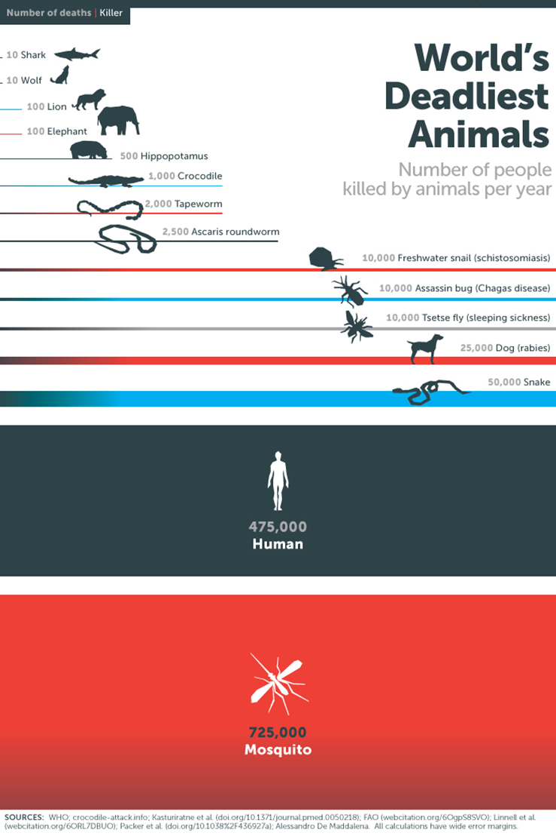
What do you think are some of the most dangerous animals?

Slide 3
FEAR
Narratives move collective action …
identification
emotions
stereotypes
character types (heroes, villains, etc.)
… and constitute collective identities by creating MEANING!
set in a particular cultural, social or normative context
referring to a common past / common future or destiny
The Other: minorities, marginalised communities, foreigners, immigrants, etc.
Popular culture
Governmental actors /state representatives
Media
International actors: International Organisations, NGOs, etc.

Slide 4
Disease and its metaphors
Military metaphors (war, aggression, enemy, fight, combat, military defense, medicine as weapon, invasion of alien organisms, etc.)
- stigmatisation, isolation, segregation
Stereotypes, myths
Political language (cancer, plague, virus, disease, etc.)
(healthy) society = (healthy) body
Words become as infective as (or much more than) the proper virus!

Slide 5
Epidemic as a dramaturgic form
Act 1: Progressive Revelation
→ communities slow to accept and acknowledge the epidemic
→ only accepted when it is obvious / unavoidable
Act 2: Managing Randomness
→ creation of a framework / reaction / explanation
→ attempt to give MEANING to what is happening
Act 3: Negotiating Public Response
→ collective action efforts
→ rituals, collective rites
→ see: quarantines imposed arbitrarily on specific minorities

Slide 6
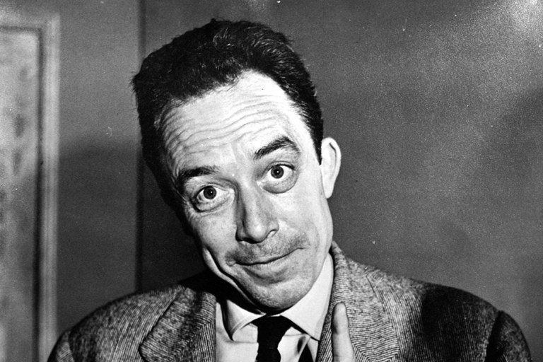
Albert Camus‘ The Plague, 1947
1) Plague as a metaphor and allegory
2) Describe the main protagonist Doctor Bernard Rieux
3) The Plague and The Great Plague in medieval Europe
4) Philosophical message: existentialism (meaning?)

Slide 7
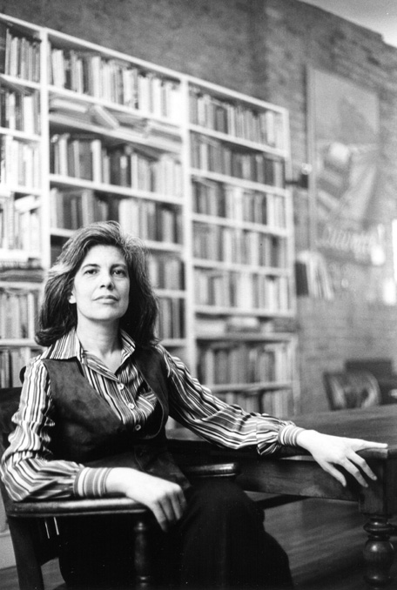
How does Susan Sontag describe the disease of HIV/AIDS in her short story ”The Way We Live Now“?
Pay particular attention to
the style of writing
the main character(s)
the major plot
the description and naming of the disease!

Slide 8
Disease in (popular) culture …
Present a famous novel about an epidemic, describe how the epidemic is portrayed and explain how the society / community reacts!
- Mario Bellatin, Salón de Belleza (1994)
- Philip Roth, Nemesis (2010)
- Jack London, The Scarlet Plague (1912)
- Jose Saramago, O ensaio sobre a cegueira (1995)
- Edgar Allan Poe, The Masque of the Red Death (1842)
- Stephen King, The Stand (1978)
- Mary Shelley, The Last Man (1826)
- Daniel Defoe, A Journal of the Plague Year (1722)
Portrayal of the Disease
Major themes
3) Major Reactions of the community/society
(political, social, economic)
4) Major consequences of the disease for the
society / community

