Slide 1
The Food Consumer
RAD2402 – Strategies in Agribusiness
Chapters 08, 31 and 32
Prof. Dr. Marcos Fava Neves
Faculdade de Administraçao (FEA/RP) – Universidade de São Paulo, desde 1995
Escola de Administração de Empresas (EAESP/FGV), desde 2018
Center for Agricultural Business - Purdue University (Indiana/USA), desde 2013
PAA – FAUBA – Universidade de Buenos Aires, desde 2006
Criador da Markestrat (www.markestrat.com.br) em 2004
Especialista em planejamento estratégico no agronegócio
www.doutoragro.com

Slide 2
How can we link environmental changes, demand driven behavior, performance, old times of marketing and empowerment of consumers?

Slide 3
1 – The Wild Sales Era
4 – A New Strategic Behavior (Demand Driven)
Architect of consumption; advertising and sales, aggressive selling (push strategy); new products for sales and profit; short term goals; manipulative; confined marketing orientation; lack of measurement; problematic relationships; don´t listen; structured towards promotion, selling and mass consumption driven product-lines
Based on paying attention and collecting information; analysis and quick reaction to environmental changes; long range approach/satisfaction and well being of buyers; integrated organization; problem solution–based approach: new ways to solve existing needs; “from trying to sell to helping to buy”;
dynamic and harmonic; decentralized and with delegation; corporate social responsibility; smooth and collaborative network; knowledge generation and dissemination; measurement (accountable marketing)
2 – The World Faces Environmental Changes
Widening of markets/internationalization; fast rate of technology change and progress; deregulation; increasing competition; communication revolution (technology); sociocultural changes; consumerist movement; environmental and green marketing; ethics behavior; societal marketing (inclusion) and other changes and trends...
5 – Performance of Demand Driven Companies
Company gives contribution to improving exchange of goods and services; promotes access and inclusion; strenght of demand and democracy; positive side effects of production and products; satisfied consumers, repeated purchases; sustainable competitive advantage and growth / share / profitability
3 – The New Era of Consumer Sovereignity
Well being; experiences and rewards; the choice is free and individual; supply exceeds demand (choice); NGO´s (countervailing power); increasing public attention; more professional purchase behavior; new and growing expectations
Soource: The Consumer´s Kingdom

Slide 4
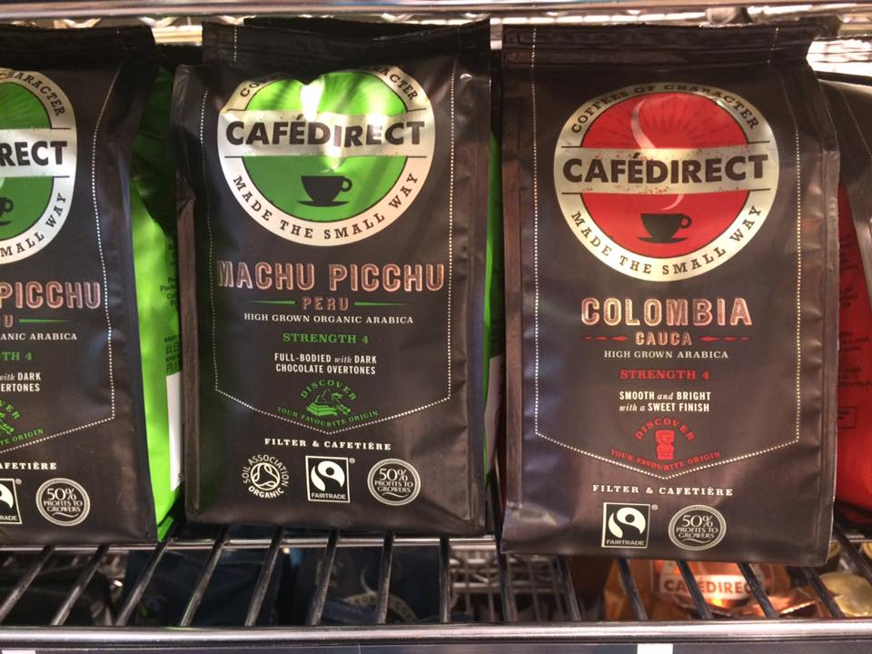

Slide 5
How can we build questions to raise ideas and issues about our capacity of understanding and satisfying consumers?

Slide 6
Consumer´s Kingdom 14 Questions…
1. How to pay attention and collect information about the consumers?
2. How to pay attention and collect information about the competitors?
3. How to pay attention and collect information about the environment?
4. How to have a deep analysis and quick reaction of environmental changes?
5. How to do a long-range approach valuing satisfaction and well being of buyers?
6. How to build an integrated organization, dynamic and decentralized?
7. How to move using a problem-solution-based approach?

Slide 7
Consumer´s Kingdom 14 Questions…
8. How to continuously search for new ways to solve existing needs?
9. How to build a corporate social responsibility method?
10. How to have a collaborative network with suppliers, distributors and service providers?
11. How to have a strong focus on market segmentation?
12. How to induce knowledge generation and dissemination?
13. How to measure marketing activities ?
14. How to do the “lock in” strategy (loyalty of consumers?

Slide 8
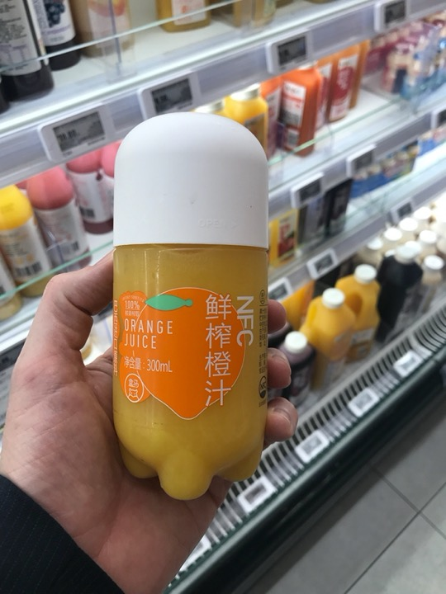

Slide 9
Buying Behavior Model
Marketing
Stimulus
Other
Stimulus
Buyer
Characteristics
The Buying
Decision Process
The Buying
Decisions
Controlled
Uncontrolled
Consumer
Product
Price
Place
Promotion
Identify the problem
Search for information
Alternatives evaluation
Buying decision
After-buying behavior
Product Choice
Brand Choice
Salesman Choice
Time of Buying
Capital Expenditure
Political
Economical
Socio-cultural
Technological
Cultural
Social
Personal
Psychological
Source: Kotler

Slide 10
Consumers Buying Decision Process
Stage of the process
How Does it Happen?
How can companies use it?
Questions to ask consumers...
Personal values and needs associated with the external influences, make the current situation different of the desired situation, thus a need appears.
Apply the most frequent and efficient stimulus
The package must communicate these values, acting as a “mini out-door.”
What need is satisfied by consuming this product?
Are these needs evident?
In what extent are the target-consumers involved with the product?
1 – Buying Needs
Identification
The search is done through internal sources
(memory, knowledge) and external sources
(market and personal
relations).
Identify how the consumer searches for information and on which sources.
The company must work on the sources that mostly influence consumers.
What product or brand does the consumer have in mind?
Is the consumer motivated to search for external sources
What are those sources?
Which are the most searched attributes?
2 - Information
Search

Slide 11
Stage of the process
How Does it Happen?
How can companies use it?
Questions to ask consumers...
The consumer will
choose the strongest alternative having the criteria that he
or she most values.
The company must identify, which attributes are most valued
How to reposition attributes, repositioning competitors, changing also the analysis of the attributes
Does the consumer evaluate and compare?
Which alternatives and criteria?
Can they be changed?
What is the result of the alternatives’ evaluation?
Are the alternatives really different?
3 - Alternatives
Evaluation
Decisions are taken related to the purchase itself, where to buy, when to buy and what to buy and, finally, how to pay.
Sales place
Alternative channels
Will the consumer spend time and energy to find the best alternative?
Where does the consumer prefer to buy the product (channel) and at what moment?
4 – Buying Decision
Comparison between the expectations and the performance of the product. From extreme satisfaction and
positive word-of-mouth
to legal action against
the company.
Keep open communication
Research to monitor the consumer satisfaction.
Is the consumer satisfied?
What are the reasons of this satisfaction/dissatisfaction?
Are these discussed with other consumers?
Is there any intention of repeating the purchase?
5 - After-buying
behavior

Slide 12
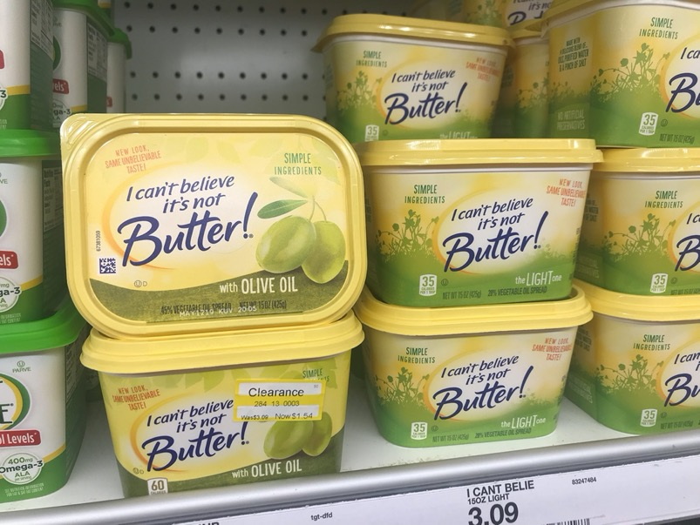

Slide 13
Developing Offers in Tune with Consumer Movements…
Environmental/Green
Consumerist
Social and Others
(ethics/rights/regulatory)
What is the amount of resources used (water, air, energy)?
Recycling and reverse logistics are possible?
How to do disposure and retrieval of waste?
Which certifications will be needed?
Can we offer compensations programs?
Is it improving quality of life?
Is it healthier?
Is it linked to the movement of smaller portions avoiding waste?
What is the impact of transport, logical systems and usage of infrastructure?
Which are the most important groups and NGO’s to be, in some way, linked to the company?
How to link to these groups?
Is the offer bringing long-term satisfaction?
Is it designed for well being of buyers?
Is it technology based or just to promote marketing and sales?
Is it designed to over consumption?
Does it bring a balance equilibrium buyer seller?
The functional value is clear?
Is need satisfaction considered as a first objective of the offer?
Will consumers perceive this?
Is the new offer a solution to simplify procedures?
Which are the most important groups and NGO’s to be, in some way, linked to the company?
How to link to these groups?
Is the offer promoting social development?
Is the offer promoting inclusion?
Is it promoting local communities development?
What are the economic or people side effects?
Can it apply for fair trade?
Is the company controlling the behavior and practices of its suppliers?
Does it have a clear, written and will communicated “corporate social responsibility” policy?
Employees satisfaction and well being is considered?
Which are the most important groups and NGO’s to be, in some way, linked to the company?
How to link to these groups?
Is the offer taking care of all ethic concerns?
Is it adjusted to the institutional (regulatory) environment (”rules of the game”) of the country or region?

Slide 14
Could we have a creative A-Z list of issues in food marketing, that could help us to raise ideas for our company?

Slide 15
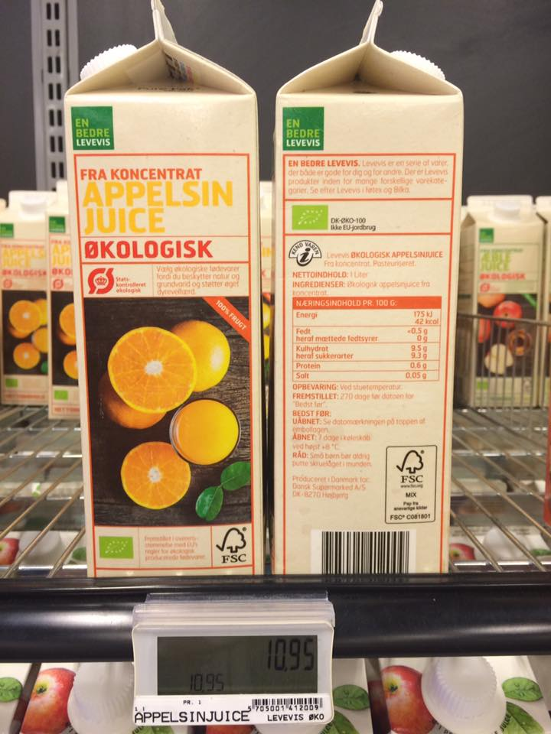

Slide 16
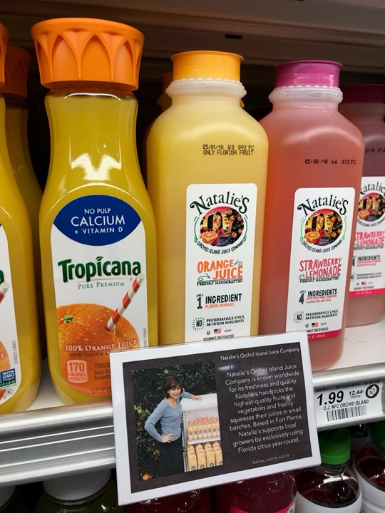

Slide 17
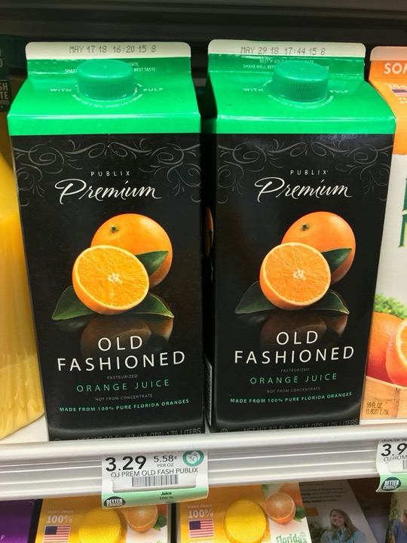

Slide 18
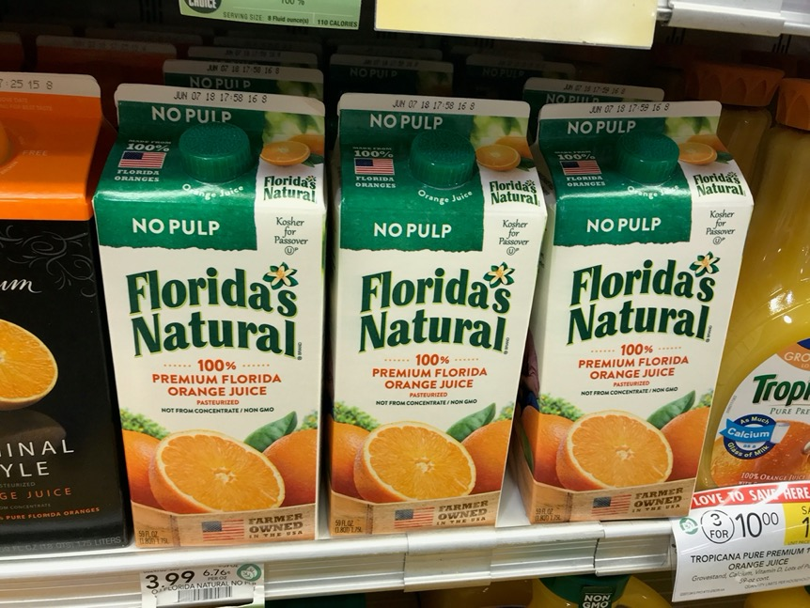

Slide 19
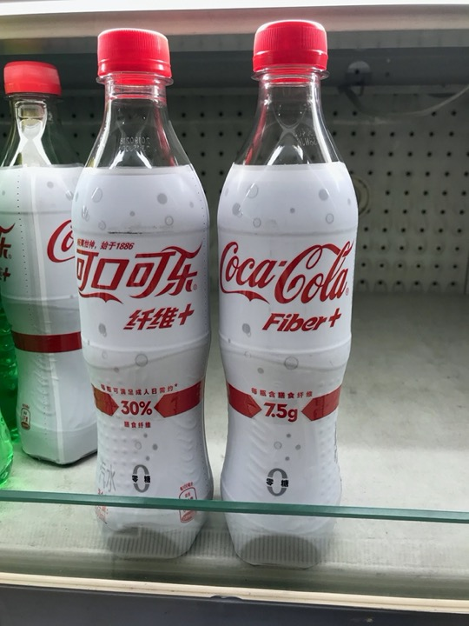

Slide 20
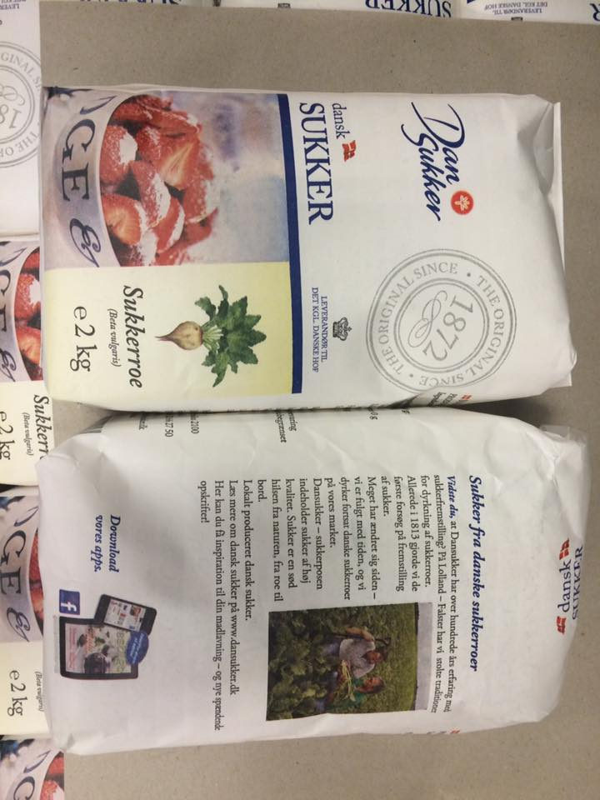

Slide 21
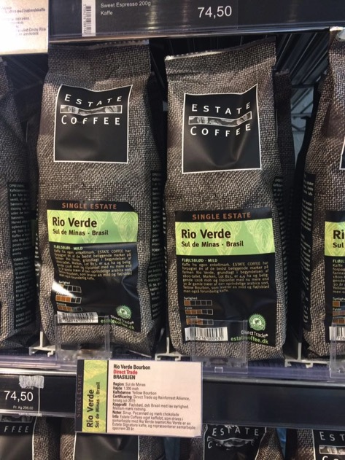
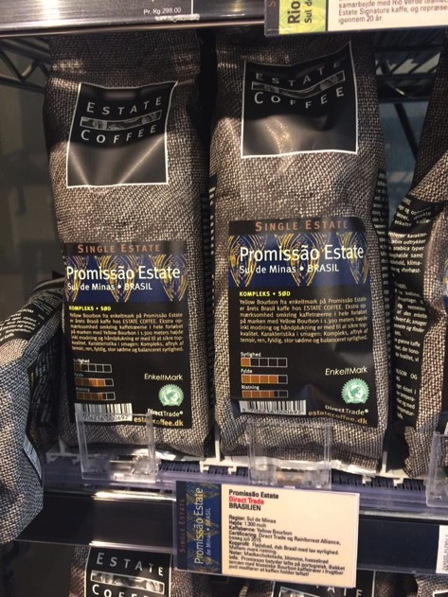

Slide 22
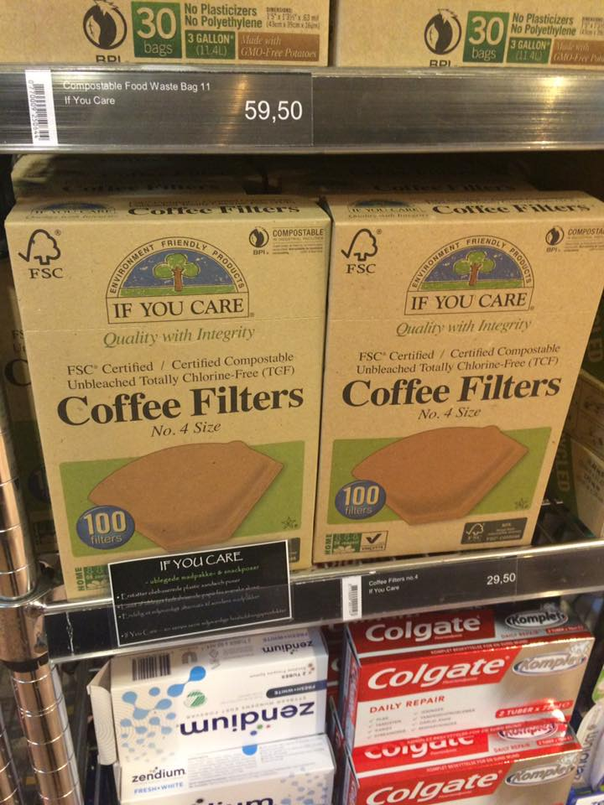
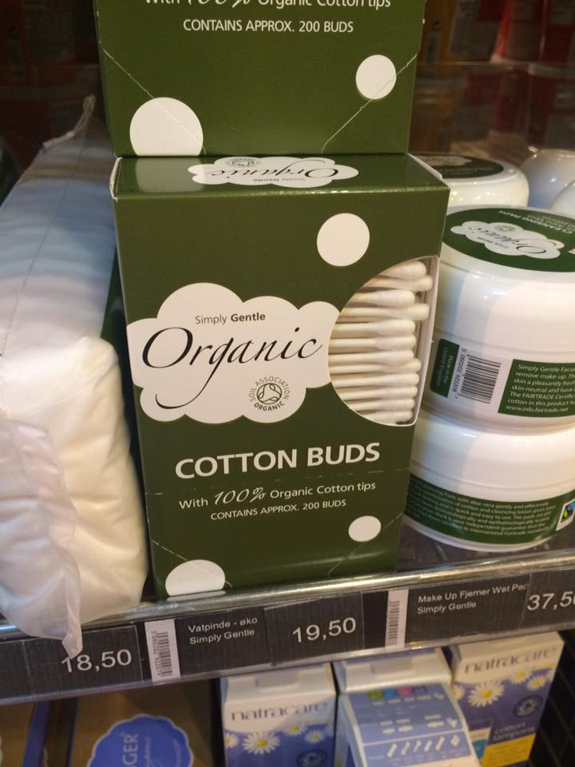

Slide 23
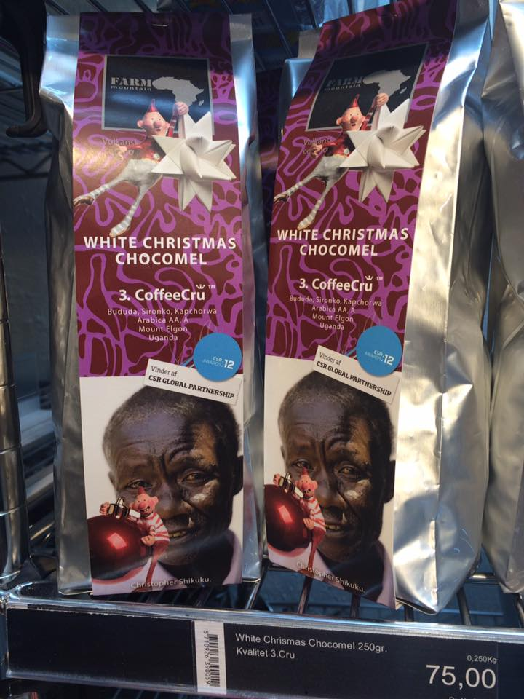
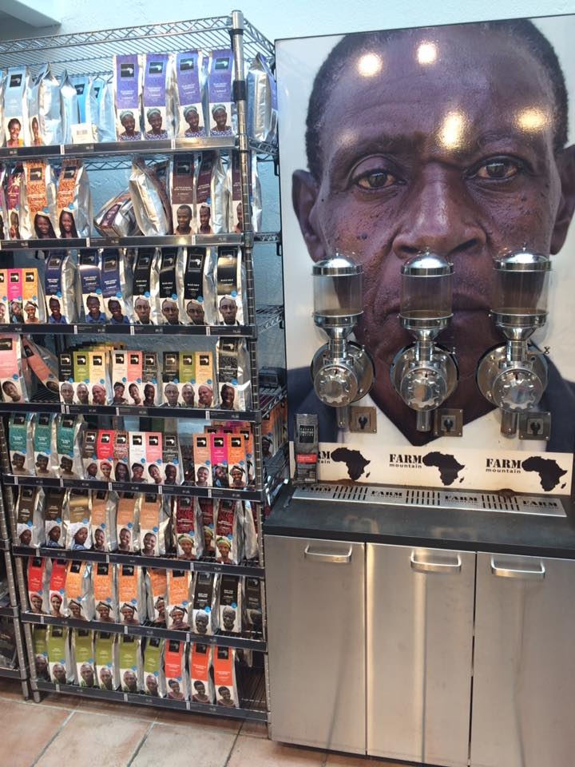

Slide 24
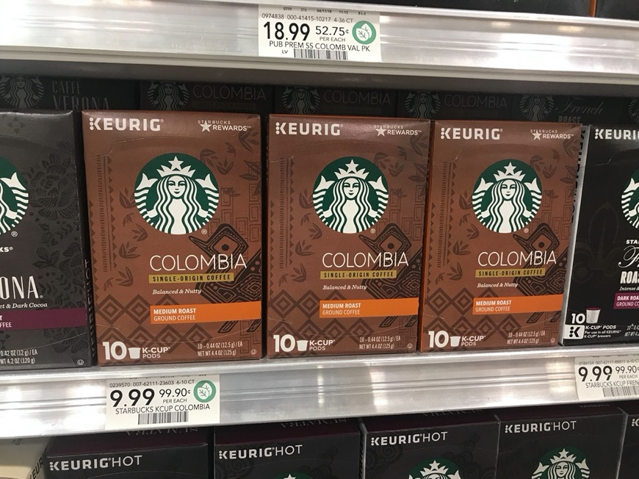

Slide 25
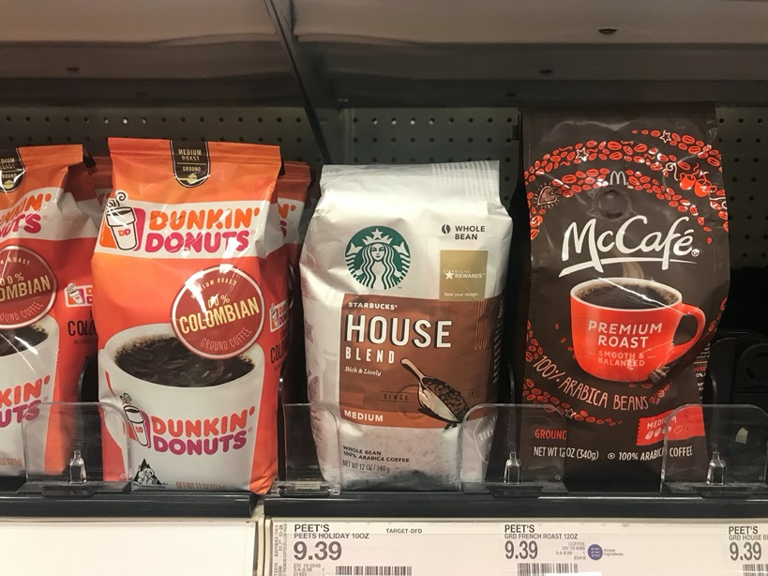

Slide 26
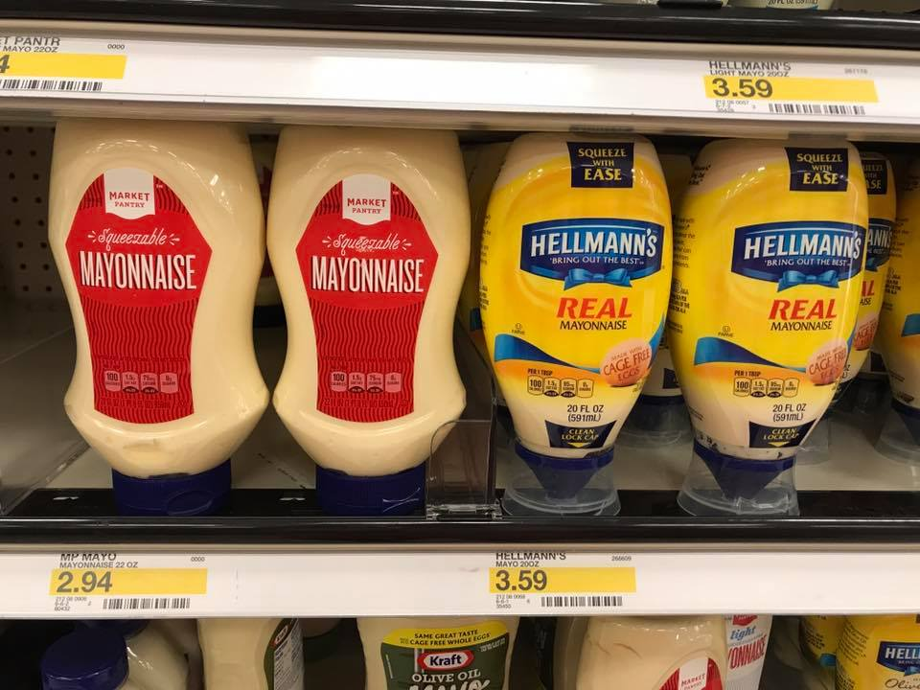

Slide 27
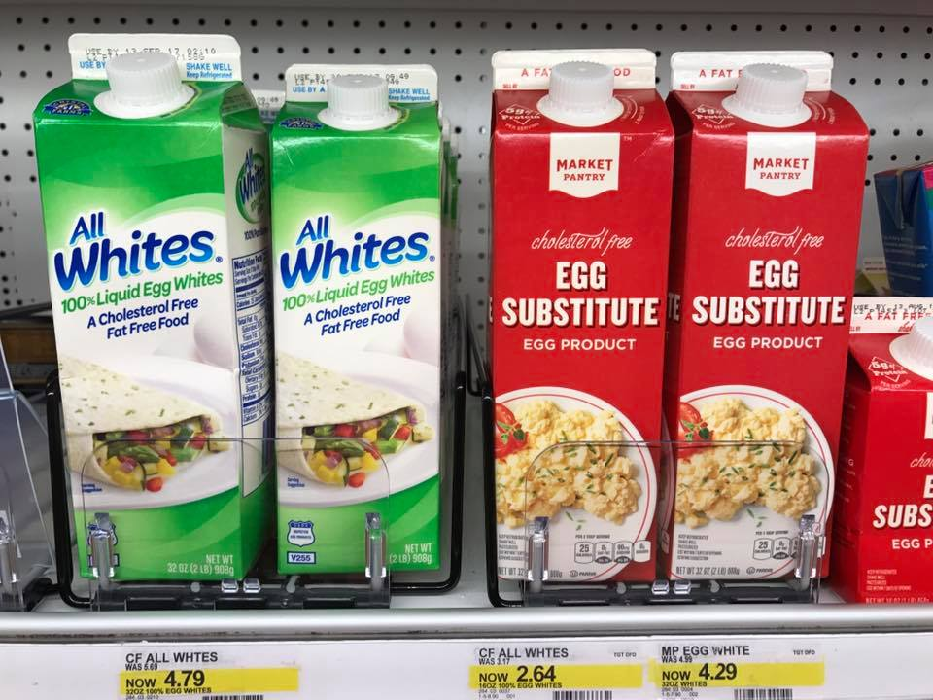

Slide 28
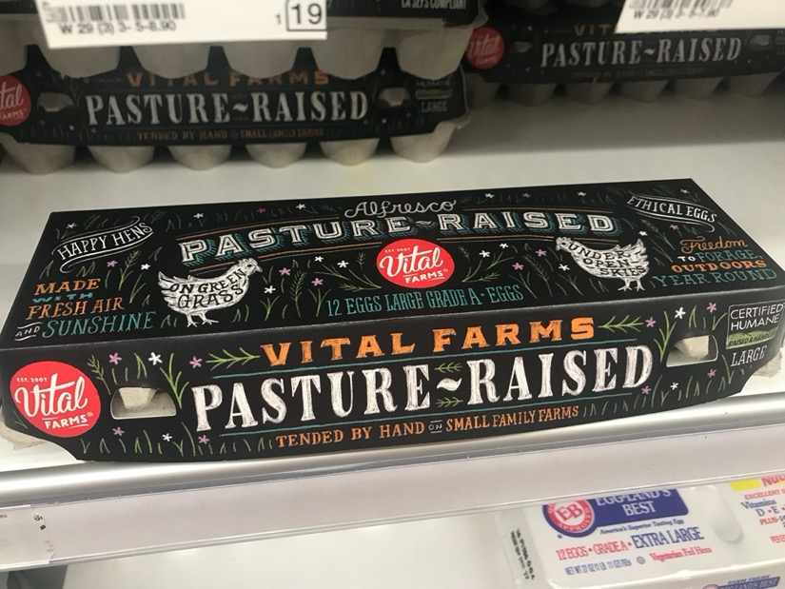

Slide 29
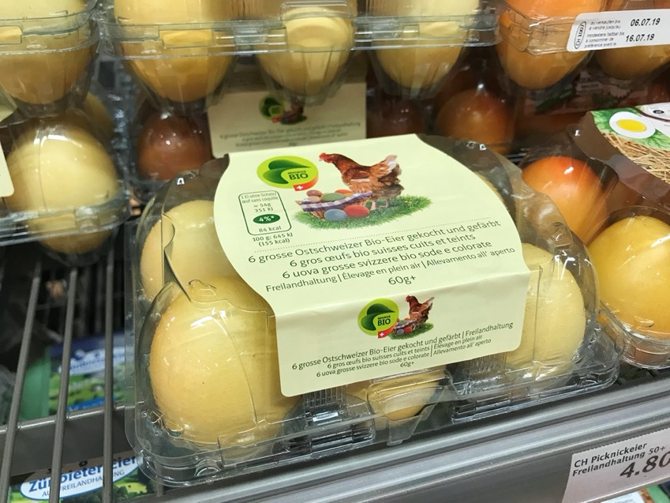

Slide 30
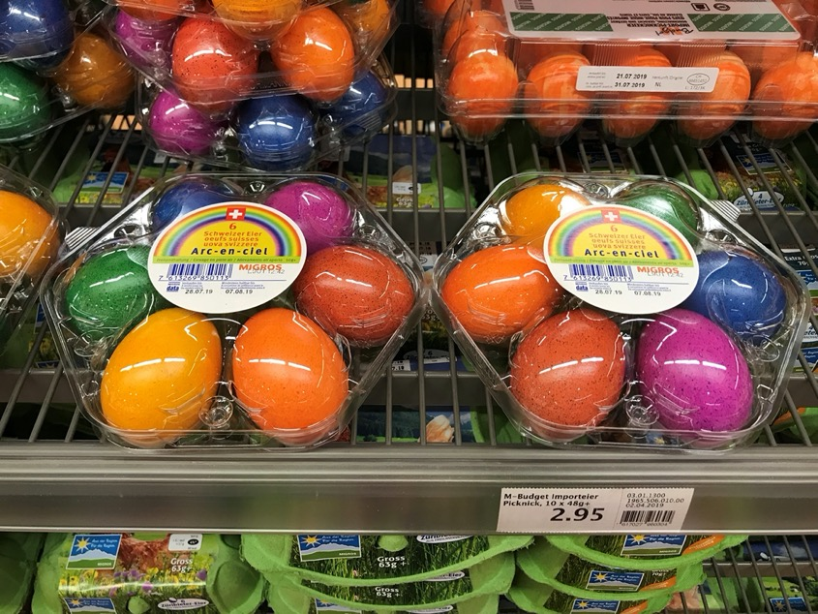

Slide 31
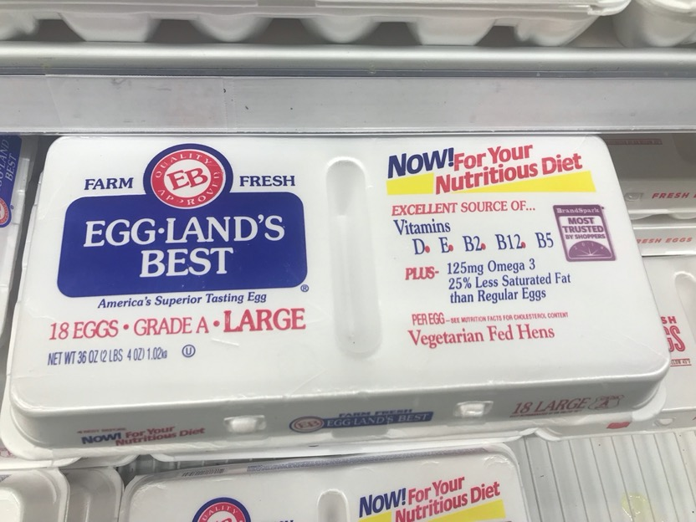

Slide 32
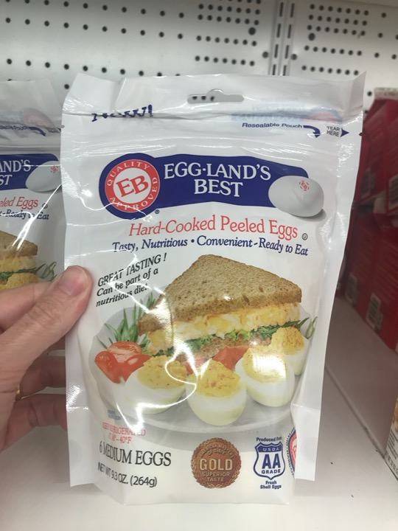

Slide 33
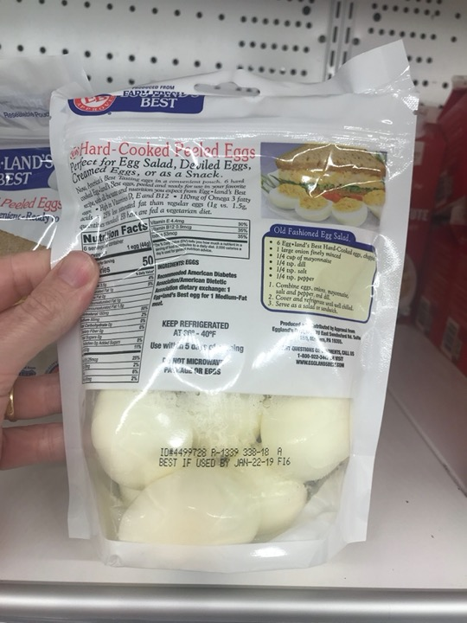

Slide 34
Marcos Fava Neves is an international expert on global agribusiness issues and a part-time professor of planning and strategy at the School of Business (FEARP) of the University of São Paulo (USP) and FGV Business School, both in Brazil. He graduated as an agronomic engineer from ESALQ/USP - Piracicaba in 1991. He earned his master’s degree in 1995 and his doctorate in management in 1999 from the FEA/USP School of Economics and Business – São Paulo. Marcos completed postgraduate studies in European agribusiness at ESSEC-IGIA in France in 1995 and in chains/networks at Wageningen University, in the Netherlands (1998-1999). In 2013 he spent the year as a visiting international professor at Purdue University (Indiana, USA) where he maintains the linkage as a permanent International Adjunct Professor. Since 2006 he is an international professor at the University of Buenos Aires, Argentina.
He has specialized in strategic-planning processes for companies and food chains and works as a board member of both public and private organizations, being member of mor than 10 international boards since 2004. Also in 2004, he created the Markestrat think tank with other partners, today employing around 60 people and doing international projects, studies and research in strategic planning and management for more than 250 agri-food business organizations. Some of these projects were very important in suggesting public policies for food chains that were implemented in Brazil with economic and social impacts.
Also as an experience in the private sector, from 1992 to 1993 he worked in citrus juice exporter and from 1994 to 1995 in a veterinarian company. In 2008, he became CEO of Brazil’s second-largest biofuel holding company, a position he occupied until 2009, when he returned to the University of São Paulo (USP) and Markestrat.
At the academic side, since 1995 (when he was hired by USP), Marcos has advised more than 30 doctorate dissertations and master’s theses and helped to form around 1200 Bachelors in Business Administration in Brazil with around 120 courses taught to undergraduates at USP.
His writings are strongly focused on supplying simple and effective methods for business. He has published more than 100 articles in international journals and has been author and editor of 63 books by 10 different publishers in Brazil, Uruguay, Argentina, South Africa, Singapore, Netherlands, China, the United Kingdom and the United States. He is also a regular contributor for China Daily Newspaper and has written two case studies for Harvard Business School (2009/2010), one for Purdue (2013) and five for Pensa/USP in the nineties. Recognized as the Brazilian academic with the largest number of international publications about orange juice and sugar cane chain and one of the top 3 most cited Brazilian authors in the area of food and agribusiness. He has reached more than 4000 citations in Google Scholar index.
Marcos is one of the most active Brazilian speakers, having done more than 1050 lectures and presentations in 25 countries. He received around 150 recognitions from Brazilian and international organizations, and is considered a “Fellow” of the IFAMA (International Food and Agribusiness Management Association), title received in Minneapolis - 2015.
Coming from a family of farmers, he is a worldwide defender of agriculture and farmer’s role in the development of the society. In the social side, together with his parents, Marcos is one of the creators and maintainers of Mucapp, a NGO that in 20 years has built more than 450 houses for families in Brazil that face very unfavorable conditions.

