Slide 1
Economic
Nationalism
(i.e., protectionism)
National
Identity
(i.e., who belongs)
THE POLITICS OF ECONOMIC NATIONALISM

Slide 2
Economic
Globalization
(i.e., export, outward-looking strategies )
National
Identity
(i.e., who belongs)
THE POLITICS OF ECONOMIC GLOBALIZATION

Slide 3
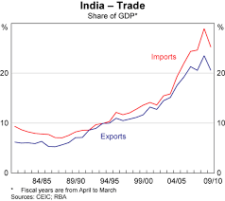
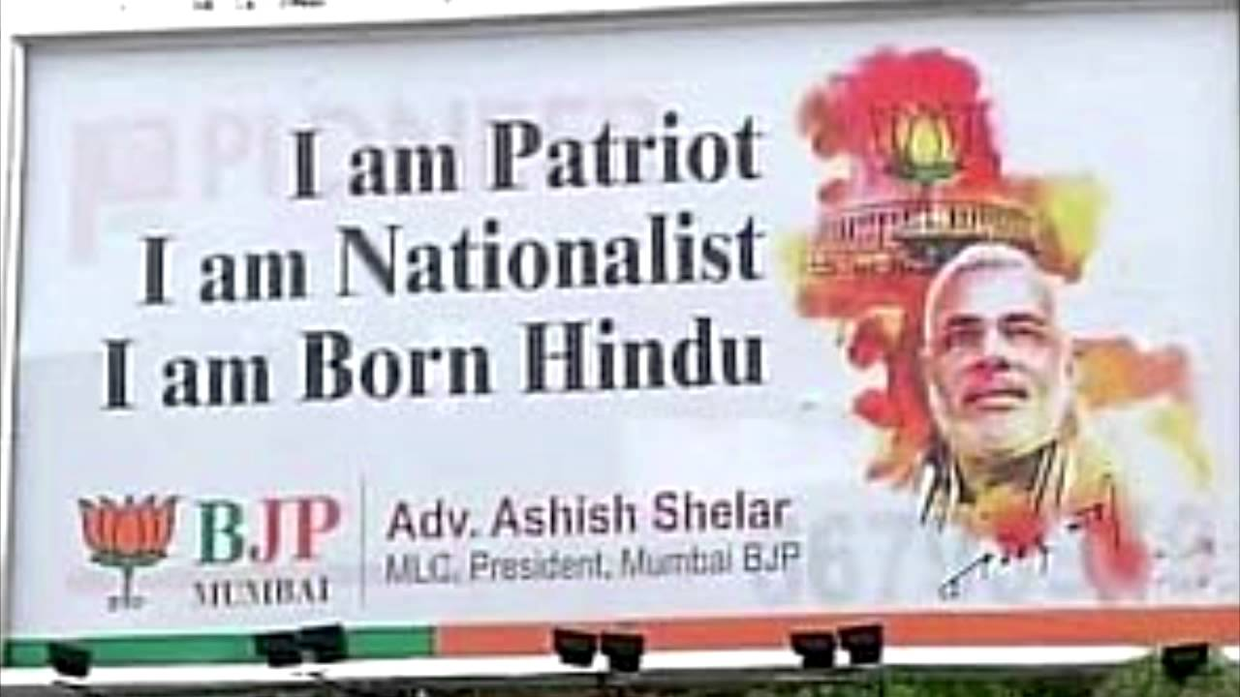
If Nationalism prevails…
THE SAME IS NOT TRUE ABOUT ECONOMIC PROTECTIONISM

Slide 4
The Politics of Economic Nationalism
Class 12
India’s Hindutva Outward-Looking Strategy
Dr. Vinícius Rodrigues Vieira (IRI-USP)
November 7, 2018

Slide 5
What does it mean to be Hindu?
“Perhaps 80% or more of all Indians identify themselves as Hindus. What this means exactly is a tricky business, for no one text or organisation can lay claim to Hinduism. Likewise with Hindu nationalism, a political ideology that is expressed differently by a variety of groups which share little more than a family resemblance” (The Economist 2014).
HINDUISM DOES NOT EQUAL HINDUTVA (THE BELIEF THAT INDIA IS ESSENTIALLY HINDU)
BUT HINDUS ARE ESSENTIAL FOR CONSOLIDATING HINDUTVA

Slide 6
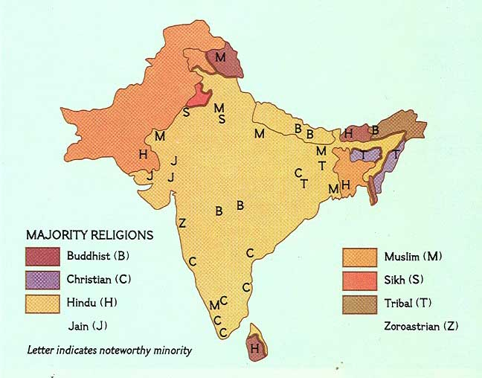

Slide 7
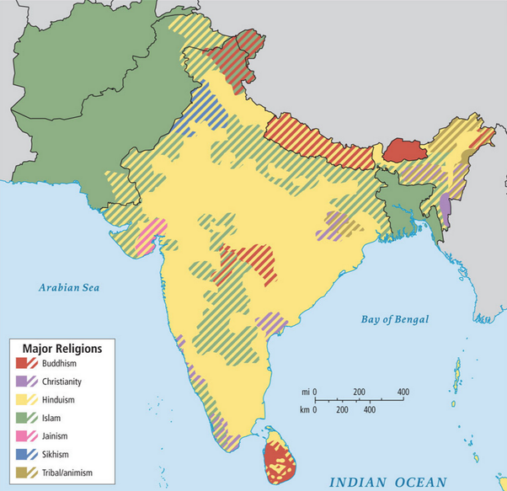

Slide 8
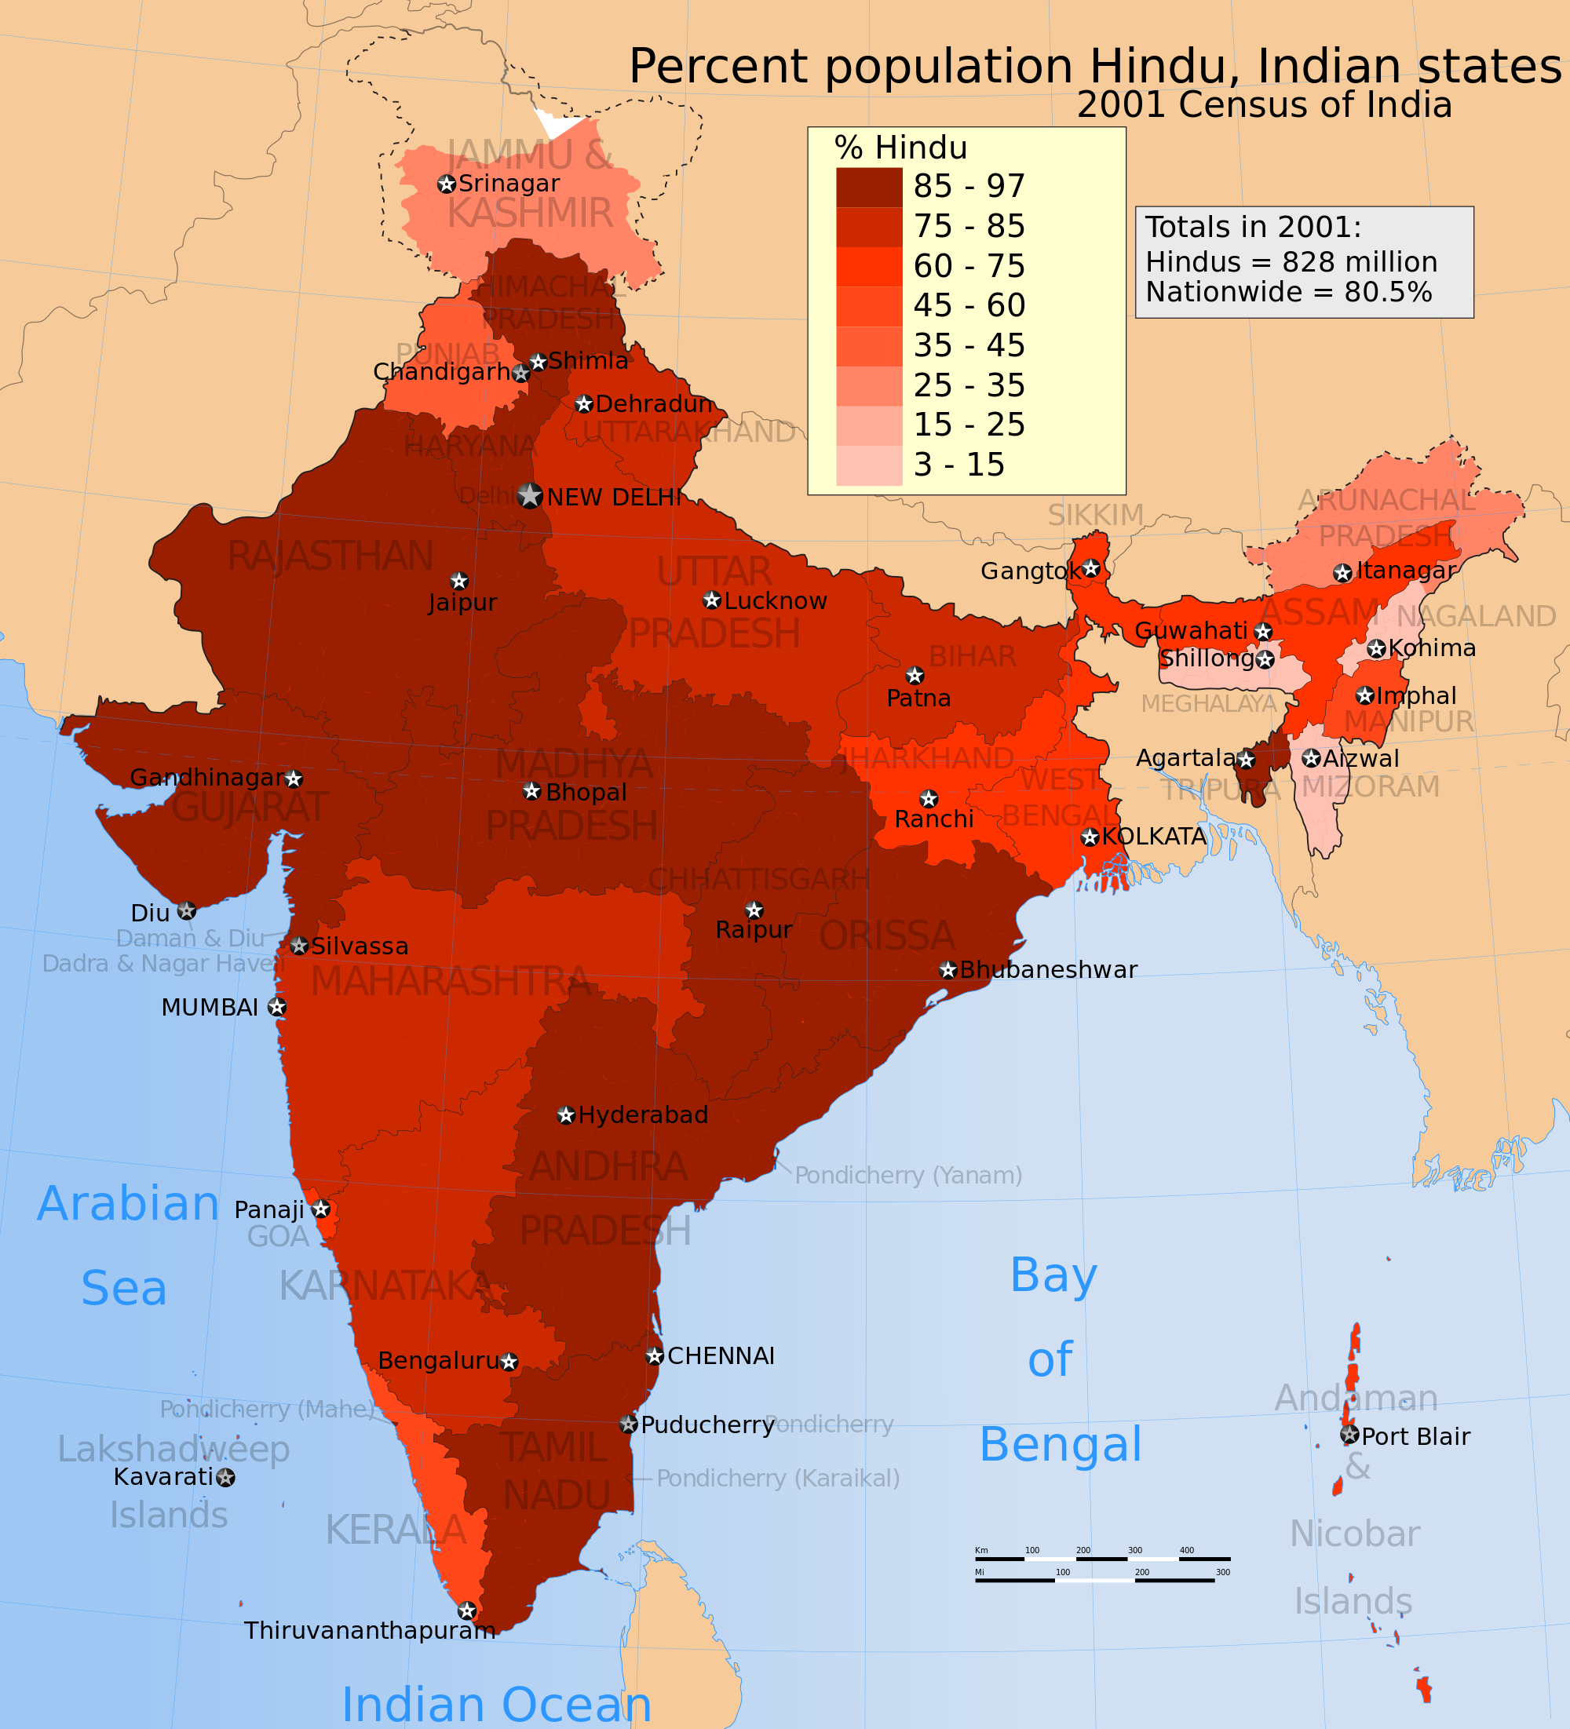

Slide 10
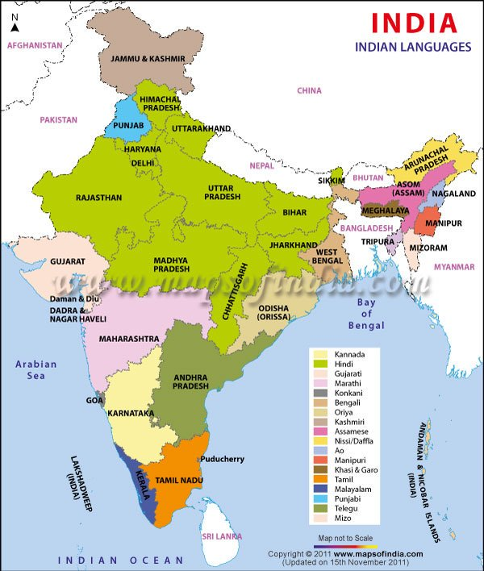

Slide 11
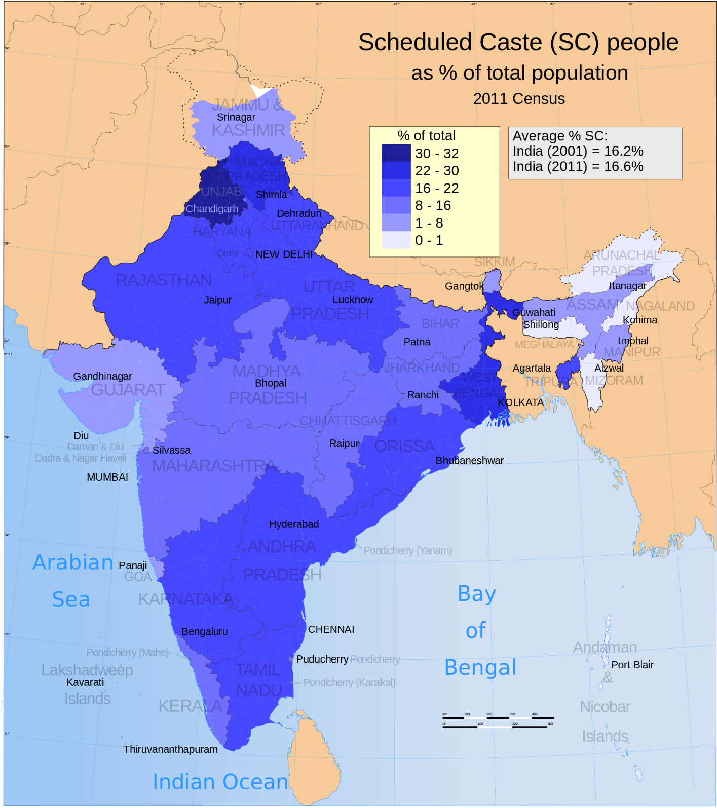

Slide 13
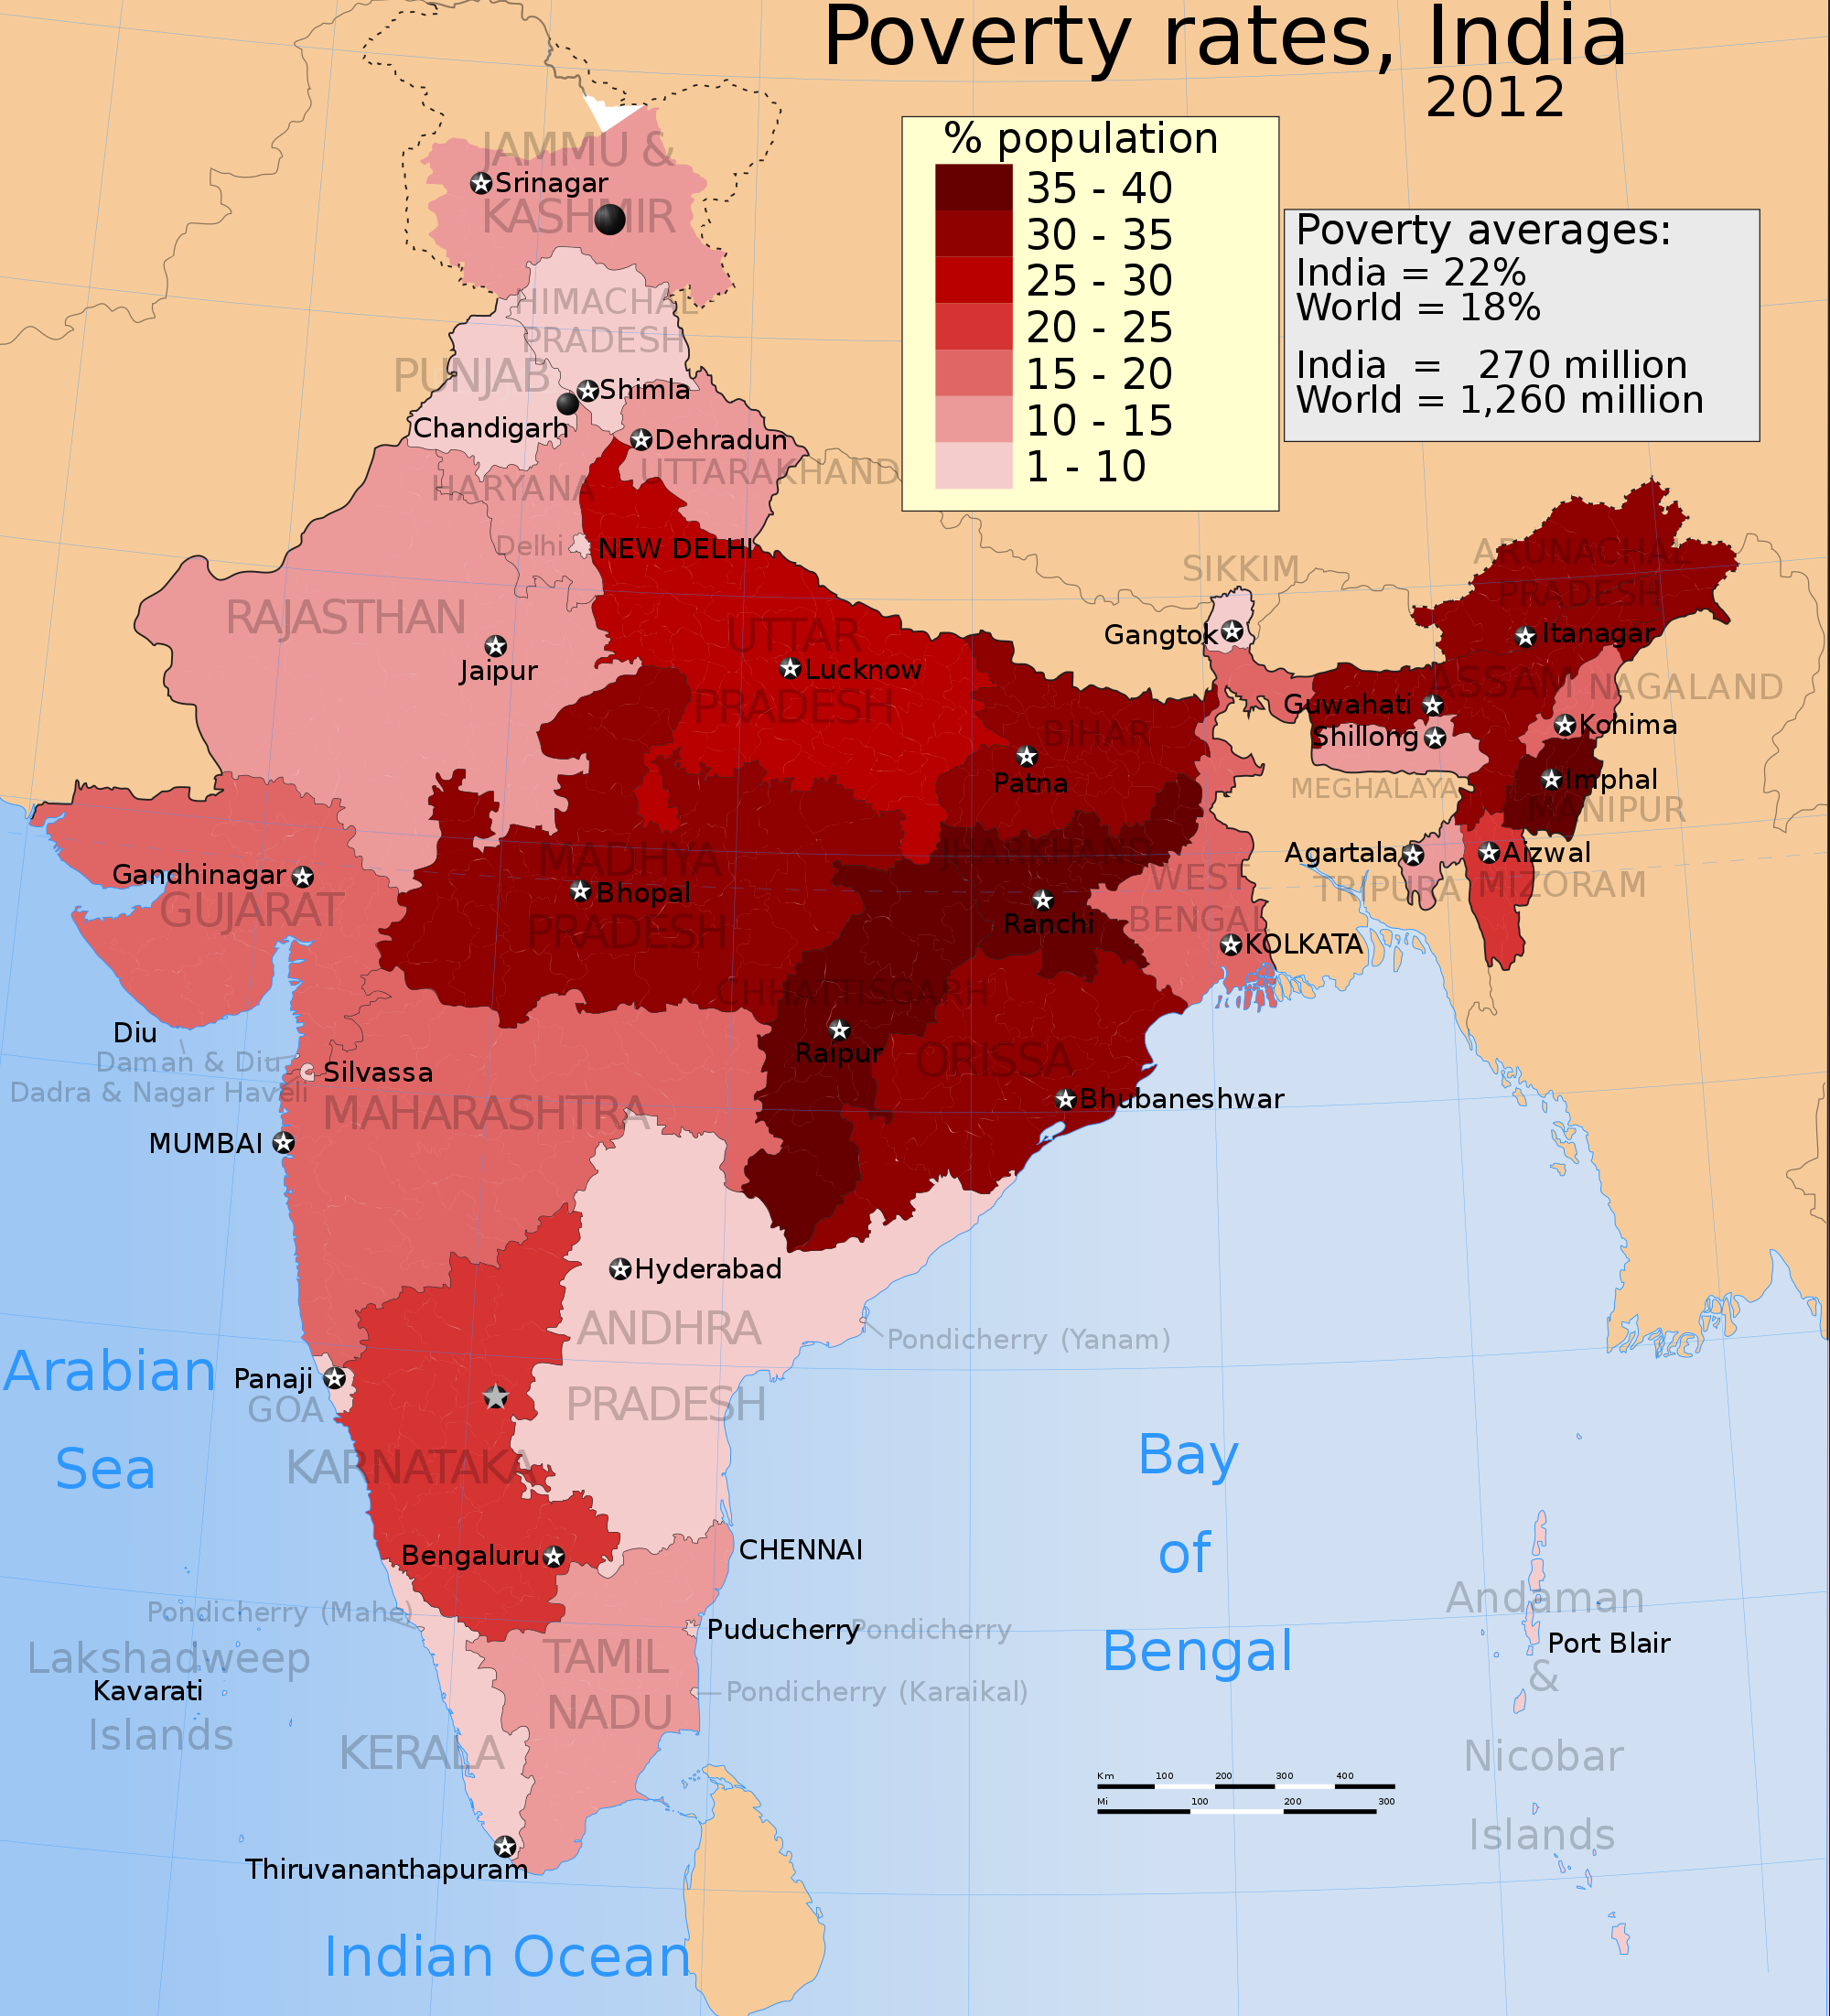

Slide 14
2014 elections

Slide 16
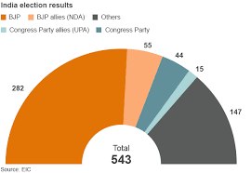

Slide 17
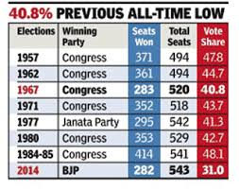

Slide 20
Hindutva: a distraction in Neoliberalism?
“Over the 1980s and 1990s we witnessed the simultaneous rise of two reactionary political projects, Hindutva and neoliberalism, to a position of dominance in India. Such a combination is not unusual, in that neoliberalism is usually allied with and promoted by socially reactionary forces (such as the hyper-nationalism of the “bureaucratic-authoritarian” dictatorships in Latin America, the implicit racism and jingoism of Thatcher and Reagan, etc.). Yet the Indian experience, while sharing this broad tendency, also contains some very distinct characteristics. We on the left have tended to understand this simultaneous rise as a straightforward cause-effect relationship. Hindutva is seen as an effort by neoliberalism, or perhaps more broadly by capitalism, to divert attention from class conflict, to divide and weaken working class struggles and to deflect class-driven anxieties on to minority communities” (Gopalakrishnan 2008, 1).
→ https://www.youtube.com/watch?v=FE8p9-rtHkY&vl=en

Slide 21
Redefining Economic Nationalism
D’Costa’s (2009) argument
“Redeﬁning economic nationalism from protectionism to the leveraging of national resources to secure economic beneﬁts from the world economy”;
→ Assumption: disruption is later compensated by economic stability and ultimately by the redistribution of economic gains through social or compensatory policies.

Slide 22
To Summarize…
“In an imperfect world any process of adjustment will entail constraints and it is obvious that some groups pay a higher cost of adjustment than others. However, open political systems are likely to mobilize popular voice to reverse the erosion in social policies and governments can be politically made to respond favourably” (D’Costa 2009, 625).
→ That is, democracy may prompt, in a first moment, reaction against economic globalization/liberalization…

Slide 23
To Summarize…
“The beneﬁts accruing from the global economy could compensate for the losses incurred due to the erosion of state sovereignty. The possible objection that global market participation results in reduced state sovereignty is nominally correct but only as long as it does not account for what the state does in response to this erosion of social policy space” (D’Costa 2009, 625).
→ … yet democracy can legitimize economic globalization/liberalization once gains benefit the majority and/or winners gain more political power although they are not the majority.

Slide 24
Hindutva used to be economic protectionist
“From the days of the Jan Sangh until the early 1980s, the Sangh Parivar had a relatively clearly denied mass base. The Jan Sangh, and then the BJP, was described as the “brahmin-baniya party”, with little following in rural areas and an inability to capture either the support of urban elites or the working class. Its party positions were a fairly direct reaction of the class position of its supporters, mainly members of the trading class. It favoured external protectionism and internal trade liberalisation, reflecting its members’ interests in unfettered access to domestic markets combined with restrictions on international competition” (Gopalakrishnan 2008, 10).

Slide 25
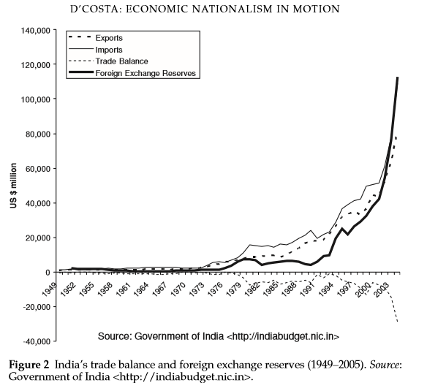

Slide 26
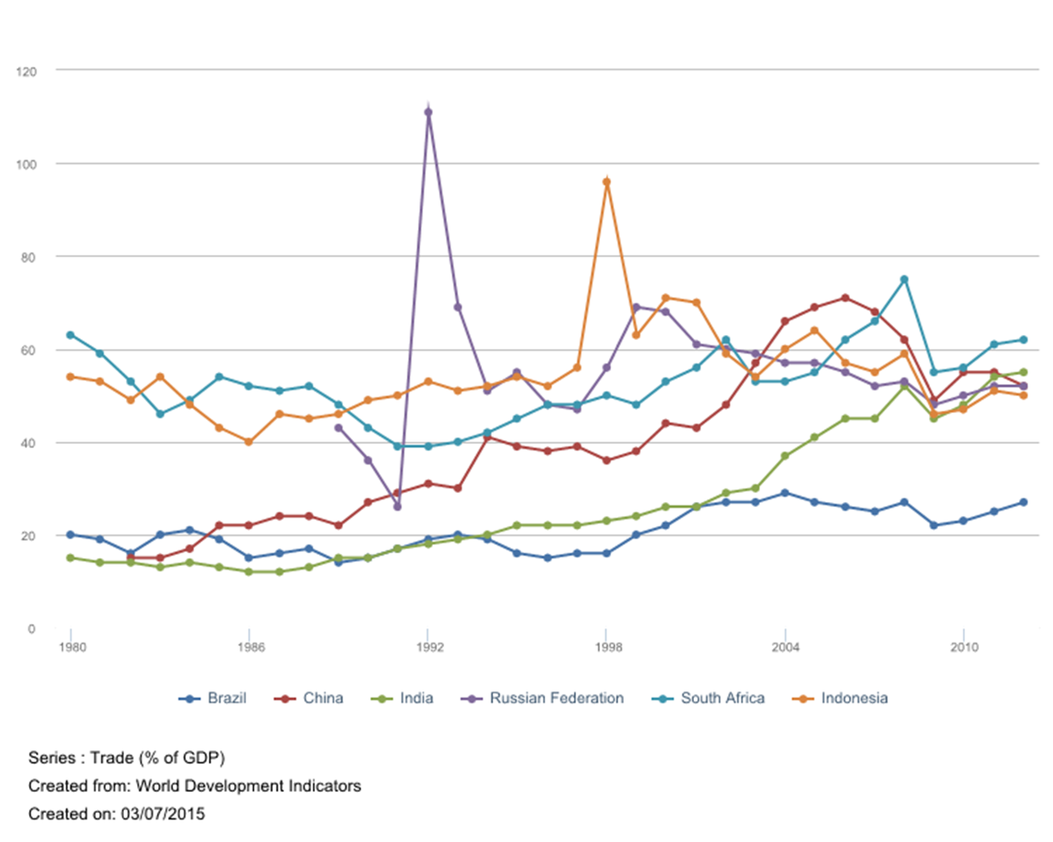

Slide 27
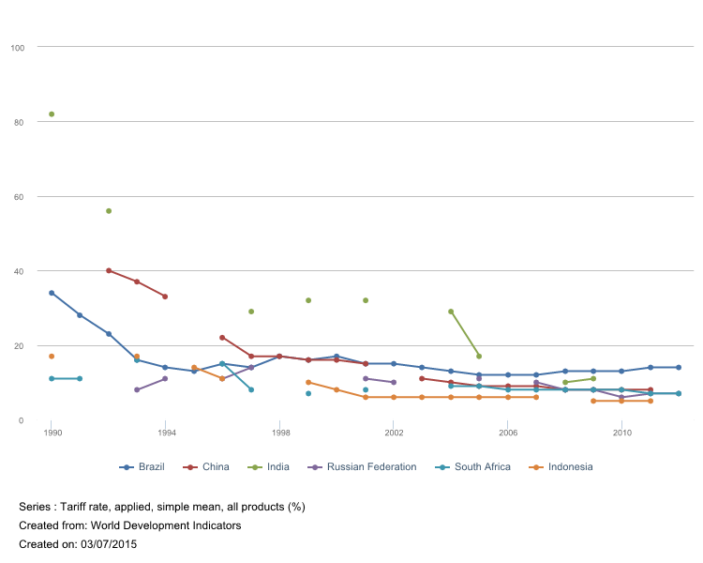

Slide 28
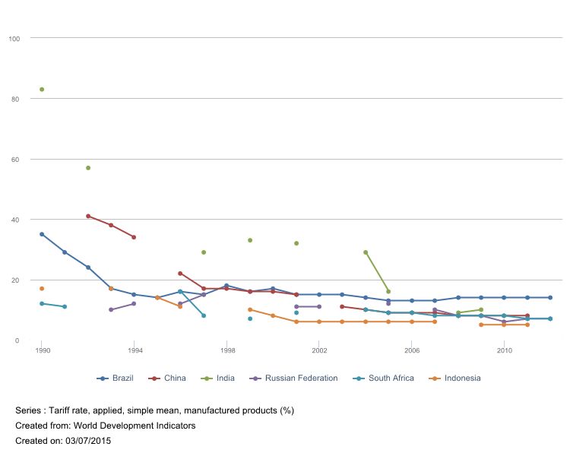

Slide 29
Empirical Analysis
D’Costa’s (2009) analysis transformations in the following industries
Steel;
Auto;
Software.

Slide 30
Empirical Analysis - Software
“The hyperglobalized software sector. There is a popular perception that the highly globalized Indian IT industry developed without the visible hand of the state. While it is true that the government did not get into production or intervene in the day to day matters through regulatory policy, the origin of the Indian IT industry can be traced to the state in the 1970s (D’Costa 2002; Evans, 1995; Sridharan, 1996). The vision of the Indian government has been to promote a viable IT industry despite the challenges of establishing a competitive electronics industry in the 1970s. But the IT industry, until global opportunities became available, was very much part of an import substitution strategy. Witness the expulsion in 1977 of American company IBM and the British company ICL from India in the late 1970s (Encarnation, 1989; Grieco, 1984). However, IBM and other IT multinationals are back with a vengeance, using Indian skills for their global growth strategy (D’Costa, 2004b; Rai, 2006)” (D’Costa’s 2009, 633).

Slide 31
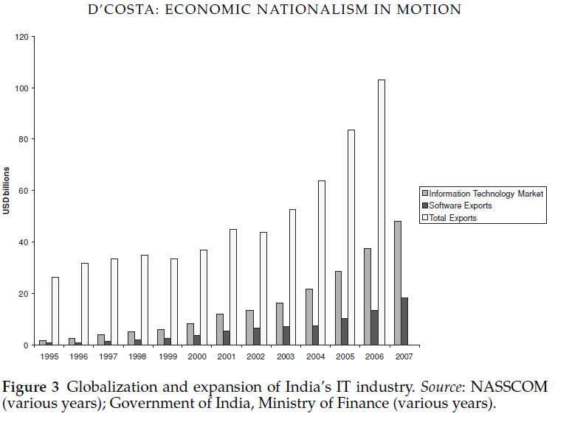

Slide 32
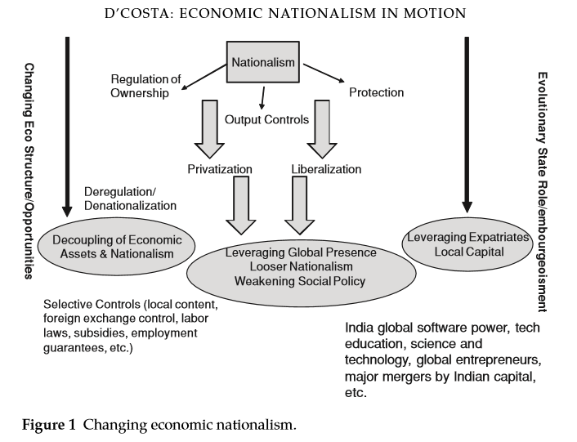

Slide 33
Empirical Analysis - Software
“Since the 1950s, a total of seven Indian Institutes of Technology have been established. These along with Regional Engineering Colleges (RECs) or now the National Institute of Technology (NIT), and the private but subsidized renowned Birla Institute of Technology and Science (BITS) are the elite technical institutions of the country. The Indian government also established several elite Indian Institutes of Management (IIM) in the country. These educational institutions serve the Indian export driven IT industry as well as multinationals. The success of India’s software exports led to the establishment of the Indian Institute of Information Technology (IIIT) in two key IT cities—Hyderabad and Bangalore. Behind the two IIITs are the government of India, the Indian software industry association (NASSCOM), state governments of Karnataka and Andhra Pradesh, and multinational IT companies. The partnership between the state and private foreign capital is indicative of a new kind of state activism aimed at creating international competitiveness” (D’Costa’s 2009, 636).

Slide 34
Empirical Analysis - Steel
“Consider Mittal Steel, currently the world’s largest steel company. It was started by an Indian who left the country in the 1970s from Calcutta, once the bastion of the classic form of economic nationalism, and at the height of state business regulation in India. Since then the company has grown by leaps and bounds through purchases of state-owned mills around the world to become the world’s largest producer of steel. Its global commercial success, while largely self-driven from abroad, has been supported by several government leaders, including that of the UK. Its acquisition of Arcelor in 2006, the world’s second largest steel company, was greeted with varying nationalist sentiments. The French government appeared alarmed over the merger, while the Indian government expressed its open support for the merger. The Indian Prime Minister and the Commerce Minister wrote to the EU on behalf of Mittal Steel” (D’Costa 2009, 637).

Slide 35
Empirical Analysis - Auto
“Unlike the steel industry there was no state ownership (except the failed Scooters India Limited). However, the transformation of the Indian auto industry began with state-ownership of the joint-venture with Suzuki Motors. It was only in 1993 that the industry was fully liberalized and until May 2007 the government held 18% of the share of Maruti Udyog, down from 80% since inception of the company. By selling its holdings to financial institutions the government of India has no direct ownership stake in the company... Maruti Suzuki can claim to have induced the development and growth of the Indian auto components industry, new flexible industry practices, and a base for compact car exports... Yet, the industry has contributed to many of the same goals that economic nationalism earlier aimed to accomplish such as exports and foreign exchange earnings, manufacturing capabilities, and the development of a competitive components sector and thus employment. In this instance the public sector has played an important role in the industry’s transformation” (D’Costa 2009, 637).

Slide 36
Empirical Analysis – Other Strategies
Mobilization of the Indian diaspora (D’Costa 2009, 640-641).

Slide 37
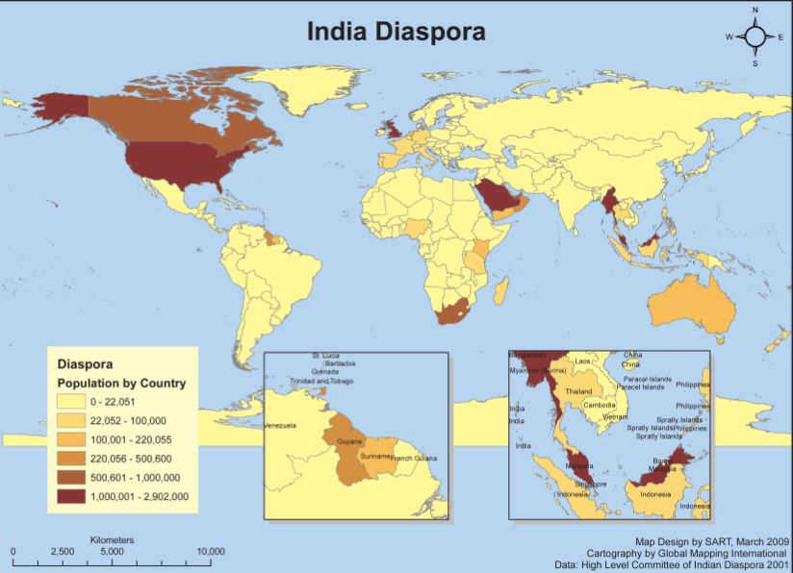

Slide 38
A material-symbolic trade-off
“[T]he movement [Hindutva] offered both enhanced security and the prospect of social mobility. The ability to make these offers was crucially linked to the support given to the movement by capital, the state and the upper castes. None of these advantages could be offered by the other 1980s’ movements, who did not enjoy such support. But this was an offer that came with a bargain. The gains on offer accrued not to the class or the community, but to the individual, and the person had to self-constitute himself or herself as an individual by abandoning all other markers of identity. As seen above, acceptance of Hindutva ideology and organisational methods brought this as its strongest implication. Thus Dalits and adivasis were explicitly or implicitly forbidden to raise issues of discrimination against their communities” (Gopalakrishnan 2008, 16).

Slide 39
Economic
Nationalism
(i.e., protectionism)

Slide 40
Economic
Nationalism
(i.e., protectionism)
National
Identity
(i.e., who belongs)
THE POLITICS OF ECONOMIC NATIONALISM

Slide 41
Economic
Globalization
(i.e., export, outward-looking strategies )
National
Identity
(i.e., who belongs)
THE POLITICS OF ECONOMIC GLOBALIZATION

